Slide 1
Progress report 進捗報告
Sekiya laboratory M1
Fujii Shogo

Slide 2
Constructing experiment environment
Experiment environment for on Mininet
Progress
Installing mininet, and testing some codes
Try to create topology and POX
MPTCP on mininet from CoNEXT’s paper
Future work
Fixed MPTCP on mininet
Learning OpenFlow controller
Switch1
Host1
Host2
Switch2
Controller

Slide 3
Related work
Xu, Hong, and Baochun Li. "RepFlow: Minimizing flow completion times with replicated flows in data centers." arXiv preprint arXiv: (2013).
Problem : Utilizing effectively multiple equal-cost paths
ECMP : deciding the flow’s route by hashing 5-tuple, cannot prevent the occurrence of hot-spot
Prior work required custom switch hardware or protocol changes
Solution : simple effective approach without any changes
Replicated flows traverse distinct paths
Developing simple queuing model

Slide 4
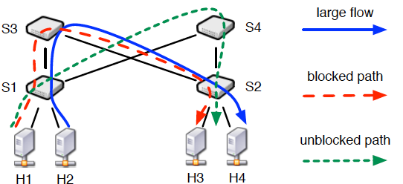
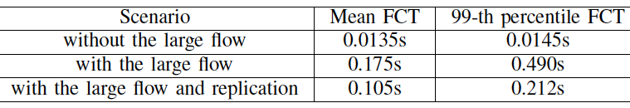
RepFlow : Motivation
Issue on ECMP : hashing does not achieve perfect randomness
ECMP sometimes can not utilize the diversity paths
With the large flow, short flows suffer from 10x worse FCT

Slide 5
RepFlow : Design
RepFlow uses flow replication to exploit multi-path diversity.
Q1 : Which should short flow be replicated?
less than or equal to 100KB are considered short flows heuristically
Q2 : When should short flow be replicated?
In the current design, proactively replicates each and every short flow
the overhead of doing so is negligible
the fact that short flows only account for a tiny fraction of total bytes
Implementation
The simplest is to create two TCP sockets when a short flow arrives.
For datacenter, using a general library or middleware is preferable.

Slide 6

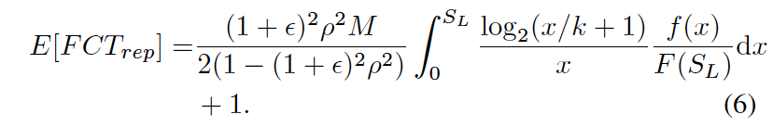
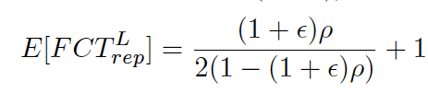
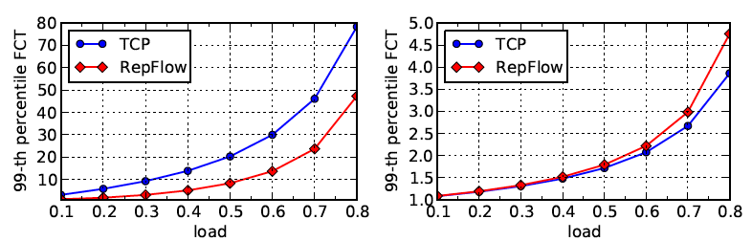
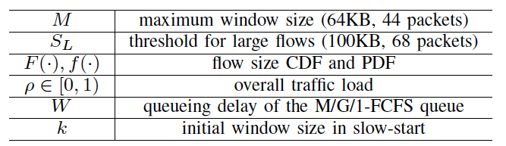
RepFlow : Analyze
Queuing model : M/G/1 first-come-first-serve queue infinite buffer
Average comp time
Short flow
replicated
Long flow
replicated

Slide 7

RepFlow summary
What is critical for short flow and tail FCT?
Queuing delay and factor
Using replication, these factors have much less probability of entering a busy queue, and the effective load they experience is greatly reduced.

Slide 8
Experimental evaluation
Simulation : NS-3
Topology : 16-pod Fat-tree 1024hosts
Benchmark traffic : Web search and data mining distribution
Schemes compared
TCP, RepFlow, DCTCP, RepFlow-DCTCP, pFabric

Slide 9
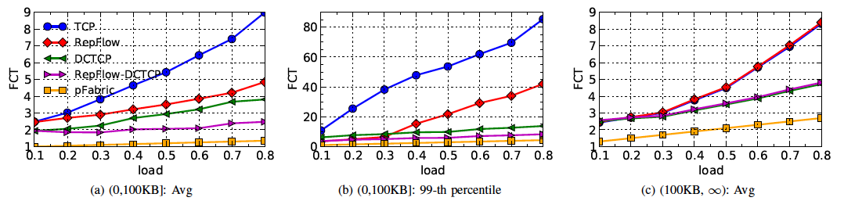
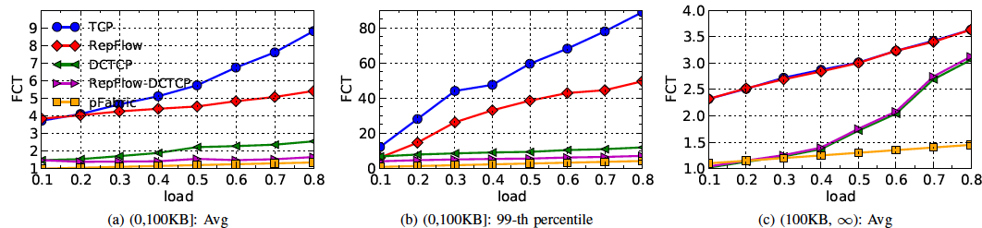
Results
Web
search
data
mining
TCP vs RepFlow
switch-based solution

Slide 10
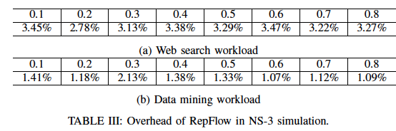
Overhead of extra flows
Replication clearly adds more traffic to the network
Since short flows only generate a tiny fraction of all bytes in both workloads
Replication does not incur excessive overhead to the network

Slide 11
Considering
ホストへのアプローチ
Without custom switch hardware and/or protocol changes
パスの数だけコピーして、速くなればオッケー
途中で複数のフローがパスを共有する問題をピンポイントという訳ではない
とりあえずショートフローが改善できれば。。
スイッチベースですると改善度合いが大きそう。
厳しいペナルティ、混雑しているリンクを通知する（DCTCPのECN）
スイッチバッファをShortflowへ空けておく取り組み
RepFlow-DCTCPは本末転倒では？？

Slide 12
提案手法もどき
Conflict

Slide 13
提案手法もどき
Balancing!
Pod内の最大マッチング問題。。
Round-Robin Matching
iSLIP(1999)

Slide 14
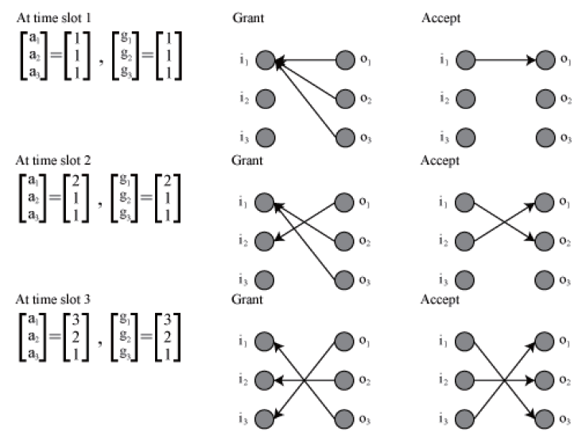
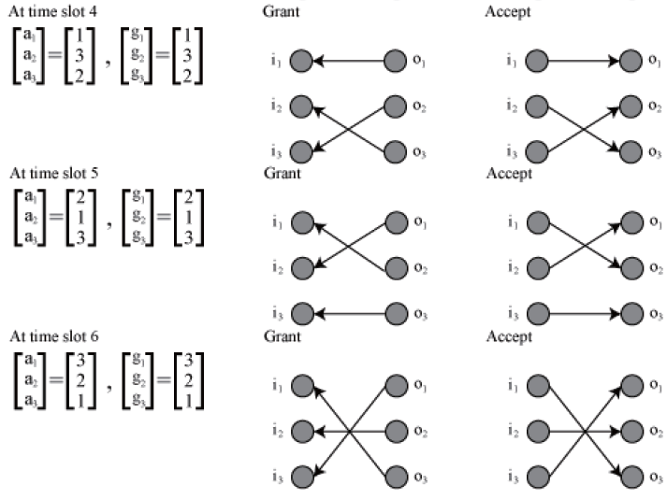
iSLIPについて。。
non-accept判定は?
パスを切り替えるためには？

Slide 15
Future work
実装
仮想環境での2サーバ、2ルータでMPTCP on mininet
Openflow コントローラの勉強
論文
maximum matching issue、MPTCP。
エンドホストへのアプローチ

