Slide 1
Progress report 進捗報告
Sekiya laboratory M1
Fujii Shogo

Slide 2
Constructing experiment environment
Experiment environment for on Mininet
Progress
Installing mininet, and testing some codes
Try to create topology and POX
MPTCP on mininet from CoNEXT’s paper
Future work
Fixed MPTCP on mininet
Learning OpenFlow controller
Switch1
Host1
Host2
Switch2
Controller

Slide 3
Related work
Ford, Alan, et al. "TCP extensions for multipath operation with multiple addresses." IETF MPTCP proposal-http://tools. ietf. org/id/draft-ford-mptcp-multiaddressed-03. txt (2011).
MPTCP concept
An MPTCP connection begins similarly to a regular TCP connection.
If extra paths are available, additional TCP sessions(subflow) are created on these paths.

Slide 4
Initiating an MPTCP Connection
Negotiating of MPTCP_capable in 3-handshake
And also carry the MP_CAPABLE option
Host A
Host B
MP_CAPABLE
[A’s key, flags]
MP_CAPABLE
[B’s key, flags]
ACK + MP_CAPABLE
[A’s key, B’s key, flags]

Slide 5
Initiating an MPTCP Connection
Negotiating of MPTCP_capable in 3-handshake
And also carry the MP_CAPABLE option
Host A
Host B
Addr A1
Addr A2
SYN + MP_CAPABLE(keyA)
SYN/ACK + MP_CAPABLE(keyB)
ACK + MP_CAPABLE(keyA, keyB)
SYN + MP_JOIN(tokenA, R-A)
SYN/ACK + MP_JOIN(HMAC-B, R-B)
ACK + MP_JOIN(HMAC-A)
ACK

Slide 6
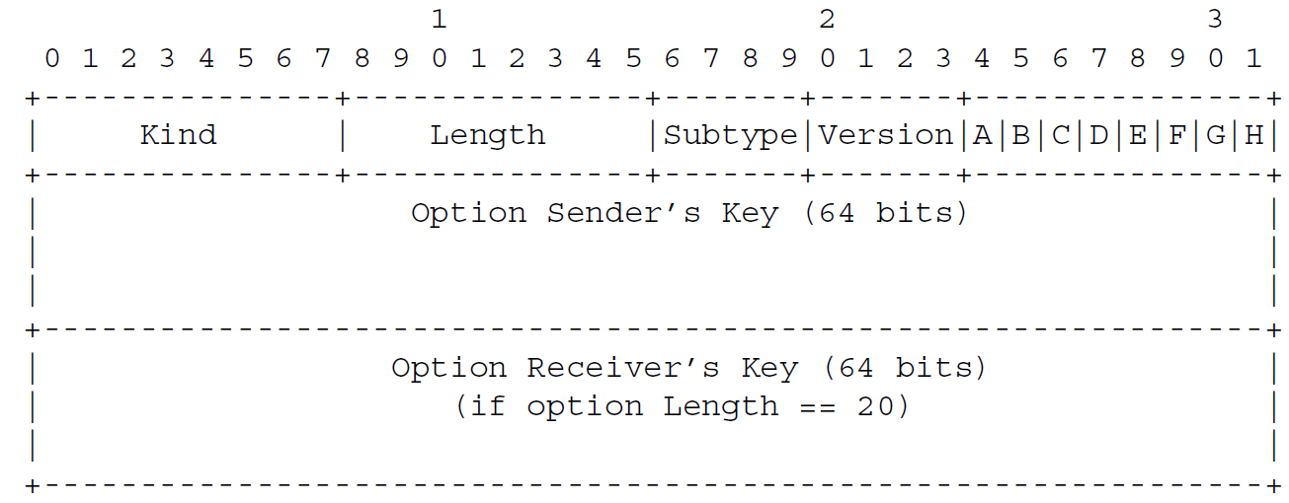
Initiating an MPTCP Connection: detail
Initiating option is used to declare the 64-bit key, for authentication

Slide 7
Starting a new subflow
Further subflows can be added to the connection.
Host A
Host B
Addr A1
Addr A2
SYN + MP_CAPABLE(keyA)
SYN/ACK + MP_CAPABLE(keyB)
ACK + MP_CAPABLE(keyA, keyB)
SYN + MP_JOIN(tokenA, R-A)
SYN/ACK + MP_JOIN(HMAC-B, R-B)
ACK + MP_JOIN(HMAC-A)
ACK

Slide 8
Starting a new subflow: the other way
Path management: to the exchange of information about additional paths between hosts.
As the second method, ADD_ADDR option
signals addresses explicitly to the other host to allow it to initiate new subflows
support operation through NATs

Slide 9
Starting a new subflow: the other way
Operation: after setup A1-B1
Host A
Host B
Addr A1
Addr A2
Addr B1
Addr B2
SYN + MP_JOIN
ADD_ADDR option
SYN/ACK + MP_JOIN
ACK + MP_JOIN
??

Slide 10
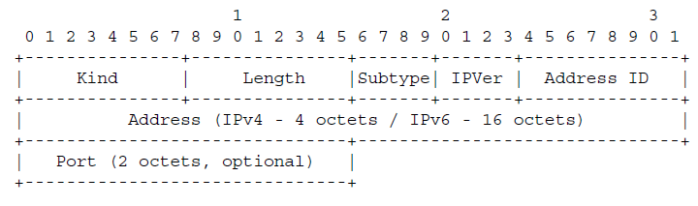
Starting a new subflow: the other way
Simultaneously, an ADD_ADDR option(5-tuple) is sent on an existing subflow, informing the receiver of the sender’s alternative address.

Slide 11
Considering
MPTCPの問題
性能に関して-ショートフロー問題
ルーティングが静的
運用に関して-IPアドレスの問題、ルーティングテーブルの問題
原理上MPTCPは5-tuple

Slide 12
提案手法もどき
Conflict

Slide 13
提案手法もどき
Balancing!
Pod内の最大マッチング問題。。
Round-Robin Matching
iSLIP(1999)

Slide 14
Issue of manageability
10.3.0.1
10.3.0.2
10.1.0.2
10.1.0.1
10.3.0.2
10.3.1.2
10.1.3.1
10.1.3.2
10.2.0.2
10.2.0.1
10.2.3.1
10.2.3.2
10.3.2.2
10.3.1.1
10.3.2.1
10.3.0.1

Slide 15
Issue of manageability
10.3.0.1
10.3.0.2
10.1.0.2:port80
NAT
10.3.0.2
10.3.1.2
NAT
10.1.3.2:port80
10.1.0.2:port81
10.1.3.2:port81
10.3.2.2
10.3.1.1
10.3.2.1
10.3.0.1

Slide 16
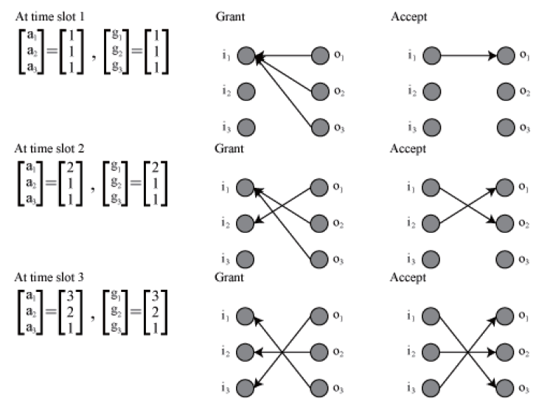
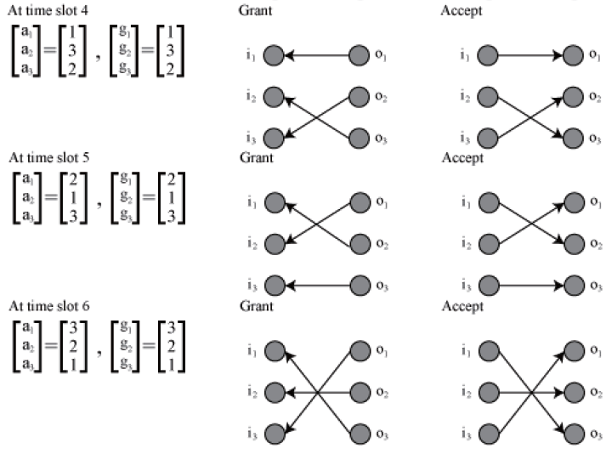
ステート型ルーティングプロトコル
non-accept判定は?
パスを切り替えるためには？

Slide 17
Future work
実装
仮想環境での2サーバ、2ルータでMPTCP on mininet
Openflow コントローラの勉強
論文
MPTCP + OpenFlow
MPTCP implementation

