Slide 1
Progress report 進捗報告
Sekiya laboratory M1
Fujii Shogo

Slide 2
Related work
Li, Yu, and Deng Pan. "OpenFlow based Load Balancing for Fat-Tree Networks with Multipath Support.”(2013)
Problem: The requirement of load balancing routing in fat-tree networks cannot be fully satisfied by traditional approaches.
Solution:
OpenFlow protocol enables monitoring traffic statistics by a centralized controller.
Achieving high performance and low latency

Slide 3
OpenFlow based load balancer
The load balancer has two important functionalities;
monitoring statics, available throughput of each link.
scheduling new flows, deciding route by dst/src adresses

Slide 4
OpenFlow based load balancer monitoring statics
Key question: “how to measure the available bandwidth on each link”.
It is difficult to measure them in direct ways from the controller or switches
Proposal: the controller queries the transmitted bytes on each port from switches periodically.
Sending STATS_REQUEST to all of its ports.
returning replies from each switches, and updating flow tables.
Switches have the available throughput info of each paths

Slide 5
OpenFlow based load balancer scheduling new flows
One characteristic of routing in fat-tree network is:
once a flow reaches the highest layer that it accesses, the path from that switch to the destination host is deterministic.
only upward traffic will be handled by Dynamic LB based on throughput
core
Finding the best link
Aggregate
Finding the best link
edge
host
4
4
4
4

Slide 6
Evaluation
Environment: 128 hosts and 80 switches fat-tree network on Mininet with Beacon controller
Monitoring: cycle length is 5 seconds.
Traffic design:
Random: A host sends packets to any other host.
Measurement: throughput and packet average delay.
Algorithm
None load balancing: random selection
Static load balancing: deciding paths by 5-tuple
Prop): Dynamic LB

Slide 7
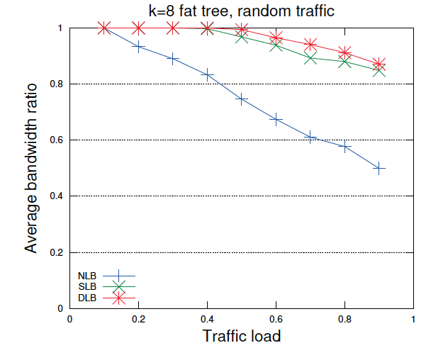
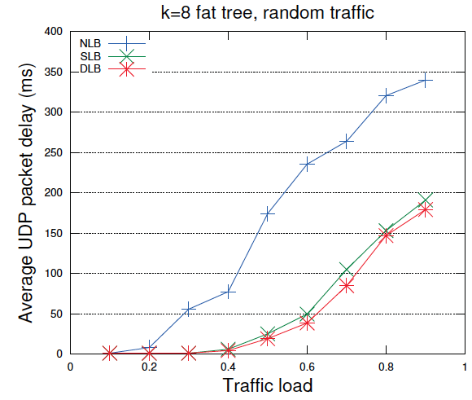
Evaluation
NLB does not load balance the traffic.
DLB outperforms SLB since it can make adaptive changes for scheduling paths based on real-time network traffic statistics

Slide 8
Considering
OpenFlow + ロードバランスのとてもシンプルな構造
スループットをメトリックとして最適決定
5[sec]間隔? 平均で消えているが・・・
Flow schedulingについて
アドレッシングの問題。dst/srcを見て、今どのレイヤーにいるか判断。
アドレスを工夫して割り当てないといけない。
Monitoringについて
スループットで本当に適しているのか? 遅延?
評価について
負荷が掛かると性能は下がる。仕方ない？最適って？
負荷分散だけでなく、輻輳制御でペナルティを課す?

Slide 9
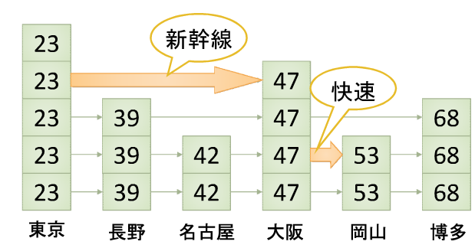
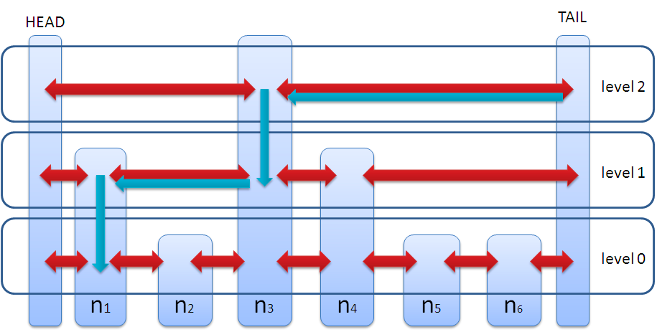
アドレスの問題について
IPアドレスだけでは厳しいのか？
P2Pでのアプローチ: Skip graph
0, 1でのアドレッシング

Slide 10
リンクをシェアしてしまったときの検証
Aggregate
edge
Share | unshared
594.535ms | 105.711ms
host
バックグラウンドとショート(70KB)
share: 濃い青のパスを共有
unshared: 水色にショート

Slide 11
Future work
実装
仮想環境での2サーバ、2ルータでMPTCP on mininet
Openflow コントローラの勉強
論文
OpenFlow + load balancing
MPTCP implementation

Slide 12
Constructing experiment environment
Experiment environment for on Mininet
Progress
Installing mininet, and testing some codes
Try to create topology and POX
MPTCP on mininet from CoNEXT’s paper
Future work
Fixed MPTCP on mininet
Learning OpenFlow controller
Switch1
Host1
Host2
Switch2
Controller

