Slide 1
Progress report 進捗報告
Sekiya laboratory M1
Fujii Shogo

Slide 2
Outline
Improving datacenter network with Multipath TCP
Background
Related work
Issues
Conclusion
Future work

Slide 3
Background
MPTCP doesn’t improve short flow traffic
Big data growth matters seriously
Facebook stores more than 300 petabytes,
and analyzes 1 petabyte data for data mining daily[1].
Transition in data center …
Increasing the number of servers with tens of thousands for scale-out.
Increasing the number of paths in DC network, for redundancy.
In cloud services, intra-traffic have been increased.
Improving the datacenter network with Multipath TCP
[1]https://www.facebook.com/notes/facebook-engineering/presto-interacting-with-petabytes-of-data-at-facebook/10151786197628920
[2]http://blog.gigaspaces.com/amazon-found-every-100ms-of-latency-cost-them-1-in-sales/
Notes:
ビッグデータをどう活用するか、関心が高まっている。
取り巻く環境もデータ量の増加。
データセンターに着目すると、どう変わってきたか?

Slide 4
Background
Why is my target short flow??
Distributed processing is common solution for the problem of big data and massive resources.
Distributed processing produces a lot of short flow.
Actually, 80% of datacenter traffic is short flow[1].
Data centers runs many interactive services, which is latency-sensitive
Short flows in datacenter network is matter.
[1]Benson, Theophilus, Aditya Akella, and David A. Maltz. "Network traffic characteristics of data centers in the wild." Proceedings of the 10th ACM SIGCOMM conference on Internet measurement. ACM, 2010.

Slide 5
Background
What is the short flow problem?
Flow completion time(FCT) for short flow in TCP is poor.
Queue: short flow queued up behind burst of packets.
Bandwidth: first-come, first served.
Popular method : ECMP load-balancing
Scenario
ECMP performs hash-based flow-level load balancing.
may direct large flows to the same path
[1]Benson, Theophilus, Aditya Akella, and David A. Maltz. "Network traffic characteristics of data centers in the wild." Proceedings of the 10th ACM SIGCOMM conference on Internet measurement. ACM, 2010.

Slide 6
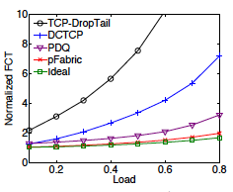
Related work: switch approach
M. Alizadeh, S. Yang, M. Sharif, S. Katti, N. M. B. Prabhakar, and S. Shenker. pFabric: Minimal near-optimal datacenter transport. In Proc. ACM SIGCOMM, 2013.
Motivation:
First-in-first-out mechanism harm the flow with high priority
Target:
Short flow, with high priority, meets deadline
Solution: with full-customize switch
Rate-control
Initial window size : static value using BDP
when drop, waiting for RTO
Queuing
Priority rule : smaller remaining flow size has higher priority
Dequeue
Result:
achieving near-optimal FCT
Fig. The effect of short flows completing for 70KB
M. Alizadeh, S. Yang, M. Sharif, S. Katti, N. M. B. Prabhakar, and S. Shenker. pFabric: Minimal near-optimal datacenter transport. In Proc. ACM SIGCOMM, 2013.

Slide 7
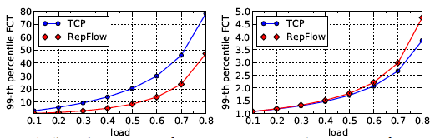
Related work: host approarch
Xu, Hong, and Baochun Li. "RepFlow: Minimizing flow completion times with replicated flows in data centers." arXiv preprint arXiv:1307.7451 (2013).
Motivation:
Reducing FCT without custom switch hardware and/or protocol changes
Target :
distributing the utilization paths
Solution :
Replicate the flows to each paths just for short flow.
Result :
99th percentile FCT was improved by about 40%
Fig. FCT of short flow
Fig. FCT of long flow
Fig. Scenario on Repflow[1]
Xu, Hong, and Baochun Li. "RepFlow: Minimizing flow completion times with replicated flows in data centers." arXiv preprint arXiv:1307.7451 (2013).

Slide 8
About my research
Requirements for datacenter network
Using modern topology for massive resources
Feasibility: easily-implementation to real data center
Application friendly : optimizing the specified traffic patterns
My research :
On FatTree topology
using Multipath TCP
improving completion time of short flow
Issue on MPTCP
Performance for specific workload
Manageability

Slide 9
A solution for short flow problem
Multipath TCP(2011)
Extending TCP to use multiple paths by a single connection
Using multiple-paths simultaneously, improving the throughput
Load balancing
ECMP
MPTCP
:flow1
:flow2
1
1
1
2
1
2
ECMP assign a path each flow
2
2
MPTCP can distribute packets for a flow

Slide 10
Issue of performance

Slide 11
Verification simulation - Environment
Traffic
Background traffic
50% of workers sends data continuously as background traffic.
Short flow
Query traffic : For 100% of workers, 1~16[KB] data is generated on average every 200ms.
Short message : For 100% of workers, 50KB~1MB data is generated on average every 500ms.
1
2
3
4
Randomness
Choosing sender and receiver nodes
1000 times on simulation
worker nodes
master nodes

Slide 12
Verification simulation - Environment
50% of worker nodes sends data continuously as background traffic (MPTCP/TCP)
For ever workers, short flow(2KB~1MB) is sent every200 or 500 [ms] (MPTCP/TCP)
Background traffic
Short flow
1
2
3
4
Fig7-2. Network topology on simulation

Slide 13
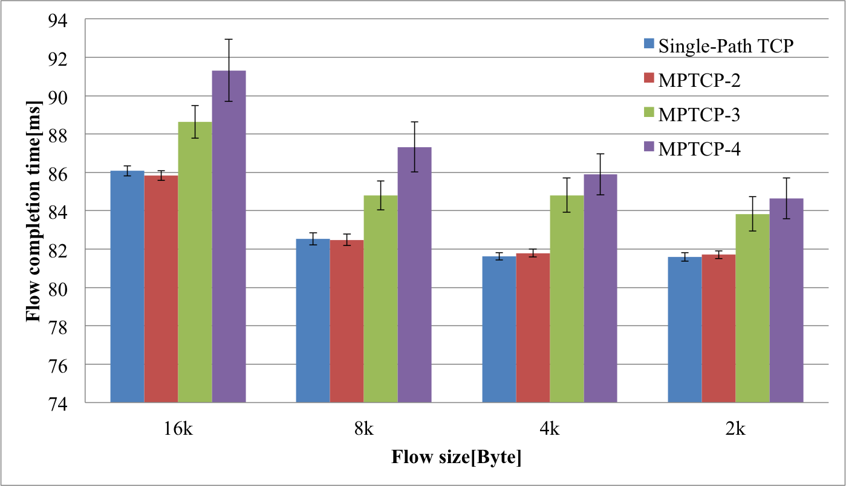
Additional simulation - Query traffic with background
6%
5%
5%
4%
Background traffic with MPTCP causes the delay of flow completion time.

Slide 14
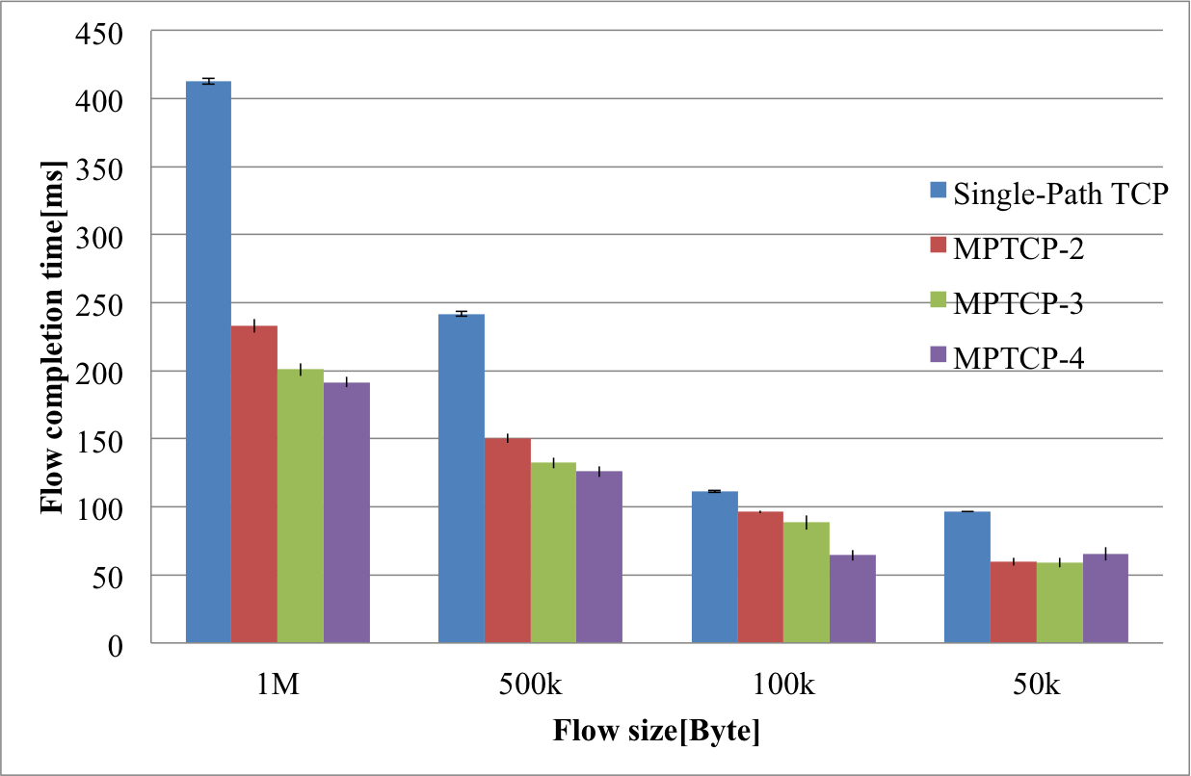
Additional simulation - Short message traffic with background
54%
28%
11%
8%
MPTCP improve the flow completion time of short message traffic.
Short message traffic is effected by background traffic.
Load balancing of MPTCP improves short message traffic.

Slide 15
Additional simulation - Results
Short message with MPTCP improves the completion time by load balancing and multi-path.
Query traffic with MPTCP did not work these functions.
the behavior is TCP with single-path
As the result, query traffic with background traffic did not improve the completion time.

Slide 16
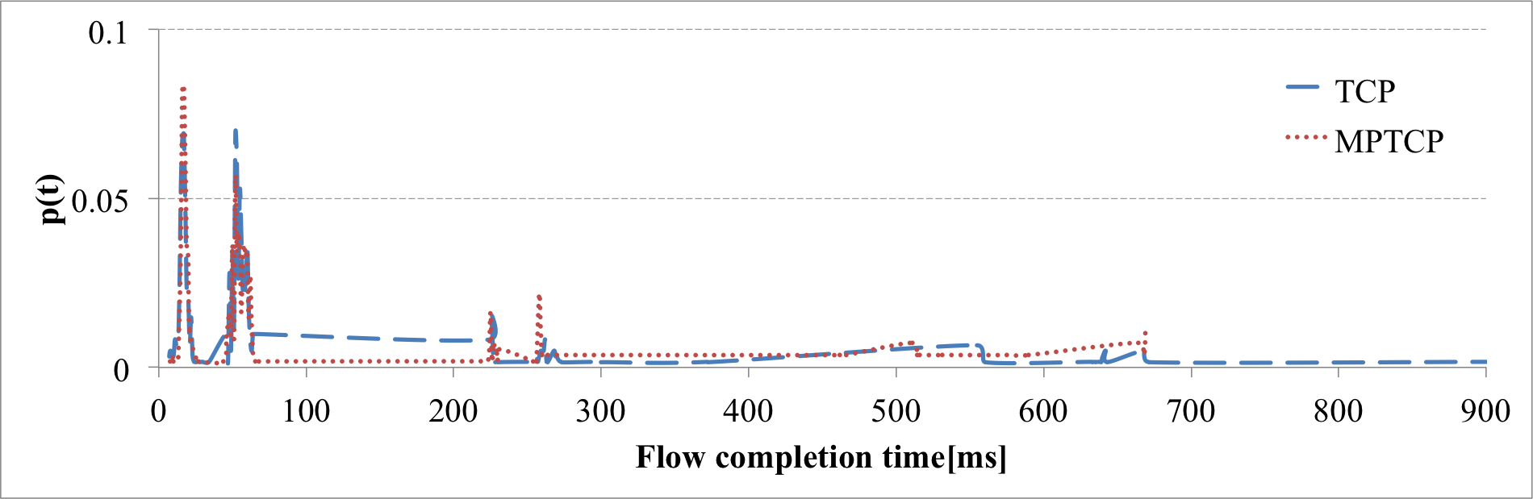
More considerations
Full window
Intensive flow
Delay with loss
Extreme delay
MPTCP didn’t improve the finish time by extreme delay’s
They occurred packet drop at the beginning of the flows.

Slide 17
提案シナリオ
Conflict

Slide 18
提案シナリオ
Balancing!

Slide 19
シミュレーション計画
仮説 : MPTCPでショートフローのコネクションをつなぐための経路を適切に選択する事で、性能が改善される
ロングフローが使っている経路にショートフローを流して遅延するのか?ショートフローは別の経路に流して改善されるのか?(改善されてほしい)
ショートフローが使う経路を適切に選択する事で、ロングフローとの衝突は避けられるか?(負荷が小さい経路を利用する事で回避)

Slide 20
仮説の検証について
bad connection – ハンドシェイクがバックグラウンドフローが占有している経路を使う
good connection – ハンドシェイクが空いている経路を使う
期待すべき結果
ショートフロー
シングルパスでしか通信できない
good connectionで改善されてほしい
ロングフロー
複数経路使う事ができる
bad connectionでもあまり変わらない
Scenario

Slide 21
Conclusion

Slide 22
Future work
仮説の検証に関して
ショートフローの通信の際、コネクションを適切に選ぶ事で性能が改善される
「適切に選ぶ」手法について考案する
MPTCPの学習
ショートフローに対して複数経路が使えない原因を調べる

Slide 23
issue of manageability

Slide 24
Issue of manageability
For using multiple paths
Multiple IP addresses are allocated to each server for the number of paths.
Designing route by setting routing table of L3-switch properly.
MPTCP implementation on kernel
MPTCP starts sending by 3way-handshake in the same way as TCP, then destination IP is decided on application.
Exchanging additional subflow’s information, sending packet with TCP option space on the connection.
Packets for 3way-handshake is delivered in the same way every time.

Slide 25
Issue of manageability
Problem1: allocation of IP address
Problem2: non-selectiveness for route
10.3.0.1
10.3.0.2
10.1.0.2
10.1.0.1
10.3.0.2
10.3.1.2
10.1.3.1
10.1.3.2
10.2.0.2
10.2.0.1
10.2.3.1
10.2.3.2
10.3.2.2
10.3.1.1
10.3.2.1
10.3.0.1

Slide 26
Conclusion

Slide 27
Conclusion
Confirmed the effect of short flow with MPTCP.
MPTCP improved short message traffic (>50KB)
MPTCP didn’t improve query traffic
Background traffic occupied paths, and short flow became queued behind background traffic.
Problems to solve
Performance for FCT of short flow
Manageability in data center, in particular for IP address and routing

Slide 28
Future work
Considering solution
SDN: utilization of address resource effectively with MPTCP
Traffic engineering: flow schedule by only end-host
Study
Simulation mininet on MPTCP and SDN
Survey the research of MPTCP with SDN
Reading MPTCP implementation source code on kernel

Slide 29
提案手法もどき
Conflict

Slide 30
提案手法もどき
Balancing!
Pod内の最大マッチング問題。。
Round-Robin Matching
iSLIP(1999)

Slide 31
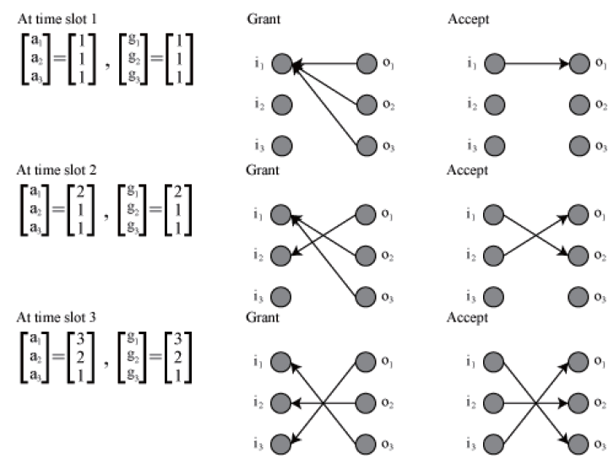
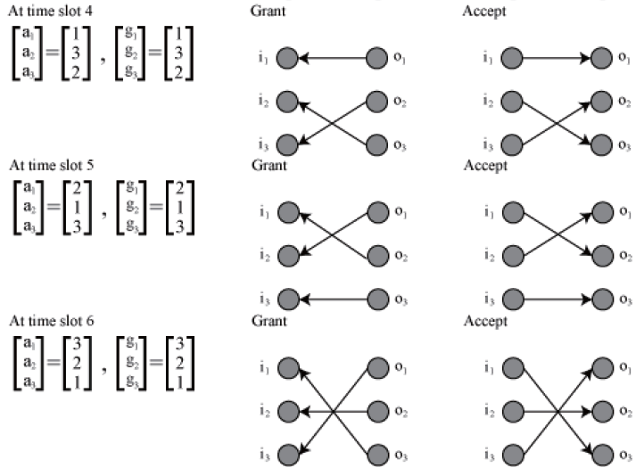
iSLIPについて。。
non-accept判定は?
パスを切り替えるためには？

