Slide 1
Paper 1
Title : BCube: A High Performance, Server-centric Network Architecture for Modular Data Centers
Guo, Chuanxiong, et al. Microsoft Research Asia
ACM SIGCOMM Computer Communication Review 2009

Slide 2
Outline
Motivation
Fault tolerant
Load balancing
accelerating bandwidth intensive application
Methodology
Server-centric approach
file systems, a file is divided into chunks, GFS etc..
Commodity switch
Interconnection structure
Routing protocol

Slide 3
Background
Bandwidth-intensive application support
One-to-one
One-to-several
One-to-all
All-to-all
Low-end commodity switches
Low-end nonprogrammable switches
Graceful performance degradation
Frequent component failure by commodity servers and switches

Slide 4
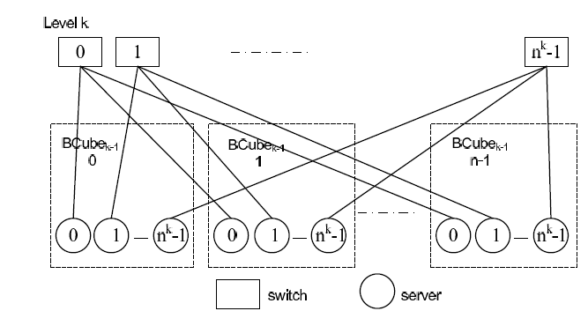
BCube structure
Servers with multiple ports
Switches connecting a constant number of servers
n : number of Bcubes
k : level k

Slide 5
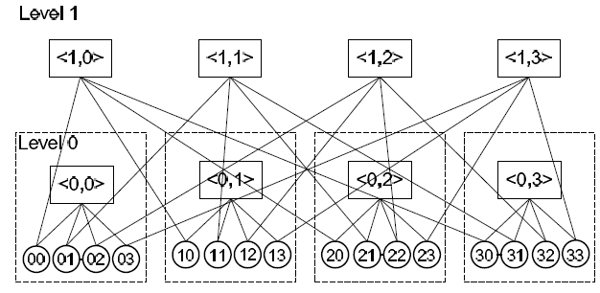
Routing
n=4, k=1
Hamming distance of [00] -> [31] is 2
00, <1,0>, 30, <0,3>, 31
00, <0,0>, 01, <1,1>, 31

Slide 6
One-to-one routing
In n=8, k =3, the path between A(0001) and B(1011)
There are h(A, B) and k+1-h(A,B) paths
0001, < 3, 001 >, 1001,< 1, 101 >, 1011
0001, < 1, 001 >, 0011,< 3, 011 >, 1011
0001, < 2, 001 >, 0101,< 1, 011 >, 0111,< 3, 111 >, 1111,< 2, 111 >, 1011
0001, < 0, 000 >, 0002,< 3, 002 >, 1002,< 1, 102 >, 1012,< 0, 101 >, 1011
These path are parallel
Each path has unique servers and switch
Speedup

Slide 7
Speedup for One-to-several Traffic
Edge-disjoint complete graph
the selected servers are located at different levels of BCube, thus improving replication reliability
a chunk to r chunk servers, 1/r chunk to each and copying

Slide 8
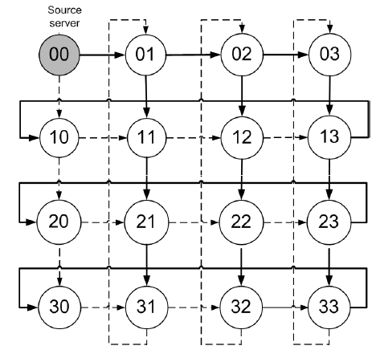
Speedup for One-to-all Traffic
A source can split a file into k+1 path
The time to deliver a file, size L, is 1/k+1
Spaninng tree

Slide 9
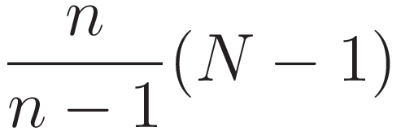
Aggregate Bottleneck Throughput for all-to-all Traffic
Bottleneck flows is receiving the smallest throughput
ABT is the number of flows times the throughput
ABT in Bcube is
the ABT of BCube increases linearly as the number of servers increases

Slide 10
BCube Source Rooting
Without coordination of the intermediate servers
Intermediate servers do not involve in routing and just forward
Using a default path selected from the parallel path set
Failed link database

Slide 11
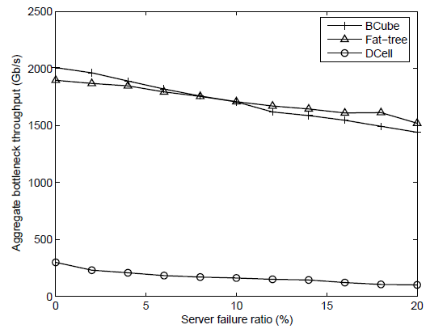
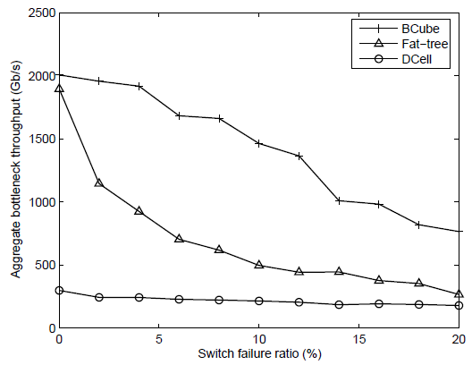
Graceful degradation
Simulation –
Bcube : n=8, k=3, 2048servers 1GB/s link
Fat-tree : 5 layers, 0~3->512switches, 4->256switches
Dcell : Dcell2 has 28 fullDCell1 with 32 servers
Notes:
Fat-treeはパスのChoice が少ない。依存しがち。コアがやられると、劇的に減衰する。
Bcubeはロバスト性あり

Slide 12
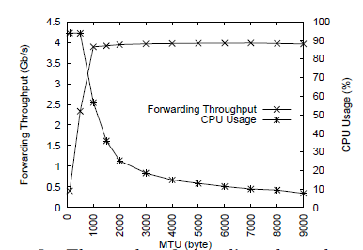
CPU Overhead for Packet Forwarding
5 servers as part of a BCube3
0000, 0001, 0010, 0100, 1000
4 TCP connections
0001 – 0100, 0010 – 1000, 0000 to all the others

Slide 13
Prototyped the BCube
Testbed
46 Dell Precision 490 servers
8 8-port mini-switch
CPU : 2GHz, 4GB DRAM
No disk access because of the performance without disk I/O

Slide 14
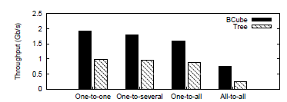
Bandwidth-intensive application support
MTU : 9KB, Sending data : 10GB
One-to-one
00->12
One-to-several
00->01, 10
One-to-all
00->15 servers
All-to-all
TCP connection with full mesh

Slide 15
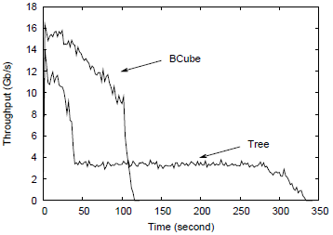
Bandwidth-intensive application support
BSR is both robust and efficient

Slide 16
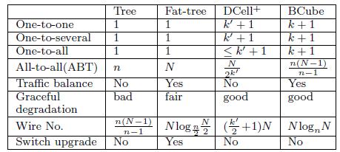
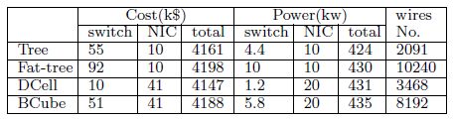
Related work
Notes:
Wireの数、スループットを上げる。その分スイッチがいる。
それに伴い、コストもかかる。

Slide 17
Future work
studying how to scale our server-centric design from the single container to multiple containers

Slide 18
Paper 1
Title : BCube: A High Performance, Server-centric Network Architecture for Modular Data Centers
Guo, Chuanxiong, et al. Microsoft Research Asia
ACM SIGCOMM Computer Communication Review 2009

Slide 19
Outline
Motivation
Scalable interconnection bandwidth
Economies of scale
Backward compatibility
Methodology
Approaching to architecture
SMP(Symmetric Multiprocessing)
MPP(Massively Parallel Processing)

Slide 20
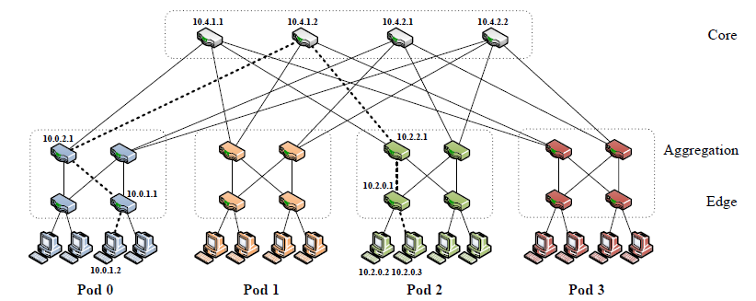
Simple Fat-tree

