Slide 1
Multipath TCPを用いたデータセンターネットワークの改善 Improving datacenter network with Multipath TCP
Sekiya laboratory M1
Fujii Shogo

Slide 2
Outline
Improving datacenter network with Multipath TCP
Background
Related work
Components of datacenter network
Reproducing simulation
Additional simulation
Conclusion

Slide 3
Background
MPTCP doesn’t improve short flow traffic
Big data growth matters seriously
Facebook stores more than 300 petabytes,
and analyzes 1 petabyte data for data mining daily[1].
Transition in data center …
Increasing the number of servers with tens of thousands for scale-out.
Increasing the number of paths in DC network, for redundancy.
In cloud services, intra-traffic have been increased.
Improving the datacenter network with Multipath TCP
[1]https://www.facebook.com/notes/facebook-engineering/presto-interacting-with-petabytes-of-data-at-facebook/10151786197628920
[2]http://blog.gigaspaces.com/amazon-found-every-100ms-of-latency-cost-them-1-in-sales/
Notes:
ビッグデータをどう活用するか、関心が高まっている。
取り巻く環境もデータ量の増加。
データセンターに着目すると、どう変わってきたか?

Slide 4
Background
Why is my target short flow??
Distributed processing is common solution for the problem of big data and massive resources.
Distributed processing produces a lot of short flow.
Actually, 80% of datacenter traffic is short flow[1].
Data centers runs many interactive services, which is latency-sensitive
Short flows in datacenter network is matter.
[1]Benson, Theophilus, Aditya Akella, and David A. Maltz. "Network traffic characteristics of data centers in the wild." Proceedings of the 10th ACM SIGCOMM conference on Internet measurement. ACM, 2010.

Slide 5
Background
What is the short flow problem?
Flow completion time(FCT) for short flow in TCP is poor.
Queue: short flow queued up behind burst of packets.
Bandwidth: first-come, first served.
Popular method : ECMP load-balancing
Scenario
ECMP performs hash-based flow-level load balancing.
may direct large flows to the same path
[1]Benson, Theophilus, Aditya Akella, and David A. Maltz. "Network traffic characteristics of data centers in the wild." Proceedings of the 10th ACM SIGCOMM conference on Internet measurement. ACM, 2010.

Slide 6
A solution for short flow problem
Multipath TCP(2011)
Extending TCP to use multiple paths by a single connection
Using multiple-paths simultaneously, improving the throughput
Load balancing
ECMP
MPTCP
:flow1
:flow2
1
1
1
2
1
2
ECMP assign a path each flow
2
2
MPTCP can distribute packets for a flow

Slide 7
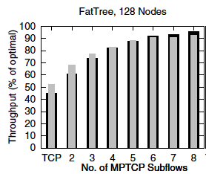
Motivated work
Raiciu, Costin, et al. "Improving datacenter performance and robustness with multipath TCP." ACM SIGCOMM Computer Communication Review. Vol. 41. No. 4. ACM, 2011.
Motivation:
effective utilization for modern density datacenter network
Target :
Multi-paths improve throughput with MPTCP
Result :
On any topologies, MPTCP worked better than existing TCP-based system
Problem:
Completion time for short-flow was not improved
Algorithm | Short Flow Finish Time(mean/stdev)
SINGLE-PATH TCP | 78 ±108 ms
MPTCP | 97 ± 106 ms
Fig. Utilization on FatTree [1]
Fig. The effect of short flows completing for 70KB
[1]Raiciu, Costin, et al. "Improving datacenter performance and robustness with multipath TCP." ACM SIGCOMM Computer Communication Review. Vol. 41. No. 4. ACM, 2011.

Slide 8
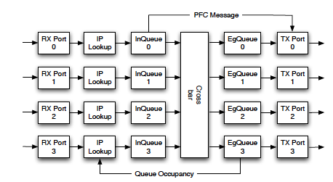
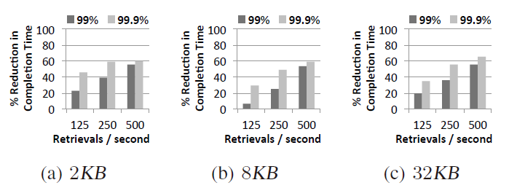
Related work
Zats, David, et al. "DeTail: Reducing the flow completion time tail in datacenter networks." ACM SIGCOMM Computer Communication Review 42.4 (2012): 139-150.
Motivation:
For user experiences, deadline of web page creation has to be met
Target :
Packet loss causes to delay
Solution :
Monitoring traffic with specified switch, and control flow with thresholds of buffer.
Result :
99th percentile completion time was improved by about 40%
Fig. proposed switch architecture[1]
Fig. Microbenchmarks for all-to-all workload
[1]Zats, David, et al. "DeTail: Reducing the flow completion time tail in datacenter networks." ACM SIGCOMM Computer Communication Review 42.4 (2012): 139-150.

Slide 9
About my research
Requirements for datacenter network
Using modern topology for massive resources
Seamless operation : without special implementation and device
Application friendly : optimizing the specified traffic patterns
My research :
On FatTree topology
using Multipath TCP
improving completion time of short flow
Verify the existing report of short flow’s problem
Analyze the result and find out the reason

Slide 10
Components of datacenter network

Slide 11
Components of data center network Topology
Traditional hierarchical topology
not holding massive servers
non-properly allocation of bandwidth
not correspond intra-datacenter traffic enough
core
aggregation
edge
host
hierarchical topology
Modern topologies
Improving utilization of bandwidth
Dense interconnect structure generates multipath on host-to-host traffic
FatTree topology[1]
Multipath is expected for not only redundancy, but performance up
[1]Al-Fares, Mohammad, Alexander Loukissas, and Amin Vahdat. "A scalable, commodity data center network architecture." ACM SIGCOMM Computer Communication Review. Vol. 38. No. 4. ACM, 2008.

Slide 12
Components of data center network Routing for multipath
Equal Cost Multi Path(ECMP)
For paths with equal-hop, balancing multiple flows with round-robin or hash
Multipath TCP(2011)
Extending TCP to use multiple paths by a single connection
Using multiple-paths simultaneously, improving the throughput
Load balancing
ECMP
MPTCP
:flow1
:flow2
1
1
1
2
1
2
ECMP assign a path each flow
2
2
MPTCP can distribute packets for a flow

Slide 13
Components of data center network Application
Distributed process
Almost all computing models is partition-aggregate model in general
This model is consisted oh a few master nodes and many worker nodes
partition-aggregate model of Presto[1]
request
query
Client
Coordinator
Worker
Aggregator
Worker
Aggregator
Aggregator
Worker
Worker
[1] http://prestodb.io/

Slide 14
reproducing simulation

Slide 15
Reproducing simulation
Environment from motivated work:
Topology : FatTree, oversubscripted 4 : 1
Traffic : 33% of nodes send data continuously(background traffic with TCP or MPTCP)
Remaining nodes send 70KB data on Poisson arrivals(200ms) with TCP
Measuring flow completion time comparing TCP and MPTCP
Simulation : my using ns-3 dce, while in motivated work using htsim or flow-level simulator
Randomness
Choosing sender and receiver nodes
1000 times on simulation
1
2
3
4
Unclearness
Parameter | Value
nodes | 16
core-aggr | 400Mbps
aggr-edge | 200Mbps
edge-host | 100Mbps
RTT | 0.5ms
Buffer | 100KB

Slide 16
Verify unclear parameter
Round Trip Time(RTT) : 0.5ms
Round trip within same datacenter is 0.5ms[1]
Buffer: 100KB
100[KB] = 400[Mbps] × 0.5[ms] ÷ 8 × 4
Bandwidth and nodes
Today’s datacenters have larger bandwidth than 400Mbps.
FatTree on simulation has 16 nodes, so setting smaller bandwidth for this small scale.
[1]http://www.linux-mag.com/id/7589/

Slide 17
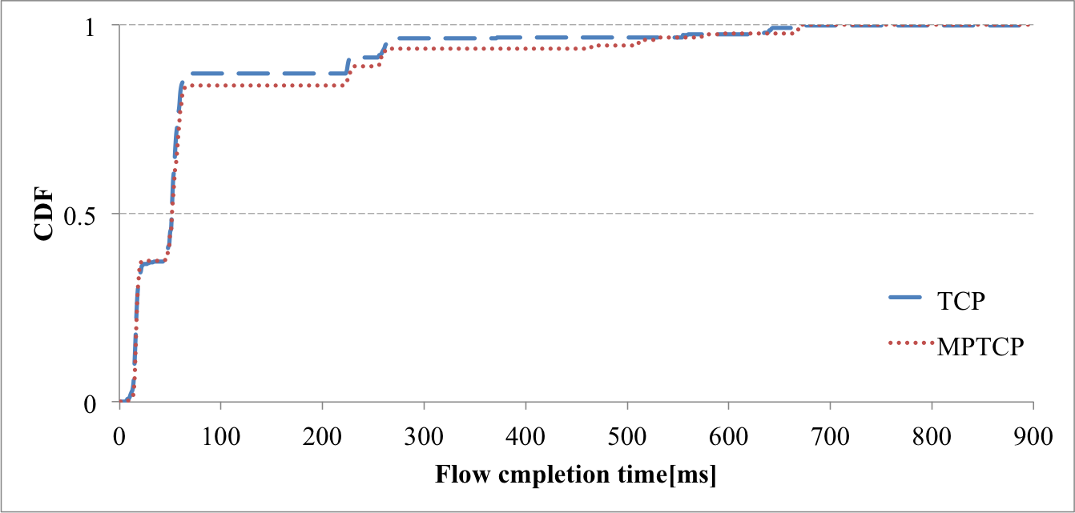
Reproducing simulation TCP vs. MPTCP
Algorithm | Short Flow Finish Time[ms] | Stdev[ms] | 99th percentile
SINGLE-PATH TCP | 78.4 | 122.5 | 266.7
MPTCP | 91 | 140.6 | 510.5
Short Flow Finish Time[ms] | Stdev[ms]
78 | 108
97 | 106
Table1. Reproducing result
Table2. Motivated work
MPTCP’ background traffic pressured bandwidth and caused short flow’s packet loss

Slide 18
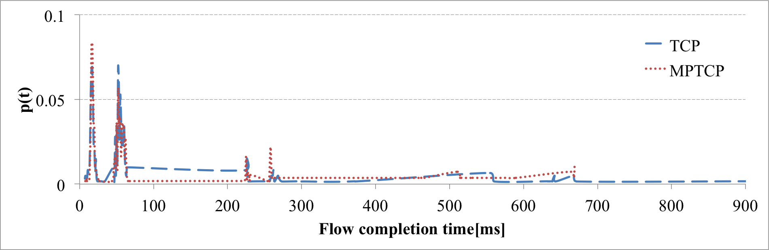
Reproducing simulation
Full window
Intensive flow
Delay with loss
Extreme delay
MPTCP didn’t improve the finish time by extreme delay’s
They were classified to 4 flow patterns

Slide 19
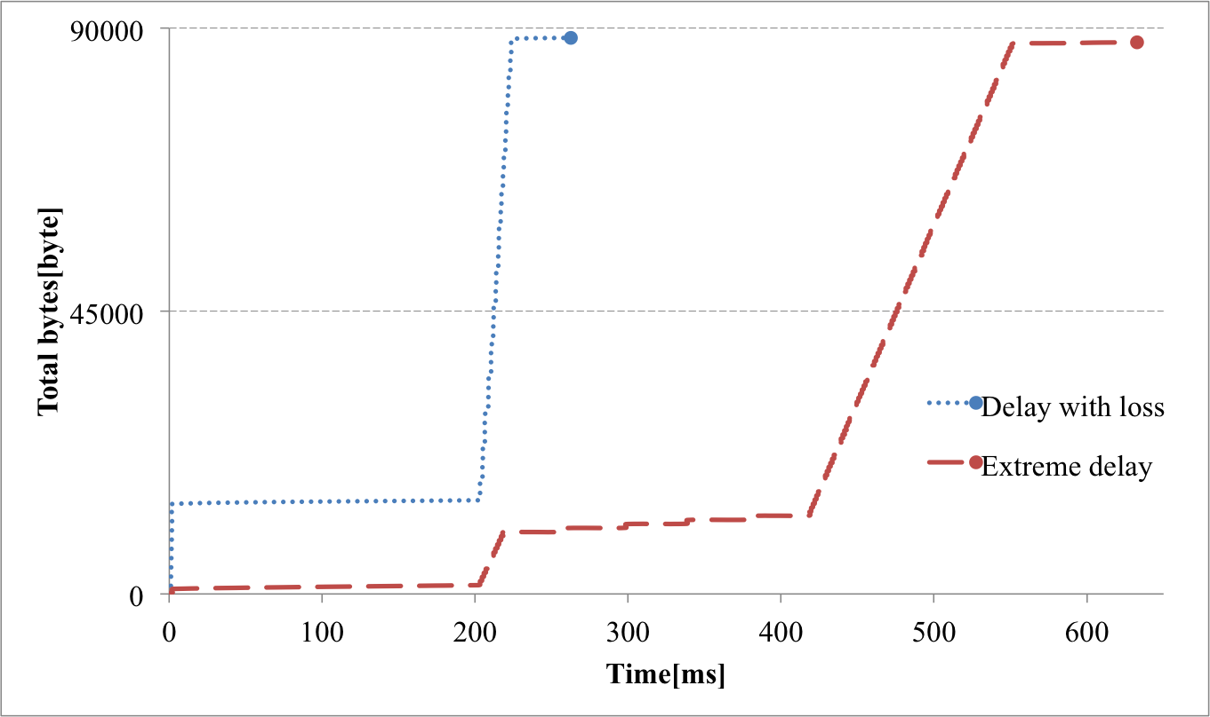
Reproducing simulation with packet loss
Delay with loss vs. Extreme delay
262ms
632ms
The traffic was generated in short term, about 10[ms], and lost packets.
Extreme delay lost packet at the beginning of the connection, and the segment size was minimized.

Slide 20
Reproducing simulation Summary
Verify the effect of background traffic between TCP and MPTCP
Background traffic with MPTCP caused more packet losses than that with TCP.
MPTCP made window size increased rapidly.
causing the bottleneck in generating short flow in a short period
Does short flow with MPTCP avoid the bottleneck by load balancing?

Slide 21
Additional simulation

Slide 22
Traffic patterns in today’s DC
Distributed processing has three traffic patterns
Characteristics of three traffic patterns
 | frequency | size | metric
Background traffic | sec order | 1MB-50MB | throughput [bytes/sec]
Short message | sec-msec order | 50KB-1MB | flow completion time[sec]
Query traffic | msec-µsec order | 2KB-50KB | flow completion time[sec]
Mix these traffic patterns comparing between TCP and MPTCP.
Verify the effect of MPTCP for short flow directly.

Slide 23
Additional simulation - Environment
Traffic
Background traffic
50% of workers sends data continuously as background traffic.
Short flow
Query traffic : For 100% of workers, 1~16[KB] data is generated on average every 200ms.
Short message : For 100% of workers, 50KB~1MB data is generated on average every 500ms.
1
2
3
4
Randomness
Choosing sender and receiver nodes
1000 times on simulation
worker nodes
master nodes

Slide 24
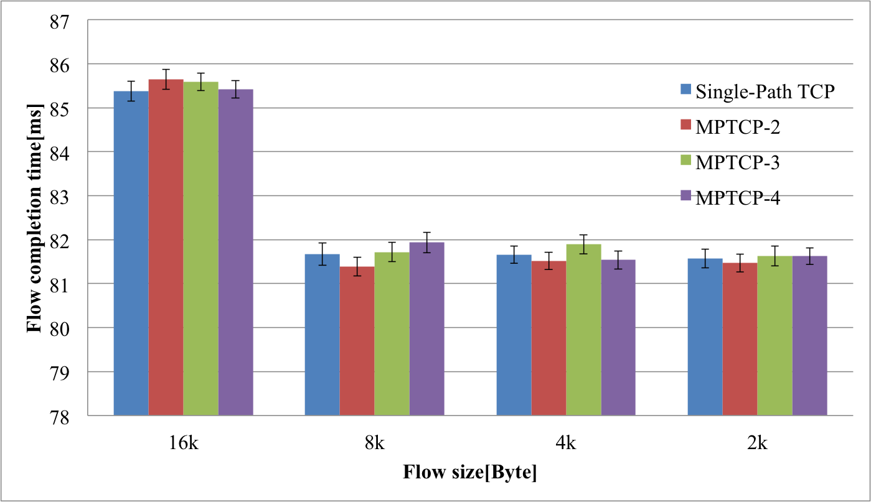
Additional simulation - Query traffic without background
MPTCP does not effect query traffic directly.
Requires consideration ….

Slide 25
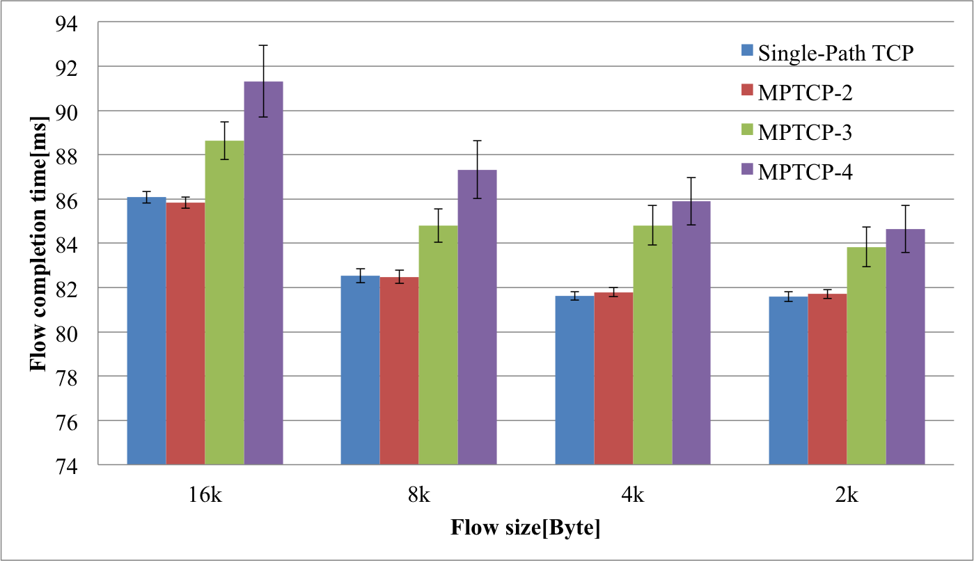
Additional simulation - Query traffic with background
6%
5%
5%
4%
Background traffic with MPTCP causes the delay of flow completion time.

Slide 26
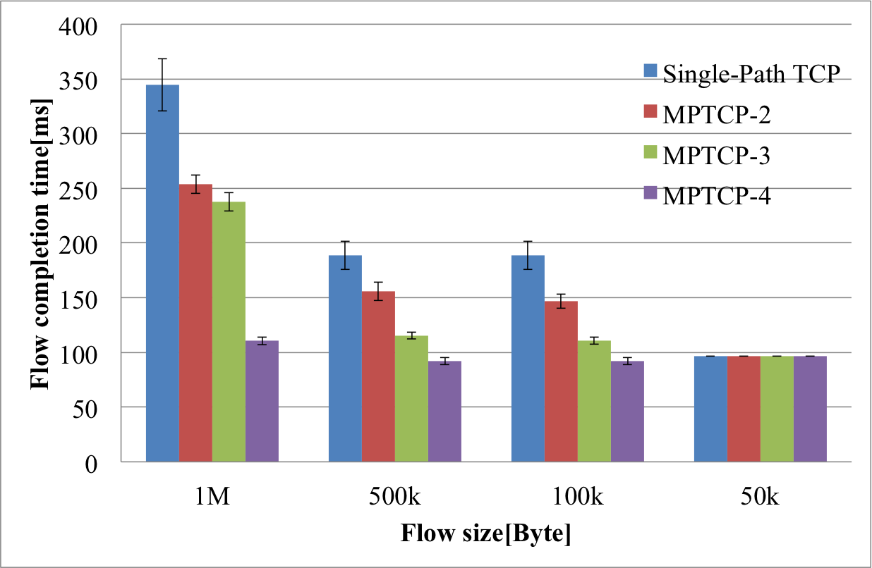
Additional simulation - Short message traffic without background
MPTCP improve the traffic larger than 50KB.
Requires consideration ….

Slide 27
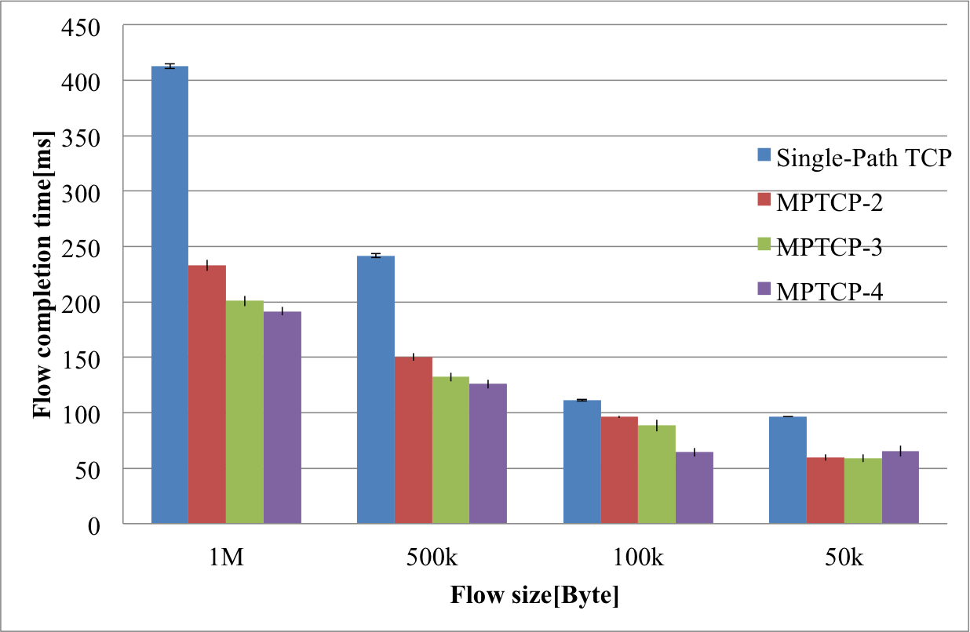
Additional simulation - Short message traffic with background
54%
28%
11%
8%
MPTCP improve the flow completion time of short message traffic.
Short message traffic is effected by background traffic.
Load balancing of MPTCP improves short message traffic.

Slide 28
Additional simulation - Results
Short message with MPTCP improves the completion time by load balancing and multi-path.
Query traffic with MPTCP did not work these functions.
Required consideration : threshold if using MPTCP or not..
As the result, query traffic with background traffic did not improve the completion time.

Slide 29
Conclusion

Slide 30
Conclusion
Reproduced the reported results about short flow and verified the effects of background traffic with MPTCP.
Background traffic occupied paths, and short flow became queued behind background traffic.
Verified the effect of short flow with MPTCP.
MPTCP improved short message traffic (>50KB)
MPTCP didn’t improve query traffic
Because of occupation of paths by MPTCP

Slide 31
Future work
Solution for the occupancy of paths with MPTCP and short flow’s becoming behind background traffic
Traffic optimization for application friendly
In distributed processing, short flow should be higher priority than background traffic.
Approach
Priority queuing : avoiding being behind background.
Bandwidth control : keeping the bandwidth for short flow.
Proposed method:
the system for QoS control
how to recognize whether high priority flow or not.

Slide 32
Background flow

Slide 33
Components of data center network Application
Distributed processing has three traffic patterns
1. Query traffic
Commanding to process partitioned tasks at the beginning of processing
The delay of bursty traffic is critical for the performance
2. Short message traffic
Managing the workers with the state updated
3. Background traffic
Sending fresh data to the workers
[1]Benson, Theophilus, Aditya Akella, and David A. Maltz. "Network traffic characteristics of data centers in the wild." Proceedings of the 10th ACM SIGCOMM conference on Internet measurement. ACM, 2010.
[2]Wilson, Christo, et al. "Better never than late: Meeting deadlines in datacenter networks." ACM SIGCOMM Computer Communication Review. Vol. 41. No. 4. ACM, 2011.

Slide 34
Status of my research Transition data center networking
0th generation : hosting systems
1st generation : very large DC
Purpose:
to reduce user’s Total Cost Ownership
Almost all services are followed client-server computing
Purpose:
high performance
Tens of thousands of servers
improving resource utilization
Client-server model
Crowd computing
Data center
(crowd)
Client
Server
Client

Slide 35
Status of my research Transition data center networking
2nd generation : Distributed DC
3rd generation : Interconnected DC
Purpose:
over capacity in a DC
Quality of Services
Service Level Agreement
Purpose:
application friendly
dynamic optimization
integrated management
flexible customization
Distributed DC
Interacting with other crowds
Client
Server
Client
crowd

Slide 36
Status of my research Common requirements and solutions
Common requirements
Solutions
1st Very Large Data center
Throughput
2nd Distributed DC
Scalability
3rd Interconnected DC
Optimization
Utilization
Availability
Flexibility
Network topology
Routing
Traffic engineering
Openflow
Virtualization

Slide 37
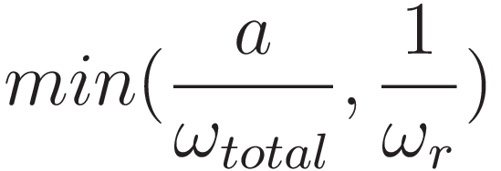



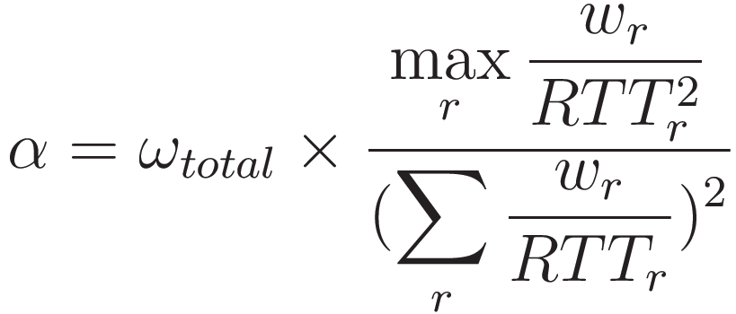


Components of data center network Routing for multipath
Congestion control
window size of subflow r
Receiving each ACK
Sum of window sizes
Packet loss
Aggressiveness
Fairness & Load balancing
ECMP
5Mb/s
MPTCP
5Mb/s
12Mb/s
11Mb/s
12Mb/s
10Mb/s
10Mb/s
11Mb/s
10Mb/s
10Mb/s
3Mb/s
8Mb/s
3Mb/s
10Mb/s

Slide 38
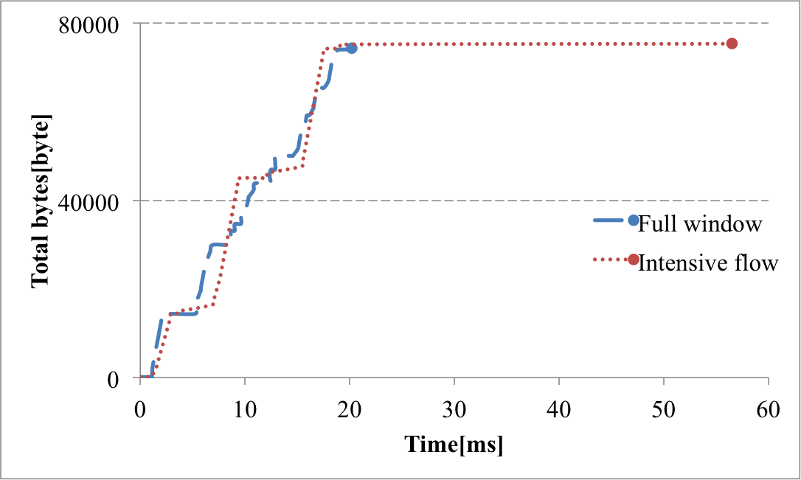
Reproducing simulation without packet loss
Full window vs. Intensive flow
22ms
58ms
Full window extended the full window size as soon as the connection.
Intensive flow sent data and ACK in bulk without full window.
As the result, the last ACKs was delayed.

