Slide 1
Webアクセススピード改善に関する研究動向 Recent trend of improving the web access speed
関谷研究室
Sekiya Lab
M1 藤居翔吾
M1 Shogo Fujii

Slide 2
Outline
Introduction
How to approach to web speeding up
The speeding up techniques
HTTP pipeline
SPDY
Evaluation and compare
Ongoing work
Conclusion

Slide 3
Outline
Introduction
How to approach to web speeding up
The speeding up techniques
HTTP pipeline
SPDY
Evaluation and compare
Ongoing work
Conclusion

Slide 4

Introduction
Notes:
インターネットは私たちの生活にはなくてはならない。
スマフォの普及
高速なウェブアクセス

Slide 5
Introduction
Motivation
Reducing web response time with manipulation of number of transactions
Research domains for reduction of web response
Hardware: Network bandwidth, CPU, Memory …
Software: Algorithm, Protocol (Pipeline, SPDY …)

Slide 6
Outline
Introduction
How to approach to web speeding up
The speeding up techniques
HTTP pipeline
SPDY
Evaluation and compare
Ongoing work
Conclusion

Slide 7
Evaluation of telecommunication
Evaluation criteria of web speeding up is
“response time”
Notes:
通信に関して、ウェブの高速化は何で決まるかというと、レスポンスタイム

Slide 8
Performance of web browsing
Peter Sevcik and Rebecca Wetzel , “Field Guide to Application Delivery Systems”, MSDN Magazine, 2006
Variable | Definition
R | Response time
Bandwidth | Rate of transfer to and from the browser
Payload | Total bytes sent to the browser
RTT | The time it takes to round-trip for connections
AppTurns | The number of requests for resources to need
Concurrent requests | Number of simultaneous requests by a browser
Cs | Compute time on the server
Cc | Compute time on the client
Notes:
2006年にレスポンス時間を表すモデル式が発表された。
そこからわかる、主な性能は

Slide 9
Performance of web browsing
Peter Sevcik and Rebecca Wetzel , “Field Guide to Application Delivery Systems”, MSDN Magazine, 2006
Variable | detail
Payload | Constant depending on HTTP
Bandwidth | Constant depending on communication method
RTT | Constant depending on distance
App Turns | variable
Concurrent requests | variable
Cs | Depending on hardware
Cc | Depending on hardware

Slide 10
Conditions for the issue
Payload and bandwidth are not considered
Not improving the spec of hardware
RTT is constant
Not consider the reconnection in the bad condition
Reducing response time

Slide 11
Outline
Introduction
How to approach to web speeding up
The speeding up techniques
HTTP pipeline
SPDY
Evaluation and compare
Ongoing work
Conclusion

Slide 12
TCP/HTTP1.1-conventional method
Client
Server
TCP connection
Layered Structure
HTTP request
Application
HTTP
HTTP response
Session
Presentation
HTTP request
HTTP response
Transport
TCP
TCP close
Concurrent requests
HTTP
1 request 1 response
TCP
limited connections per 1 server
Notes:
階層構造
TCP, HTTP~
HTTPは１リクエスト１レスポンス

Slide 13
HTTP/pipeline
Client
Server
TCP connection
Multiple requests on a single TCP connection
Without waiting for the corresponding responses
HTTP request
HTTP response
TCP close
Reducing App Turns(RTT)

Slide 14
SPDY
Multiple requests per a TCP connection
Multistream
Server push
Unnecessary of HTTP requests
Layered Structure
Application
HTTP
Session
SPDY
Presentation
SSL
Transport
TCP
Reducing the number of transactions

Slide 15
SPDY – Server Push
Client
Server
TCP connection
Concurrent requests
Reducing unnecessary HTTP request
HTTP request
Request of streams with server push
Pushing data streams without request
Reducing the number
of transactions
HTTP response
TCP close

Slide 16
Outline
Introduction
How to approach to web speeding up
The speeding up techniques
HTTP pipeline
SPDY
Evaluation and compare
Ongoing work
Conclusion

Slide 17
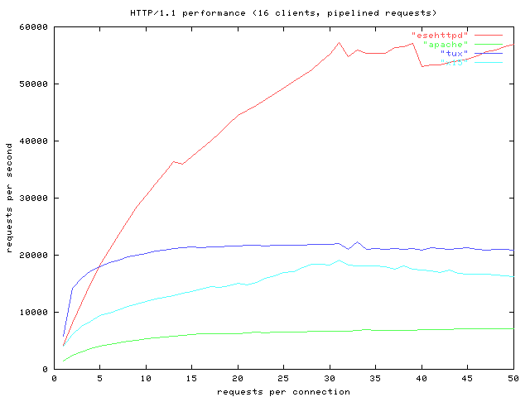
Evaluation of HTTP pipeline
esehttpd with HTTP pipeline/on
apache without HTTP pipeline/off
tux without HTTP pipeline/off
x15 without HTTP pipeline/off
Transfer of very small data[2byte]
Handle more requests with HTTP pipeline
Akira Higuchi, “Getting High Performance With Esehttpd", http://esehttpd.sourceforge.jp/doc/ja/ high-performance.html

Slide 18
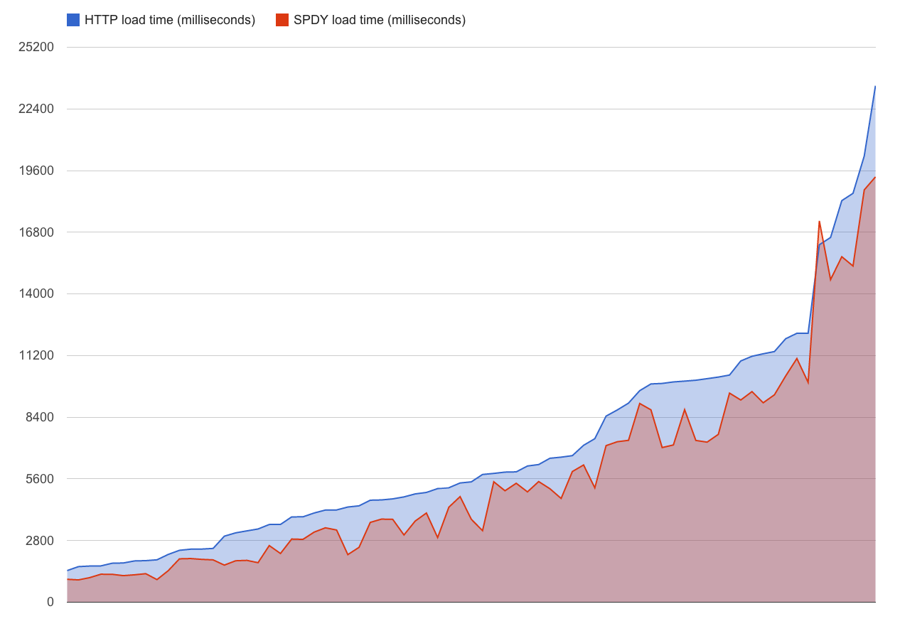
Evaluation SPDY Performance on Mobile Networks
For 77 URLs
3G network
Uplink bandwidth of 1 Mbps
Downlink bandwidth of 2 Mbps
Round-trip delay of 150 [ms]
packet loss of less than 1%
average page load time reduction of 23%
77 URLs Sorted by heavy loading
Matt Welsh, Ben Greenstein, and Michael Piatek,“SPDY Performance on Mobile Networks”,https://developers.google.com/speed/articles/spdy-for-mobile,2012

Slide 19
Evaluation SPDY Performance on Mobile Networks
Parallelization of 5 files downloading
All files download starting
Waiting time
Matt Welsh, Ben Greenstein, and Michael Piatek,“SPDY Performance on Mobile Networks”,https://developers.google.com/speed/articles/spdy-for-mobile,2012
Notes:
この図はGoogleによるSPDYの評価です
HTTP/1.1では、〜
SPDYでは〜

Slide 20
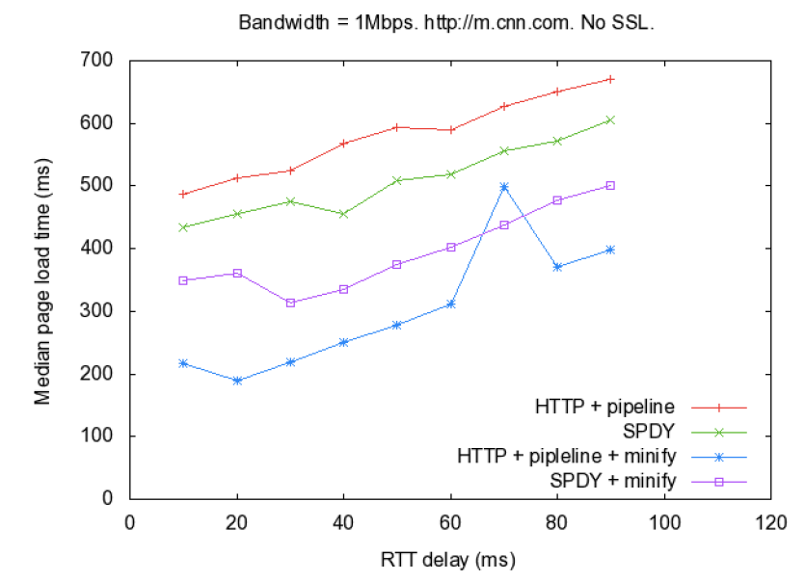
Comparison HTTP pipeline and SPDY
The CNN mobile web
11 objects(1html, 1CSS and 9 images)
totaling 38.5kB
HTTP pipeline – 11 connections
SPDY – 1 connection
SPDY is better than HTTP pipeline
Padhye, Jitu. "A comparison of SPDY and HTTP performance." (2012).

Slide 21
The reasons for different performance
Multiplexing of HTTP requests
HTTP pipeline
TCP : 2, Pipelines : 8
SPDY
TCP : 1, Multistream : more than 100
For the number of transactions,
the difference in spread
SPDY > HTTP pipeline

Slide 22
Outline
Introduction
How to approach to web speeding up
The speeding up techniques
HTTP pipeline
SPDY
Evaluation and compare
Ongoing work
Conclusion

Slide 23
Current web page
Many requests for small resources from multiple hosts
The trend of Web
Metric | Nov 15 2010 | Jun 1 2013
Avg. page siza | 702[kB] | 1462[kB]
Resources / page | 74 | 92
Domain | 10 | 16
"HTTP Archive", http://httparchive.org/, June. 2013.
Web page
Server1
Server2
Server3

Slide 24
Evaluation SPDY Performance on Mobile Networks
three modes – HTTP, HTTPS and SPDY
the top 500 websites in the US, as defined by Alexa
Chrome browser (version 18) supports SPDY
5 different network speeds, including Cable, DSL, low-latency mobile and high latency mobile.
Network Speed (Down/Up Kbps, Latency ms) | SPDY vs HTTPS | SPDY vs HTTP
Cable (5,000/1,000, 28) | SPDY 6.7% faster | SPDY 4.3% slower
DSL (1,500/384,50) | SPDY 4.4% faster | SPDY 0.7% slower
Low-Latency Mobile (780/330,50) | SPDY 3% faster | SPDY 3.4% slower
High-Latency Mobile (780/330,200) | SPDY 3.7% faster | SPDY 4.8% slower
Guy Podjarny, “Not as SPDY as You Thought” http://www.guypo.com/technical/not-as-spdy-as-you-thought/ , 2012
Notes:
光ケーブル, DSL：ツイスト線, 遅延の少ない携帯回線、遅延の多い携帯回線.
HTTPS暗号化、round tripが多く必要

Slide 25
Not suitable for SPDY
Lots of 3rd-party domains with
SPDY cannot reuse the connection
Very few resources without connection reuse
SPDY may not help it if the number of resources is less than 6
High packet-loss links
SPDY does worse than HTTP with high RTT and high packet loss
Roberto Peon, “SPDY It’s Here!”,
http://commondatastorage.gzoogleapis.com/io2012/presentations/live%20to%20website/1201.pdf, 2012

Slide 26
SPDY - TCP / SSL
Client
Server
Layered Structure
TCP connection
Application
HTTP
Session
SPDY
3-handshake
Presentation
SSL
SSL connection
Transport
TCP
SSL handshake
At the beginning
more transactions

Slide 27
Ongoing work-1
Steven Rosenberg, Surbhi Dangi, Isuru Warnakulasooriya, “Data and Network Optimization Effect on Web Performance”, Silicon Valley Campus report 2012
Motivation
improving the performance of various types of websites
Methodology
Two software approach to improve network performance
Content optimization and compression(BoostEdge)
Optimization network protocol(SPDY)

Slide 28
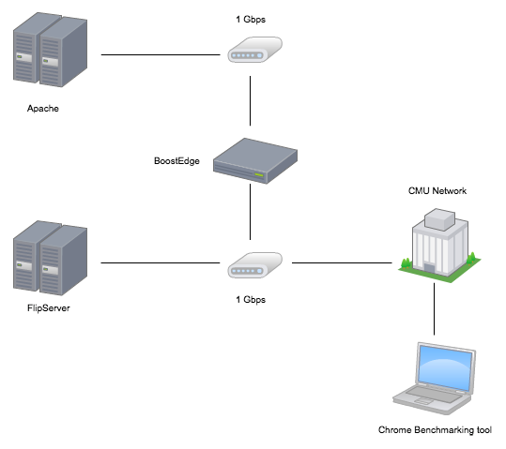
Data and Network Optimization Effect on Web Performance
BoostEdge : Web accelerator for speeding up
Forcing a client to optimally cache data.
Enabling lossy image compression to the client screen size.

Slide 29
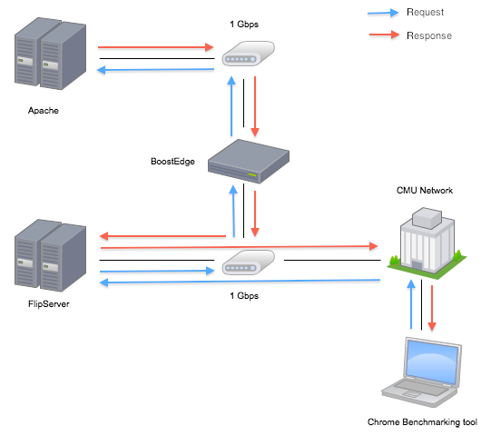
Data and Network Optimization Effect on Web Performance
Cache
Compression

Slide 30
Data and Network Optimization Effect on Web Performance
websites with the highest number of HTTP requests
Website | Size[kb] | HTTP Requests
LATimes | 2049.6 | 160
WashigtonPost | 1487.6 | 109
CNN | 1379.8 | 109
MapQuest | 1231.7 | 78
Answers | 1035.2 | 39
The results for 5 websites with the highest number of HTTP requests
Testcase | Averaged page load time[ms] | Error
HTTP | 13685.1 | 3.31
HTTP_through_FlipServer | 14839.8 | 1.3
SPDY_through_FlipServer | 12757.2 | 1.54
SPDY_through_FlipServer_w_BoostEdge | 5846.2 | 2.3
HTTP_through_FlipServer_w_BoostEdge | 8112.1 | 2.13
HTTP_w_BoostEdge | 7116.6 | 1.69

Slide 31
Data and Network Optimization Effect on Web Performance
BoostEdge
Boost for heavy data
SPDY
Boost for small data
Supports of various pages
Multi domain ??

Slide 32
Ongoing work-2
Gen Mineki, Satoshi Uemura, and Teruyuki Hasegawa,“SPDY Accelerator for Improving Web Access Speed",ICACT 2013, Jan. 2013.
Motivation
Faster web access with SPDY in multi-domain configuration on mobile network
Methodology
Reducing SPDY sessions
Reverse proxy
Cache system

Slide 33
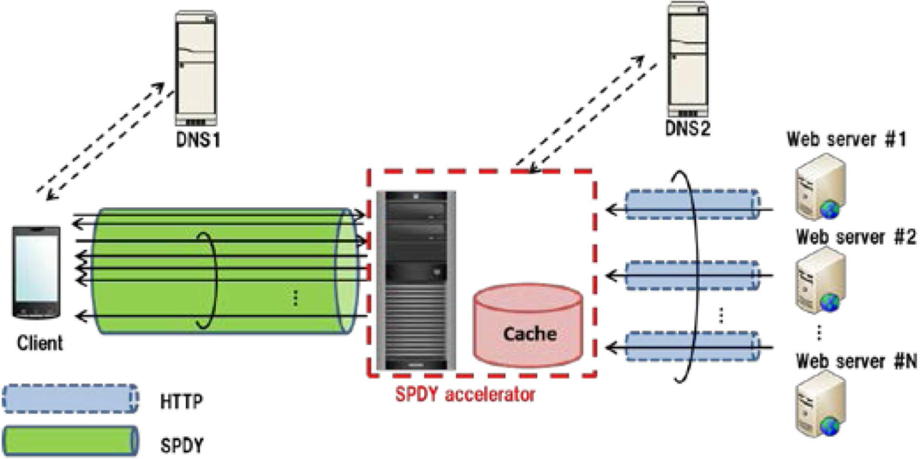
Proposed method
Gen Mineki, Satoshi Uemura, and Teruyuki Hasegawa,“SPDY Accelerator for Improving Web Access Speed",ICACT 2013, Jan. 2013.

Slide 34
For multi domain requests
Embed
resource
Sub Server A
HTML
Embed
resource
Client
Main Server
Sub Server B
Embed
resource
Sub Server C
Needing many connections open and close

Slide 35
SPDY Accelerator for Improving Web Access Speed
HTML
Embed
resource
Main Server
Sub Server A
SPDY
connections
Embed
resource
Client
SPDY
Accelerator
Sub Server B
Embed
resource
Sub Server C
1 SPDY connections between client and SPDY accelerator

Slide 36
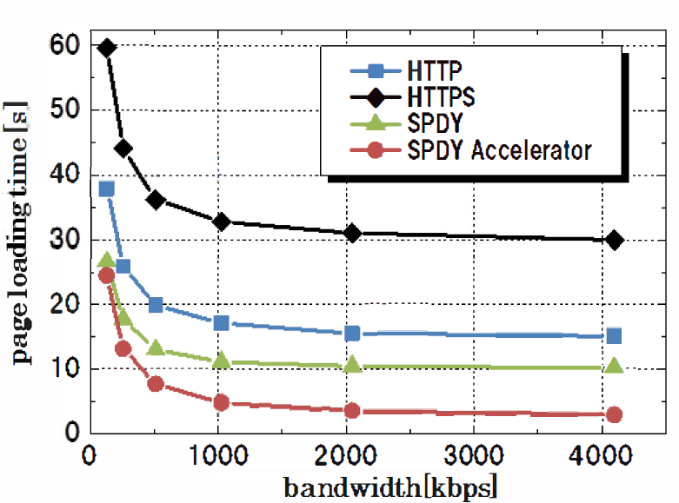
SPDY Accelerator for Improving Web Access Speed
7 hosts, 44 resources, 42 images, 1 html file, 1 CSS
Total size is 320 [kb]
RTT is 150 [ms]
The page-loading time can be reduced for multiple domain
In low latency network
In high latency network, like mobile network
Gen Mineki, Satoshi Uemura, and Teruyuki Hasegawa,“SPDY Accelerator for Improving Web Access Speed",ICACT 2013, Jan. 2013.

Slide 37
Outline
Introduction
How to approach to web speeding up
The speeding up techniques
HTTP pipeline
SPDY
Evaluation and compare
Ongoing work
Conclusion

Slide 38
Conclusion
Demonstrating the way of improving the web access speed
Reducing RTT is effective approach
SPDY is the best
Ongoing work approaches issues of current web
Heavy data, multiple small datas
Multi domain configuration
Future work
Speeding up in poor communication environment

