Slide 1
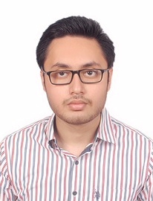



Shoham Srivastava
Analyst/Software Engineer
Bachelor of Engineering
Computer Science Engineering: 2017- 2021
Skills
Noida
Python Java 8
Cobol
JCL
ISPF
Database
SQL database – DB2, Oracle
Web Technologies
HTML5
CSS3
Java Script
Add Ons
GitHub
shoham.srivastava@capgemini.com
+91 7355581551
A4
A self driven learner with Front-End and Back-End knowledge. Passionate about implementing and launching new projects.
Ready to learn new technologies/Frameworks and implement them to further improve my knowledge.
A team player with good communication skill always ready to work for the enrichment of knowledge.
Has working knowledge on JCL and COBOL on an intermediate level.
Music Go App
Completed end to end case study of Music Go application with music playing abilities , using python library Tkinter and using Oracle as a database for making music libraries. Tkinter is used for user interface.
Coded and designed Static Web Pages
Developed website with HTML5 and CSS3 Along Frameworks like DJANGO to make website more interactive and dynamic.
Check out my work on GitHub & Video Profile

