Slide 1
Comparative Analysis of Web Development Frameworks For Building Scalable And Efficient web Applications
Submitted By
Group Number 02
Alam, Md. Shohanul
Id : 12-22494-3
SALMAN,N.S.
Id : 18-38488-2

Slide 2
Outline
Introduction
Problem Statement
Scope of The Research
Objectives
Limitations
Literature Review
Research Methodology
Expected Results
Work Schedule
References

Slide 3
Introduction
Web development is a rapidly evolving field
Efficient and scalable web applications are required to handle increasing amounts of traffic and user data
Frameworks play a critical role in web development
Frameworks provide pre-built components and tools for faster and more efficient application development
Not all frameworks are equal, and choosing the right one for a given project can be a challenging task
Comparative analysis of web development frameworks is necessary to determine their ability to build scalable and efficient web applications.

Slide 4
PROBLem Statement
Problem: Need to identify the most effective web development frameworks for building scalable and efficient web applications.
Developers under increasing pressure to build applications that can handle large volumes of traffic and user data while maintaining performance.
Different frameworks have different strengths and weaknesses when it comes to scalability and efficiency.
Difficult for developers to choose the best framework for their needs.

Slide 5
Scope of the research
Focus on a comparison of the most popular web development frameworks: Angular, React, Vue, and Laravel
Frameworks were chosen based on their popularity and adoption rate in the industry
Evaluation based on their ability to build scalable and efficient web applications
Performance metrics used include response time, memory usage, and user experience
Industry-standard benchmarking tools will be used to measure and compare framework performance

Slide 6
OBJECTIVES
Identify the most popular web development frameworks
Evaluate the scalability and efficiency of these frameworks
Compare the strengths and weaknesses of different frameworks
Provide recommendations for choosing the best framework for a given project
Provide recommendations for choosing the best framework for a given project

Slide 7
LIMITATIONs
One limitation of this research paper is the limited scope of frameworks that will be evaluated.
Many other frameworks are available that may be better suited for certain types of applications or use cases.
The evaluation of a framework's performance can vary depending on the application architecture, hosting environment, and other factors beyond the scope of this research paper.

Slide 8
LITERATURE REVIEW
The choice of web development framework is critical for scalability and efficiency.
Popular frameworks include Angular, React, Vue, and Laravel.
Angular is developed by Google and is comprehensive for complex web applications.
React is developed by Facebook and is known for its simplicity and ease of use.
Several studies have shown Angular and React to be highly scalable and efficient.

Slide 9
Vue is a new, popular, and simple framework developed by Evan You
Laravel is a widely used PHP framework known for its simplicity and efficiency
Angular is a comprehensive framework developed and maintained by Google, highly scalable and efficient
React, developed and maintained by Facebook, is known for its simplicity and efficiency
These frameworks are widely adopted in the industry and have been shown to be highly scalable and efficient in several studies
Developers should carefully evaluate their requirements to choose the framework that best suits their needs.

Slide 10
Research METHODOLOGY
The purpose of this research is to identify the most effective web development framework among Angular, React, Vue, and Laravel for building scalable and efficient web applications.
The evaluation approach focused solely on performance metrics and did not consider other factors such as ease of use, developer community, or cost.
A series of benchmark tests were conducted using industry-standard tools to evaluate the scalability and efficiency of the four frameworks.
A sample web application was created using each framework with the same set of features and functionality.
Apache JMeter was used to simulate user traffic on each application and measure response time, throughput, and error rate for each framework.
Memory usage and CPU usage were also measured during the tests.

Slide 11
Google Lighthouse was used to evaluate the user experience of each application
Multiple tests were conducted and the average performance metrics were taken to ensure accuracy and reproducibility
All applications were tested on the same hosting environment, using the same database and web server configuration
Data was collected from multiple sources and analyzed to provide a comprehensive comparison of each framework's scalability and efficiency
Rigorous benchmark testing, code analysis, and data analysis were employed to provide an objective comparison of the most popular web development frameworks.

Slide 12
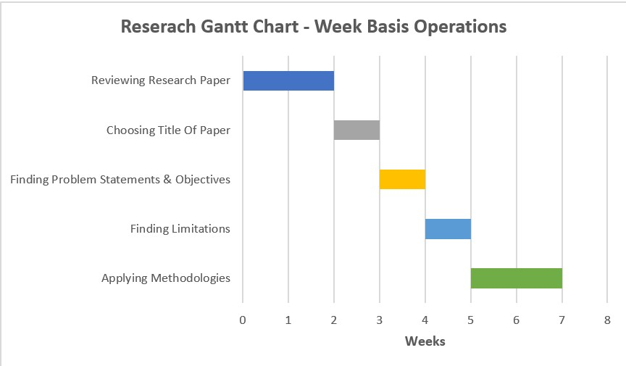

Slide 13
REFERENCES
[1] S. Greif, "Comparing AngularJS, React, Vue.js and More," 2018.
[2] J. Shaheb, "Comparing Popular Frontend Frameworks: Angular, React, and Vue," 2020.
[3] A. Virdi, "A Comprehensive Guide to Laravel 5.5," 2018.
[4] S. Srinivasan, "Scalability: The Key to E-commerce Success," 2019.
[5] E. Chen, "Efficiency vs. Scalability: What’s the Difference?," 2019.
[6] N. Chhetri, "A Comparative Analysis of Node.js (Server-Side JavaScript)," February 2016.
[7] U. Ibrahim, J. B. Hayfron-Acquah, and F. Twum, "Comparative Analysis of Codeigniter and Laravel in Relation to Object-Relational Mapping, Load Testing and Stress Testing," February 2018.
[8] P. Jaiswal and S. Heliwal, "Competitive Analysis of Web Development Frameworks," January 2022.

Slide 14
THANK YOU

