Slide 1
Obect tracking method:
Image Frame
RGB to HSV
Using::cvtColor()
Filer to get object
Using::inRange()
Filer by Erode & dilate image
Using::erode()
Using::dilate()
Find coutours
Using:: findContours() with Hierarchy
Get object position
Using:: moments()

Slide 2

Multi Obect tracking method:
Ball 1
Ball 2
Ball 3
Vector Obj( , …., )
Ball 4
Ball 5
Ball 6
Vector Obj(ball1,ball2….,balln)
X pos
Y pos
X pos
Y pos

Slide 3
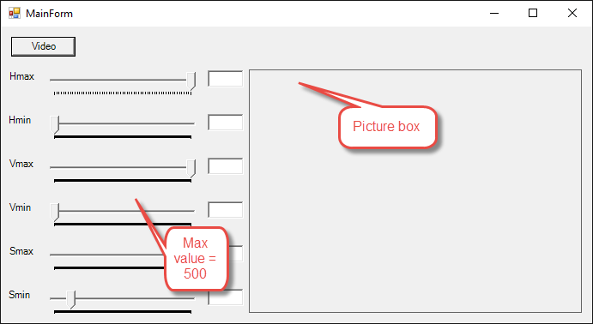

Slide 4
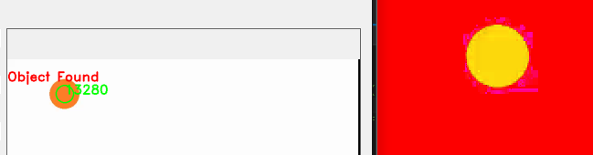
Obect tracking method:
Step 1: Color Filtering
cvtColor() -> BGR to HSV
inRange() -> Between a max and min threshold (binary)

Slide 5

Obect tracking method:
Step 2: Erode & dilate image
After Erode: After Deilate

Slide 6
Obect tracking method:
Step 3: Find Contours
Input: Binary image
Output: a vector of contours. The outline of all objects found in binary image
Step 4: “Moments” Method
Input: vector of countours
Output: x,y coordinates of largest contours, Defined by its inner area.

