Slide 1

Library Management System
By,
Sohedul Islam id: 152002005
Rijwan Hosain id: 152002007
Zahirul Islam id: 151002032

Slide 2
Authentication
Registration
Question for forgot password
Login
Forgot Password
Contacts info
Student info
Staff info

Slide 3
Management
Books
Books info
Location info
Borrows Book info
Fines info
Manager operation

Slide 4
Gantt chart:
Weeks Project activities | 1 | 2 | 3 | 4 | 5 | 6 | 7 | 8 | 9
Planning
Design
Coding
Testing
Delivery

Slide 5
Pert Diagram:
 | Activity | Predecessor | Duration(week)
1 | Planning | ---- | 4
2 | Design | Planning | 4
3 | Coding | Planning | 5
4 | Testing | Design, Coding | 3
5 | Delivery | Testing | 1
4 | Design | 8
5 | 4 | 9
0 | Planning | 4
0 | 4 | 4
9 | Testing | 12
9 | 3 | 12
12 | Delivery | 13
12 | 1 | 13
4 | Coding | 9
4 | 5 | 9

Slide 6
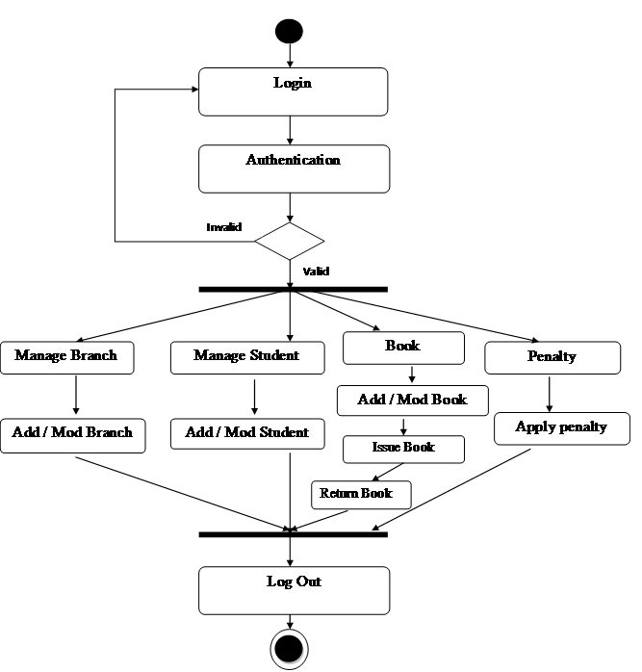
Activity Diagram for Manager

