Slide 1
License Plate Recognition
OpenCV3.1 Application
Jacky Le 7Sep2016

Slide 2
1. Architect
Detect License Plate
Character training
Load img
Load traning imgs
Pre img processing
Get feature data
Convert to Binary
Training
Draw Rect around object
Save SVM training file
Find the Rect we suspect as License plate
Recognize character base on SVM predic

Slide 3
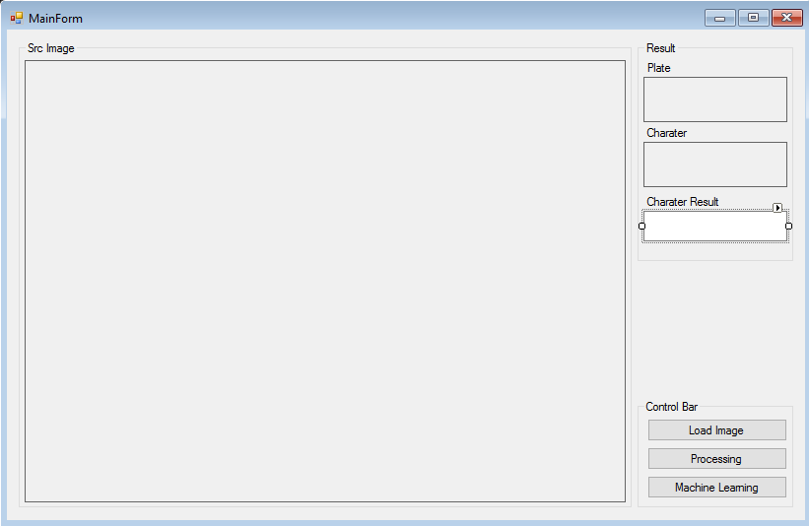
2. GUI <User interface>

Slide 4
3. Module – SVM Training
//Train SVM OpenCV 3.1 definition
Ptr<SVM> svm = SVM::create();
svm->setType(SVM::C_SVC);
svm->setKernel(SVM::RBF);
svm->setGamma(0.5);
svm->setC(16);
svm->setTermCriteria(TermCriteria(TermCriteria::MAX_ITER, 100, 1e-6));
vector<string> folders = list_folder(trainImgpath); // FOLDER KEEP The training images
Mat src;
Mat data = Mat( number_of_sample * number_of_class, number_of_feature, CV_32FC1);
Mat label = Mat(number_of_sample * number_of_class, 1, CV_32SC1);
number_of_sample * number_of_class = 30*10
number_of_feature = 32
Data
dat1, dat2, …. datn
dat11, dat21, …. datn1
…
Label
Label1, label2,……labeln
http://docs.opencv.org/trunk/d1/d73/tutorial_introduction_to_svm.html

Slide 5
3.1 Module – SVM Training/data,label get data
for (size_t i = 0; i < folders.size(); ++i)
{
vector<string> files = list_file(folders.at(i));
string folder_path = folders.at(i);
string label_folder = folder_path.substr(folder_path.length() - 1);
for (size_t j = 0; j < files.size(); ++j)
{
src = imread(files.at(j));
vector<float> feature = calculate_feature(src);
for (size_t t = 0; t < feature.size(); ++t)
{data.at<float>(index, t) = feature.at(t);}
label.at<int>(index, 0) = i;
index++;
}
}
// SVM Train OpenCV 3.1
svm->trainAuto(ml::TrainData::create(data, ml::ROW_SAMPLE, label));
svm->save(savepath);
Need to calculate feature for each sample to train

Slide 6
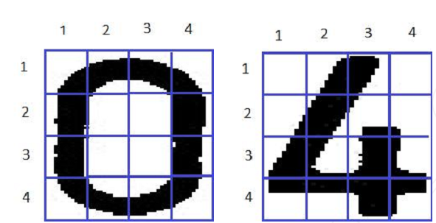
3.2 Module – SVM Training/Feature calculation
Example we have 2 character image 0 and 4
We need resize 2 image to same size and divide as 16 small area as picture
As you can see we can find difference between 2 image on cell(1,1)(1,4)(2,2)... on those cell total back pixel are difference.
This app i used 32 features, we can use more features for the training to get more precision

Slide 7
3.2 Module – SVM Training/Feature calculation
Mat img;
threshold(src, img, 100, 255, CV_THRESH_BINARY);
vector<float> r;
//vector<int> cell_pixel;
resize(img, img, Size(40, 40));
int h = img.rows/4;
int w = img.cols/4;
int S = count_pixel(img);
int T = img.cols * img.rows;
for(int i = 0; i < img.rows; i += h)
{
for(int j = 0; j < img.cols; j += w)
{
Mat cell = img(Rect(i,j, h , w));
int s = count_pixel(cell); // get black pixcel
float f = (float)s/S;
r.push_back(f);
}

Slide 8
3.2 Module – SVM Training/Feature calculation
for(int i = 0; i < 16; i+= 4)
{
float f = r[i] + r[i+1] + r[i+2] + r[i+3];
r.push_back(f);
}
for(int i = 0; i < 4; ++i)
{
float f = r[i] + r[i+4] + r[i+8] + r[i+ 12];
r.push_back(f);
}
r.push_back(r[0] + r[5] + r[10] + r[15]);
r.push_back(r[3] + r[6] + r[9] + r[12]);
r.push_back(r[0] + r[1] + r[4] + r[5]);
r.push_back(r[2] + r[3] + r[6] + r[7]);
r.push_back(r[8] + r[9] + r[12] + r[13]);
r.push_back(r[10] + r[11] + r[14] + r[15]);
r.push_back(r[5] + r[6] + r[9] + r[10]);
r.push_back(r[0] + r[1] + r[2] + r[3] + r[4] + r[7] + r[8] + r[11] + r[12] + r[13] + r[14] + r[15]);

Slide 9
4. Module – Main/Load image
// Load image by dialog
OpenFileDialog^ dgOpen = gcnew OpenFileDialog();
dgOpen->Filter = "Image(*.bmp; *.jpg)|*.bmp;*.jpg|All files (*.*)|*.*||";
if (dgOpen->ShowDialog() == System::Windows::Forms::DialogResult::Cancel) return;
// assign image to the picture box & srcImage
Bitmap^ bmpSrc = gcnew Bitmap(dgOpen->FileName);
ptbSrc->Image = bmpSrc;
ptbSrc->Refresh();
srcImg = imread(stringTochar.ConvertString2Char(dgOpen->FileName));

Slide 10
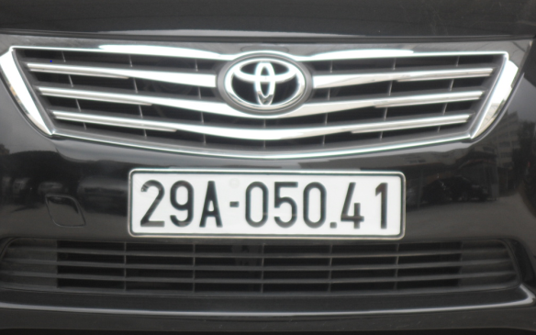
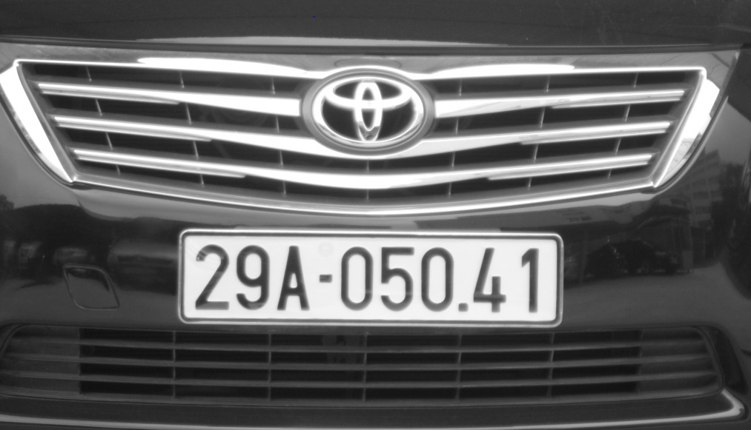
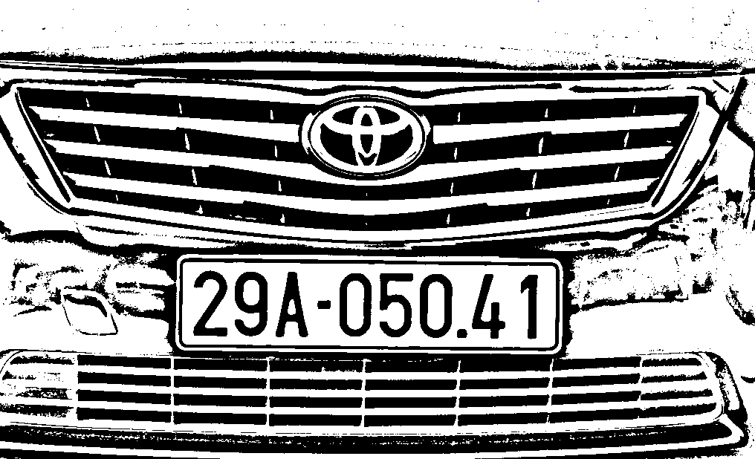
4.1 Module – Main/Pre-image process
// Preimage processing
image | Convert to gray | Convert to binary
 | cvtColor(image, gray, CV_BGR2GRAY); | adaptiveThreshold(gray, binary, 255, CV_ADAPTIVE_THRESH_GAUSSIAN_C, CV_THRESH_BINARY, 55, 5);

Slide 11
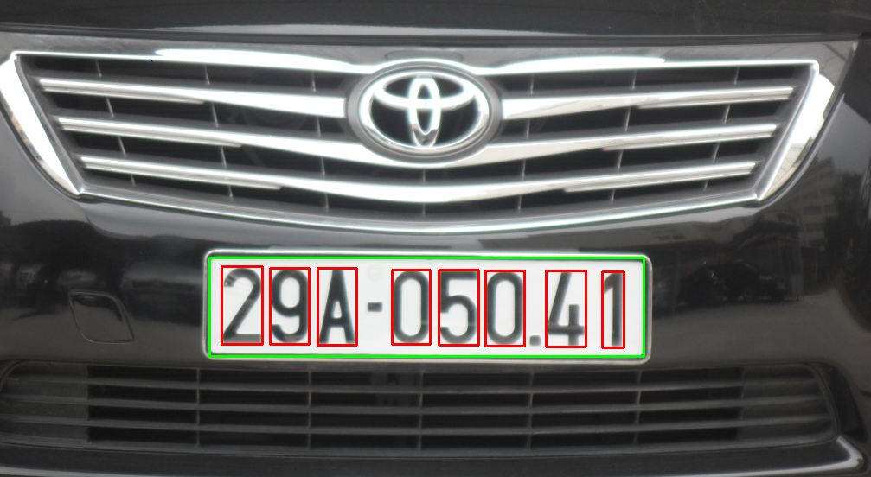
4.2 Module – Main/Find contours and detect the plate
// Detect the plate
Binary image | Find contours | Detect the plate (base on rect size and ratio
 | findContours(binary, contours, hierarchy, CV_RETR_TREE, CV_CHAIN_APPROX_SIMPLE, cv::Point(0, 0)); | findContours(sub_binary, sub_contours, sub_hierarchy, CV_RETR_TREE, CV_CHAIN_APPROX_SIMPLE, cv::Point(0, 0));

Slide 12
4.3 Module – Main/Recognize character inside ls plate detected
// Recognize license plate base on SVM predict
// Plate recognition
for (size_t i = 0; i < characters.size(); i++)
{
string result;
for (size_t j = 0; j < characters.at(i).size(); ++j)
{
char cs = character_recognition(characters.at(i).at(j));
result.push_back(cs);
}
text_recognition.push_back(result);
System::String^ str = gcnew System::String(result.c_str()); // Convert std string to System String
textBox1->Text += str;
}

