Slide 1
TMDB Box Office Prediction
Aditya Changati Shobha Ojha

Slide 2
Content
Objectives and Goals
Data Cleaning
EDA
Preparation for Modeling
Modeling
Linear Regression
Random Forest
Gradient Boosting
Support Vector Regression
Improvements and Potentials

Slide 3
Objective and Goals
For the project:
The primary goal is to build a machine-learning model to predict the revenue of a new movie given such features as budget, release dates, genres, production companies, production countries… The modeling performance is evaluating based on the MSE and R2
For personal development:
Understanding Data Cleaning
Understanding EDA
Understanding Machine Learning Concepts and Applications

Slide 4
Data Cleaning
Identify and remove rows with NA
Replacing budget with mean values since budget does not have null values but few columns have values zero
Generating dummy variables for categorical variables

Slide 5
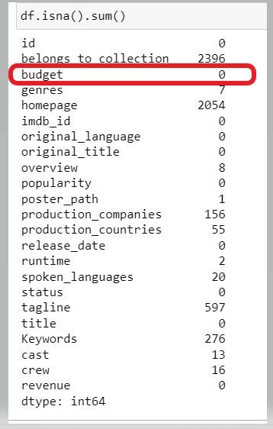
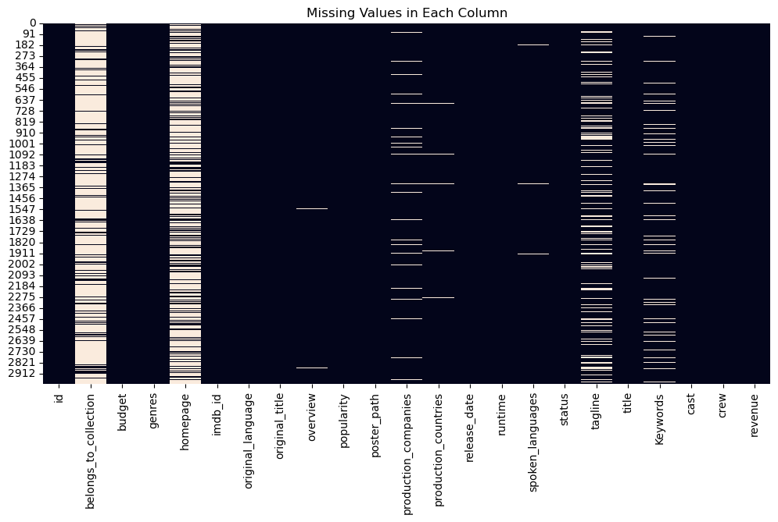
Handling Missing Values

Slide 6
Data Exploratory Analysis

Slide 7
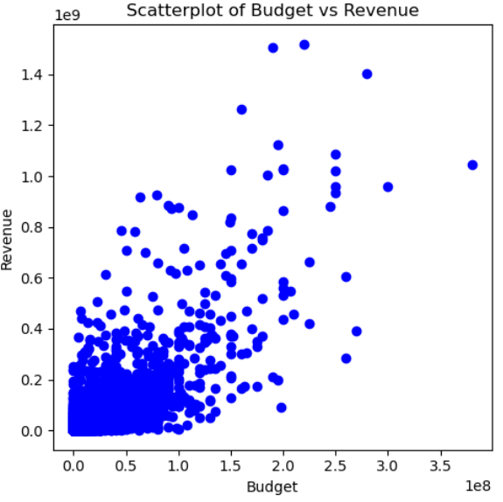
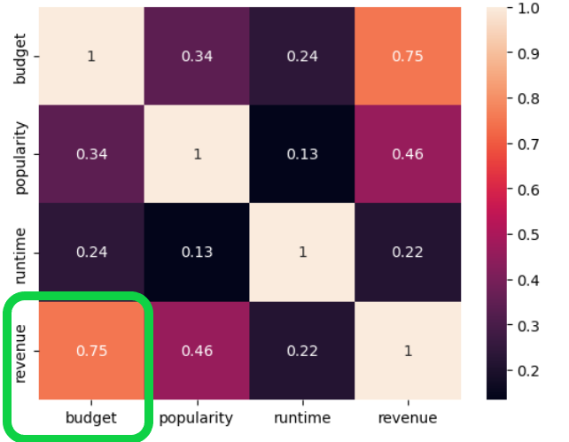
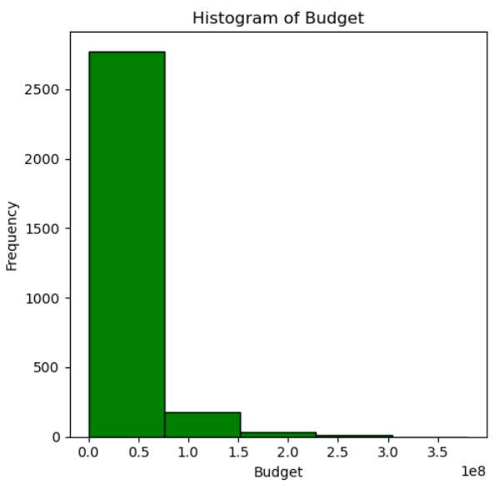
Relation Between Revenue and Budget
we can see from the heatmap that the Pearson correlation coefficient between budget and revenue is notably high with coefficient of .75. We can see the same from scatter plot as well as the frequency matrix.
Hence, we can say that budget is the most important variable

Slide 8
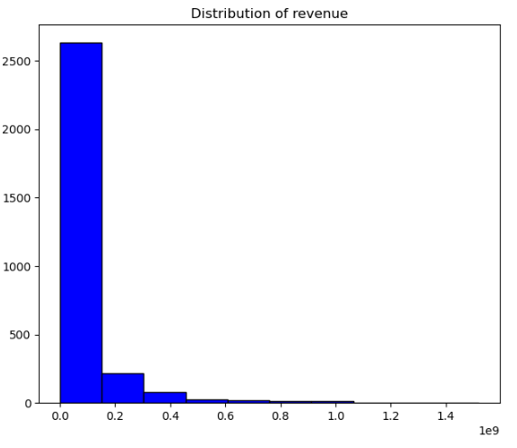
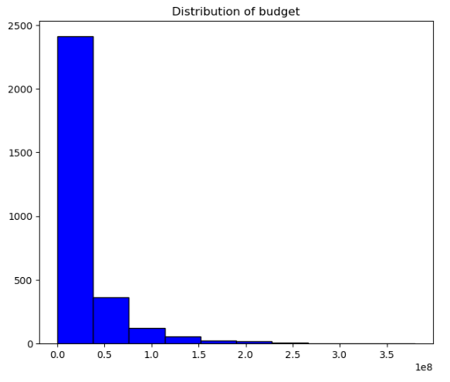
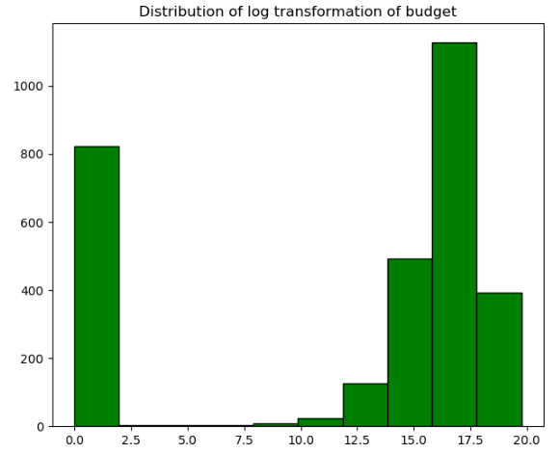
Transforming Budget into Log_Budget
The budget and revenue data was transformed into a logarithmic scale to normalize the distribution and reduce skewness The original budget and revenue distribution is highly right-skewed (as we can see from the graph), indicating that most movies have a low budget, with a few outliers having very high budgets/revenue. After log transformation, the distribution appears more symmetrical and likely follows a normal distribution more closely. This transformation will improve the performance and validity of statistical analyses and regression models by meeting their assumptions of normality.

Slide 11
MORE FUNDINGS = SUCCESS!!!

Slide 12
Test the Model with Test Dataset
Predict model with X_test_id3
Predict model with X_train_id3
Comparing the accuracy score with the score after fit

Slide 14
What Can be done to Improve?
Clean data more thoroughly
Maybe use companies that’s founded in certain period of time
Have a better way to categorize acquired, ipo, failed, operating
Used a variety of models to get the best model for the job

Slide 15
Potential
Can use unsupervised learning to organize operating companies into cluster
Dividing companies to either tech or non-tech
Model variety

Slide 16
THANK YOU!

Slide 17
Data and tools used:
Data: Startup Success/Fail Dataset from Crunchbase
Tableau for EDA and Visualization
Python (pandas, scikitlearn) for data cleaning and modeling
ChatGPT and other online resources for coding and ML-related questions

