Slide 1

Stock Market Performance Analysis:
Tesla, Inc. (TSLA)
BUS9552/Sum18
Presented by: Shokolatte Tachikawa

Slide 2
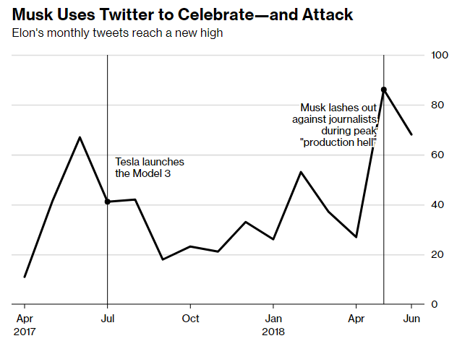

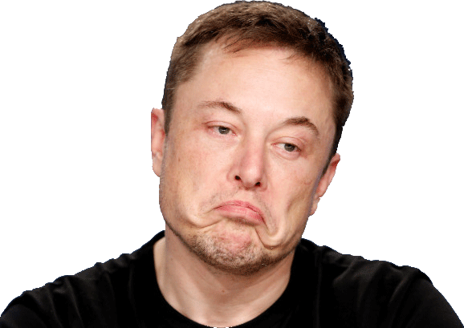


Company Overview
Data: Twitter
>>So far, Tesla's Elon Musk has only been successful at tricking people into thinking he's a success. – New York Post 07/21/18
Notes:
Our company was , famous for one of the co-founders, Elon Musk who also is a CEO of SpaceX, formerly established the predecessor of PayPal. The company’s reputation is closely correlated to Mr. Musk’s every moves, statements and comments made in both public and private and it reflects in the stock price directly recently. You might recall the recent backlash after Mr. Musk called the rescue a pedo during Thai cave incident
Having said that, let’s move on to the next slide to see

Slide 3


90-Day Analysis (Apr. 25 to Jul. 24, 2018)
“Tesla will hit its weekly Model 3 production goal of 5,000 by the end of June”
“Cave diver is a pedo”
High: | 373.73
Low: | 273.42
Median: | 308.90
Average: | 311.35
Concerns on Tesla 3 Sales Results

Slide 4

“He has yet to succeed at anything but somehow spins every failure into proof of imminent success. His only accomplishment has been this decades-long Jedi mind trick.”
Our Target (Oct. 24, 2018)
340.00USD
Elon is a innovator and investment in innovation will achieve Tesla’s profitability.

