Slide 1


Data Management for Data Science -
Homework Assignments
Prof. Domenico Lembo
Prof. Riccardo Rosati
Shokoufeh Mansourihafshejani - 1889621
Masoumeh Shariat - 1916321

Slide 2
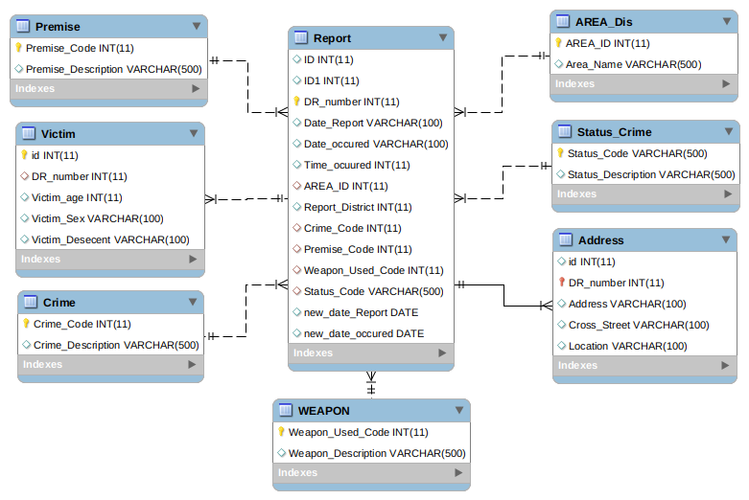
Diagram of Tables
Crime in Los Angeles(Crime data from 2010 through September 2017)
https://www.kaggle.com/cityofLA/crime-in-los-angeles

Slide 3
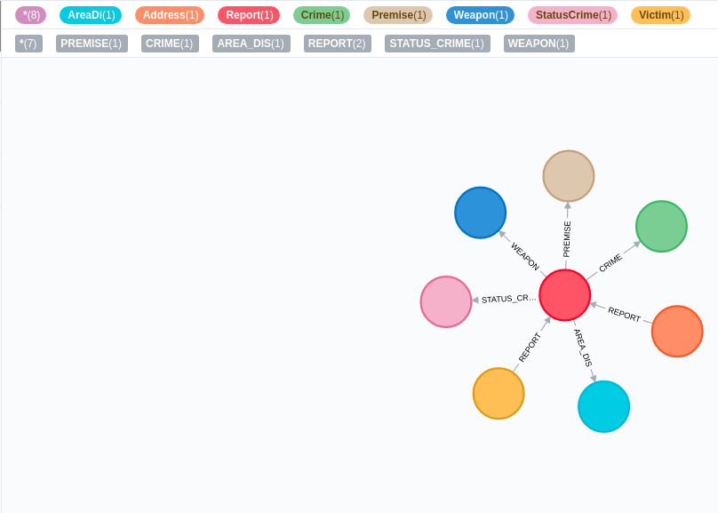
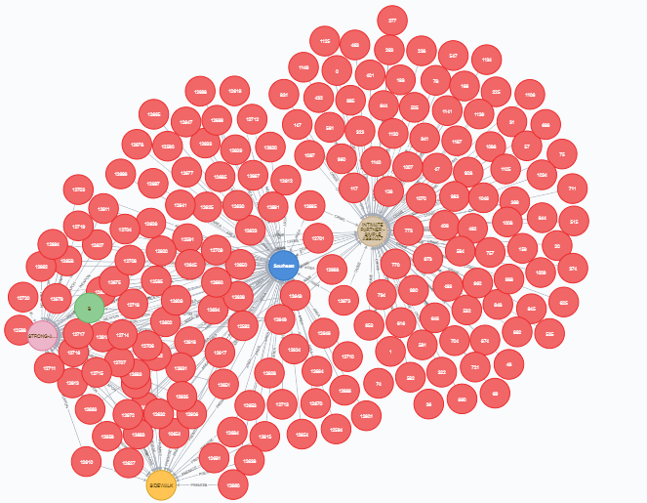
CALL db.schema.visualization()
Pagina <number>

Slide 4
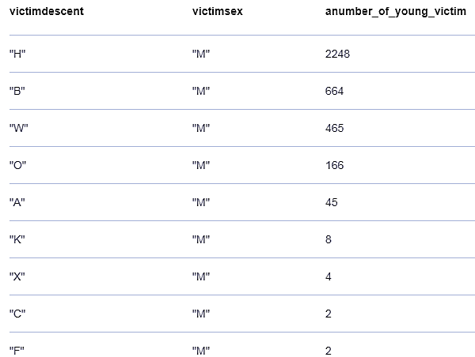
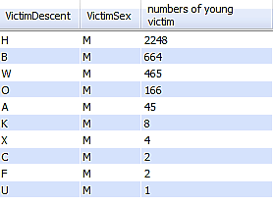
Q1. Return the youngest male victims in each descent. Young men(less than 30 and more than 18 years old).
NEO4J Cypher Query
match (v:Victim)
where (v.victimAge>18 and v.victimAge<30) and
v.victimSex="M"
return v.victimDescent as victimdescent ,v.victimSex as
victimsex,
count(v.victimAge) as anumber_of_young_victim
order by count (v.victimAge) desc
create index on :victim(victimage)
create index index_victage for (v:victim) on (v.victimage)
drop index index_victage
My SQL Query
SELECT VictimDescent, VictimSex,count(VictimAge) as
`numbers of young victim`
FROM victim FORCE INDEX (idx_age)
WHERE (VictimAge<30 AND VictimAge>18) AND VictimSex='M'GROUP BY VictimDescent order by count(VictimAge) desc;
Pagina <number>

Slide 5
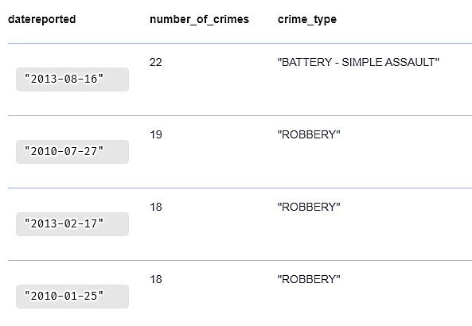

Q2: Finding the date that the most crime were reported.
NEO4J Cypher Query
match (r:Report) -[Report]- > (c:Crime)
return r.newDate as datereported,count(r.newDate)as
number_of_crimes ,c.crimeCodeDescription as
crime_type
order by count(r.newDate)desc
My SQL Query
select new_date as datereported, count(new_date) as number of crimes,
crime.crimecodedescription as crime_type
from report inner join crime
on report.crimecode=crime.crimecode
group by new_date,crimecodedescription
order by count(datereported) desc;
Pagina <number>

Slide 6
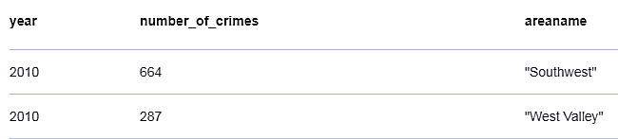

Q3: Return the number of crimes that happened in 2010 in West area.
NEO4J Cypher Query
match (r:Report) -[report]- > (a:Area)
Where r.newDate.year =2010 and toUpper(a.areaName) contains "WEST"
return r.newDate.year as year,count(r.newDate.year)
as number_of_crimes,a.areaName as areaname
order by count(r.newDate.year ) desc
My SQL Query
select datereported,count(year(new_date)),areaname
from report as r inner join area a on t.areaid=a.areaid
where a.areaname like '%west%' and year(new_date)=2010
group by year(new_date),areaname;
Pagina <number>

Slide 7
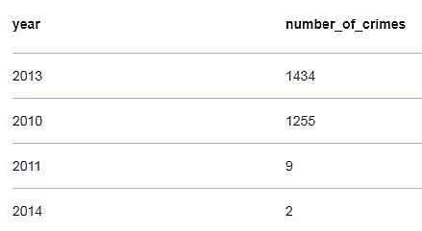

Q4: Return the number of reported crimes that their victim Descents are White ‘W’.
NEO4J Cypher Query
match (r:Report) -[report]- > (v: Victim)
Where v.victimDescent='W'
return r.newDate.year as year,count(r.newDate)
as number_of_crimes
order by count(r.newDate) desc
My SQL Query
select year(new_date) as year, count(year(new_date)) as number_of_crimes
from report R
inner join victim V on R.drnumber=V.drnumber
where victimdescent='w’
group by year(new_date)
order by count(year(new_date)) desc;

Slide 8
Q5: Return dates and places that kidnapping occurred and the age of victim and weapons were used.
NEO4J Cypher Query
MATCH (node1)<-[:VICTIM]-(node2)-[:WEAPON]->(node3)
MATCH (node4)<-[:CRIME]-(node2)-[:PREMISE]->(node5)
WHERE toUpper(node4.crimeCodeDescription) CONTAINS "KIDNAPPING"
AND node1.victimAge IS NOT null
RETURN node2.newDate as Date,node1.victimAge as Age, node3.weaponDescription as Weapon, node5.premiseDescription as place
order by Date
My SQL Query
select DateOccurred,VictimAge,WeaponDescription,PremiseDescription as 'the place that kidnapping occured'from total_crime as T inner join crime as C on T.CrimeCode=C.CrimeCodeINNER JOIN Premise as P ON P.PremiseCode=T.PremiseCode INNER JOIN victim as V ON T.DRNumber=V.DRNumberINNER JOIN weapon as W ON T.WeaponUsedCode=W.WeaponUsedCodewhere c.CrimeCodeDescription like '%KIDNAPPING%' order by DateOccurred ;
Titolo Presentazione
09/05/20

Slide 9
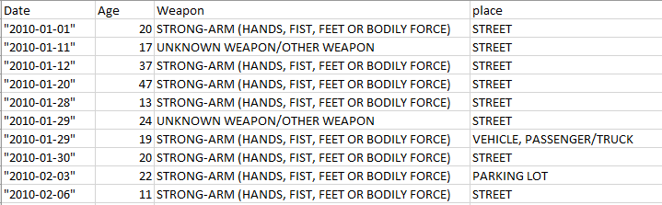
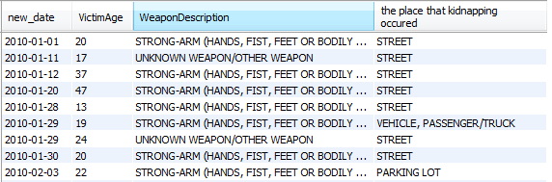

Slide 10
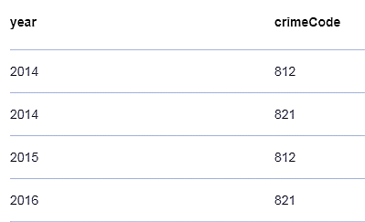

Q6: crimes that offended in people less than 18 for years after 2014
NEO4J Cypher Query
MATCH (node1)<-[:VICTIM]-(node2)-[:CRIME]->(node3)
WHERE node1.victimAge <=18 AND date(node2.newDate).
year>=2014
RETURN DISTINCT date(node2.newDate).year as year
,node3.crimeCode as crimeCode
ORDER BY year
My SQL Query
select year(new_date) as year_report, crimecode
from report r
inner join victim v on r.drnumber = v.drnumber
where victimage <18
group by year_report,crimecode
having min(year_report)>=2014
order by year(new_date), count(crimecode) desc;

Slide 11
Q7: return the average age of victims, who are female or male but they are less than 18 for each year and show the type of weapon that used most for these crimes
NEO4J Cypher Query
MATCH (node1)<-[:VICTIM]-(node2)-[:WEAPON]->(node3)
WHERE (node1.victimAge <18 OR node1.victimSex ="F")
WITH date(node2.newDate).year as year,
node1.victimSex as victimSex,
avg(node1.victimAge) as average_age, count(node3.weaponUsedCode)as number_used_weapon,
node3.weaponDescription as weapon_discription
ORDER BY year,number_used_weapon desc
WITH year,
collect([victimSex,average_age,number_used_weapon,weapon_discription])[..2] as w unwind w as Sex_avgAge_NumberUsed_weaponDiscription
RETURN year, Sex_avgAge_NumberUsed_weaponDiscription
My SQL Query
SET @ranking = 0, @prev_val = NULL;
select *,
@ranking:= if (@prev_val=Year_Report, @ranking+1, 1) as ranking , @prev_val := Year_Report
from
(select year(R.new_date) as Year_Report, Avg(V.Victimage), V.VictimSex , count(W.WeaponUsedCode), W.WeaponDescription
from Victim as V
inner join Report as R on V.DRnumber = R.Drnumber
inner join WEAPON as W on W.WeaponUsedCode = R.WeaponUsedCode
where (V.Victimage < 18 or V.VictimSex = 'F’)
group by Year_Report, V.VictimSex, W.WeaponUsedCode
order by Year_Report, count(W.WeaponDescription) desc) t
having ranking <= 2;

Slide 12
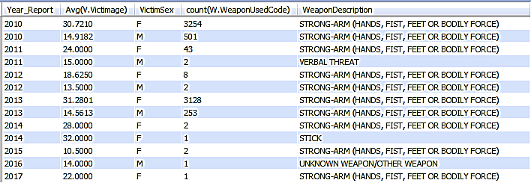
Q7: return the average age of victims, who are female or male but they are less than 18 for each year and show the type of weapon that used most for these crimes

Slide 13
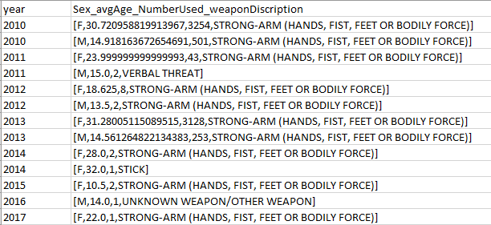
Q7: return the average age of victims, who are female or male but they are less than 18 for each year and show the type of weapon that used most for these crimes
Titolo Presentazione
09/05/20

Slide 14
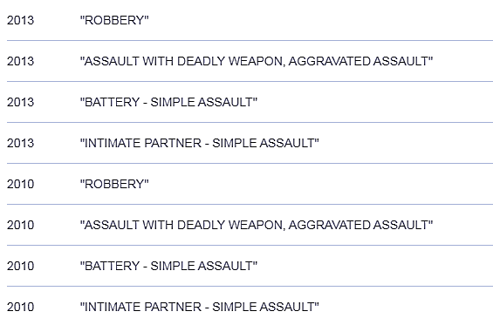
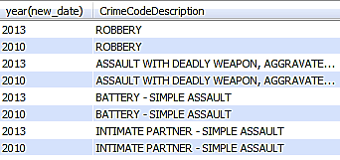
Q8: crimes that happen more than 500 times each year
NEO4J Cypher Query
MATCH (node1)<-[:CRIME]-(node2)
WITH date(node2.newDate).year as year,node1.crimeCodeDescription as crimeDescription,count(*) as f
WHERE f>500
RETURN year,crimeDescription
ORDER BY year desc
My SQL Query
select year(new_date), CrimeCodeDescription
from Crime C join Report R on C.CrimeCode = R.CrimeCode
group by year(R.new_date),CrimeCodeDescription
having count(C.CrimeCodeDescription)>500 ;

Slide 15
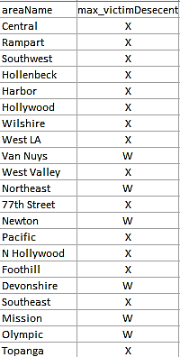
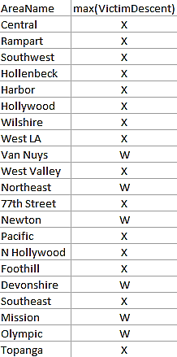
Q9: return race of victims that be offended most in each area
NEO4J Cypher Query
MATCH (node1)<-[:VICTIM]-(node2)-[:AREA]->(node3)
WITH node3.areaName as areaName,max(node1.victimDescent) as max_victimDesecent
RETURN distinct areaName,max_victimDesecent
My SQL Query
select AreaName, max(VictimDescent)
from area as A
join Report as R on A.AreaID = R.AreaID
inner join Victim as V on R.DRnumber = V.DRnumber
group by AreaName;

