Slide 1






ArcGIS Pro - Select by Attributes ·
Select by Attributes
What this lesson covers
Locate the tool
Find Select By Attributes in the ArcGIS Pro workspace.
Read the pane
Recognize the purpose of each section of the query interface.
Select by Attributes identifies the records whose stored values satisfy a defined logical condition. In ArcGIS Pro, the result is a selected subset that can be inspected, exported, summarized, or used in subsequent spatial analysis.
Write valid SQL
Construct expressions using fields, operators, and values.
Control selection logic
Understand selection types and compound conditions.
Diagnose errors
Identify common syntax and logic problems.
01

Slide 2





ArcGIS Pro - Select by Attributes
Why attribute selection matters
From data records to analytical subsets
A GIS layer has two faces
Selection is a filtering operation
The subset becomes usable evidence
A feature layer is simultaneously spatial and tabular. Each feature corresponds to a record in the attribute table.
Attribute selection isolates only those records that satisfy a specified logical condition.
Selected records can be reviewed, summarized, mapped, exported, or passed into later analysis.
Conceptual takeaway
Selection by Attribute is not merely a software command. It formalizes an analytical criterion as a query over table records, thereby converting a large layer into a defensible subset for further interpretation.
02

Slide 3
ArcGIS Pro - Select by Attributes
From table to map
How a query becomes a highlighted subset
Table concept ↔ map result
Rows become features
A row
one feature on the map
Every row in an attribute table belongs to a feature on the map. A query tests each row; the rows that pass are highlighted — and so are their features. Selecting the data selects the geography.
A field
an attribute you can test
A query
a true / false test per row
ROWS
+
TEST
+
SELECTED
Passing rows
highlighted in table and map
Example: BOROUGH = 'Bronx' → Bronx features light up
The selection
a reusable subset of features
Attributes live in the table, but every selection you make appears on the map.
03

Slide 4




ArcGIS Pro - Select by Attributes
ArcGIS Pro workspace orientation
Locate the interface zones before locating the tool
ArcGIS Pro
Ribbon
Project
Map
Insert
Analysis
View
Edit
Imagery
Share
The ribbon organizes commands by tab and functional group.
Map tab
Select
Select By
Attributes
Select By
Location
Clear
Selection commands for active map work are exposed here.
Selection group
Contents pane
Contents
Map view
Verify the target layer before opening any selection tool.
parks_nyc
boroughs
Map view
subway_lines
The selected result is reflected spatially in the view.
basemap
04

Slide 5
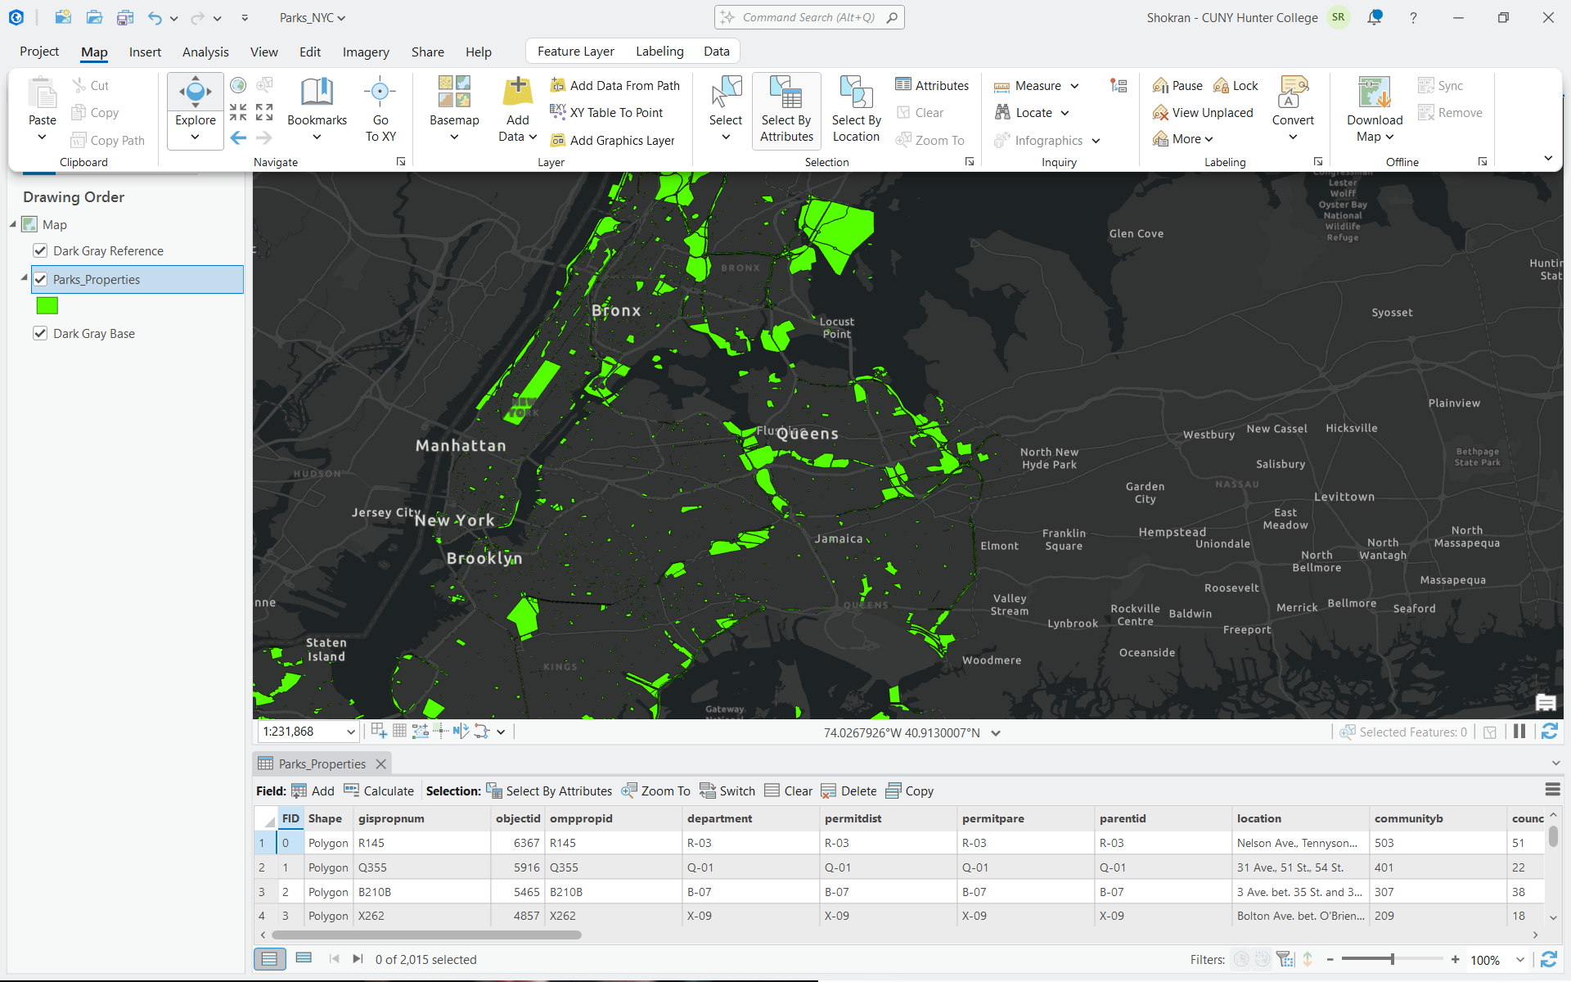
ArcGIS Pro - Select by Attributes
How to access Select By Attributes
Use the Map ribbon or the attribute table toolbar
1
Confirm the target layer
In the Contents pane, make sure the intended layer is active before you open the tool.
2
Use the Map ribbon
On the Map tab, go to the Selection group and click Select By Attributes.
3
Or use the table toolbar
When the attribute table is open, the Selection toolbar also provides Select By Attributes.
Both entry points open the same Select By Attributes pane.
05

Slide 6




ArcGIS Pro - Select by Attributes
Choosing the correct selection tool
Selection commands serve different analytic purposes
Select
Select By Attributes
Select By Location
Manual selection by clicking or drawing over features in the map. Useful for interactive inspection.
Selection based on table values and SQL expressions. Appropriate when the criterion is stored in fields.
Selection based on spatial relationships such as intersect, contain, or within a distance.
Rule of thumb Use Select By Attributes when the criterion lives in the table; use Select By Location when the criterion is spatial.
06

Slide 7




ArcGIS Pro - Select by Attributes
Selecting is not filtering
Selection, definition query, and interactive select
Four things students confuse
Which one do I want?
Interactive Select
Click features on the map by hand — no query involved.
A
Highlights a subset?
Selection — reversible, non-destructive
Select by Attributes
B
Hides other rows?
Build a query; matching rows are highlighted.
Definition query — a display filter
C
Removes data?
A selection
Neither — your table is untouched
A highlighted subset — all data stays visible and usable.
D
Rule of thumb
Select to analyze, filter to declutter
Definition query
Hides non-matching rows from the layer entirely.
Selecting marks rows; it never deletes or hides your data.
07

Slide 8
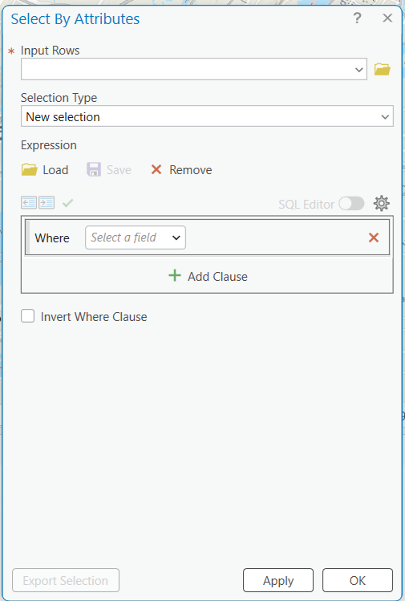
ArcGIS Pro - Select by Attributes
Opening the Select By Attributes pane
Read the interface before writing the query
Input Rows
Choose the layer or table whose records you want to query.
Selection Type
Specify whether the query creates a new selection or modifies an existing one.
Expression area
Where the WHERE clause is constructed. Each clause tests records in the table.
SQL Editor toggle
Off shows the guided clause builder; on lets you type SQL directly.
Apply and OK
Apply runs the query and keeps the pane open; OK runs it and closes the pane.
08

Slide 9
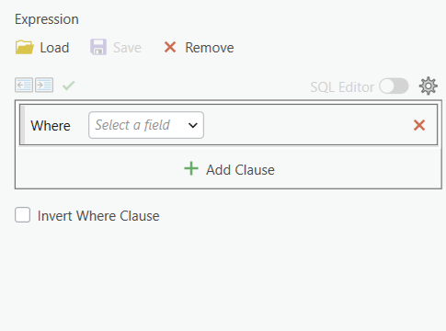
ArcGIS Pro - Select by Attributes
Clause builder and SQL Editor
Build expressions visually when SQL Editor is off
Recommended beginner workflow
1
Leave SQL Editor off at first.
Opens the guided builder, which structures the expression clause by clause.
2
Start with the Where row.
Choose a field, then an operator, then a value, in the proper order.
3
Use Add Clause for compound logic.
Add a second clause when the question requires AND or OR logic.
4
Use Invert Where Clause carefully.
Inversion returns the complement and changes the logical meaning.
5
Toggle SQL Editor on when needed.
Switch on to inspect or type the SQL syntax directly.
Guided clause builder — the Where row, Add Clause, Invert, and SQL Editor toggle.
09

Slide 10
ArcGIS Pro - Select by Attributes
Formulating attribute queries in ArcGIS Pro
What SQL is doing here
BOROUGH = 'Bronx' AND ACRES > 5
SQL as query grammar
Common expression patterns
What SQL means here
Equality
BOROUGH = 'Bronx'
SQL stands for Structured Query Language. In Select By Attributes you typically write a WHERE-clause style condition rather than a full SQL statement.
Numeric threshold
ACRES > 5
Compound condition
BOROUGH = 'Bronx' AND ACRES > 5
FIELD
+
OPERATOR
+
VALUE
List membership
TYPE IN ('Neighborhood', 'Regional')
Example: BOROUGH = 'Bronx'
Missing values
MANAGER IS NULL
Interpret each expression as a true / false test applied to every record.
10

Slide 11



ArcGIS Pro - Select by Attributes
The three-part structure of a query
Field, operator, value
FIELD
OPERATOR
VALUE
Where should ArcGIS Pro look?
+
What relationship is being tested?
=
What should the field match?
BOROUGH
=
'Bronx'
BOROUGH = 'Bronx'
11

Slide 12
ArcGIS Pro - Select by Attributes
Operator cheat-sheet
The operators you'll actually use
Operators at a glance
Beyond = and >
Comparison
= <> > < >= <=
Operators decide how a value is tested. A handful of comparison, pattern, and set operators cover almost every query you'll write in ArcGIS Pro.
Wildcard %
LIKE 'Bro%' — any characters
Wildcard _
LIKE 'Bron_' — one character
COMPARE
+
PATTERN
+
SET
Set list
IN ('Bronx', 'Queens')
Example: BOROUGH LIKE 'Bro%'
Range / null
BETWEEN 1 AND 5 · IS NULL
Text values need quotes; % and _ are wildcards, not literal characters.
12

Slide 13
ArcGIS Pro - Select by Attributes
Syntax depends on data type
Quotation marks, numbers, and null values
Rule
Correct
Avoid
Important notes
Text needs single quotes
BOROUGH = 'Bronx'
BOROUGH = Bronx
Text values should be enclosed in single quotation marks.
Numbers are not quoted
ACRES > 5
ACRES > '5'
Double quotation marks are not the default way to express text values in these beginner expressions.
Null uses IS NULL
ArcGIS Pro may validate syntax even when the analytical logic is wrong; interpret the expression carefully.
MANAGER IS NULL
MANAGER = ''
Connectors must be explicit
Use the field and unique-values controls to avoid preventable spelling errors.
...'Bronx' AND ACRES > 5
...'Bronx' ACRES > 5
13

Slide 14



ArcGIS Pro - Select by Attributes
Compound expressions
AND, OR, and NOT change the logic of the selection
AND
OR
NOT
narrows
expands
excludes
BOROUGH = 'Bronx'
AND ACRES > 5
BOROUGH = 'Bronx'
OR BOROUGH = 'Queens'
NOT BOROUGH =
'Manhattan'
Both conditions must be true.
Either condition can be true.
The condition is reversed.
Analytical caution Syntactically valid SQL can still express the wrong question. Read compound conditions slowly.
14

Slide 15
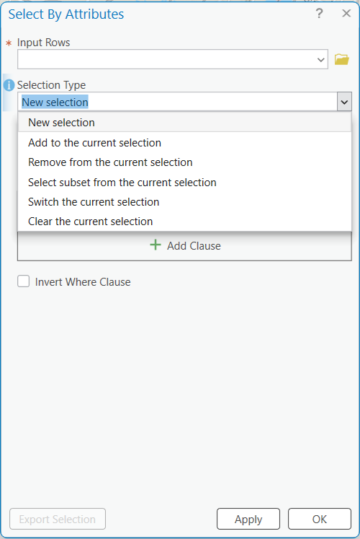
ArcGIS Pro - Select by Attributes
Selection Type options
Use the dropdown to control how a new query behaves
1
New selection Replaces any current selection with the new query's records.
2
Add to the current selection Adds the matching records to those already selected.
3
Remove from the current selection Subtracts matching records from the current selection.
4
Select subset from current selection Keeps only selected records that also satisfy the expression.
5
Switch the current selection Inverts the selected and unselected records.
6
Clear the current selection Clears the selection entirely.
Tip Begin most classroom exercises with New selection so the output is easy to interpret.
15

Slide 16
ArcGIS Pro - Select by Attributes
Worked example
From an analytical question to a valid expression
1
Identify the categorical condition
QUESTION
BOROUGH = 'Bronx'
Which parks in the Bronx are larger than five acres?
2
Identify the numeric threshold
ACRES > 5
RELEVANT FIELDS
3
Combine both conditions
BOROUGH
ACRES
BOROUGH = 'Bronx' AND ACRES > 5
SELECTION TYPE
4
Interpret the result
New selection
The selected subset contains only records satisfying both conditions.
16

Slide 17
ArcGIS Pro - Select by Attributes
Debug it: broken vs fixed
Read the error, isolate the clause, fix one thing
Why a query fails
Broken → fixed
Missing quotes
Text values need single quotes around them: 'Bronx'.
A
Missing quotes
BOROUGH = Bronx → = 'Bronx'
Wrong data type
B
Quoted number
Do not quote numbers — ACRES > 5, not '5'.
ACRES > '5' → ACRES > 5
C
Case mismatch
Case and spelling
'bronx' → 'Bronx'
'bronx' is not 'Bronx'; watch for trailing spaces too.
D
Wrong operator
= a list → IN ('Bronx','Queens')
Logic slip
AND vs OR can narrow or widen the result unexpectedly.
Change one clause at a time, then re-run — do not rewrite the whole query.
17

Slide 18
ArcGIS Pro - Select by Attributes
What a selection unlocks
A selection is a starting point, not the finish line
What you can do with it
From selection to result
Export
Save the selected features as a brand-new layer.
A
Select
BOROUGH = 'Bronx' AND ACRES > 5
Summarize
B
Export
Get statistics for just the selected records.
right-click → Data → Export Features
C
Summarize
Edit and calculate
Summary Statistics on the selection
Update field values on the selected rows only.
D
Reuse
the selection becomes a tool input
Feed analysis
Use the subset as input to a geoprocessing tool.
Most analysis begins the moment you have the right subset selected.
18

Slide 19
ArcGIS Pro - Select by Attributes
Troubleshooting and guided practice
Check both syntax and logic
Common problems
Practice prompts
No records selected
Check spelling, quotations, field choice, and whether the value actually exists.
A
Select parks in Queens.
BOROUGH = 'Queens'
Too many records selected
B
Records where ACRES is greater than 10.
Review logical connectors; OR often broadens the query more than intended.
ACRES > 10
C
Bronx parks larger than 5 acres.
Syntax error
BOROUGH = 'Bronx' AND ACRES > 5
Use the field and unique-values lists; validate before running the query.
D
Records where TYPE is Neighborhood or Regional.
TYPE IN ('Neighborhood', 'Regional')
Unexpected output
Check the active Selection Type and clear any previous selection if needed.
Recommendation Ask students to state the question in natural language before writing the SQL.
19

Slide 20
ArcGIS Pro - Select by Attributes
Knowledge check
Check your understanding before moving on
1
What's the real difference between a selection and a definition query?
2
In BOROUGH = 'Bronx' AND ACRES > 5, why are the quotes only around 'Bronx'?
Click to reveal answer
Click to reveal answer
Answer A selection is a reversible, visible subset. A definition query hides non-matching rows entirely.
Answer Text values need single quotes; numbers like 5 are never quoted.
3
Which operator lets you match a list of values, like Neighborhood or Regional parks?
4
Which Selection Type replaces whatever was previously selected with your new query's results?
Click to reveal answer
Click to reveal answer
Answer The IN operator — e.g. TYPE IN ('Neighborhood', 'Regional').
Answer New selection.
20

Slide 21
ArcGIS Pro - Select by Attributes
Recap and what's next
You can query the table — next, query the map
Key takeaways
Up next: Select by Location
Query = field + operator + value
Every expression tests one field against a value.
A
New question
which features are NEAR or INSIDE others?
Syntax follows data type
B
New driver
Quotes for text, none for numbers, IS NULL for blanks.
a spatial relationship, not a field value
C
Same habit
Logic with AND / OR / NOT
read the query as a plain sentence
Combine clauses to narrow or widen the result.
D
Carry it over
combine attribute and location selections
Select, then verify
Troubleshoot clause by clause; a selection is reusable.
You've mastered querying the table — now you're ready to query the map.
21

