Slide 1
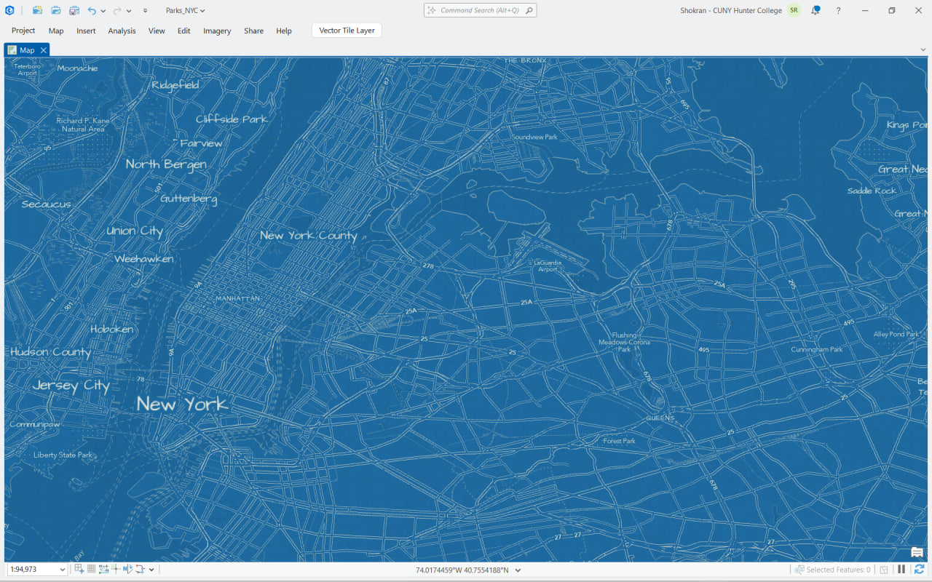




ArcGIS Pro - Map Classification
01 / 21

Slide 2
ARCGIS PRO — MAP CLASSIFICATION
What We'll Cover
Click any row to jump straight there.
›
01 Symbology pane: what you're looking at
›
11 Classification methods compared
›
02 Single Symbol
›
12 Choosing a classification method
›
03 Unique Values
›
13 Common confusions
›
04 Graduated Colors
›
14 Worked example
›
05 Bivariate Colors
›
15 Your turn — hands-on lab
›
06 Unclassed Colors
›
16 Knowledge check
›
07 Graduated Symbols
›
17 Recap & what's next
›
08 Proportional Symbols
›
09 Dot Density
›
10 Charts
02 / 21

Slide 3
ARCGIS PRO — MAP CLASSIFICATION
Learning Objectives
By the end of this topic, you will be able to:
1
Identify the renderer options in the Symbology pane and explain what each one draws.
2
Choose the right renderer for a given data type — categories, counts, rates, or two variables at once.
3
Explain how a classification method (Natural Breaks, Quantiles, Equal Interval, Standard Deviation) turns raw numbers into map classes.
4
Predict how changing the classification method or number of classes changes the story a map tells.
5
Spot common symbology mistakes — using counts instead of rates, too many classes, or a method that hides outliers.
03 / 21

Slide 4
ARCGIS PRO — MAP CLASSIFICATION
Why Symbology & Classification Matter
The same dataset can look like completely different stories depending on how it's classified. Symbology isn't just decoration — it's an argument about what matters in the data.
▸
A map is an argument
Choosing a renderer and a classification method is an editorial decision — it decides what the reader notices first.
▸
The wrong method can mislead
Equal Interval on skewed data can hide almost every feature in a single class, making real variation invisible.
▸
Small choices, big consequences
Changing from 4 to 7 classes, or from counts to rates, can flip who looks "high" and who looks "low" on the map.
04 / 21

Slide 5
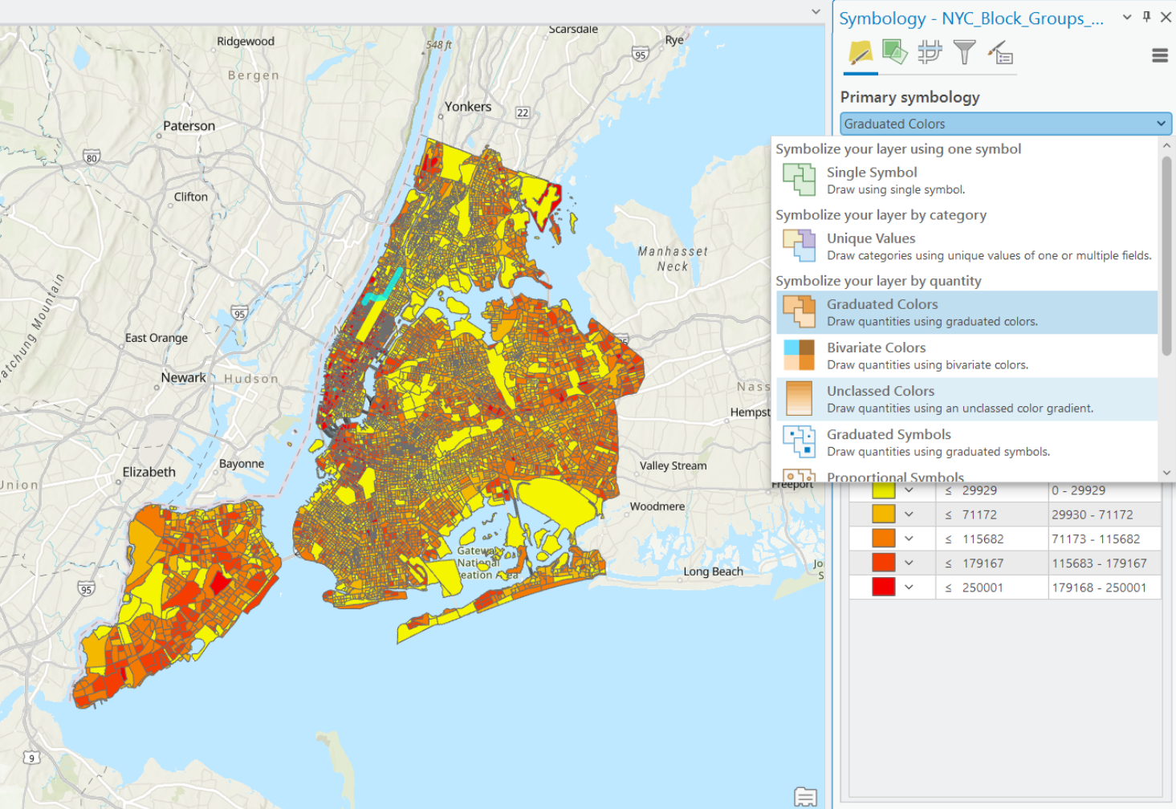
ARCGIS PRO — MAP CLASSIFICATION
Symbology pane: what you’re looking at
The Symbology pane is where you choose how a layer is drawn (renderer + settings).
Primary symbology options
Single Symbol
Unique Values
Graduated Colors
Bivariate Colors
Unclassed Colors
Graduated Symbols
Proportional Symbols
Dot Density
Charts
1
Choose a renderer from Primary symbology
2
Options are grouped by what your data is
05 / 21
3
Classes / symbols / legend settings appear below

Slide 6
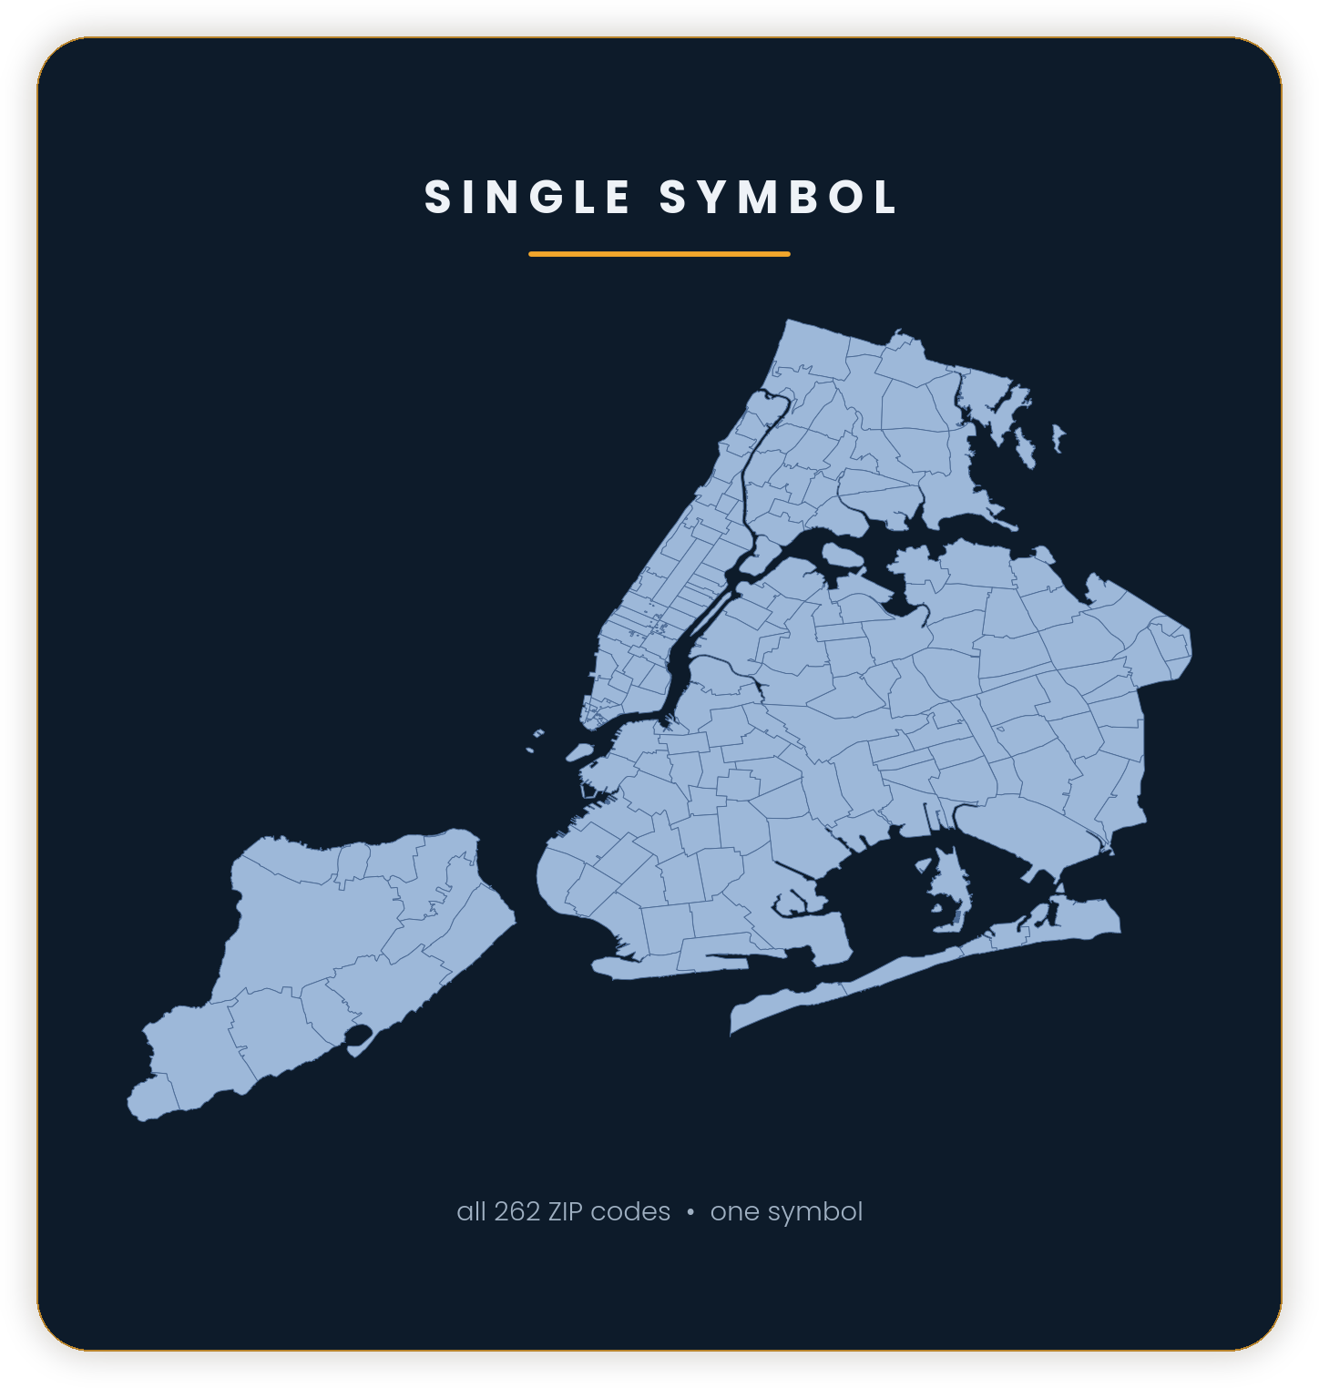
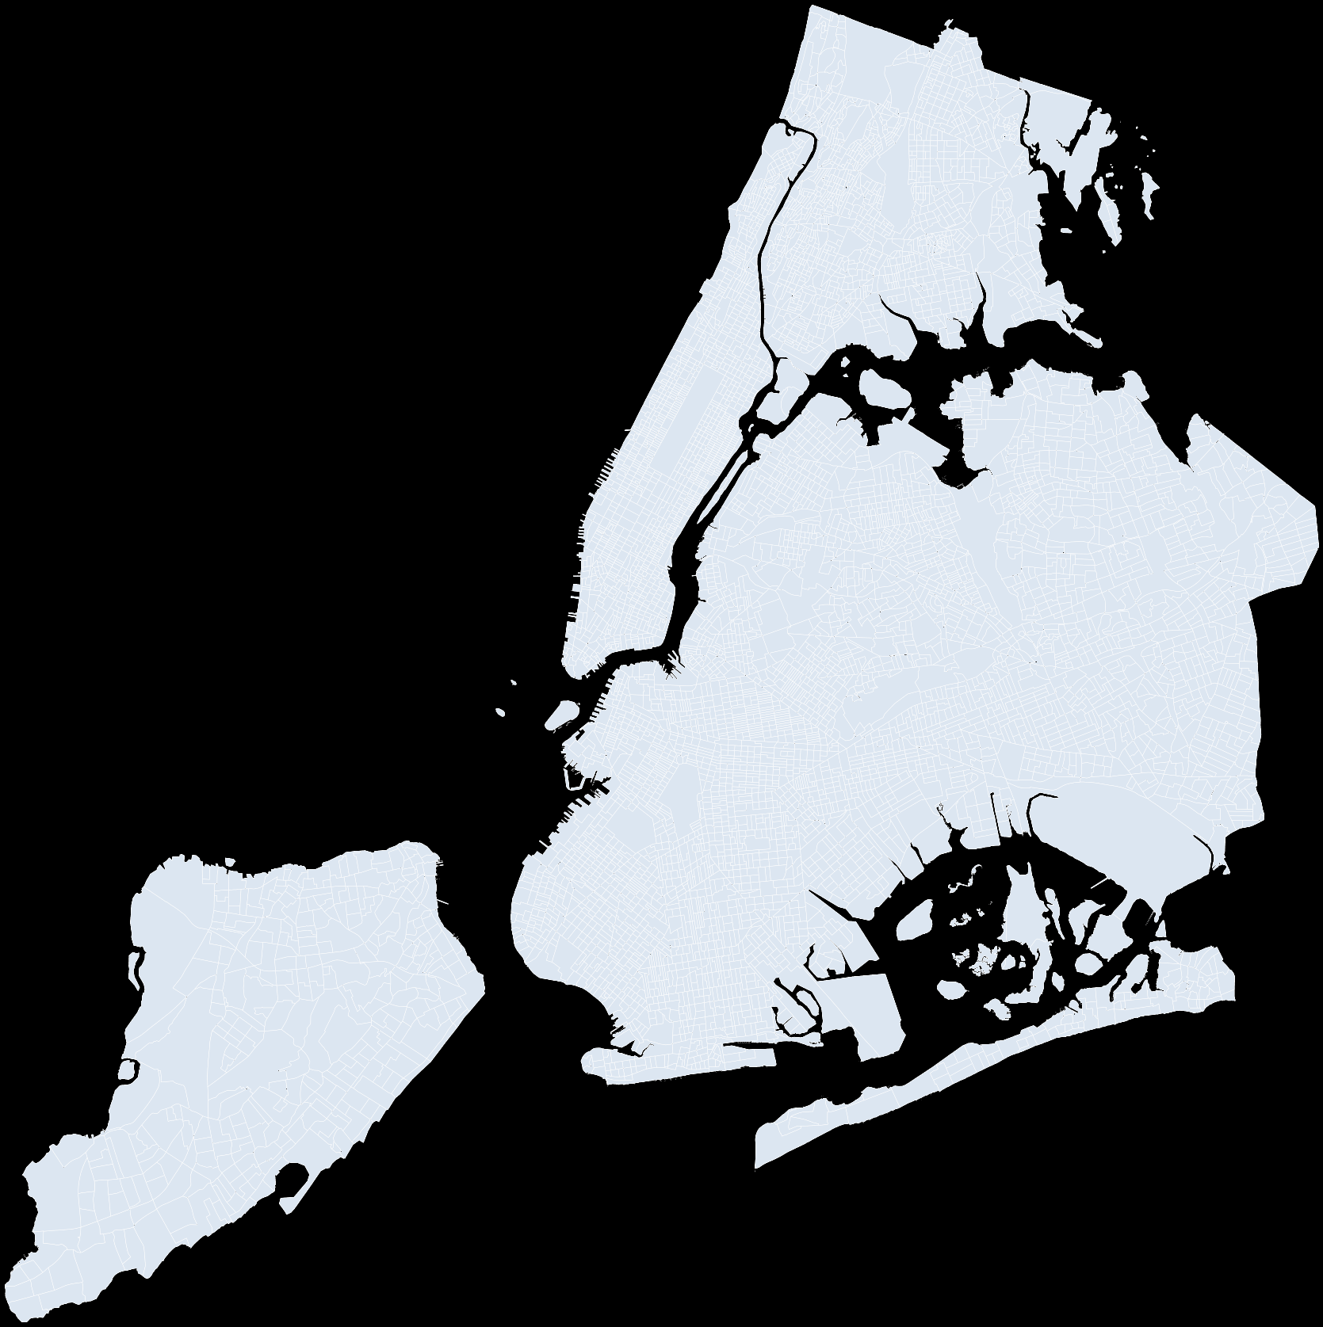
ARCGIS PRO — MAP CLASSIFICATION
Qualitative (1 class)
Single Symbol
What it does
Draws every feature with the same symbol.
Good for outlines and reference layers.
Best for
Boundaries
Context layers
Watch out
Not for categories
Not for magnitude
CONCEPT
All features → same look
Path: Symbology ▸ Primary symbology ▸ Single Symbol
06 / 21

Slide 7
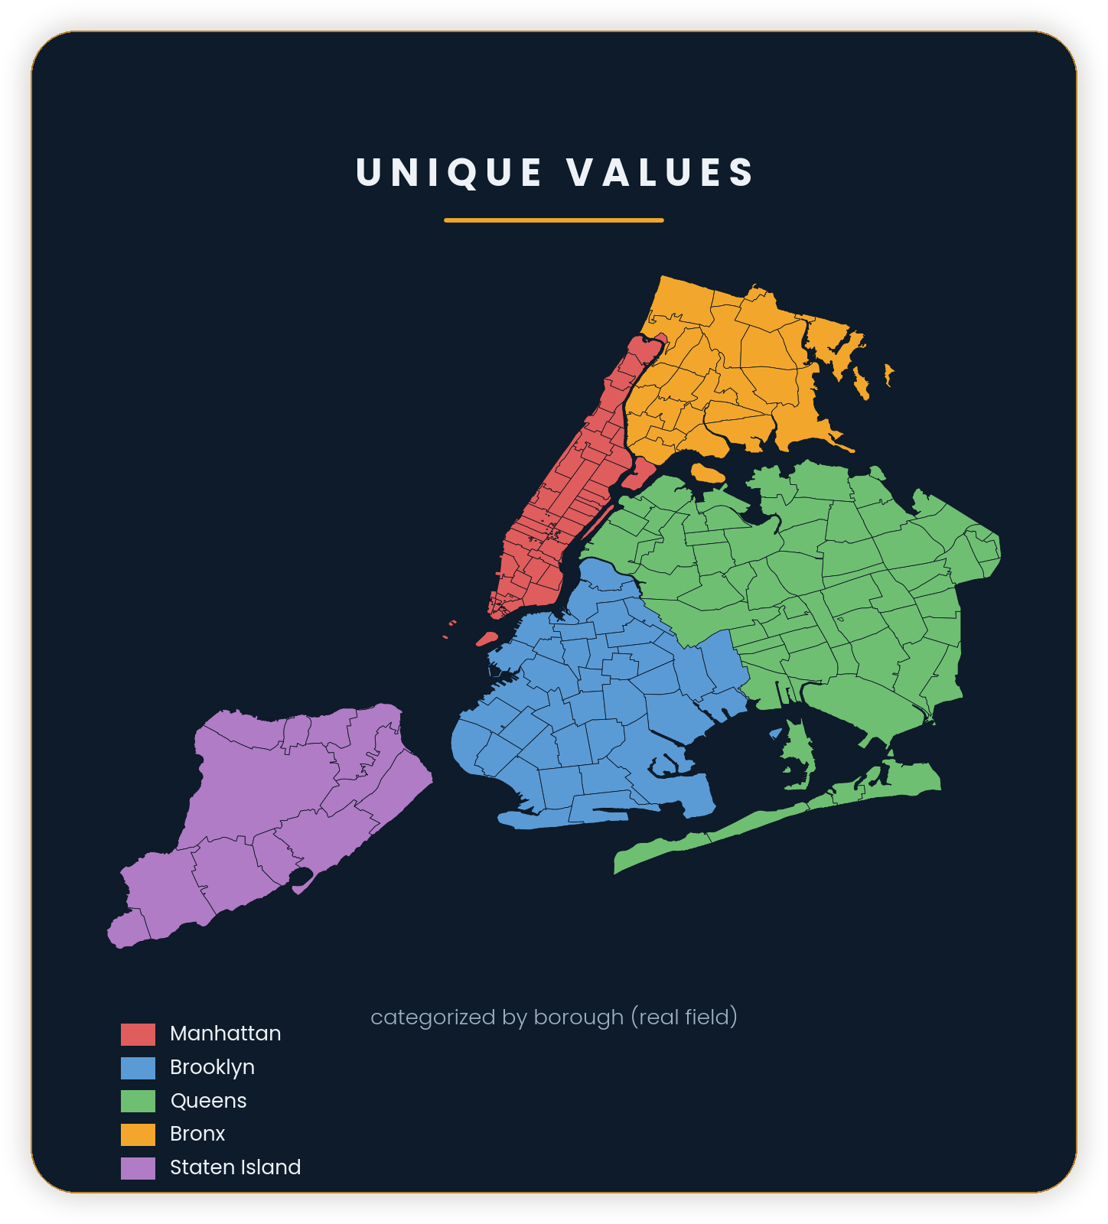
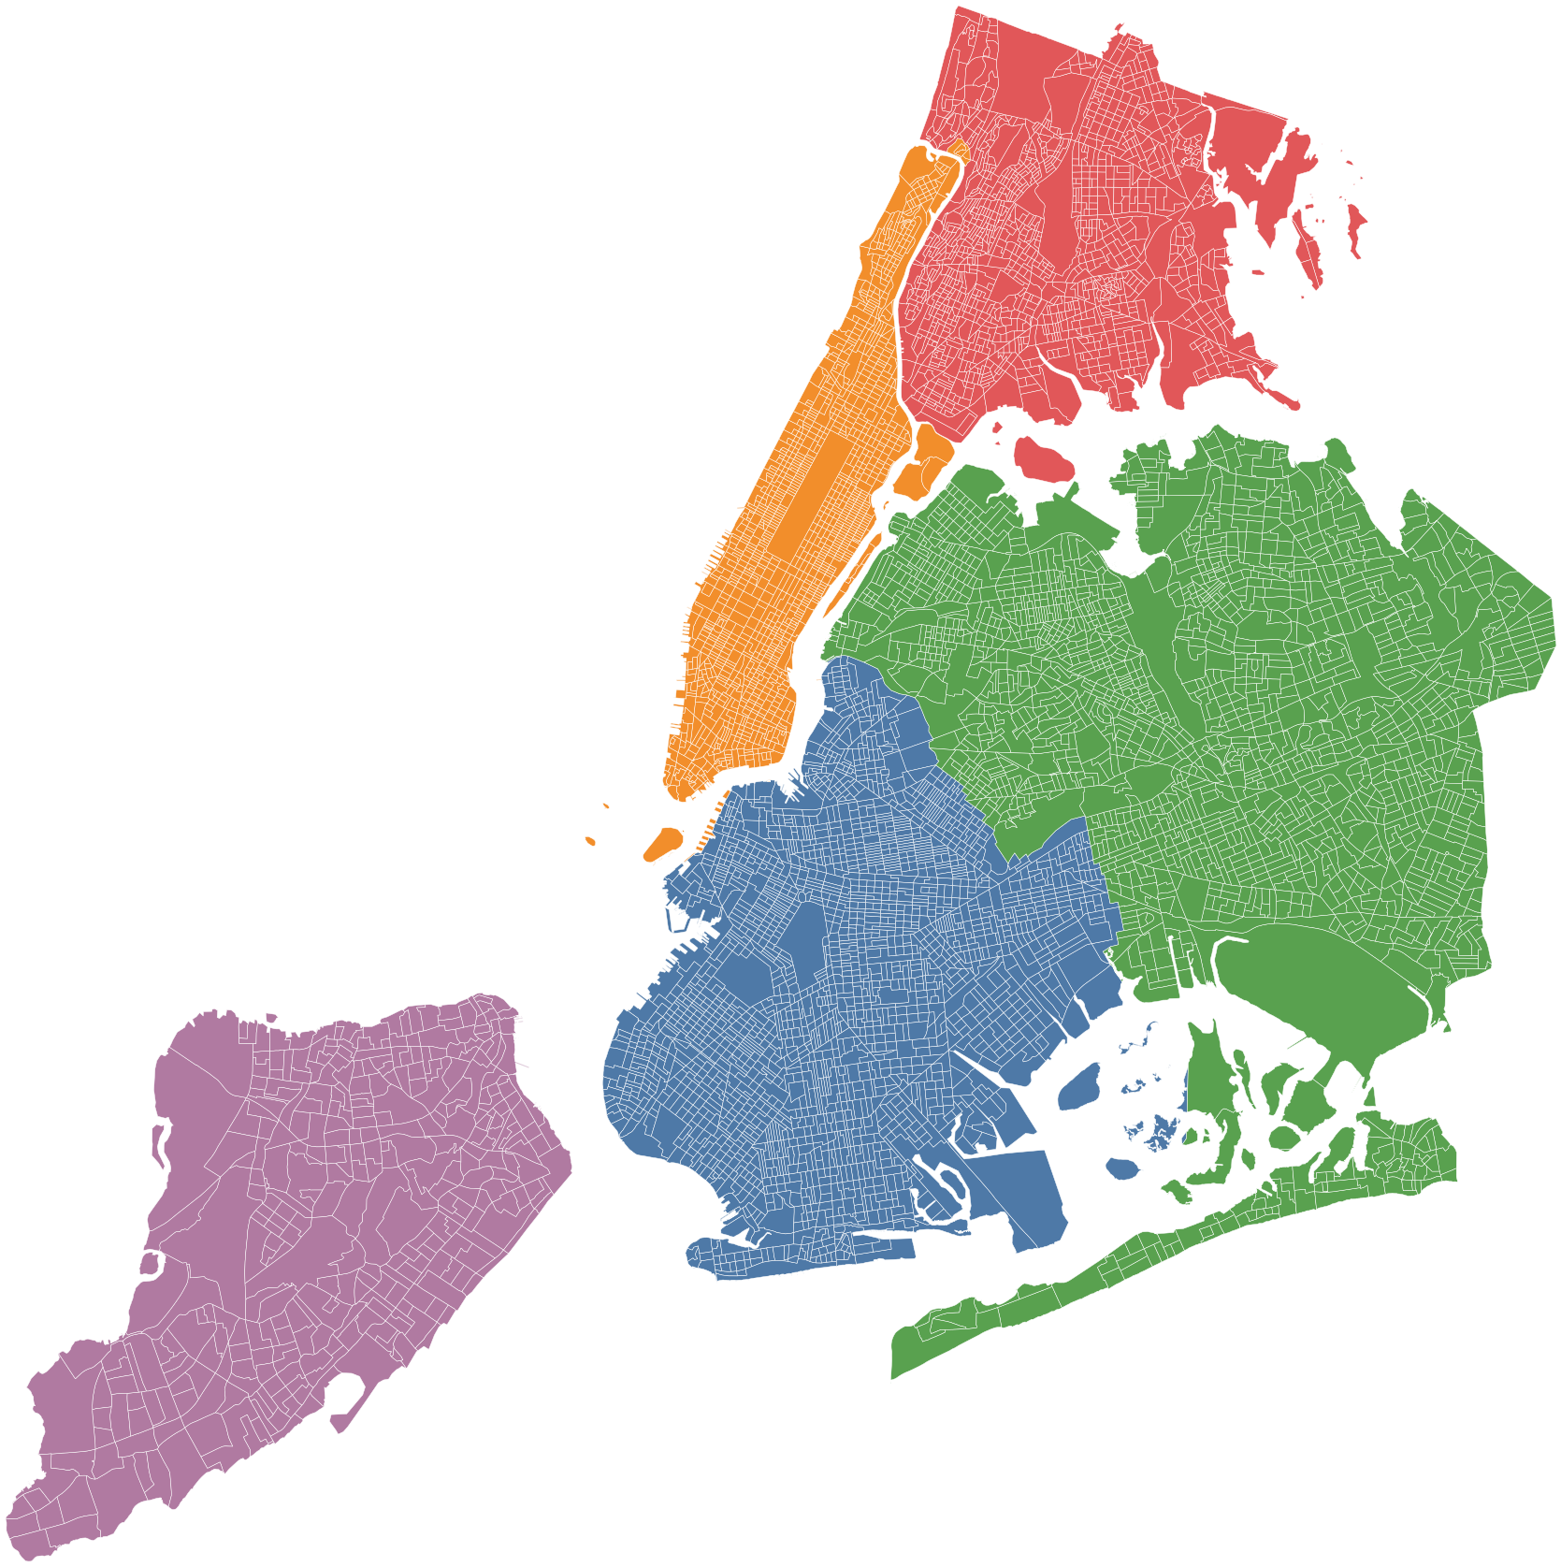
ARCGIS PRO — MAP CLASSIFICATION
Categorical
Unique Values
What it does
Assigns a different symbol/color to each category.
Categories come from one (or more) fields.
Best for
Land use / zoning
Administrative areas
Watch out
Too many categories
Random colors = chaos
CONCEPT
Categories (A/B/C)
Path: Symbology ▸ Primary symbology ▸ Unique Values
07 / 21

Slide 8
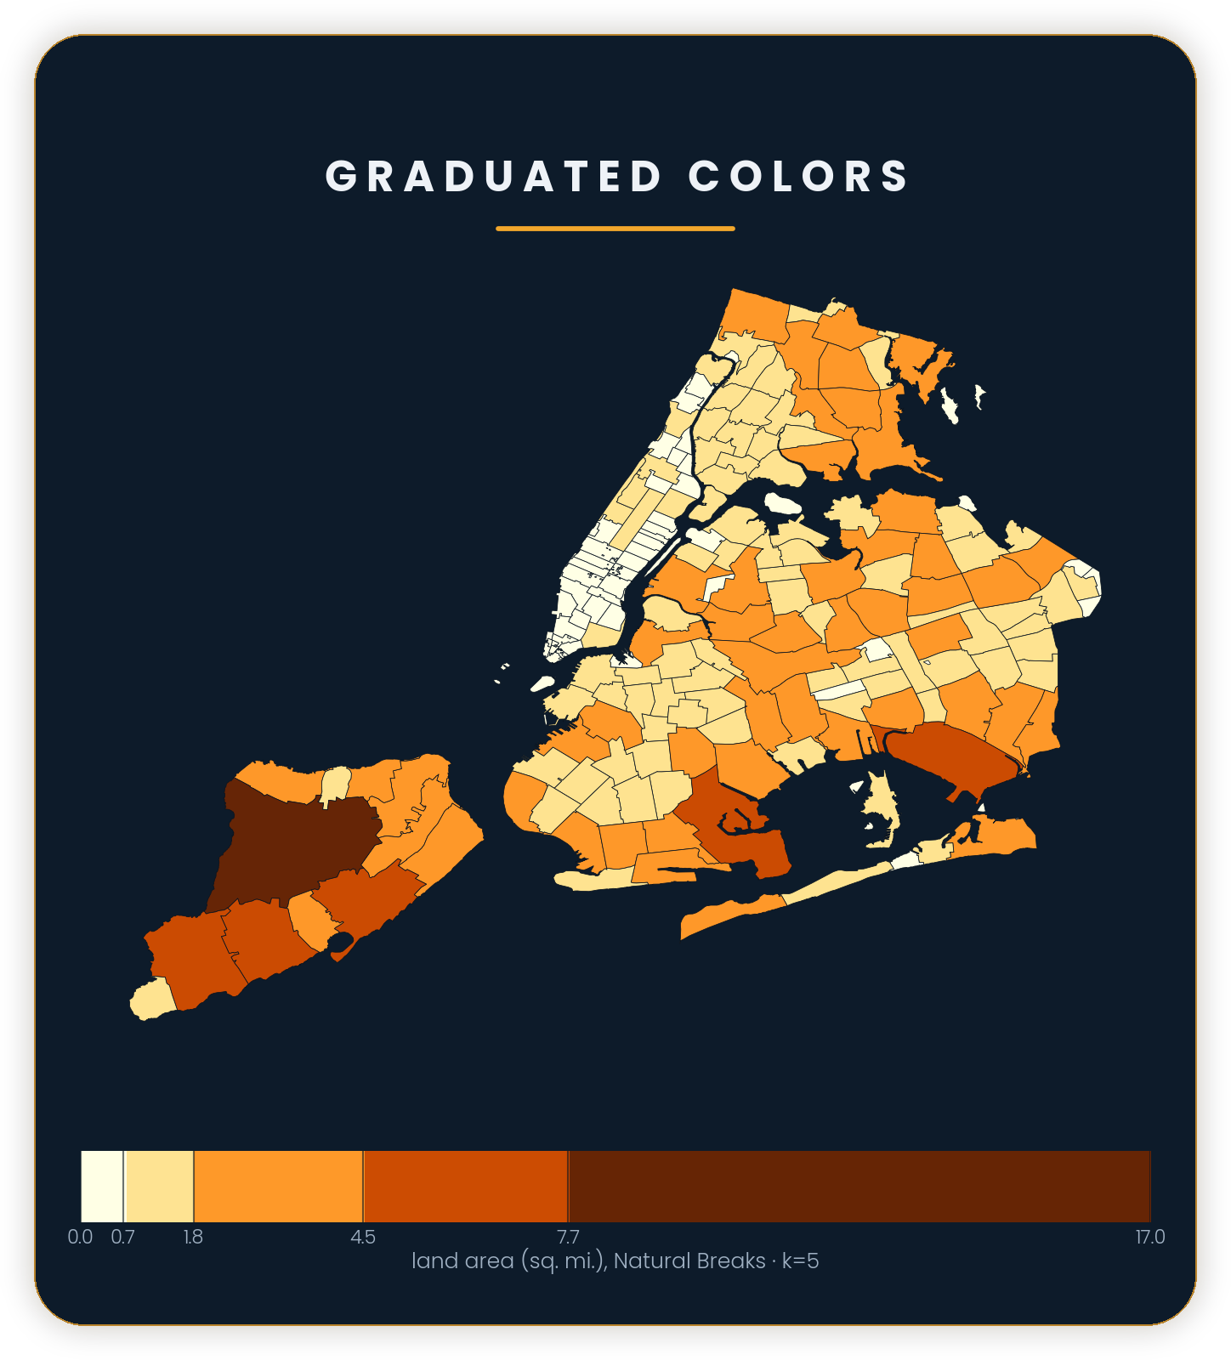
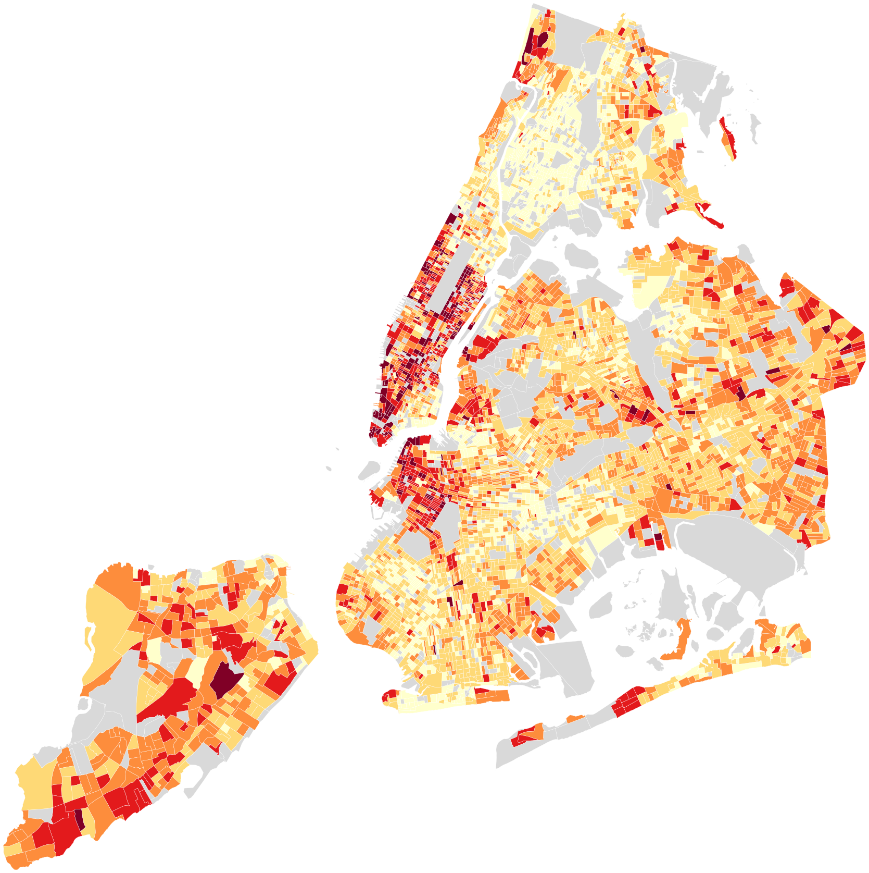
ARCGIS PRO — MAP CLASSIFICATION
Quantitative (binned)
Graduated Colors
What it does
Groups numeric values into classes (bins).
Each class gets a color shade.
Best for
Choropleths (rates/indices)
Comparing areas
Watch out
Counts vs rates
Class breaks change the story
CONCEPT
Classes (bins)
Path: Symbology ▸ Primary symbology ▸ Graduated Colors
08 / 21

Slide 9
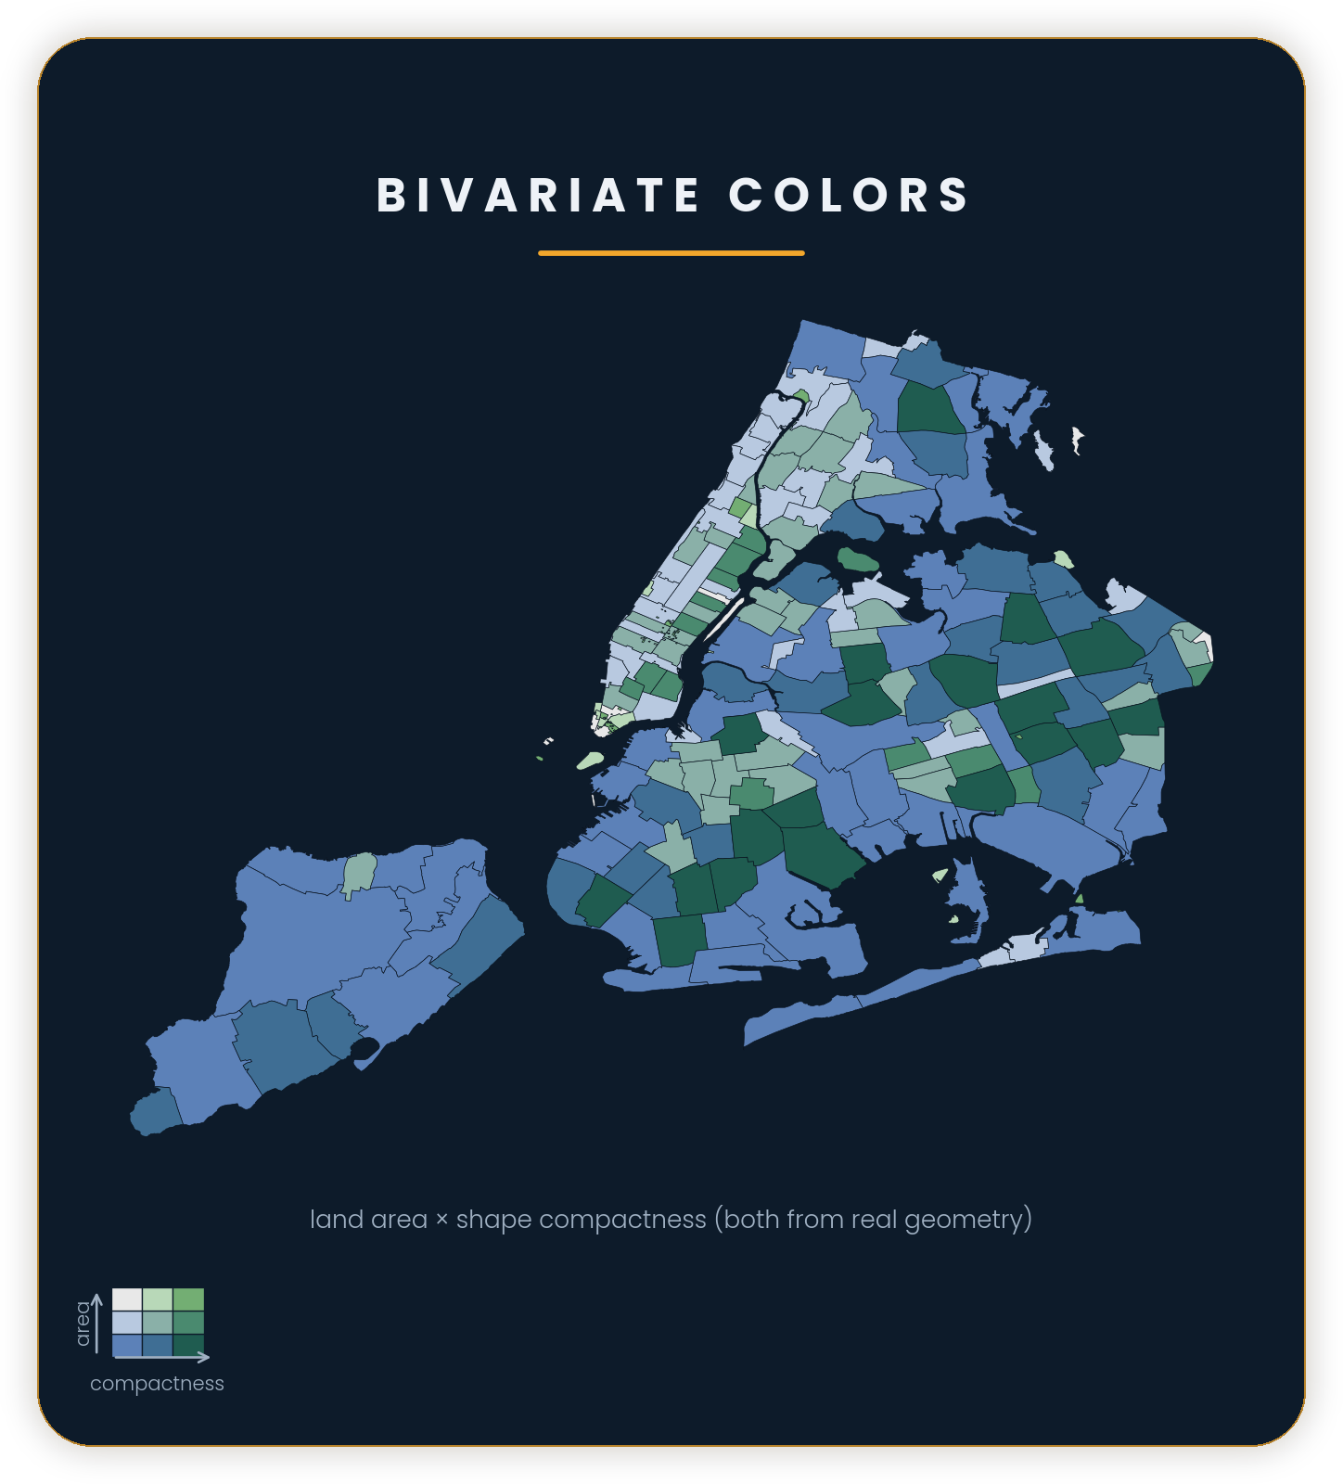
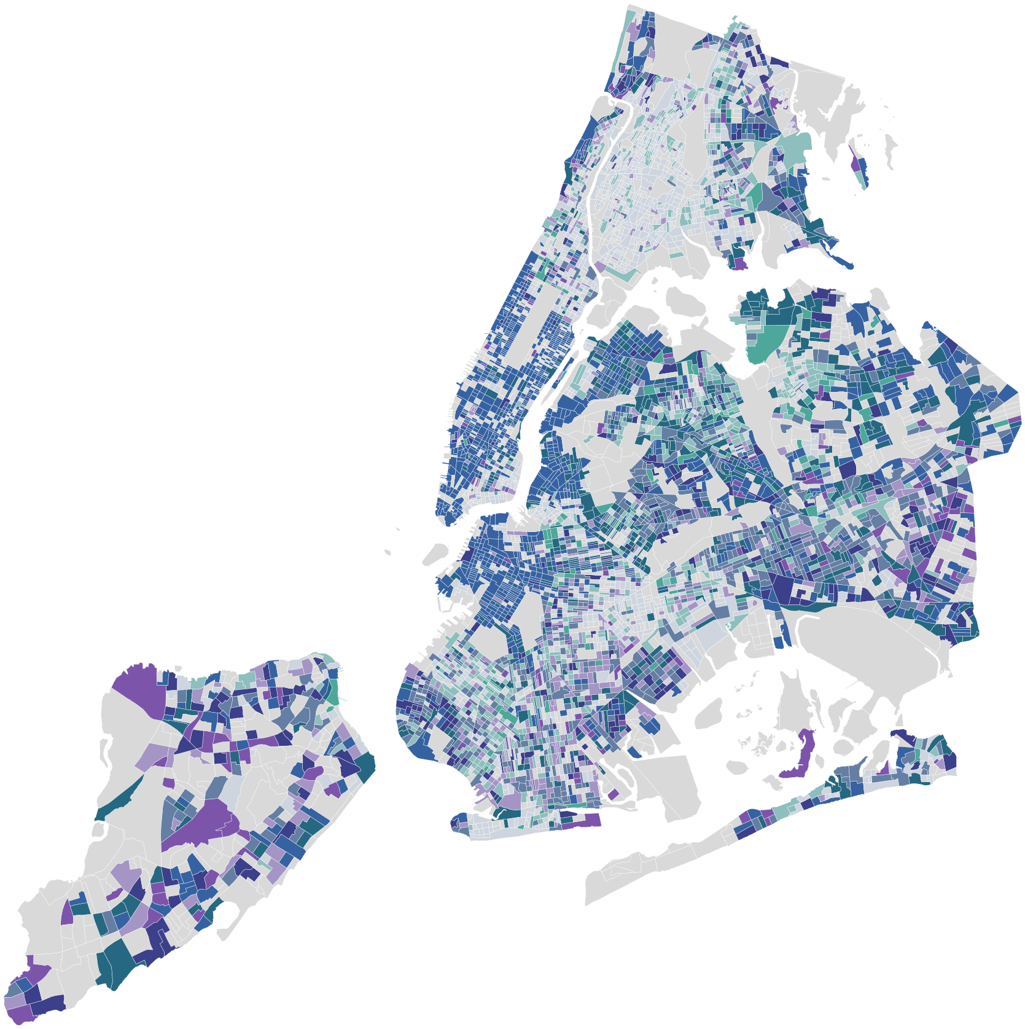
ARCGIS PRO — MAP CLASSIFICATION
Two variables
Bivariate Colors
What it does
Uses a color grid to show two fields at once.
Each axis is classified (2×2, 3×3, 4×4…).
Best for
Spot high-high / low-low
Explore relationships
Watch out
Legend can confuse
Too many classes
CONCEPT
Two variables at once
Path: Symbology ▸ Primary symbology ▸ Bivariate Colors
09 / 21

Slide 10
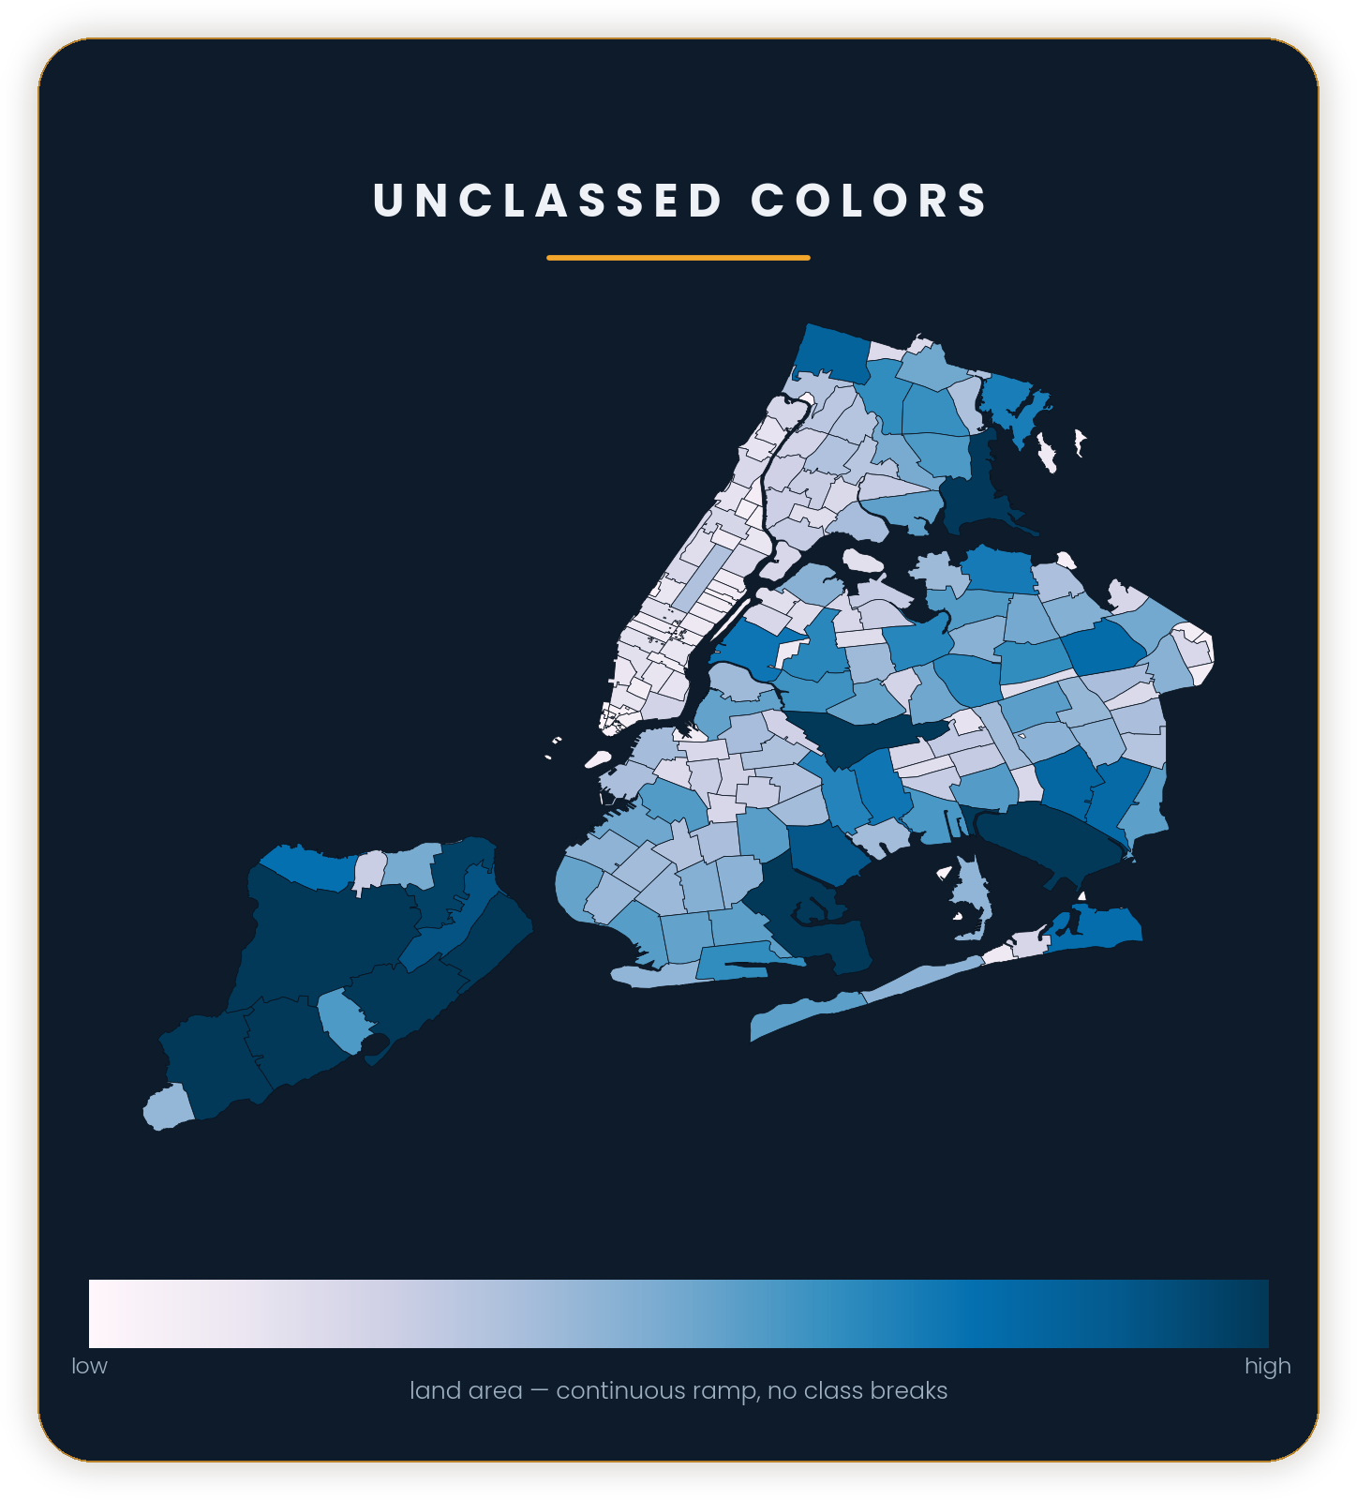
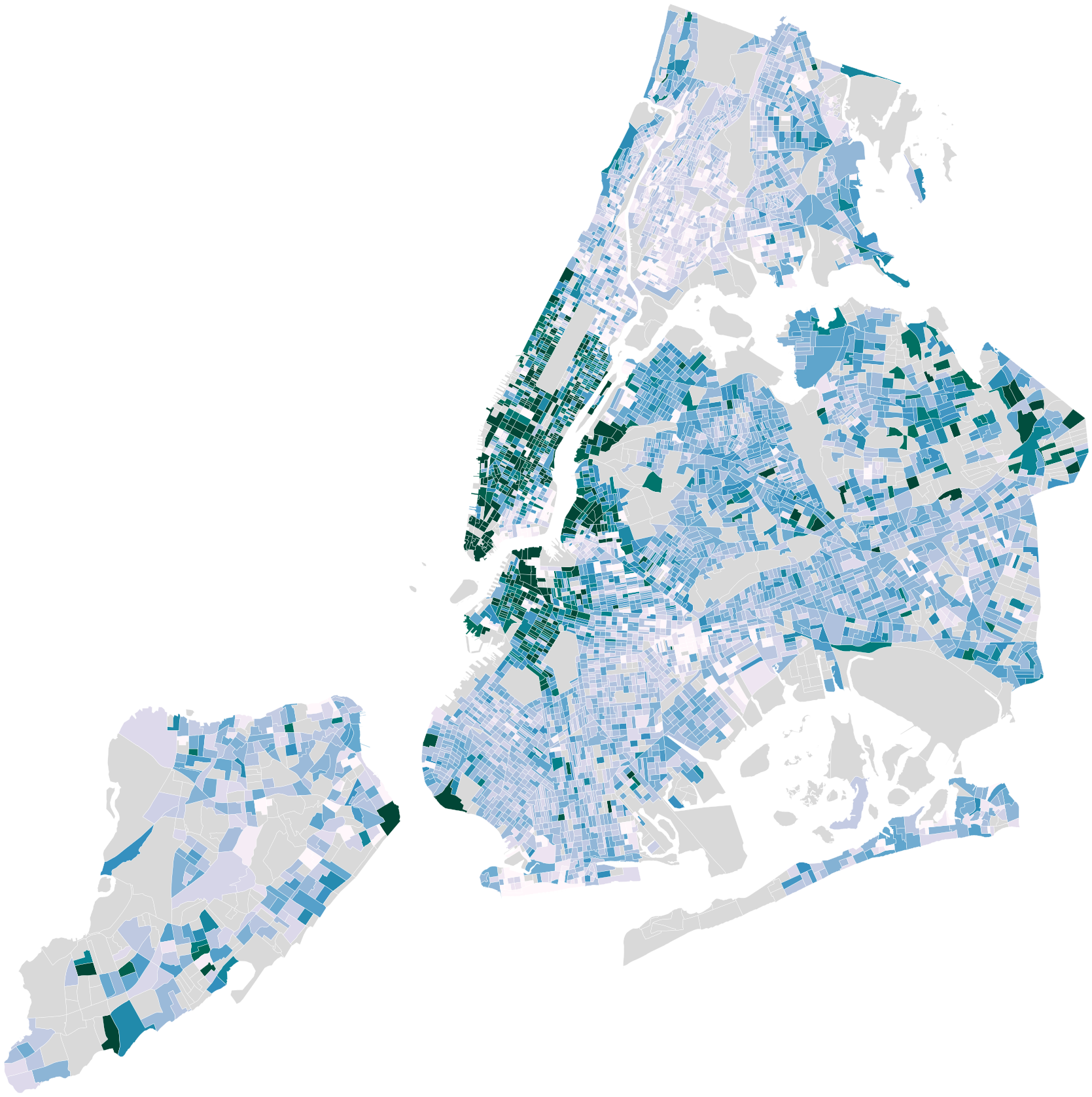
ARCGIS PRO — MAP CLASSIFICATION
Quantitative (continuous)
Unclassed Colors
What it does
Uses a continuous color scheme (no class breaks).
Each value gets a slightly different shade.
Best for
Smooth variation
Uncertain data / MOE
Watch out
Harder legend
Color perception limits
CONCEPT
Continuous ramp
Path: Symbology ▸ Primary symbology ▸ Unclassed Colors
10 / 21

Slide 11
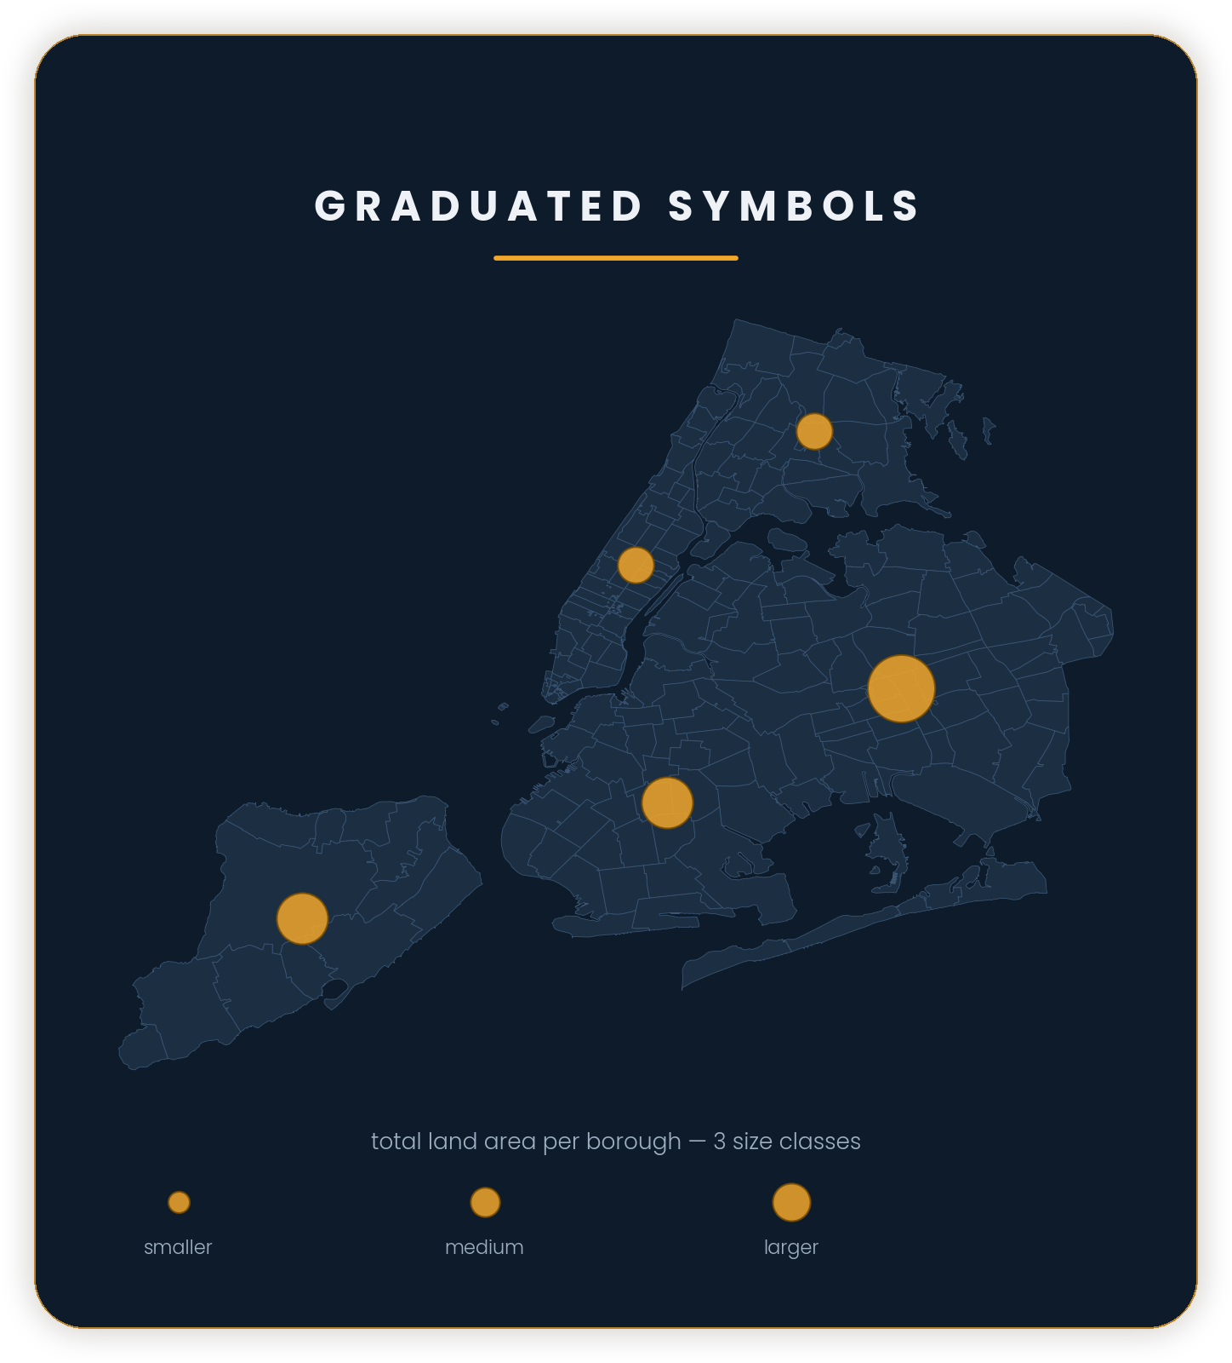
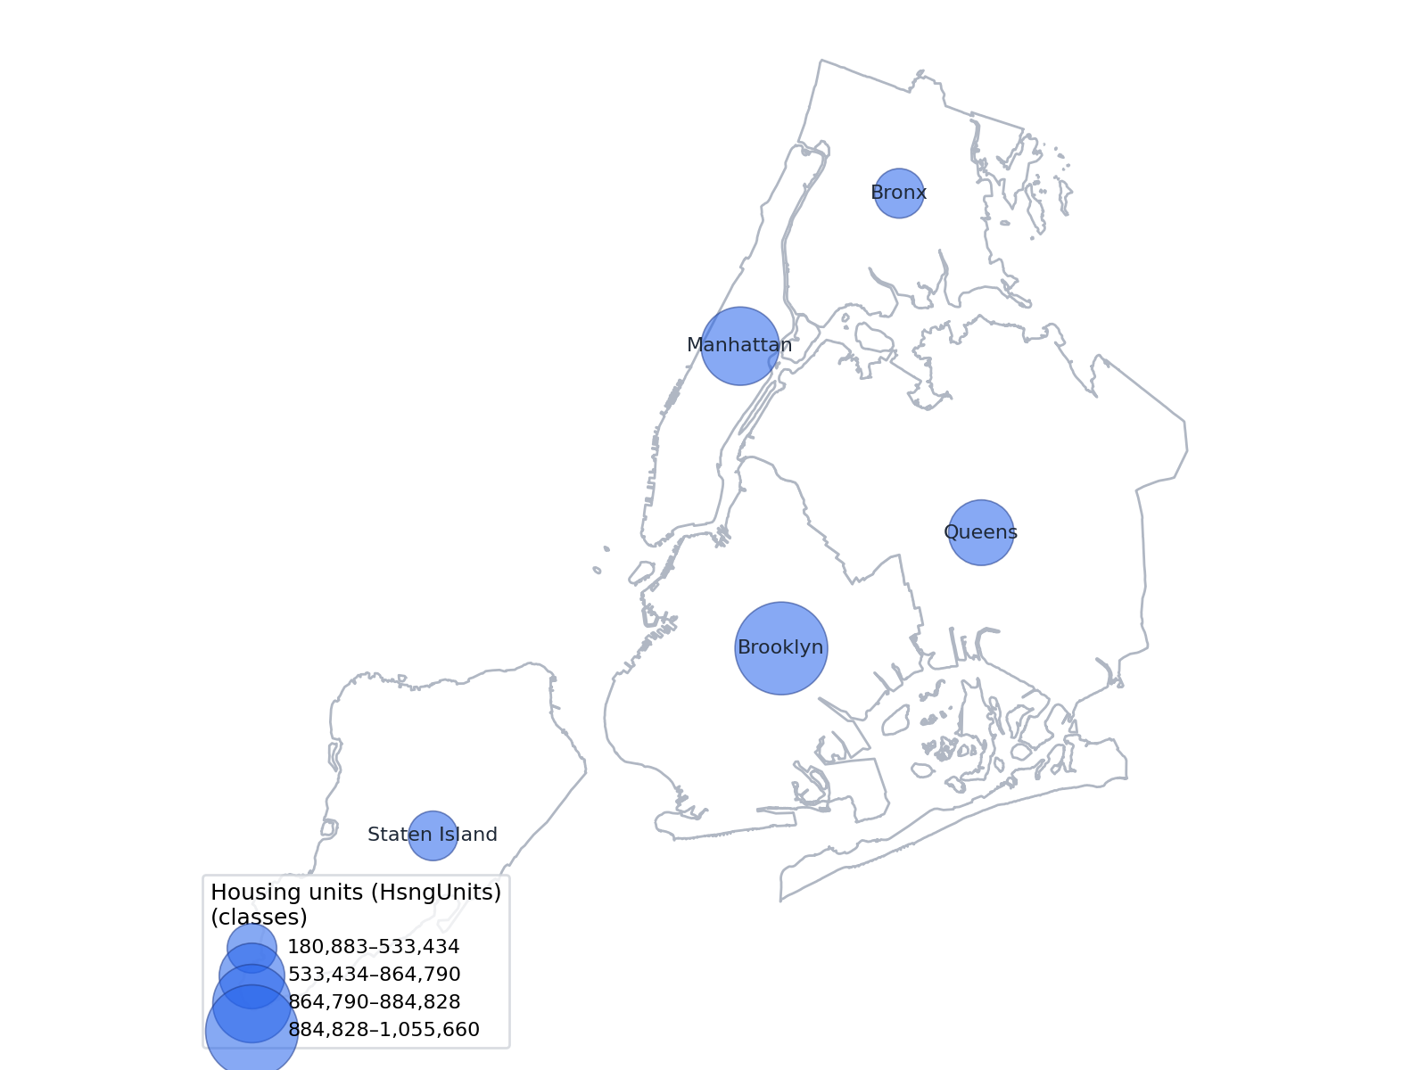
ARCGIS PRO — MAP CLASSIFICATION
Quantitative (binned size)
Graduated Symbols
What it does
Sizes symbols by classes (bins).
Legend shows a few discrete sizes.
Best for
Simpler than proportional
Counts by place
Watch out
Small differences hidden
Class breaks matter
CONCEPT
Binned sizes
Path: Symbology ▸ Primary symbology ▸ Graduated Symbols
11 / 21

Slide 12
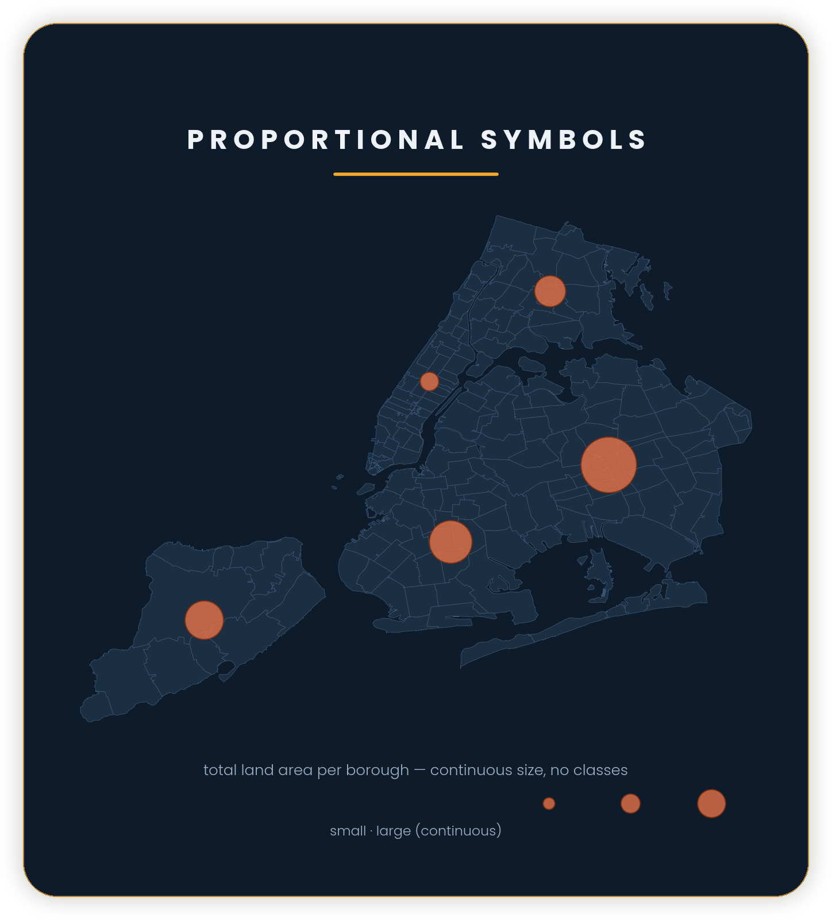
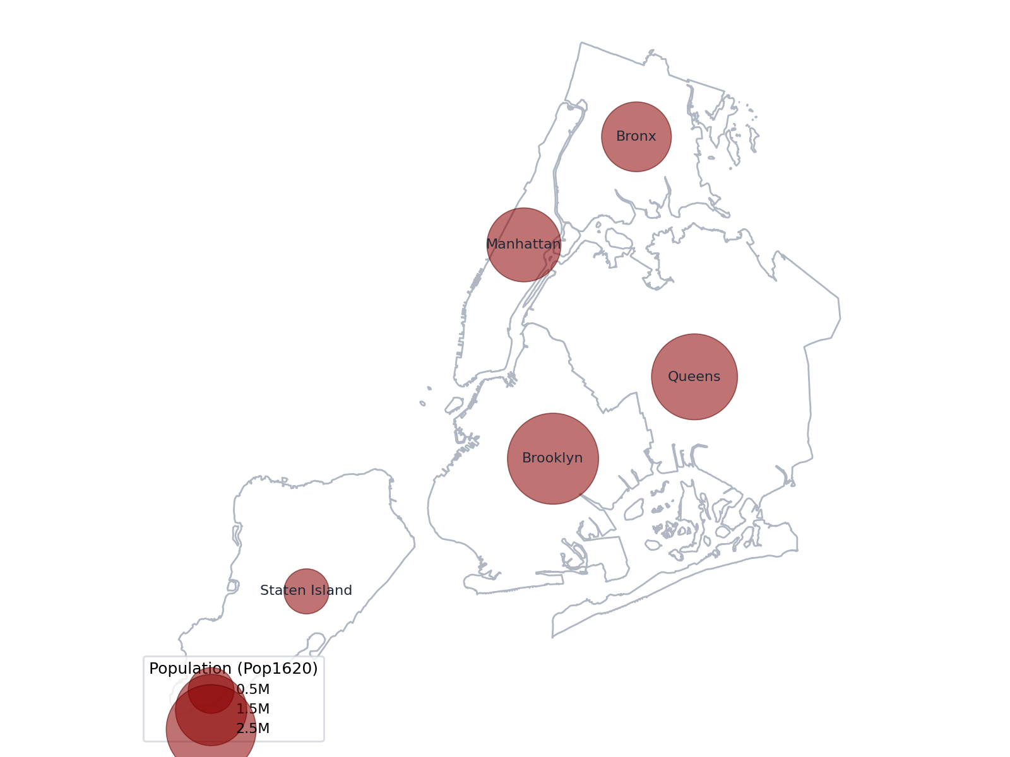
ARCGIS PRO — MAP CLASSIFICATION
Quantitative (continuous size)
Proportional Symbols
What it does
Sizes each symbol to its value (no classes).
Can be relative size or actual units.
Best for
Big value ranges
Point quantities
Watch out
Outliers dominate
Circles misread
CONCEPT
Continuous size
Path: Symbology ▸ Primary symbology ▸ Proportional Symbols
12 / 21

Slide 13
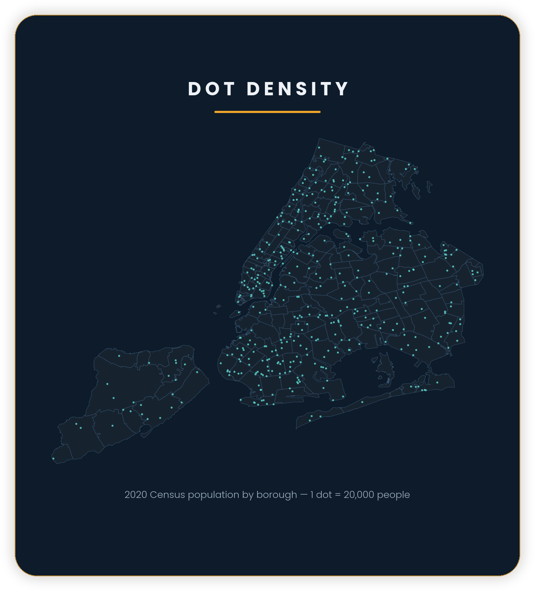
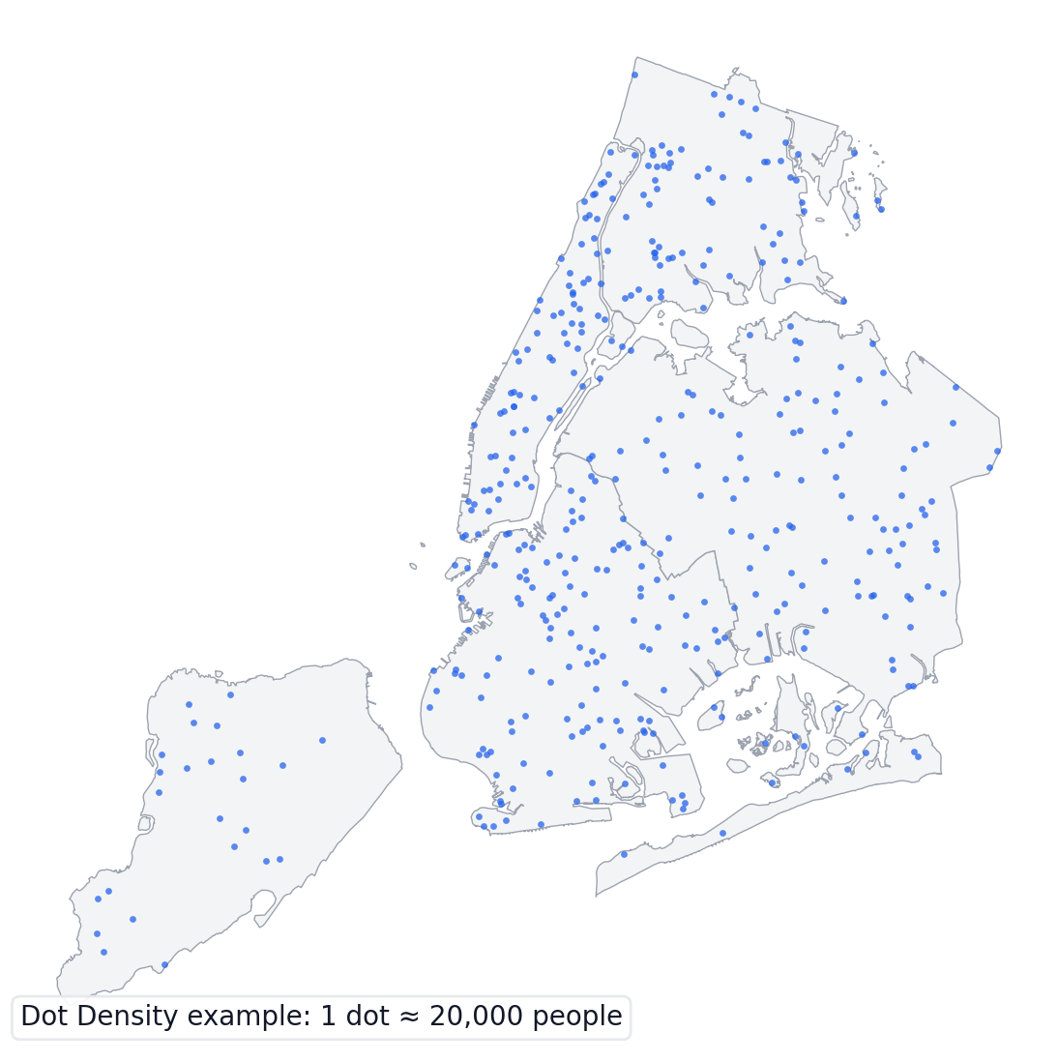
ARCGIS PRO — MAP CLASSIFICATION
Quantitative (distribution)
Dot Density
What it does
Places dots inside polygons.
Each dot represents a fixed quantity.
Best for
Show distribution
Large totals
Watch out
Dots are random placement
Choose dot value carefully
CONCEPT
Dots represent counts
Path: Symbology ▸ Primary symbology ▸ Dot Density
13 / 21

Slide 14
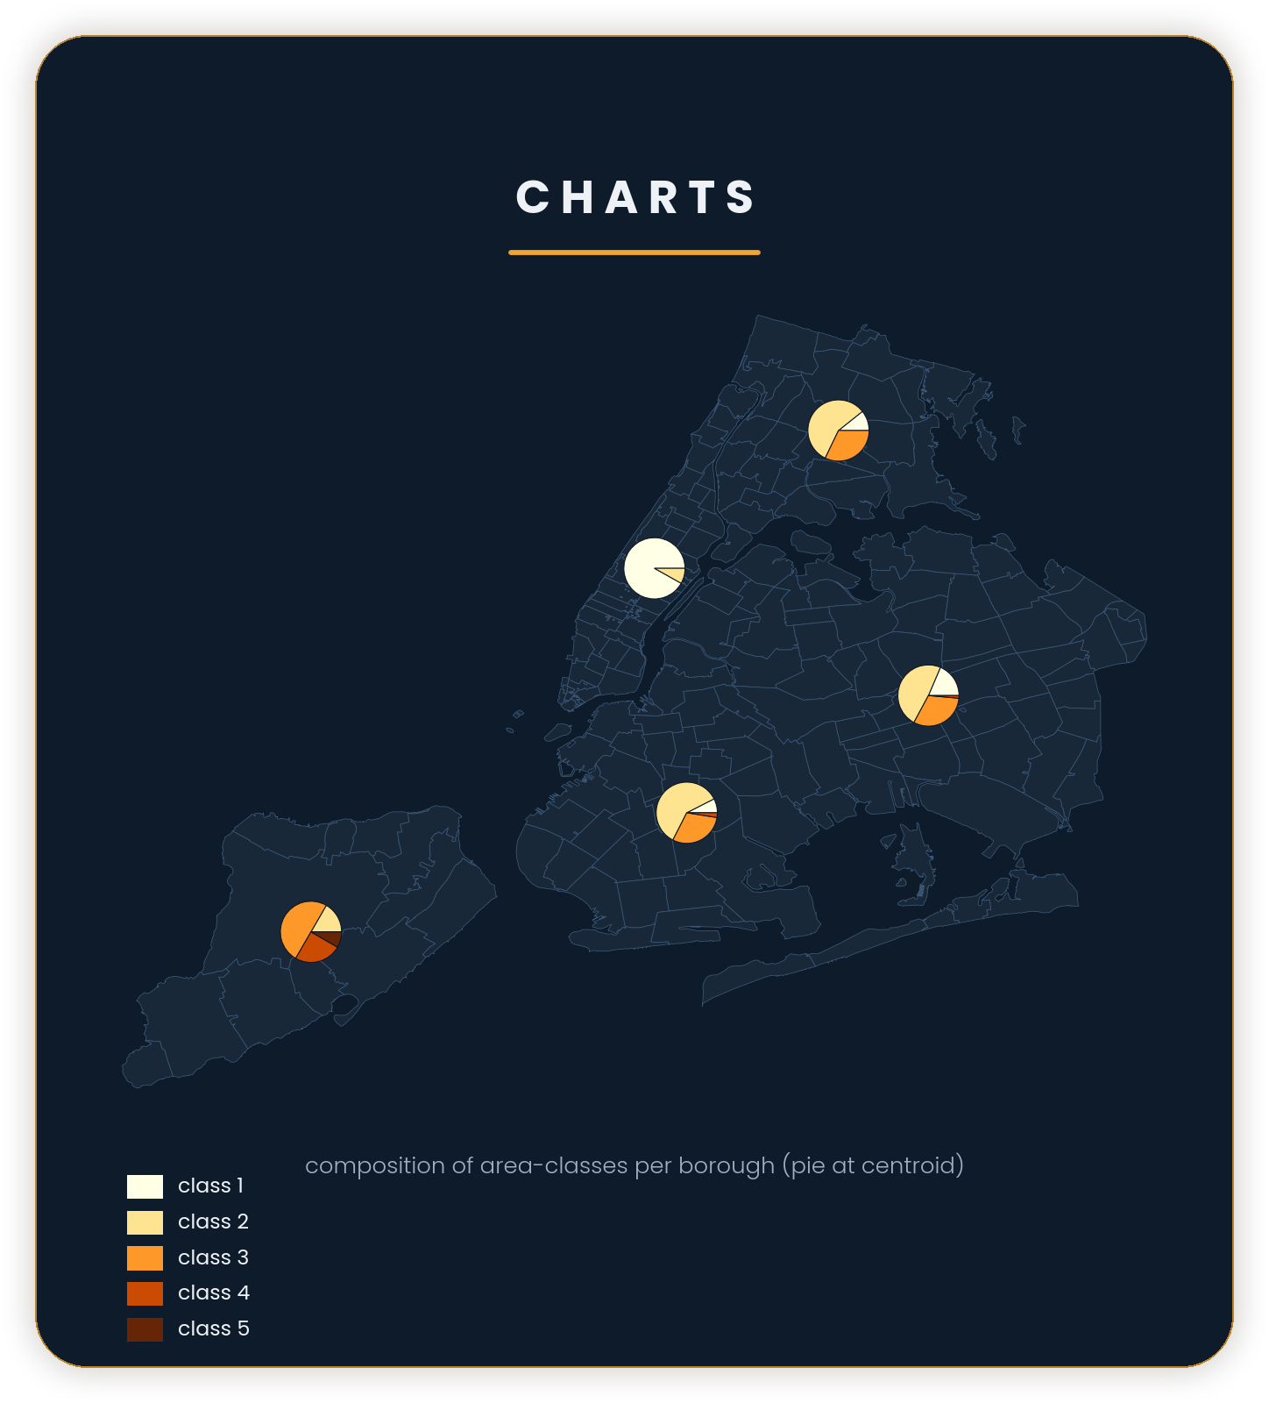
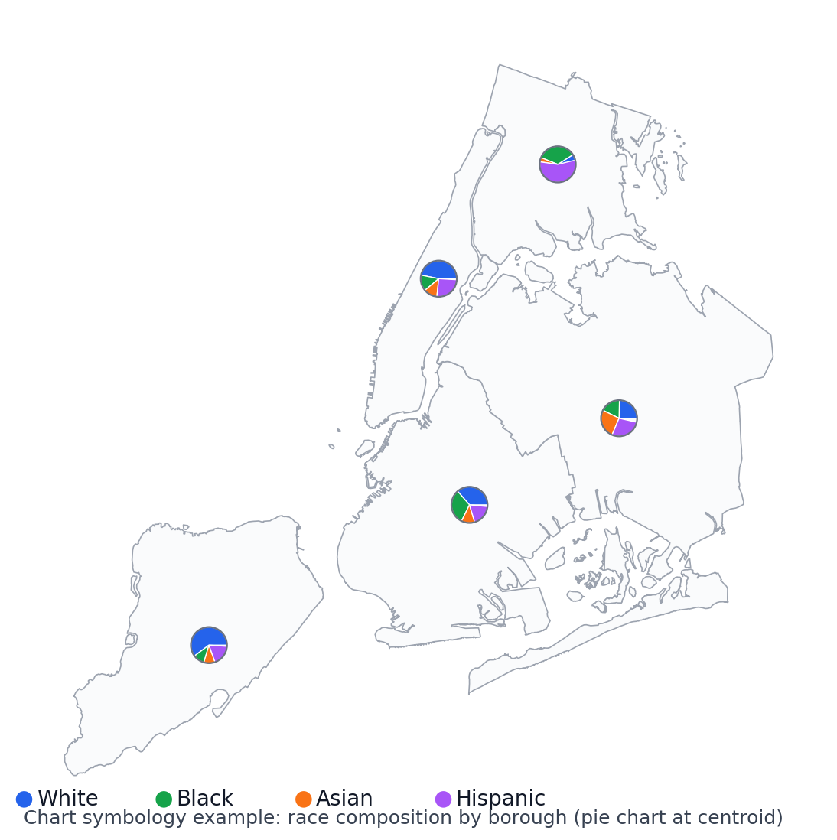
ARCGIS PRO — MAP CLASSIFICATION
Multiple fields
Charts
What it does
Draws charts (pie/bar) at each feature/point.
Each slice/bar is a different field.
Best for
Composition (parts of whole)
Compare groups
Watch out
Overlaps quickly
Too many slices
CONCEPT
Multiple fields per place
Path: Symbology ▸ Primary symbology ▸ Charts
14 / 21

Slide 15
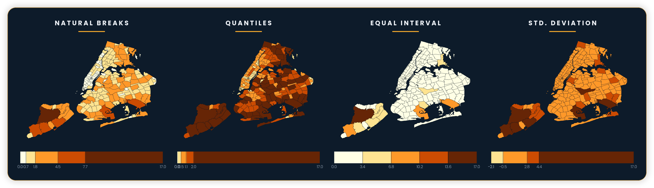
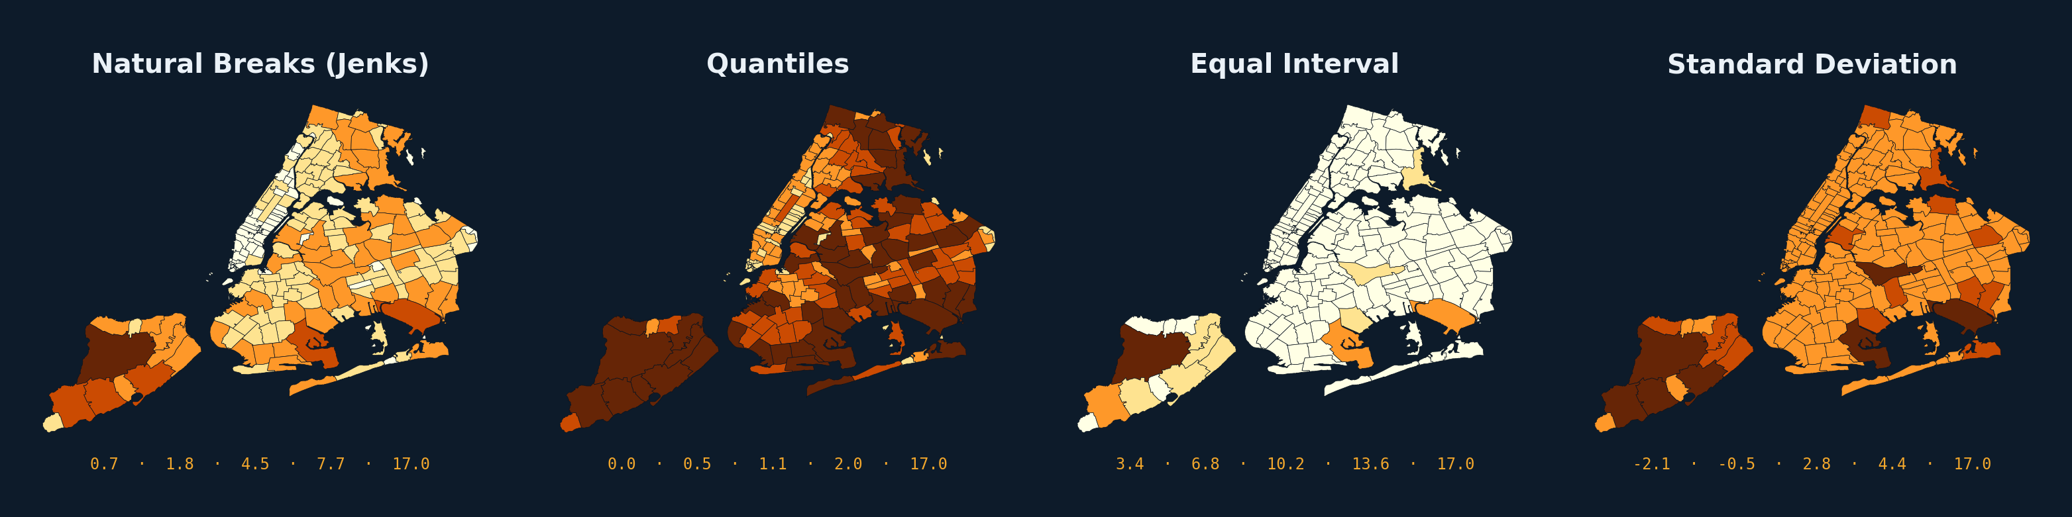
ARCGIS PRO — MAP CLASSIFICATION
Classification Methods Compared
The exact same data — land area of 262 real NYC ZIP codes — classified four different ways.
15 / 21

Slide 16
ARCGIS PRO — MAP CLASSIFICATION
Choosing a Classification Method
A quick reference for picking a method that fits both your data and your purpose.
Natural Breaks (Jenks)
Use when: Your data has real clusters or gaps; you want one honest, well-fitted map.
Watch out: Breaks shift with the data, so two different layers aren't directly comparable.
Quantiles
Use when: You want a clean legend where every class covers roughly the same number of features.
Watch out: Class breaks can land in odd spots and split apart similar values.
Equal Interval
Use when: You're comparing multiple maps or time periods and need consistent, easy-to-read breaks.
Watch out: A single outlier stretches the range and can crush most features into one class.
Standard Deviation
Use when: You want to highlight how far each feature sits above or below the average.
Watch out: Less intuitive for a general audience; assumes a roughly normal distribution.
16 / 21

Slide 17
ARCGIS PRO — MAP CLASSIFICATION
Common Confusions
Four pairs that look similar in the Symbology pane but mean very different things.
Graduated Colors vs. Graduated Symbols
Unclassed vs. Graduated Colors
Both bin numeric data into classes — Colors shades polygons/lines by class; Symbols sizes point markers by class. Same math, different visual channel.
Unclassed uses a smooth, continuous ramp (no bins); Graduated Colors groups values into a handful of discrete classes. Unclassed shows subtle variation, Graduated is easier to read at a glance.
Bivariate Colors vs. Charts
Quantiles vs. Equal Interval
Bivariate encodes two fields into ONE color grid per feature; Charts draws a separate small pie/bar per feature. Bivariate is one field on your eyes; Charts asks the reader to compare shapes.
Quantiles guarantees an equal COUNT of features per class; Equal Interval guarantees an equal-size RANGE per class. They can produce very different-looking maps from the same data.
17 / 21

Slide 18
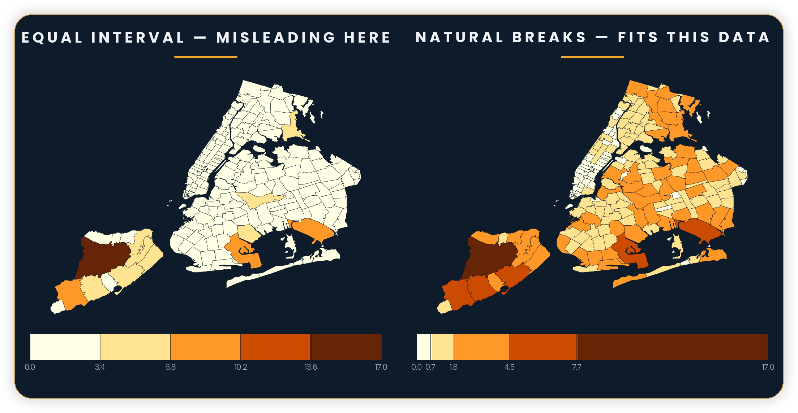
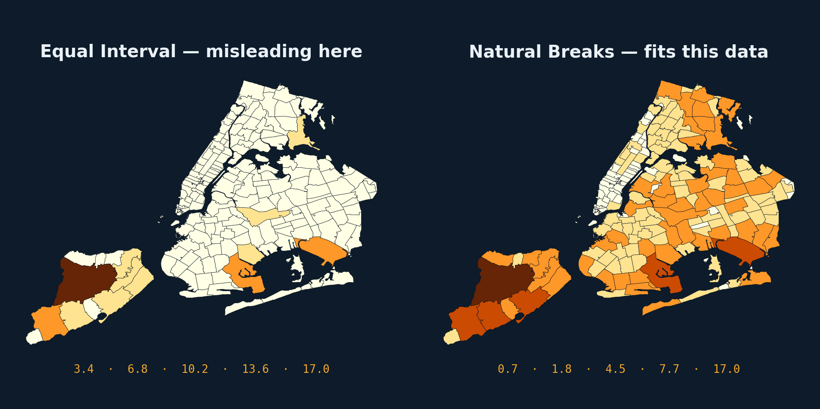
ARCGIS PRO — MAP CLASSIFICATION
Worked Example: Same Data, Two Stories
262 real NYC ZIP codes, classified by land area (sq. mi.) — Equal Interval vs. Natural Breaks.
Equal Interval: one huge ZIP code (Staten Island's largely undeveloped west side) stretches the range so far that almost every other ZIP falls into the lowest class. The map goes nearly blank.
Natural Breaks: the same outlier still exists, but the breaks are placed at real gaps in the data — so the rest of the city's variation becomes visible again.
18 / 21

Slide 19
ARCGIS PRO — MAP CLASSIFICATION
Your Turn — Hands-On Lab
Practice
TASK — classify a numeric field three different ways and compare the results.
1
Open the Symbology pane on a layer with a numeric field (population, income, or land area).
2
Set the renderer to Graduated Colors. Method = Natural Breaks (Jenks), Classes = 5. Note the class breaks.
3
Switch Method to Quantiles (keep Classes = 5). Compare the new breaks and how the map's colors shift.
4
Switch Method to Equal Interval. Which version tells the clearest story? Which could mislead a reader?
ANSWER KEY (reveal in class)
EXPECTED RESULT (reveal in class)
Natural Breaks usually reads best for one map — it fits the real gaps. Quantiles evens out the legend but can split similar values. Equal Interval only works cleanly if the data has no big outliers.
Three visibly different maps from identical data. Natural Breaks and Quantiles should look fairly close; Equal Interval diverges the most if your field has any outliers.
19 / 21

Slide 20
ARCGIS PRO — MAP CLASSIFICATION
Knowledge Check
Q1
What's the difference between Graduated Colors and Unclassed Colors?
Graduated Colors bins values into discrete classes; Unclassed Colors uses a continuous, unbinned color ramp.
▸ Click to reveal answer
Q2
Your data has 5 clear natural clusters. Which classification method fits best?
Natural Breaks (Jenks) — it places breaks at the biggest gaps in the data.
▸ Click to reveal answer
Q3
True or False: Quantiles always create classes with an equal RANGE of values.
False — Quantiles creates classes with an equal COUNT of features; Equal Interval is the one with equal ranges.
▸ Click to reveal answer
Q4
Why can Equal Interval mislead when data has one huge outlier?
It divides the full value range into equal-size bins, so the outlier stretches the range and squeezes almost everything else into a single class.
▸ Click to reveal answer
20 / 21

Slide 21
ARCGIS PRO — MAP CLASSIFICATION
Recap & What's Next
RECAP
WHAT'S NEXT
✓
Nine renderers in Primary symbology — from Single Symbol to Charts.
→
Turn a classified layer into a finished, labeled map layout.
✓
Classification methods (Natural Breaks, Quantiles, Equal Interval, Std. Deviation) turn numbers into map classes.
→
Practice choosing renderers for your own datasets.
✓
The same data can tell very different stories depending on the method chosen.
→
Explore how classification choices affect legends and printed maps.
✓
Watch for: counts vs. rates, too many classes, and outliers that distort Equal Interval.
21 / 21

