Slide 1
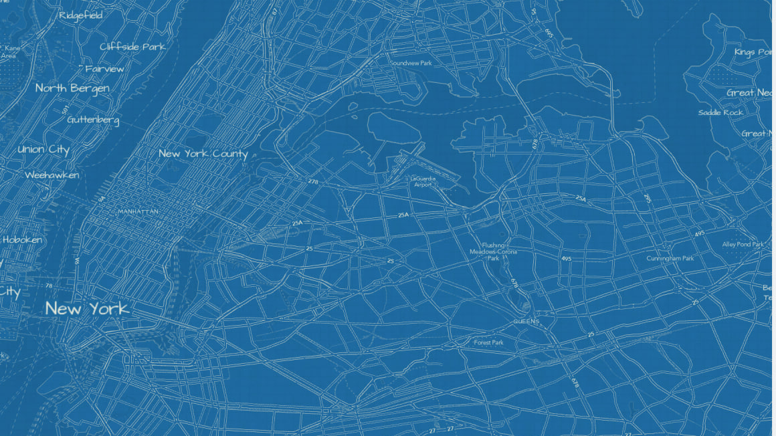
CARTOGRAPHIC PRINCIPLES
Cartographic Principles
Designing Maps That Communicate
From purpose and visual hierarchy to projections, honest classification, and export —
the ideas underneath every well-made map.
JUMP TO A SECTION
01 Foundations
02 How the Eye Reads a Map
03 Color
04 Type
05 The Geometry of Maps
06 Composition & Layout Design
07 Designing Responsibly
08 From Map to Layout & Export
09 Bringing It Together
01 / 36
A companion to Symbology & Map Classification

Slide 2
CARTOGRAPHIC PRINCIPLES
WHERE TO GO
Table of Contents
Every section and slide is a clickable jump -- click any row to go straight there.
SECTION 01 · FOUNDATIONS
SECTION 05 · THE GEOMETRY OF MAPS
SECTION 08 · FROM MAP TO LAYOUT & EXPORT
›
Purpose & Audience
›
Why Every Map Lies (A Little)
›
Layout Basics
›
Map Anatomy
›
Common Projections
›
Activate & Navigate the Map Frame
SECTION 02 · HOW THE EYE READS A MAP
›
Generalization & Scale
›
Essential Layout Elements
SECTION 06 · COMPOSITION & LAYOUT DESIGN
›
A Full Layout, Assembled
›
Visual Hierarchy & Figure-Ground
›
Aligning & Arranging Elements
›
Bertin's Visual Variables
›
Composition & Balance
›
Build Workflow
›
Symbol Size: Good vs. Bad
›
Composition: Good vs. Bad
›
Share & Export Ribbon
SECTION 03 · COLOR
›
Legend Design
›
Export Formats: PDF vs. PNG vs. TIFF
›
Insets & Locator Maps
›
Color Schemes
›
Scale-Bar Formats
SECTION 09 · BRINGING IT TOGETHER
›
Color & Perception
›
Basemap Selection & Restraint
›
Case Study: Before & After
›
Color: Good vs. Bad
›
Knowledge Check
SECTION 07 · DESIGNING RESPONSIBLY
SECTION 04 · TYPE
›
Closing Recap
›
MAUP & Cherry-Picked Breaks
›
Further Reading: Real-World Galleries
›
Label Hierarchy
›
Accessibility
›
Label Placement
02 / 36
›
Output Context

Slide 3
CARTOGRAPHIC PRINCIPLES
SECTION 01 · FOUNDATIONS
Purpose & Audience
The one question to ask before any design choice: who's reading this, why, and for how long?
Expertise Level
Decision Supported
Viewing Context
A GIS analyst can parse a 7-class quantile choropleth instantly; a general audience needs 3-4 classes and plain-language labels.
An exploratory map for analysts can show everything at once; a map meant to drive one decision should mute everything except that single pattern.
A dashboard glanced at for seconds needs bigger text and fewer classes than a printed report a reader studies for ten minutes.
Every design decision downstream — classification complexity, label density, color palette — should trace back to this answer. (For the standard map-type taxonomy — reference, thematic, pragmatic — see the Power of Maps deck.)
03 / 36

Slide 4
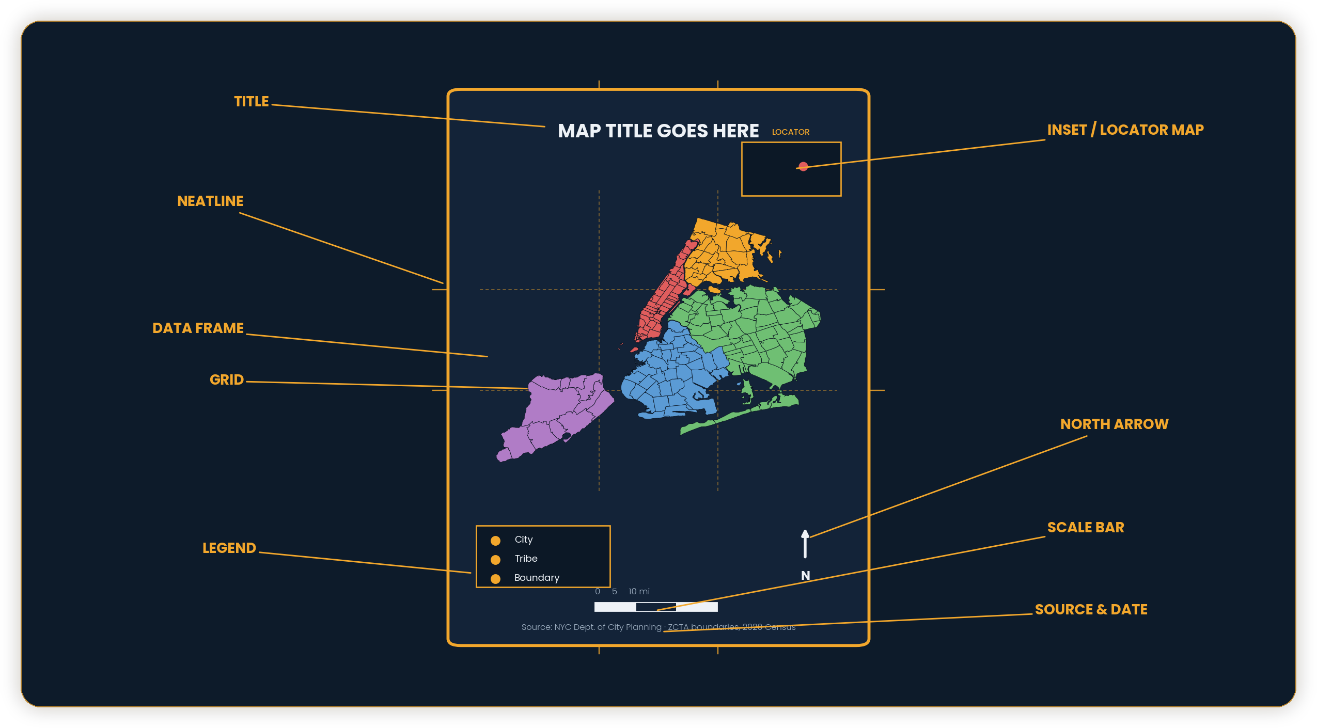
CARTOGRAPHIC PRINCIPLES
SECTION 01 · FOUNDATIONS
Map Anatomy
The parts a finished map is built from — independent of any particular software.
See Essential Layout Elements (Section 08) for where each of these lives in ArcGIS Pro. Grid: Layout tab ▸ Map Frame ▸ Grids — 2D maps only; grids aren't available on 3D scenes.
04 / 36

Slide 5
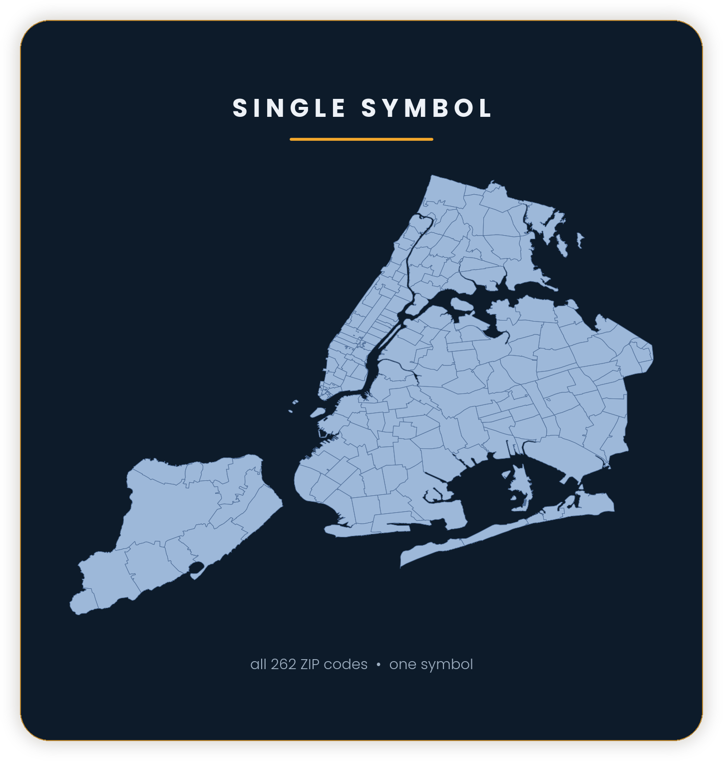
CARTOGRAPHIC PRINCIPLES
SECTION 02 · HOW THE EYE READS A MAP
Visual Hierarchy &
Figure-Ground
THE EYE READS IN ORDER
Contrast and weight decide what's seen first, second, third — not the order you drew it in.
FIGURE vs. GROUND
The data (figure) needs to visually separate from the basemap (ground). A busy basemap under bold data is the most common hierarchy failure.
ONE FOCAL POINT
If everything is emphasized, nothing is. Mute what's context; sharpen what's the point.
05 / 36

Slide 6
CARTOGRAPHIC PRINCIPLES
SECTION 02 · HOW THE EYE READS A MAP
Bertin's Visual Variables
The basic vocabulary for encoding data visually — and which variables the eye reads as ordered.
SIZE
VALUE
HUE
SATURATION
Ordered · quantitative. Bigger reads as “more.” Used by graduated & proportional symbols.
Ordered. Light-to-dark reads naturally as low-to-high — the basis of sequential color ramps.
Unordered. Red vs. blue vs. green reads as different categories, not more/less.
Weakly ordered. Muted-to-vivid can suggest confidence or intensity.
SHAPE
ORIENTATION
TEXTURE
Unordered. Distinguishes categories — a circle vs. a triangle vs. a square.
Unordered, limited range. Useful for direction/flow, easily overused.
Unordered. Dot density is a texture variable — pattern reads before precise count.
06 / 36

Slide 7
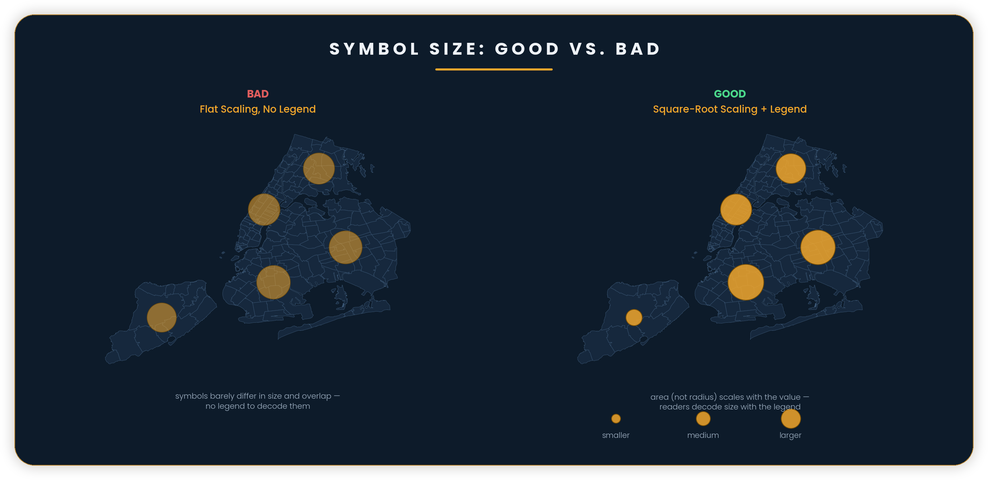
CARTOGRAPHIC PRINCIPLES
SECTION 02 · HOW THE EYE READS A MAP
Symbol Size: Good vs. Bad
Size is one of Bertin's ordered variables — but only if the scaling and legend actually let readers decode it.
07 / 36

Slide 8
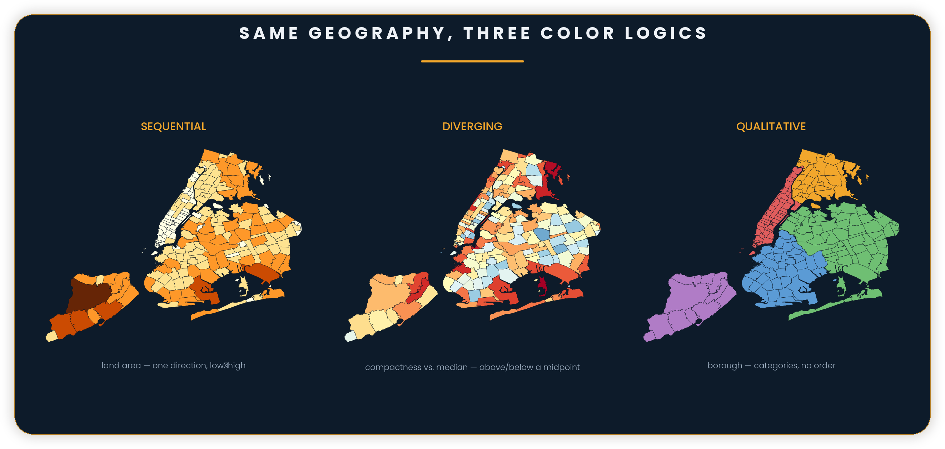
CARTOGRAPHIC PRINCIPLES
SECTION 03 · COLOR
Color Schemes
Sequential, diverging, and qualitative — three color logics, three different kinds of data.
08 / 36

Slide 9
CARTOGRAPHIC PRINCIPLES
SECTION 03 · COLOR
Color & Perception
Color carries meaning before it carries data — and that meaning isn't universal.
CULTURAL ASSOCIATIONS
CONTRAST ON DARK vs. LIGHT
COLORBLIND-SAFE DESIGN
Red often reads as danger or heat, blue as cold or water, green as “go” or nature — in Western contexts. These associations can help or actively mislead depending on the audience.
The same hue reads differently on a dark basemap than a white one — test your palette on the actual background, not a swatch on white.
About 8% of men have some form of color vision deficiency. Red-green diverging ramps are the most common failure — covered in depth in Accessibility.
Rule of thumb: choose color for what it means to your specific audience first, and how it looks second.
09 / 36

Slide 10
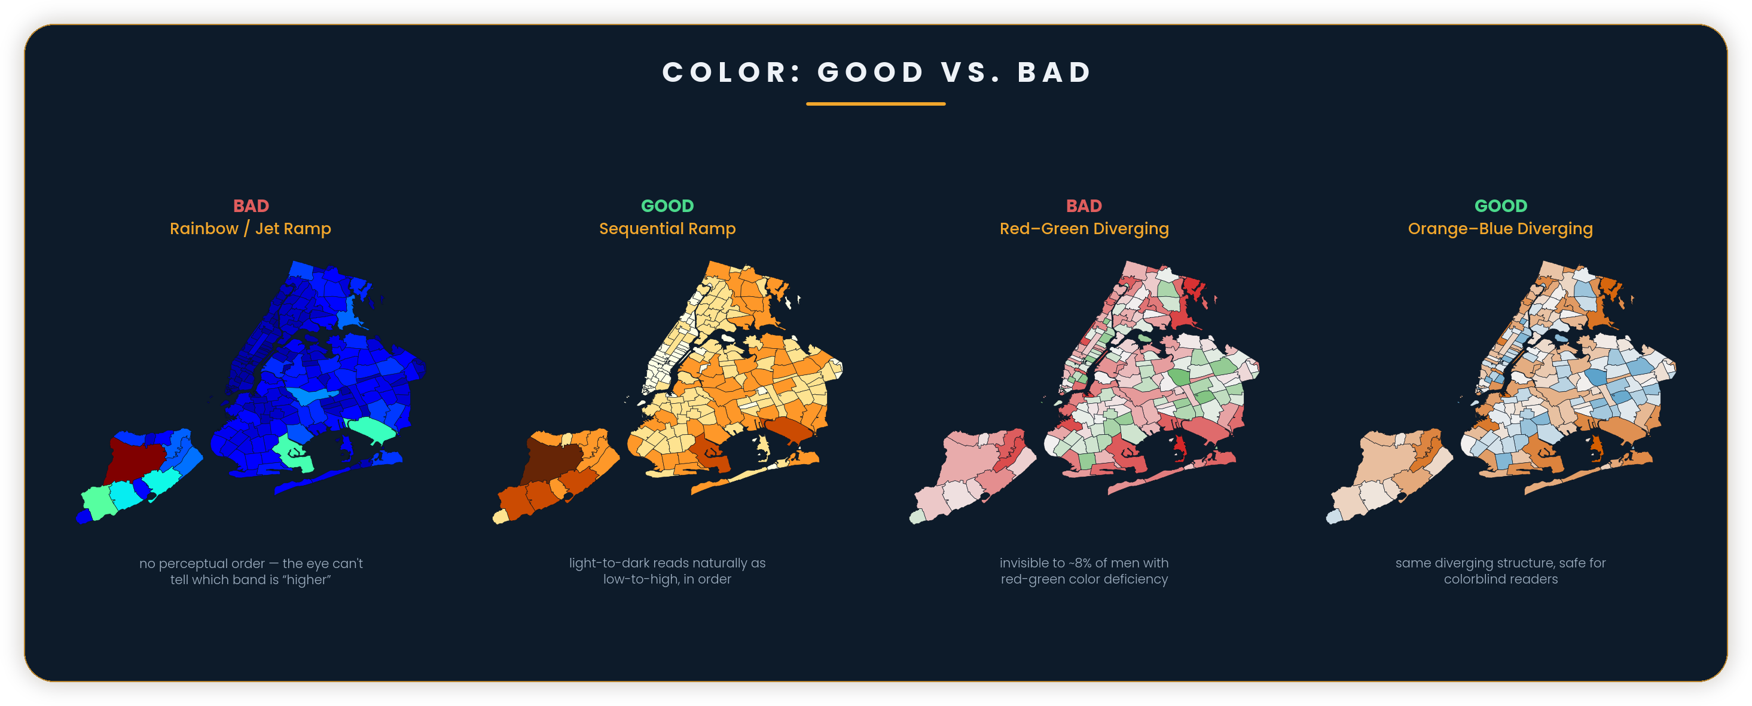
CARTOGRAPHIC PRINCIPLES
SECTION 03 · COLOR
Color: Good vs. Bad
The same underlying data, four palette choices — two that communicate, two that mislead or exclude.
10 / 36

Slide 11
CARTOGRAPHIC PRINCIPLES
SECTION 04 · TYPE
Label Hierarchy
Type weight, size, and style reinforce the same structure the map's visual hierarchy already set up.
New York City
Manhattan · Brooklyn · Queens
Chelsea Astoria Park Slope
5th Ave Northern Blvd 7th Ave
SIZE + WEIGHT STEP DOWN
Each tier of geography (city, borough, neighborhood, street) gets a visibly smaller, lighter label — never the same size for two different scales of thing.
DON'T USE MORE THAN 3-4 TIERS
Beyond four visually distinct label tiers, readers stop being able to tell them apart at a glance — the hierarchy collapses back into noise.
11 / 36

Slide 12
CARTOGRAPHIC PRINCIPLES
SECTION 04 · TYPE
Label Placement
The label engine's job: fit every name in without collisions, ambiguity, or covering the thing it names.
COLLISION AVOIDANCE
PRIORITY RULES
HALOS & LEADER LINES
When labels would overlap, the engine shrinks, moves, or drops lower-priority ones — silently. Always spot-check dense areas.
Set which labels must always show (rank/weight) so a big city doesn't get dropped in favor of a small town that happened to fit first.
A soft halo keeps text readable over a busy basemap; a leader line ties a label to a point it couldn't sit directly on top of without crowding.
In ArcGIS Pro this is Maplex Label Engine territory — most of these rules are configurable per label class, not just on or off.
12 / 36

Slide 13
CARTOGRAPHIC PRINCIPLES
SECTION 05 · THE GEOMETRY OF MAPS
Why Every Map Lies
(a Little)
The Earth is a sphere. Every flat map is a projection — and every projection has to trade away something to make that translation work.
THE GREENLAND PROBLEM
On a standard Web Mercator map, Greenland looks roughly the same size as Africa. In reality, Africa is about 14 times larger. Next slide: what a projection actually trades away, and how to pick one on purpose.
13 / 36

Slide 14
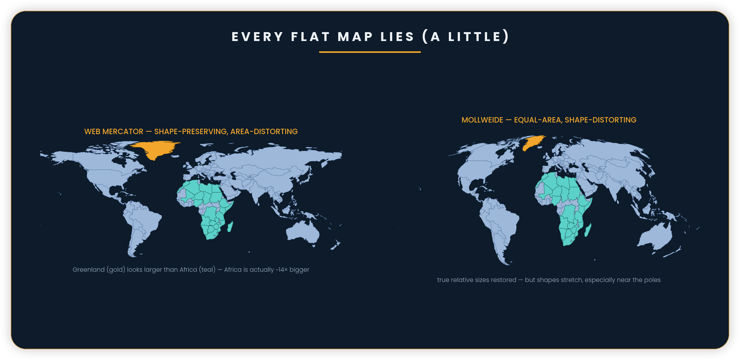
CARTOGRAPHIC PRINCIPLES
SECTION 05 · THE GEOMETRY OF MAPS
Common Projections
Every projection preserves something and distorts something else — shape, area, distance, or direction.
14 / 36

Slide 15
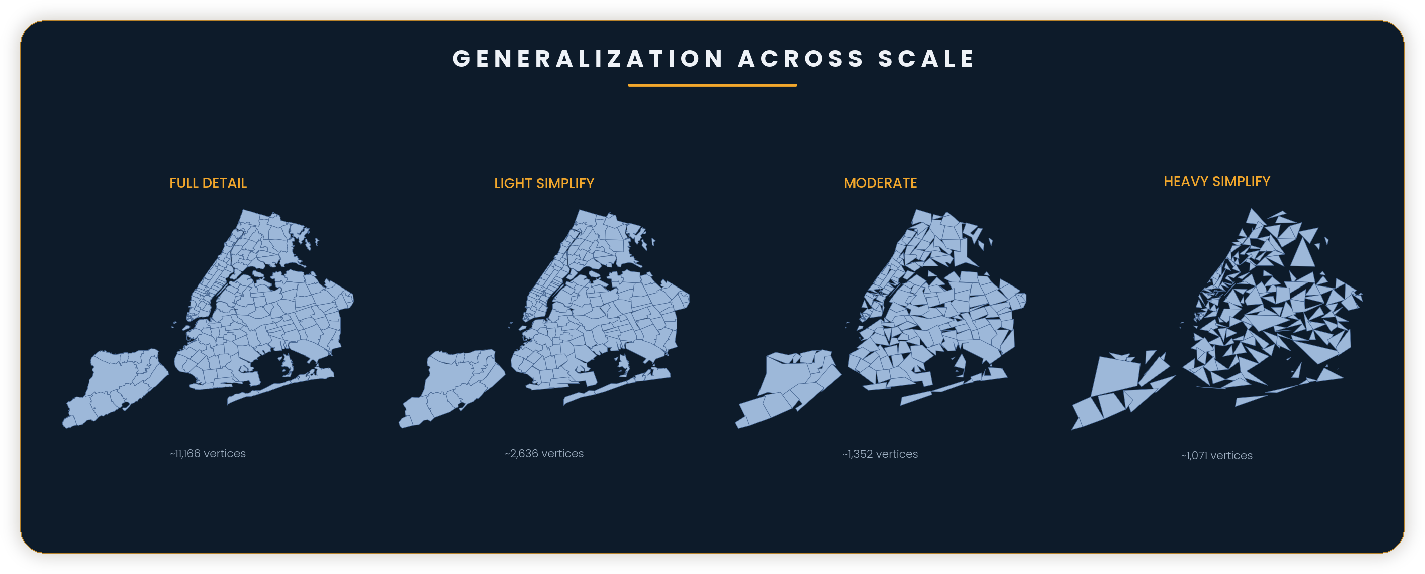
CARTOGRAPHIC PRINCIPLES
SECTION 05 · THE GEOMETRY OF MAPS
Generalization & Scale
Simplification, selection, and smoothing across zoom levels — more detail isn't automatically better.
Over-detailed geometry at a small scale slows rendering and adds visual noise without adding information the reader can use.
15 / 36

Slide 16
CARTOGRAPHIC PRINCIPLES
SECTION 06 · COMPOSITION & LAYOUT DESIGN
Composition & Balance
Treat the map as a designed page, not just a plot of data dropped on a canvas.
VISUAL BALANCE
GRID ALIGNMENT
WHITESPACE IS A TOOL
A large map frame on one side needs a counterweight — legend, text block, or simply generous whitespace — on the other, or the page reads lopsided.
Title, legend, scale bar, and map frame edges should snap to a shared grid. Misaligned elements read as sloppy even when the data is right.
Empty space isn't wasted space — it's what lets the eye rest and tells the reader which elements belong together.
In ArcGIS Pro: Layout tab ▸ Align / Distribute snaps elements to each other; Guides & Grids give you a fixed reference to design against.
16 / 36

Slide 17
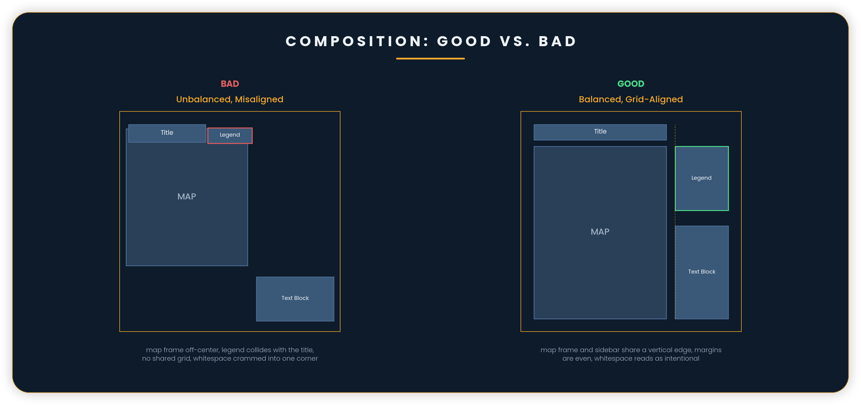
CARTOGRAPHIC PRINCIPLES
SECTION 06 · COMPOSITION & LAYOUT DESIGN
Composition: Good vs. Bad
The same four elements, two arrangements — one reads as an accident, one reads as a decision.
17 / 36

Slide 18
CARTOGRAPHIC PRINCIPLES
SECTION 06 · COMPOSITION & LAYOUT DESIGN
Legend Design
The legend is the map's dictionary — confusing or incomplete, and the rest of the design doesn't matter.
ORDER MATCHES THE DATA
OMIT WHAT'S OBVIOUS
GROUP RELATED CLASSES
Sequential or ordered data should list light-to-dark or low-to-high; qualitative categories can follow a logical grouping instead of an arbitrary one.
If a symbol reads unambiguously without an explanation — a single blue line for water — leave it out. A legend that documents everything is a wall of text nobody reads.
Past 7-8 entries, start grouping under subheads (e.g., “Roads” with Highway / Local / Trail beneath it) instead of one long flat list.
18 / 36

Slide 19
CARTOGRAPHIC PRINCIPLES
SECTION 06 · COMPOSITION & LAYOUT DESIGN
Insets & Locator Maps
When your map's extent isn't self-explanatory, a small inset tells the reader where they are in the bigger picture.
WHEN TO INCLUDE ONE
WHEN TO SKIP IT
KEEP IT SUBORDINATE
Use an inset whenever the main map's extent could be mistaken for somewhere else, or is zoomed in far enough that broader context helps — a neighborhood, a single county.
A widely-recognized extent — a whole country, a globally familiar city — rarely needs one. It adds clutter without adding information.
An inset should never compete visually with the main map — smaller, quieter colors, tucked into a corner that doesn't cover data.
19 / 36

Slide 20
CARTOGRAPHIC PRINCIPLES
SECTION 06 · COMPOSITION & LAYOUT DESIGN
Scale-Bar Formats
Three ways to represent scale — pick based on how the map will actually be reproduced.
REPRESENTATIVE FRACTION
VERBAL SCALE
GRAPHIC (BAR) SCALE
e.g., 1:24,000 — precise and compact, but meaningless the moment the map is resized (a PDF zoomed in, a slide projected larger).
“1 inch = 2,000 feet” — easier to read at a glance than a ratio, but breaks under the same resizing problem.
A segmented bar that resizes WITH the map — the only format that survives printing, projecting, or zooming. Default to this for anything that might be resized.
20 / 36

Slide 21
CARTOGRAPHIC PRINCIPLES
SECTION 06 · COMPOSITION & LAYOUT DESIGN
Basemap Selection & Restraint
The basemap's job is to give context without competing with your data.
MATCH THE TASK
MUTE IT
STRIP WHAT'S UNUSED
A street basemap for a walkability study; a minimal gray canvas for a data-dense choropleth; imagery for anything about land cover or terrain.
Desaturate or lighten the basemap so your data — the figure — stays the visual focus. See Figure-Ground.
Turn off basemap layers your reader doesn't need. Every visible layer competes for attention, even ones that aren't part of the map's message.
21 / 36

Slide 22
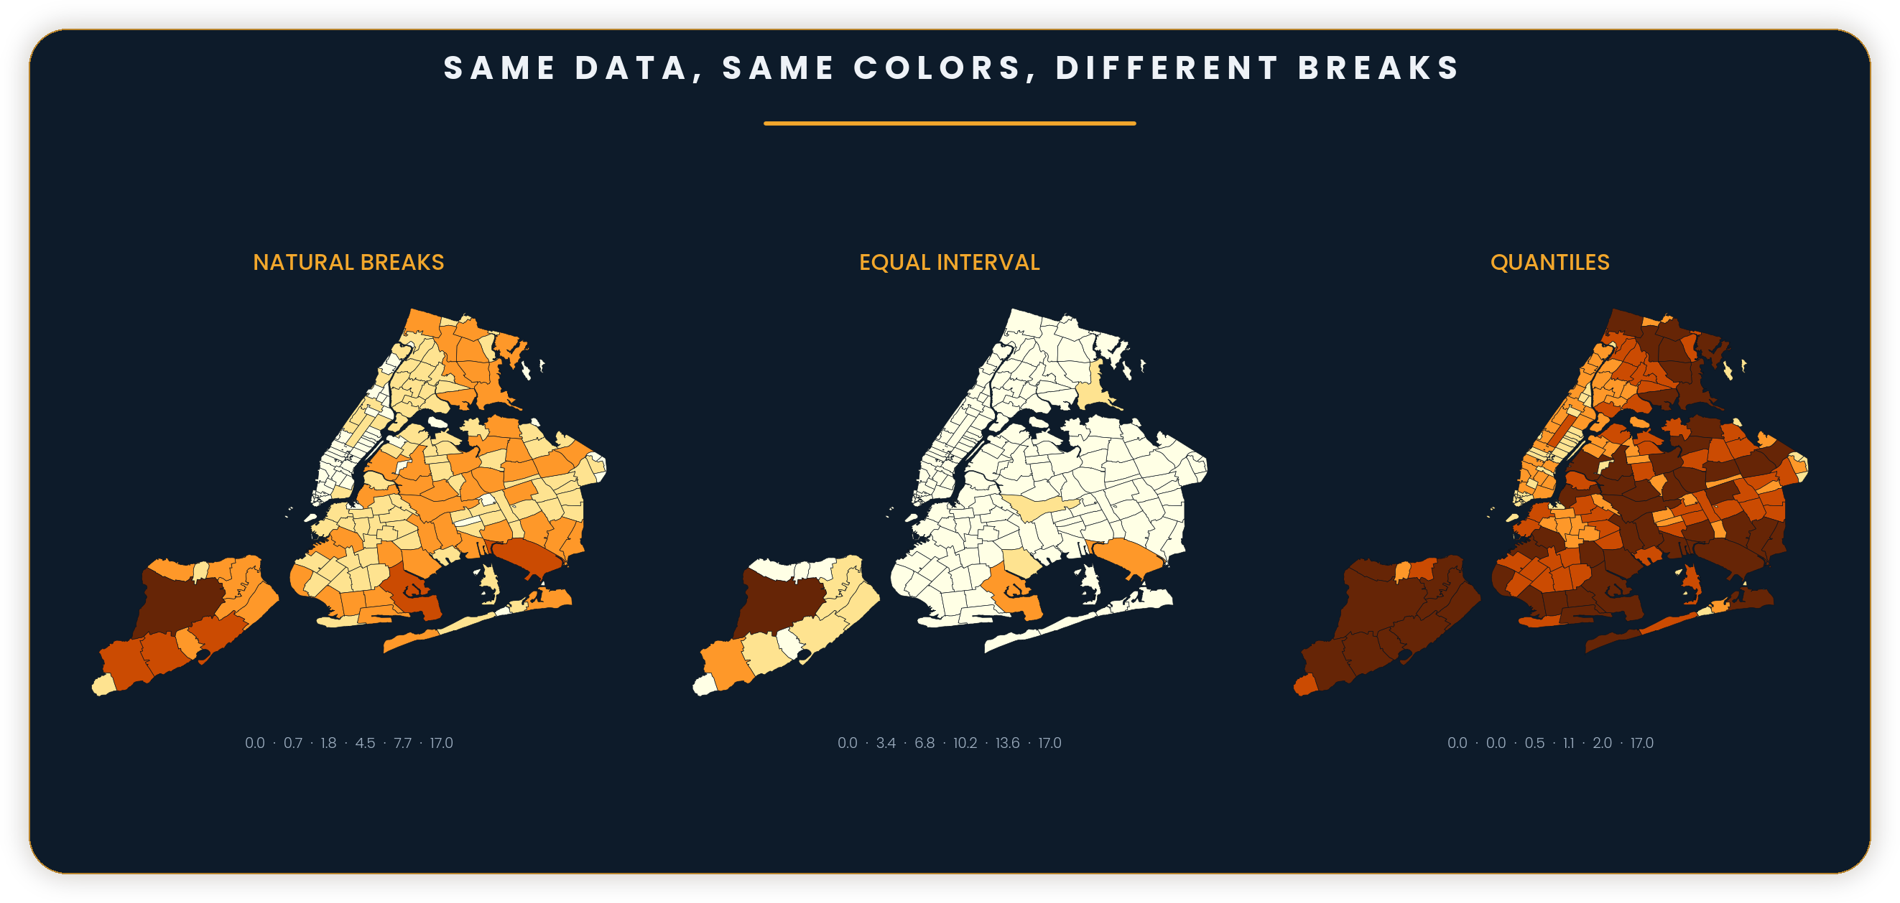
CARTOGRAPHIC PRINCIPLES
SECTION 07 · DESIGNING RESPONSIBLY
MAUP & Cherry-Picked Breaks
Where the class boundaries fall is a choice, not a neutral fact — the same values, the same colors, can be made to tell different stories.
The same discipline applies to raw counts vs. normalized rates (see Power of Maps' Choropleth Mapping) and to choosing breaks that flatter an argument (see Politics & Ethics of Mapping). For the classification methods themselves, see the companion Map Classification deck.
22 / 36

Slide 23
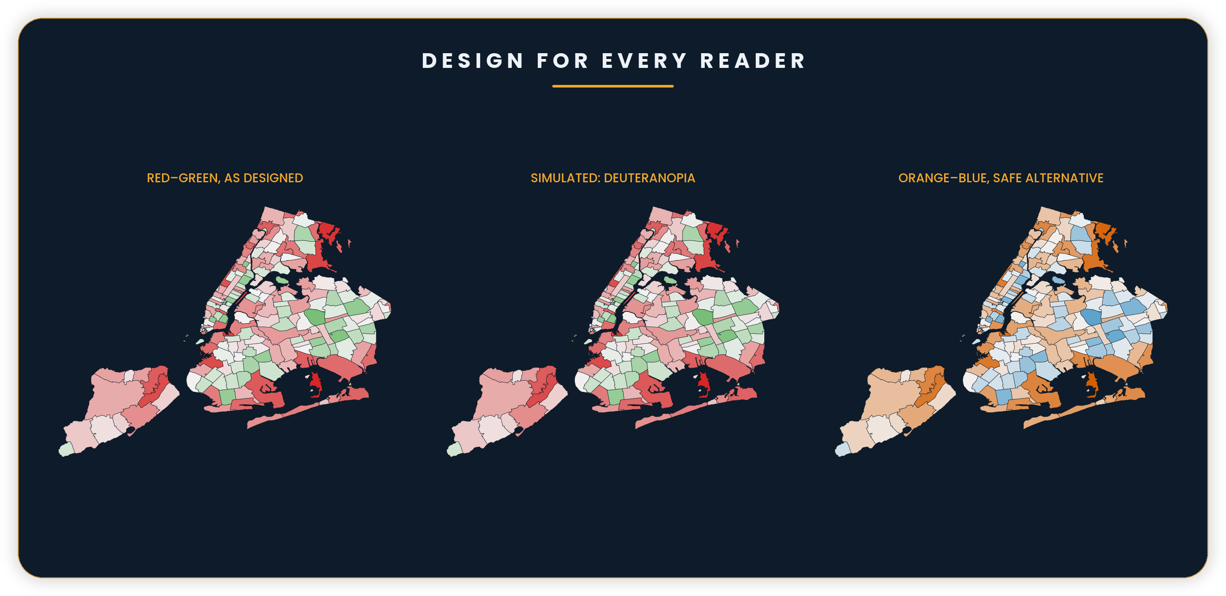
CARTOGRAPHIC PRINCIPLES
SECTION 07 · DESIGNING RESPONSIBLY
Design for Every Reader
About 8% of men have some form of color vision deficiency — simulate before you ship.
23 / 36

Slide 24
CARTOGRAPHIC PRINCIPLES
SECTION 07 · DESIGNING RESPONSIBLY
Output Context
Design for the medium the map will actually be viewed in — not the one it was designed on.
PRINT
SCREEN / WEB
PROJECTOR / SLIDES
Highest resolution requirement (300 DPI+). Colors shift under ink (CMYK) vs. screen (RGB) — proof before a large run.
Lower DPI is fine, but expect variable screen brightness and color calibration — keep contrast generous.
Often the worst-lit, lowest-contrast environment of the three. Bump text size and contrast well beyond what looks necessary on your own monitor.
The same export can't always serve all three well — this is exactly why ArcGIS Pro separates file type, resolution, and dimensions as independent export settings, coming up next.
24 / 36

Slide 25





CARTOGRAPHIC PRINCIPLES
SECTION 08 · FROM MAP TO LAYOUT & EXPORT
Layout Basics
ArcGIS Pro
A layout is a page you can print or share. A map frame is a window into a map.
Map
Insert
Analysis
View
Share
WHERE IN THE MENU
New Layout
Map Frame
North Arrow
Scale Bar
Legend
Insert ▸ New Layout ▸ Map Frame
Catalog pane ▸ Layouts (store + rename pages)
Layouts
Layout Elements
PATH
Insert ▸ New Layout ▸ Map Frame
Legend
Map Title Goes Here
25 / 36

Slide 26



CARTOGRAPHIC PRINCIPLES
SECTION 08 · FROM MAP TO LAYOUT & EXPORT
Activate & Navigate
the Map Frame
ArcGIS Pro
Map
Insert
Analysis
View
Share
Inserting a map frame drops in a snapshot. Activating it lets you pan and zoom inside — before anything exports.
Explore
Pan
Zoom In
Zoom Out
Navigate
HOW TO ACTIVATE
◈ ACTIVATED — drag/scroll pans & zooms this frame only
Double-click the map frame (or select it, then Layout tab ▸ Map Frame ▸ Activate). Its border switches to a dashed outline.
WHILE ACTIVE
Pan and zoom like Map view — only this frame changes, not the source map.
Legend
EXIT ACTIVATION
Map Title Goes Here
Click Close Activation on the contextual tab, or double-click outside the frame, to resume arranging elements.
26 / 36

Slide 27




CARTOGRAPHIC PRINCIPLES
SECTION 08 · FROM MAP TO LAYOUT & EXPORT
Essential Layout
Elements
ArcGIS Pro
Map
Insert
Analysis
View
Share
Each is its own movable element, bound to a map frame.
New Layout
North Arrow
Scale Bar
Legend
Text
WHERE IN THE MENU
Insert ▸ Legend / Scale Bar / North Arrow / Text
Layouts
Layout Elements
Legend
City
N
Tribe
Boundary
0 5 10 mi
Map Title Goes Here
27 / 36

Slide 28
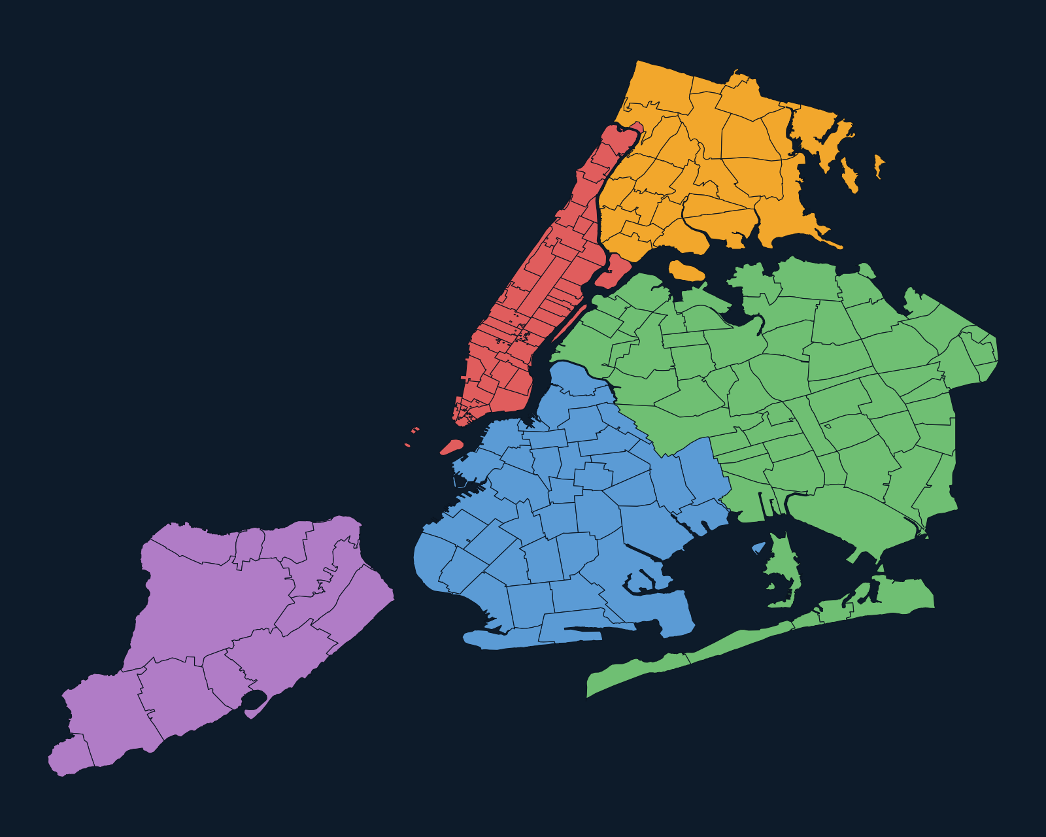
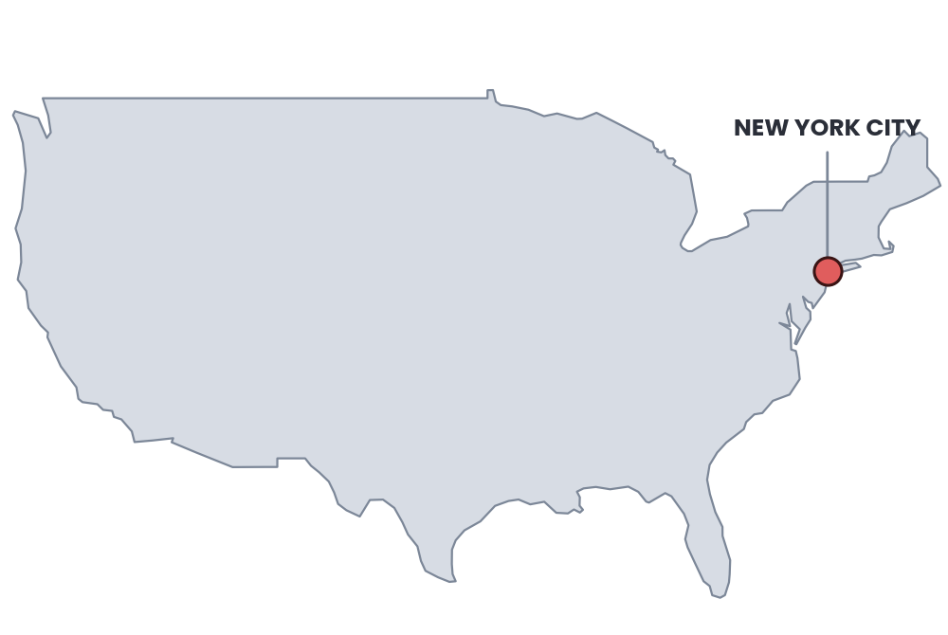
CARTOGRAPHIC PRINCIPLES
SECTION 08 · FROM MAP TO LAYOUT & EXPORT
A Full Layout,
Assembled
ArcGIS Pro
Map
Insert
Analysis
View
Share
Every element from this section, on one real sheet — including an inset, which only makes sense once there's real content to locate.
North Arrow
Scale Bar
Legend
Map Frame
THE INSET
A small locator map dropped into its own frame — here, showing where NYC sits within the U.S. — gives viewers context a single close-up view can't.
Layout Elements
LOCATOR: NYC IN THE U.S.
SAME MAP, THROUGHOUT
Legend
The main frame reuses the five-borough NYC map from earlier in this deck, now carrying a title, legend, north arrow, and scale bar.
Manhattan
N
Brooklyn
Queens
Bronx
0 5 10 mi
Cartographic Principles — Five Boroughs
28 / 36

Slide 29



CARTOGRAPHIC PRINCIPLES
SECTION 08 · FROM MAP TO LAYOUT & EXPORT
Aligning & Arranging
ArcGIS Pro
Map
Insert
Layout
Share
Layout tab ▸ Align / Distribute / Guides / Grids.
SMART GUIDES
Align
Distribute
Group
Guides
Grids
Pink alignment guides snap element edges and centers to each other as you drag — no ruler math needed.
Arrange
Show
Legend
City
N
Tribe
Boundary
0 5 10 mi
Map Title Goes Here
29 / 36

Slide 30
CARTOGRAPHIC PRINCIPLES
SECTION 08 · FROM MAP TO LAYOUT & EXPORT
Create a Layout: The Workflow
Map first → layout → export. Six steps, in order, every time.
1
Finish symbology + labeling in Map view
2
Insert a New Layout (choose paper size + orientation)
3
Insert a Map Frame (pick the map you want)
4
Activate the map frame to pan/zoom the map inside it
5
Add layout elements (legend, north arrow, scale bar, text) + align them
6
Export — PDF for print, PNG/JPG for slides or web
30 / 36

Slide 31


CARTOGRAPHIC PRINCIPLES
SECTION 08 · FROM MAP TO LAYOUT & EXPORT
Share & Export
ArcGIS Pro
Export Map (Map view) skips the legend & scale bar. Export Layout keeps them.
Analysis
View
Imagery
Share
Help
WHERE IN THE MENU
Print Layout
Task Layout
Export Layout
Capture To Clipboard
Share ▸ Export Layout / Export Map
Presets give you a fast start for common outputs.
Save As
Share As
AIX
PDF
PDF
Default AIX
Flattened PDF
GeoRef PDF
TIFF
PDF
JPEG
GeoTIFF
Vector PDF
Web JPEG
31 / 36

Slide 32
CARTOGRAPHIC PRINCIPLES
SECTION 08 · FROM MAP TO LAYOUT & EXPORT
Export Formats
Export Layout
WATCH OUT
You control file type, resolution, and output settings independently.
FILE TYPE
• Low DPI = blurry text on print
PDF
▾
RESOLUTION (DPI)
• Export Map ≠ Export Layout — Map skips the legend & scale bar
300
PDF
Printing + reports.
Vector-crisp text at any size.
WIDTH x HEIGHT
3300 x 2550 px
• Clip to graphics extent can unexpectedly crop content
CLIP TO GRAPHICS EXTENT
PNG
Off
Slides / web.
Lossless, supports transparency.
TIFF
Publication-quality images.
Large files, archival.
Export
32 / 36

Slide 33
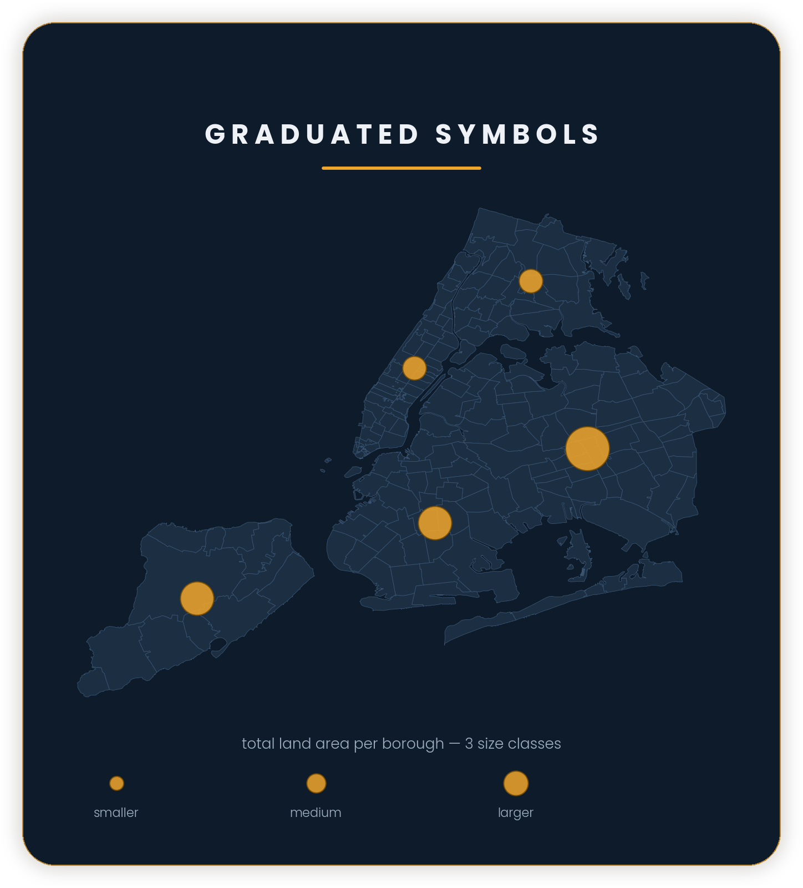
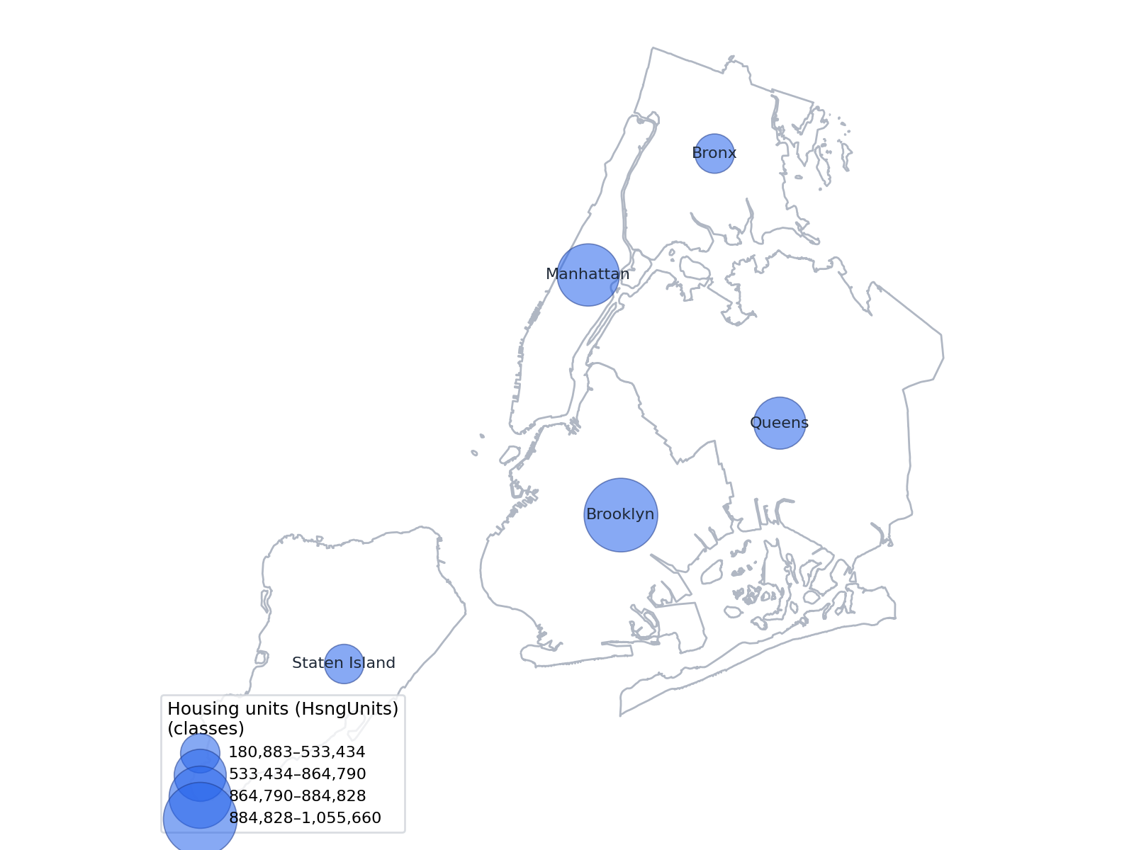
CARTOGRAPHIC PRINCIPLES
SECTION 09 · BRINGING IT TOGETHER
Case Study: Before & After
Same data, same technique (Graduated Symbols) — applying these principles end to end.
AFTER
BEFORE
33 / 36

Slide 34
CARTOGRAPHIC PRINCIPLES
SECTION 09 · BRINGING IT TOGETHER
Knowledge Check
Q1
What's the real difference between a reference map and a thematic map?
A reference map shows where things are (accuracy first); a thematic map shows a pattern in data (one clear message first).
▸ Click to reveal answer
Q2
Why does Web Mercator make Greenland look about the same size as Africa?
Mercator preserves shape and direction but distorts area — and that distortion grows toward the poles, inflating high-latitude landmasses like Greenland.
▸ Click to reveal answer
Q3
True or False: raw population counts by region are usually a good choropleth variable.
False — raw counts mostly just show where the land area (or base population) is largest; use a normalized rate instead (e.g., people per sq. mi.).
▸ Click to reveal answer
Q4
In ArcGIS Pro, what's the difference between Export Map and Export Layout?
Export Map (from Map view) exports just the map data — no legend, scale bar, or title. Export Layout exports the full designed page.
▸ Click to reveal answer
34 / 36

Slide 35
CARTOGRAPHIC PRINCIPLES
SECTION 09 · BRINGING IT TOGETHER
Principles Checklist
The short version — worth pinning above your desk.
✓
Know the map's purpose and audience before anything else
✓
Pick a projection on purpose, not by default
✓
Separate figure from ground — give the data visual priority
✓
Generalize geometry to match the map's actual scale
✓
Match the visual variable to the data type (ordered vs. categorical)
✓
Design for colorblind readers by default, not as an afterthought
✓
Normalize choropleth data — rates, not raw counts
✓
Proof the export at the resolution and medium it will actually be viewed in
35 / 36
Companion deck: Symbology & Map Classification

Slide 36
CARTOGRAPHIC PRINCIPLES
SECTION 09 · BRINGING IT TOGETHER
Further Reading: Real-World Galleries
For more inspiration once the fundamentals are second nature — curated by real cartographers and institutions, not built for this deck.
Tufts GIS Poster Expo Gallery
NACIS Atlas of Design
ICA Commission on Map Design
Student cartography posters spanning choropleth design, 3D terrain, and more, from Tufts' GIS course sequence.
A biennial, juried showcase of the year's best cartography, published by the North American Cartographic Information Society.
Ongoing map-design research and experiments from the International Cartographic Association.
These galleries feature copyrighted work by individual cartographers and institutions — browse and enjoy, but ask before reusing any of the images themselves.
Sources
Tufts GIS Poster Expo Gallery — sites.tufts.edu/gis/2018-gis-poster-expo-gallery
NACIS Atlas of Design — atlasofdesign.org
ICA Commission on Map Design — mapdesign.icaci.org
36 / 36

