Slide 1
Power of Maps
& Map Types
Power of Maps • Map Types
JUMP TO A SECTION
01 Power of Maps
02 Map Types
01/59

Slide 2
Table of Contents
Two sections, each broken into its own sub-topics — click any of them to jump straight there
SECTION 01 · POWER OF MAPS
SECTION 02 · MAP TYPES
›
Course Materials & Resources
›
Types of Maps
›
Learning Objectives
›
Reference Maps
›
What Is Cartography?
›
Thematic Maps
›
The Power of Maps
›
Pragmatic Maps
›
Visualization vs. Communication
›
Persuasive Maps
›
Communicating with Maps
›
Mapping Techniques
›
Interactive Maps
›
Recap & What's Next
02/59

Slide 3
SECTION 01
Power of Maps
The same data can tell very different stories, depending on how it's mapped
PROJECTION
COLOR
FRAMING
Every flattening of the globe distorts something.
Palette choice shapes the emotional read of the data.
What's included — and excluded — sets the narrative.
03/59

Slide 4
Course Materials & Resources
Recommended reading
Thematic Cartography and Geovisualization (4th ed.)
1
Slocum, McMaster, Kessler & Howard (2023)
Core text — 3rd edition available at the campus library
Making Effective Maps: Cartographic Visualization for GIS
2
Sarah Schlosser — Open Access
https://colorado.pressbooks.pub/makingmaps/
How Charts Lie
3
Alberto Cairo (2019)
Readable exploration of how visualizations mislead — highly recommended
04/59

Slide 5
Learning Objectives
By the end of this lecture, you will be able to…
Define cartography and distinguish cartographic visualization from communication
1
Identify and compare the major types of maps and their intended purposes
2
Apply the five-step framework for designing a map that communicates effectively
3
Select an appropriate mapping technique for a given dataset and analytical purpose
4
Critically evaluate how design choices in maps can reinforce or distort spatial data
5
05/59

Slide 6
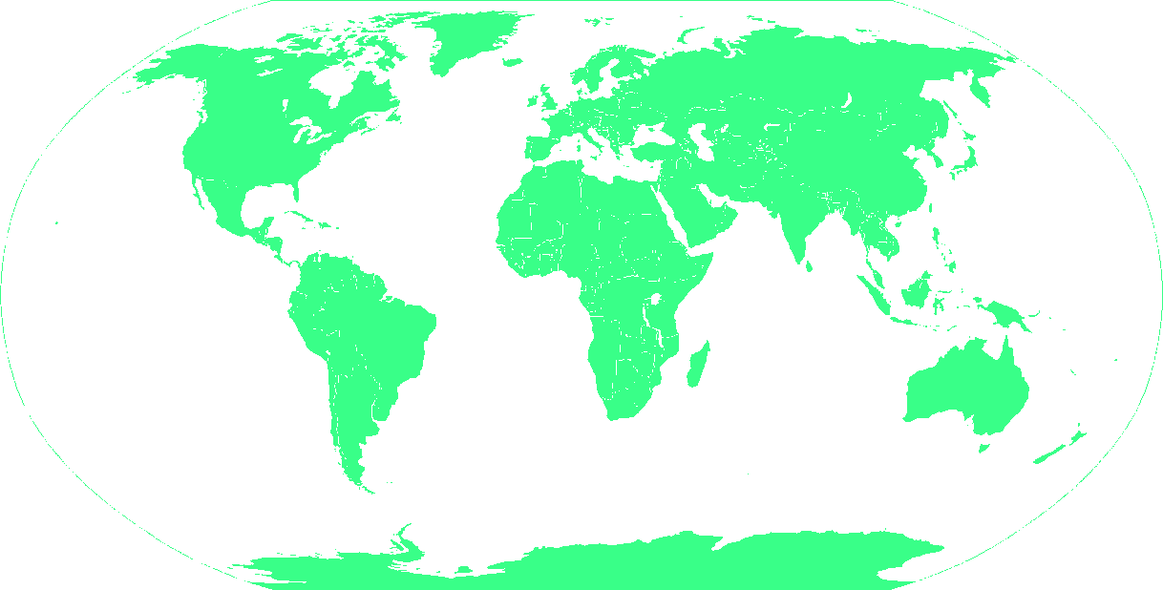
What Is Cartography?
Art + Science + Communication
Cartography is the discipline of designing, producing, and studying maps as tools for recording, visualizing, and communicating spatial information.
Science
Accurate spatial data, coordinate systems, projections
“A map is not a mirror of reality — it is an argument about what matters.”
Art
Visual design, color theory, cognitive clarity
Communication
Mark Monmonier, How to Lie with Maps
Audience, purpose, and message
06/59

Slide 7
The Power of Maps
The same data — very different stories
How a map is designed shapes how we understand — and feel about — the world it depicts.
📊
Scale & Projection
🎨
Color Choice
Mercator vs. equal-area projections change perceived country sizes dramatically
A diverging red-blue palette implies conflict; green-yellow suggests an environmental gradient
📍
What's Included
🔢
Data Classification
Labeling only some cities or omitting borders frames political narratives
Choosing 3 vs. 7 class breaks can make inequality look trivial or extreme
07/59

Slide 8
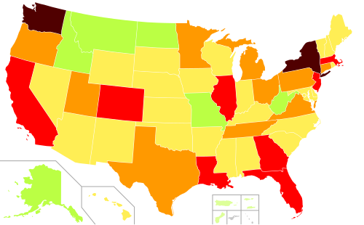
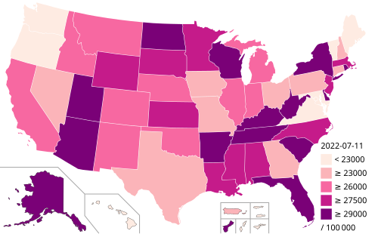
The Power of Maps — Same Data, Different Picture
COVID-19 Case Mapping
Mapping COVID-19 cases by raw count vs. per-capita rate tells completely different stories about where the outbreak hit hardest.
Raw Count by State
Cases per 100,000 People
7-class rainbow color scheme, equal intervals
5-class sequential scheme, quantile breaks
Populous states (CA, TX, NY) dominate the map
Smaller rural states show the highest per-capita rates
CDC COVID Data Tracker — https://covid.cdc.gov/covid-data-tracker/
Our World in Data — https://ourworldindata.org/coronavirus
08/59

Slide 9
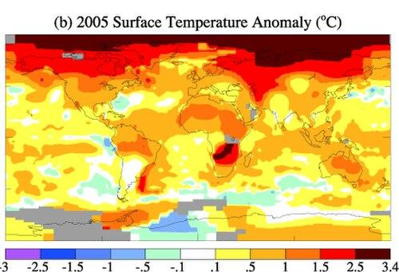
The Power of Maps — Framing Time
Climate Anomaly Maps
A temperature anomaly map doesn’t just show where it’s warm — it forces the viewer to confront change over time.
Source: NASA Earth Observatory — https://earthobservatory.nasa.gov/global-maps
Key insight: the diverging blue→red palette is a rhetorical choice — it emphasizes warming. A monochromatic scheme would feel far less alarming.
09/59

Slide 10
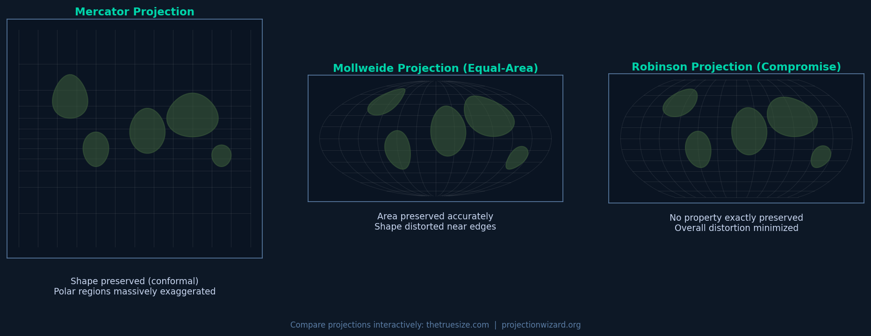
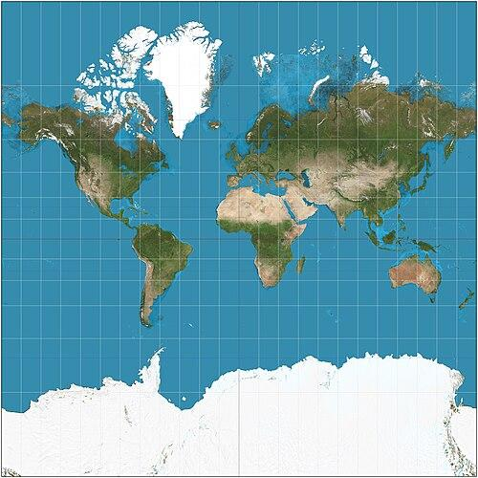
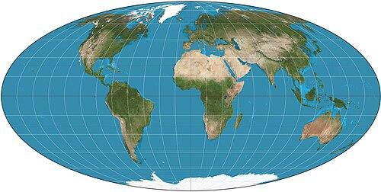
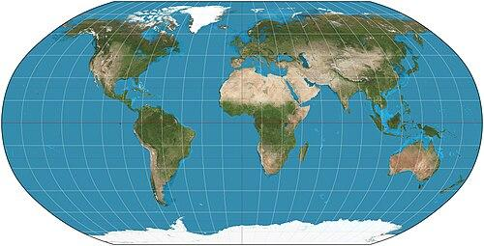
The Power of Maps — Projection Choices
Flattening the world always involves a trade-off
Every flat map distorts reality. Choosing a projection means choosing which distortion to prioritize.
Mercator
Mollweide
(Equal-Area)
Robinson
(Compromise)
[PROJECTION
ILLUSTRATION]
[PROJECTION
ILLUSTRATION]
[PROJECTION
ILLUSTRATION]
Conformal (shape preserved)
Area preserved
No property exactly right
Enormously exaggerates polar regions — Greenland appears the size of Africa
Distorts shape, especially near the edges
Overall distortion minimized — used by National Geographic for decades
10/59
Compare projections interactively: https://www.thetruesize.com/ | https://projectionwizard.org/

Slide 11
Visualization vs. Communication
Two distinct — but related — purposes
🔍
Cartographic
Visualization
📢
Cartographic
Communication
Purpose is exploration — the message is not yet known
Purpose is presentation — a clear message is defined
Used by analysts to detect spatial patterns and anomalies
Designed for a specific audience and context
May be rough, interactive, or iterative
Requires deliberate, polished design choices
Example: exploring disease clusters in a GIS tool
Example: a public health poster showing vaccination rates
Context shapes perception: the Ebbinghaus illusion shows how surrounding elements change how we read the same central object — maps work the same way.
11/59

Slide 12
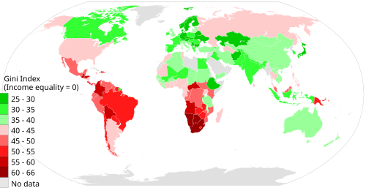
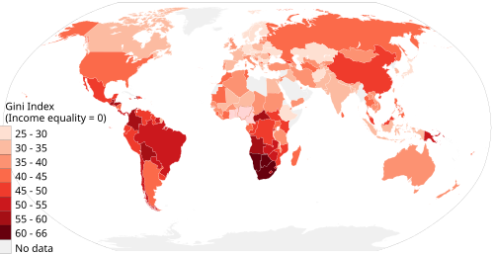
Communicating with Maps
Which map tells the story more clearly?
The same global income inequality data — visualized two ways. Which design choices help, and which obscure?
7-class rainbow scheme, equal-interval breaks
5-class sequential scheme, quantile breaks
[MAP PLACEHOLDER]
[MAP PLACEHOLDER]
✓ Effective — directionality and pattern are clear
12/59
Source: OECD Income Distribution & Poverty — https://stats.oecd.org/Index.aspx?DataSetCode=IDD

Slide 13
5 Steps for Communicating with Maps
A decision framework for effective map design
1
Understand the Phenomenon
What does this spatial pattern represent in the real world?
2
Define Purpose & Audience
Who will use this map, and what decision should it support?
3
Collect Appropriate Data
Match data type, resolution, and source to the map’s purpose
4
Design & Construct
Choose symbols, colors, projection, and layout deliberately
5
Evaluate Effectiveness
Test with real users — does the map communicate what you intended?
13/59

Slide 14
Communicating with Maps — Case Study
Air Quality in Los Angeles: applying the 5 steps
Phenomenon
Daily Air Quality Index (AQI) readings at monitoring stations across LA County
Purpose
Alert residents to unhealthy zones — public health communication
Data
EPA AirNow hourly AQI, interpolated across the county using kriging
Design
Sequential yellow→red palette with clear health-risk labels and a legend
Evaluation
User testing: residents correctly identified risk zones within 5 seconds
14/59
Source: EPA AirNow — https://www.airnow.gov/ | AQMD — https://www.aqmd.gov/

Slide 15
SECTION 02
Map Types
A working taxonomy for choosing the right map for the job
REFERENCE
THEMATIC
TECHNIQUE
Where things are — roads, borders, terrain.
A pattern or variable expressed across space.
Choropleth, isarithmic, proportional & more.
15/59

Slide 16
Types of Maps
A taxonomy — but not a rigid one
📍
Reference Maps
Show where things are — roads, rivers, buildings, political borders
📊
Thematic Maps
Show a particular topic or spatial pattern across geographic space
🚇
Pragmatic Maps
Optimize for navigation or practical use over geographic accuracy
📣
Persuasive Maps
Designed to influence beliefs or emotions, often through distortion
Note: in practice, most real-world maps combine elements from multiple categories.
16/59

Slide 17
Reference Maps
What’s there, and where?
Reference maps record the locations of natural and human-made features without imposing an analytical argument. Emphasis is on completeness, accuracy, and currency.
Physical features
Human-made features
Mountains, rivers, coastlines, lakes, forests
Roads, railways, buildings, political boundaries, cities
Reference elements
Critical for
Latitude/longitude graticule, scale bar, north arrow
Military operations, emergency response, urban planning, navigation
17/59
Example: USGS National Map Viewer — https://apps.nationalmap.gov/viewer/

Slide 18
Reference Maps — Examples
Topographic and base maps in practice
USGS 7.5-Minute Topographic Quadrangles
1
Show elevation contours, rivers, trails, and place names. Used by hikers, surveyors, and engineers.
https://apps.nationalmap.gov/viewer/
OpenStreetMap
2
Community-built reference map covering roads, buildings, land use, and more — free and global.
https://www.openstreetmap.org/
Google Maps (Base Layer)
3
Combines satellite imagery with roads, transit, labels, and landmarks — the world’s most-used reference map.
https://maps.google.com/
18/59

Slide 19
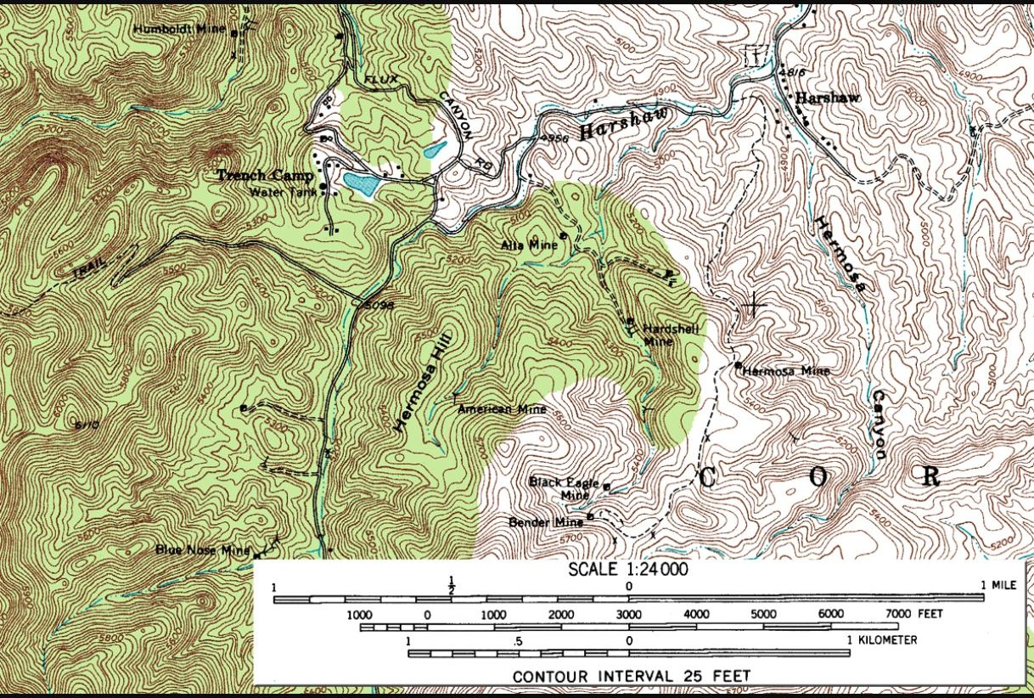
USGS Topographic Quadrangle
Elevation, contours, and trails at 1:24,000 scale
USGS 7.5-minute quadrangles are the classic American topographic reference map — contour lines trace elevation, blue lines trace water, and black lines trace trails and roads.
SHOWN HERE
Harshaw Quadrangle, Santa Cruz County, Arizona (1958 edition)
CONTOUR INTERVAL
25 feet — each line is a step in elevation
STILL LIVE TODAY
apps.nationalmap.gov/viewer/ serves the modern digital US Topo series
Image: USGS, public domain, via Wikimedia Commons
19/59

Slide 20
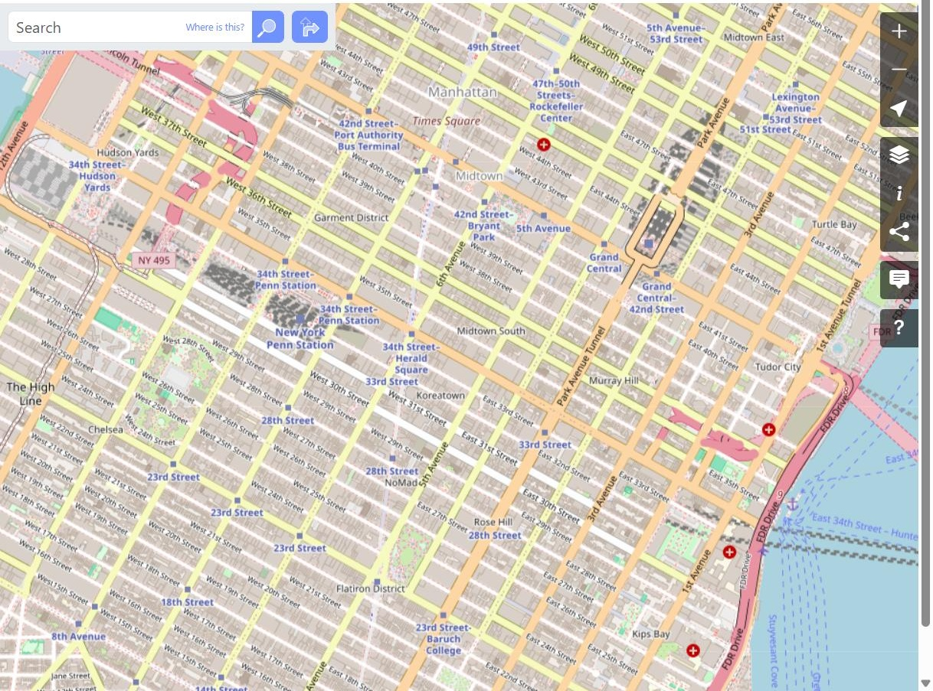
OpenStreetMap
A reference map built by its own users
OpenStreetMap is edited by a global community of volunteers — every road, building, and footpath is contributed and verified by people, then released back to everyone.
SHOWN HERE
Midtown Manhattan — the standard OSM “Carto” tile layer
LICENSE
Open Database License (ODbL) — free to reuse and adapt, with attribution
POWERS
Countless apps and sites, from Wikipedia infoboxes to transit trackers
Image: © OpenStreetMap contributors, ODbL
20/59

Slide 21
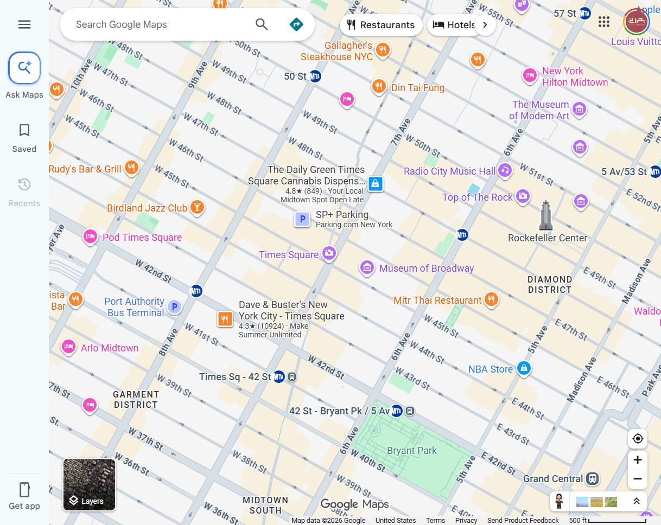
Google Maps (Base Layer)
The world's most-used reference map
Google Maps layers road networks, transit lines, business listings, and satellite imagery into one continuously-updated base map used by billions of people every month.
SHOWN HERE
Midtown Manhattan — standard roadmap view with live business labels
BUILT FROM
Licensed imagery/data plus Google's own mapping and user contributions
USE NOTE
Reuse is permitted for educational purposes with Google's attribution kept intact
Map data ©2026 Google — used per Google's Geo Guidelines
21/59

Slide 22
Thematic Maps
Showing the pattern, not just the place
Thematic maps depict a specific topic to reveal spatial patterns, distributions, and relationships.
💰
GDP per capita by country (World Bank 2023)
🌡
Global average temperature anomalies (NOAA)
https://data.worldbank.org/indicator/NY.GDP.PCAP.CD
https://www.climate.gov/maps-data
🦥
Malaria incidence rate by district (WHO 2023)
🌾
Global wheat production by country (FAO STAT)
https://www.who.int/teams/global-malaria-programme
https://www.fao.org/faostat/
🗳
Voter turnout by county — US 2020 election
🌍
Human Development Index by country (UNDP 2023)
https://electionlab.mit.edu/
https://hdr.undp.org/
22/59

Slide 23
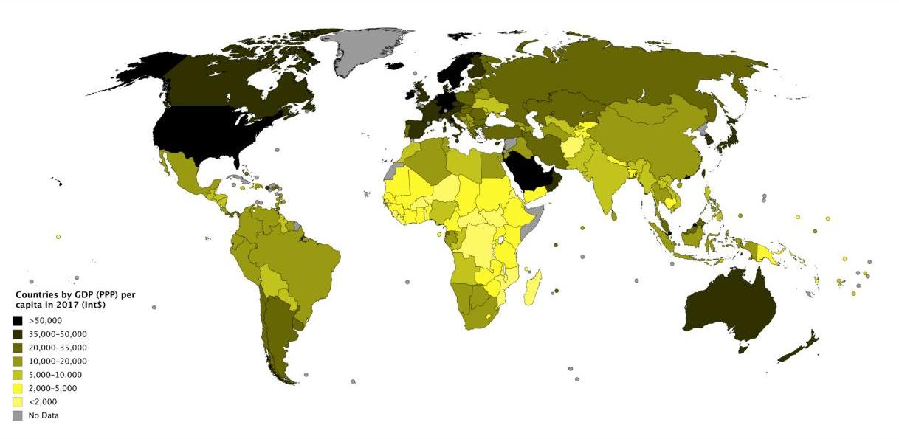
GDP per Capita by Country
A Choropleth of Global Wealth
Shading every country by its economic output per person turns a table of GDP figures into an instantly readable pattern of relative wealth.
SHOWN HERE
Countries by GDP (PPP) per capita, 2017 — IMF World Economic Outlook Database
PATTERN REVEALED
A sharp gradient: North America, Europe, the Gulf states, and East Asia sit far above most of Africa, South Asia, and Central America
SAME METRIC AS
The World Bank GDP-per-capita indicator this slide links to
Image: JackintheBox, CC BY-SA 4.0, via Wikimedia Commons
23/59

Slide 24
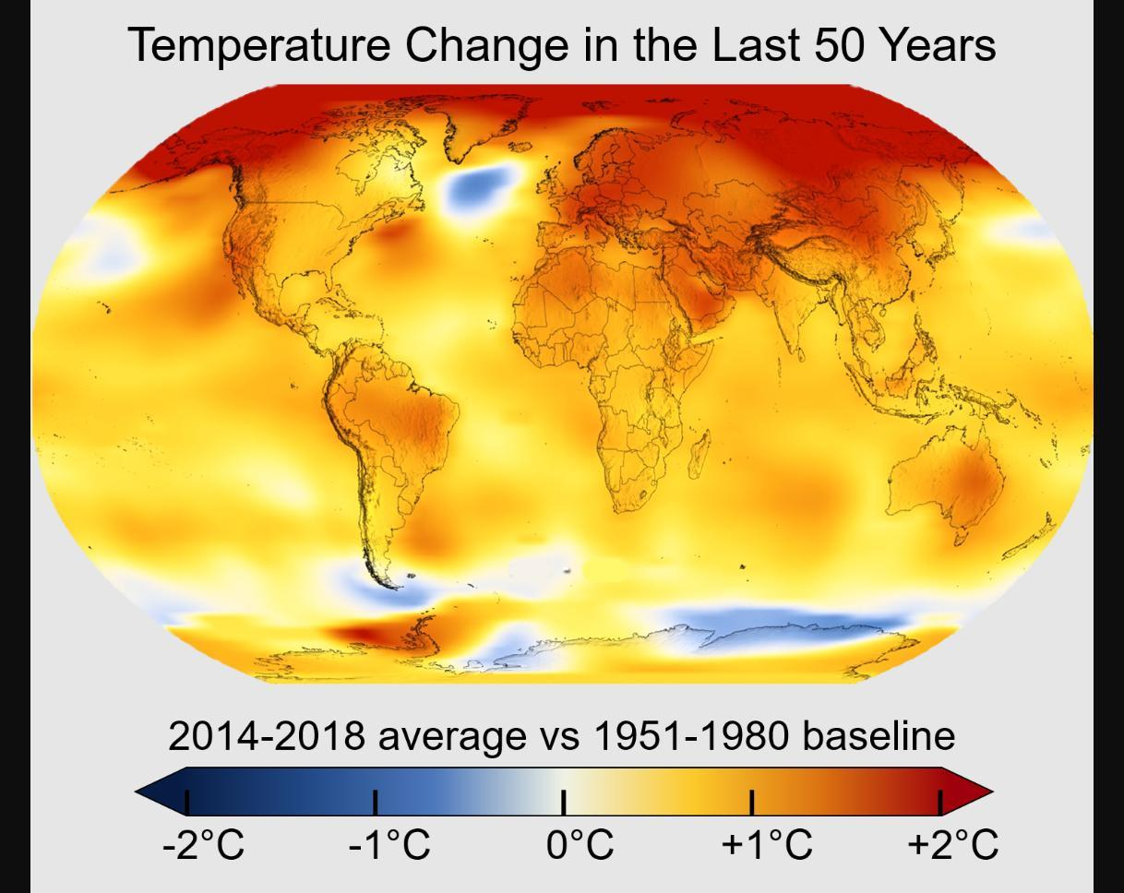
Global Temperature Anomalies
Warming Mapped Against a Fixed Baseline
Comparing recent average temperatures to a 20th-century baseline turns a single global-average number into a map of where warming is actually concentrated.
SHOWN HERE
Temperature change over the last 50 years — 2014-2018 average vs. the 1951-1980 baseline
PATTERN REVEALED
Warming concentrates at high northern latitudes (Arctic, Siberia); a few ocean pockets barely changed or cooled slightly
SAME IDEA AS
The NOAA climate.gov maps and data this slide links to
Image: NASA's Scientific Visualization Studio, public domain, via Wikimedia Commons
24/59

Slide 25
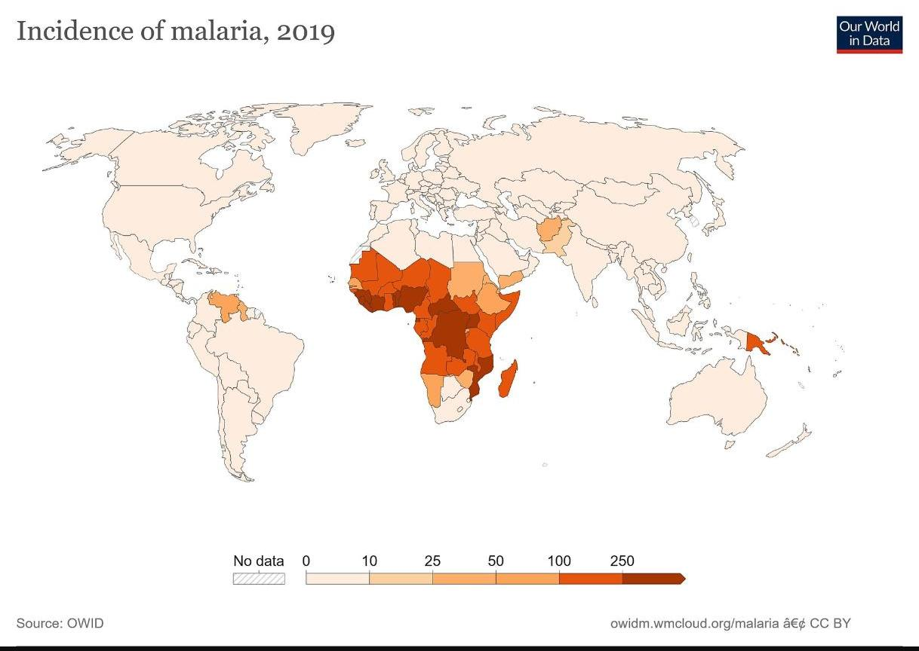
Malaria Incidence by Country
A Public-Health Burden, Mapped
Shading each country by incidence rate turns WHO surveillance data into an immediate picture of where malaria's burden actually falls.
SHOWN HERE
Incidence of malaria per 1,000 population at risk, 2019 — Our World in Data, sourced from the WHO
PATTERN REVEALED
The overwhelming share of cases cluster across Sub-Saharan Africa, with only scattered pockets elsewhere
SAME SOURCE AS
The WHO Global Malaria Programme this slide links to
Image: Our World in Data, CC BY 4.0, via Wikimedia Commons
25/59

Slide 26
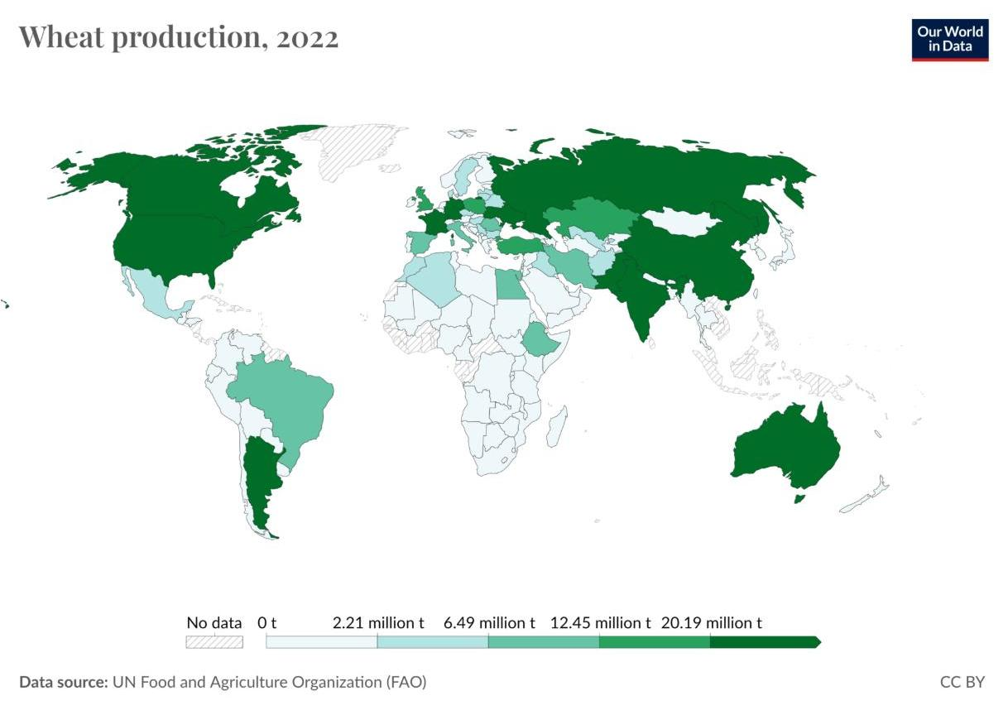
Global Wheat Production
Where the World's Grain Comes From
A production choropleth compresses a year of harvest tonnage, country by country, into one map of the world's breadbaskets.
SHOWN HERE
Wheat production by country, 2022 — UN Food and Agriculture Organization data
PATTERN REVEALED
China, India, Russia, the US, and the EU dominate output; production falls off sharply outside temperate grain-belt regions
SAME DATASET AS
The FAOSTAT database this slide links to
Image: Our World in Data, CC BY 4.0, via Wikimedia Commons
26/59

Slide 27
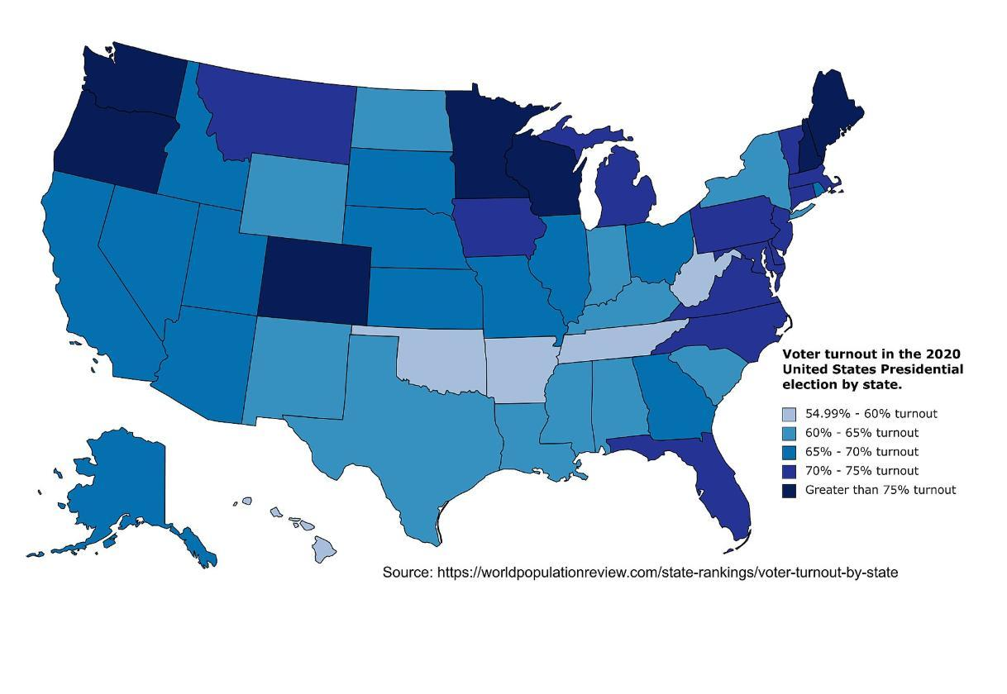
Voter Turnout — 2020 US Election
State-Level Participation, Mapped
Turnout choropleths reveal which states voted at the highest rates — a pattern a raw table of percentages doesn't show at a glance.
SHOWN HERE
Share of eligible voters who cast a ballot in the 2020 US presidential election, by state
A NOTE ON SOURCE
No open-licensed county map exists; this state-level view uses the same kind of turnout data as the MIT Election Lab link above
PATTERN REVEALED
Turnout topped 75% in Minnesota, Colorado, and several New England states, while parts of the South stayed closer to 55-60%
Image: Mr. Banana Fana Fo Filly, CC BY-SA 4.0, via Wikimedia Commons
27/59

Slide 28
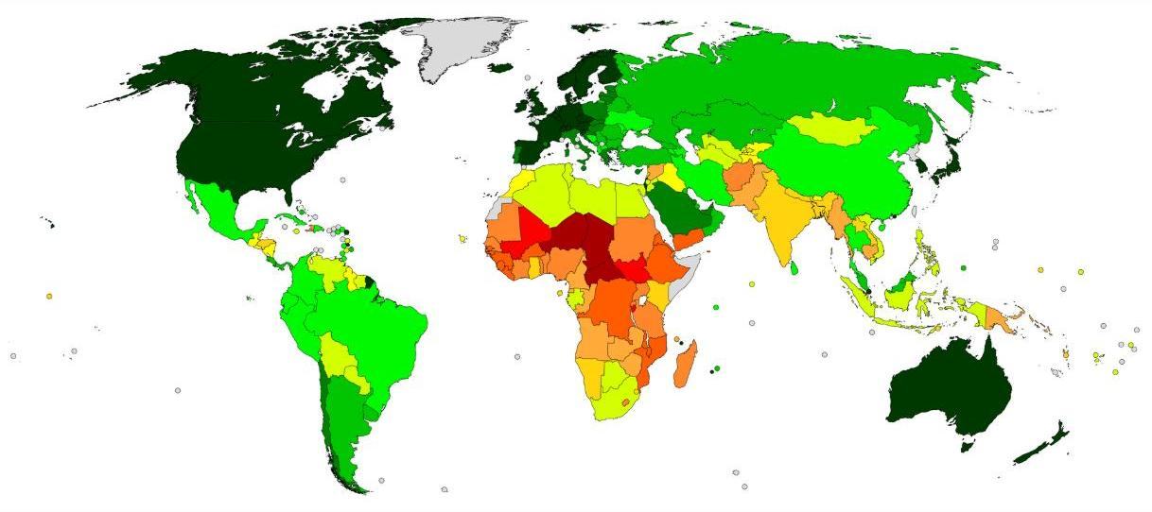
Human Development Index
Well-Being as a Single Composite Map
HDI blends life expectancy, education, and income into one score per country, then shades the map from deep red (lowest) to dark green (highest).
SHOWN HERE
Countries by Human Development Index, 2021
PATTERN REVEALED
Highest band: North America, Europe, East Asia, Oceania. Lowest band: the Sahel and parts of Central Africa
SAME SOURCE AS
The UNDP Human Development Reports this slide links to
Image: Allice Hunter and JackintheBox, CC BY-SA 4.0, via Wikimedia Commons
28/59

Slide 29
Pragmatic Maps
Designed for utility, not geographic accuracy
Pragmatic maps prioritize usability and navigability over geographic fidelity. They deliberately warp space to make complex systems legible.
Transit / Subway Map
Straightens curves, adjusts station spacing — optimized for understanding connections, not distance
NYC MTA Subway Map
https://new.mta.info/map/5256
Indoor / Wayfinding Map
Schematic layout of gates, services, and paths — not to scale, but instantly navigable
Airport Terminal Layout
Campus Map
Highlights buildings, services, parking — adjusted to fit print without precise distances
University Campus Brochure Map
29/59

Slide 30
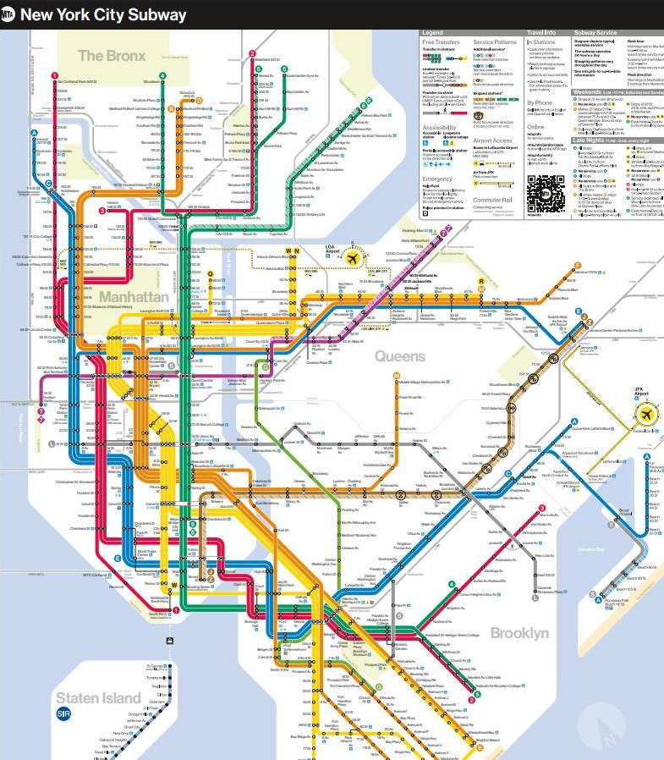
Transit / Subway Map
NYC MTA Subway Map
Subway diagrams abandon true geography almost entirely — lines are straightened and stations evenly spaced so riders can read connections at a glance.
SHOWN HERE
The official MTA system map — every subway line, transfer point, and accessibility icon across the five boroughs
WHAT'S WARPED
Real curves and true distances are dropped; lines run as straight or gently-angled paths regardless of the track's actual shape
USE NOTE
Reproduced here for educational, non-commercial commentary; map © Metropolitan Transportation Authority
30/59
Source: Metropolitan Transportation Authority (MTA)

Slide 31
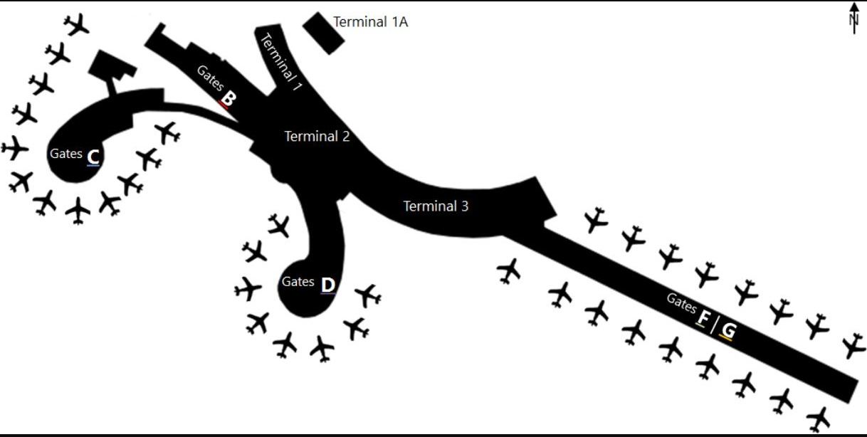
Indoor / Wayfinding Map
Airport Terminal Layout
Airport terminal maps abandon geographic accuracy almost entirely — concourses are drawn as straight or gently curved ribbons so travelers can instantly see which gate cluster to walk toward.
SHOWN HERE
Vienna International Airport — check-in and gate areas by terminal and pier
WHAT'S WARPED
Physical distances and building shapes are simplified into schematic ribbons — real terminals are rarely this tidy
SAME LOGIC AS
Hospital wayfinding maps, mall directories, and theme-park guide maps
Image: Domser, CC BY-SA 3.0, via Wikimedia Commons
31/59

Slide 32
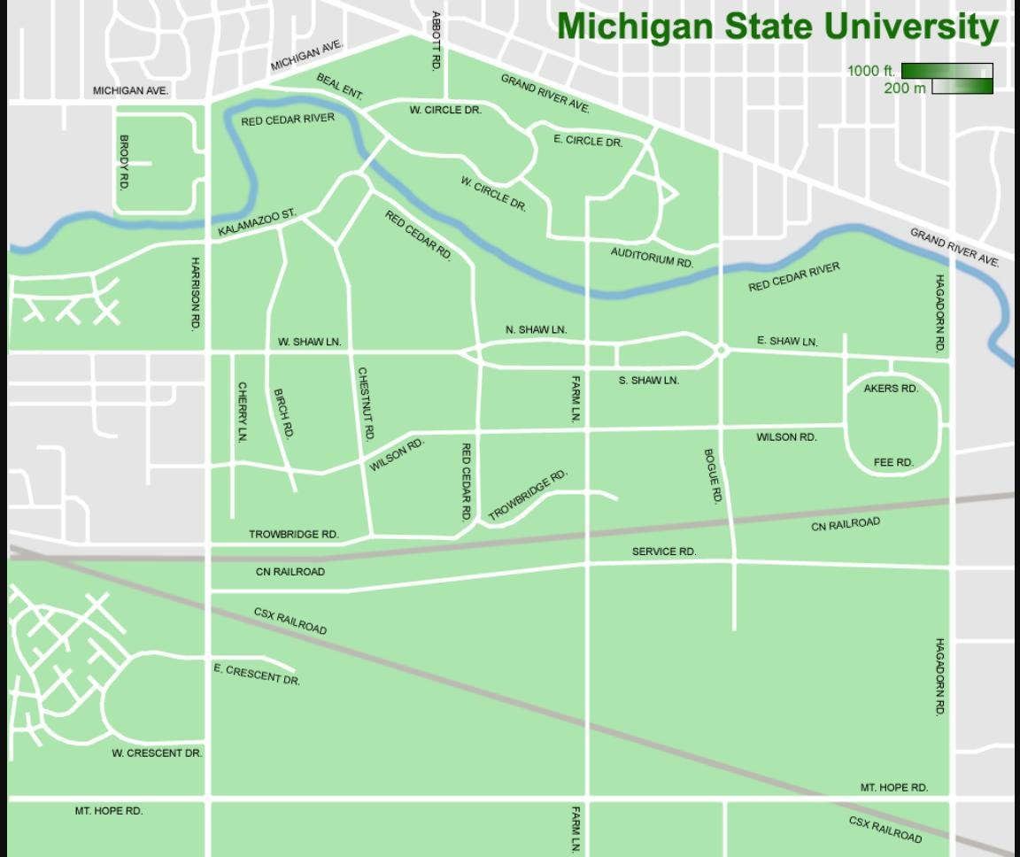
Campus Map
University Campus Brochure Map
A campus map trades surveying precision for legibility — buildings and paths are simplified and only the features a visitor needs — buildings, parking, roads — are kept.
SHOWN HERE
Michigan State University — campus roads, the Red Cedar River, and grounds
DESIGNED FOR
First-time visitors and new students getting from a parking lot to a specific building, fast
COMMON FEATURES
Building-name labels, a simplified street grid, and a scale bar sized for a printed handout
Image: Shadowlink1014, CC BY-SA 3.0, via Wikimedia Commons
32/59

Slide 33
Persuasive Maps
When maps are arguments, not records
Persuasive maps are crafted to influence beliefs, fears, or political views — often through selective inclusion, exaggeration, or misleading symbology.
Distorted Size
Selective Labeling
Showing one country looming over neighbors to imply territorial threat
Naming disputed territories with one side’s preferred place names
Color Psychology
Omission
Enemy territory in red, friendly territory in green — instantly biasing the viewer
Leaving out civilian infrastructure to make air campaigns appear more ‘surgical’ than they were
33/59
Cornell Persuasive Cartography Collection: https://persuasivemaps.library.cornell.edu/

Slide 34
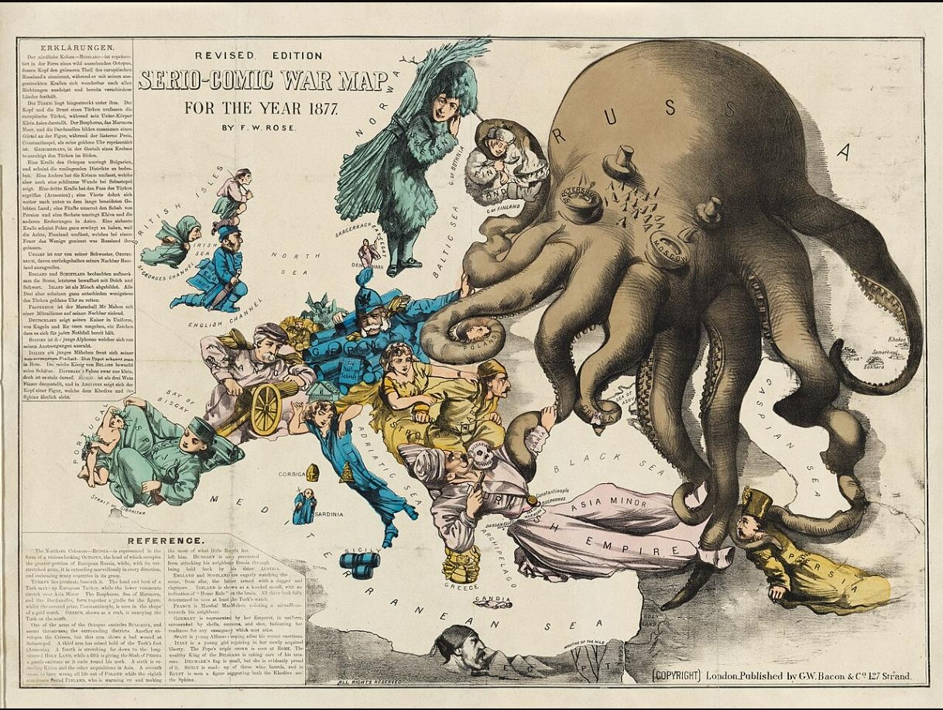
Distorted Size
Showing one country looming over its neighbors
Fred W. Rose's 1877 “Serio-Comic War Map” redraws the Russian Empire as a monstrous octopus, its tentacles physically reaching into Poland, Turkey, Persia, and beyond — exaggerated scale standing in for exaggerated threat.
THE TECHNIQUE
The octopus's body is drawn far larger than Russia's landmass, and its limbs extend well past its real borders
WHY IT WORKED
It turned an abstract geopolitical anxiety — Anglo-Russian rivalry — into an instantly readable monster
THE LINEAGE
The same “octopus map” device was reused against nearly every 20th-century adversary in turn
Image: Fred W. Rose (1877), public domain, via Cornell University — PJ Mode Collection
34/59

Slide 35
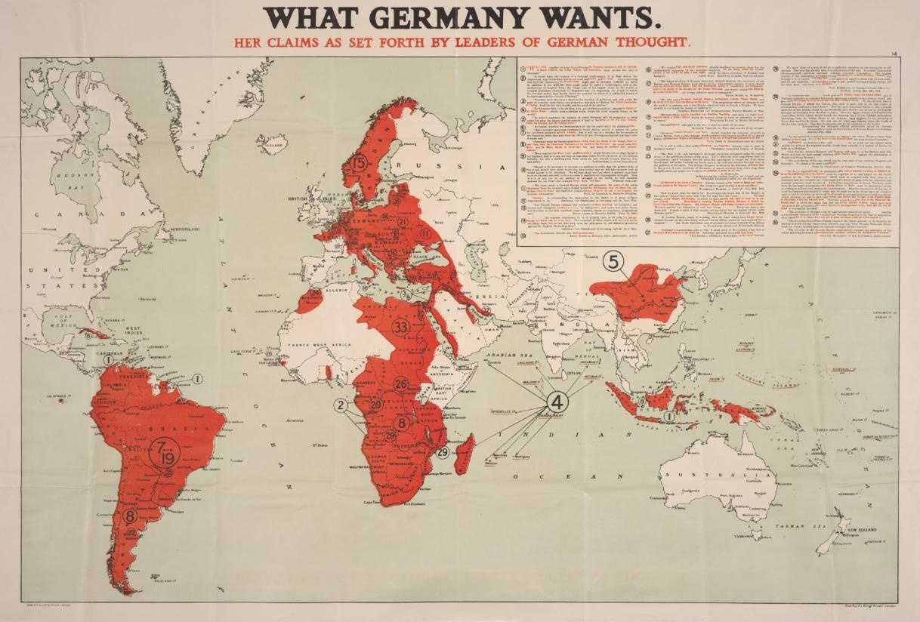
Selective Labeling
Whose claim gets to be the map's label
This 1917 British map takes wartime German commentary at face value and stamps foreign, sovereign territory with numbered claims under the banner “What Germany Wants” — turning one side's stated ambitions into the map's own labels.
THE TECHNIQUE
Numbered call-outs and red overlays relabel other countries' territory as pre-claimed, regardless of who actually controlled it
WHY IT WORKED
Printed and distributed in wartime Britain, it made diplomatic rhetoric look like an already-decided land grab
STILL RELEVANT
Labeling contested territory with only one side's name or claim still appears in border and naming disputes today
Image: Edward Stanford (1917), public domain, via Cornell University — PJ Mode Collection
35/59

Slide 36
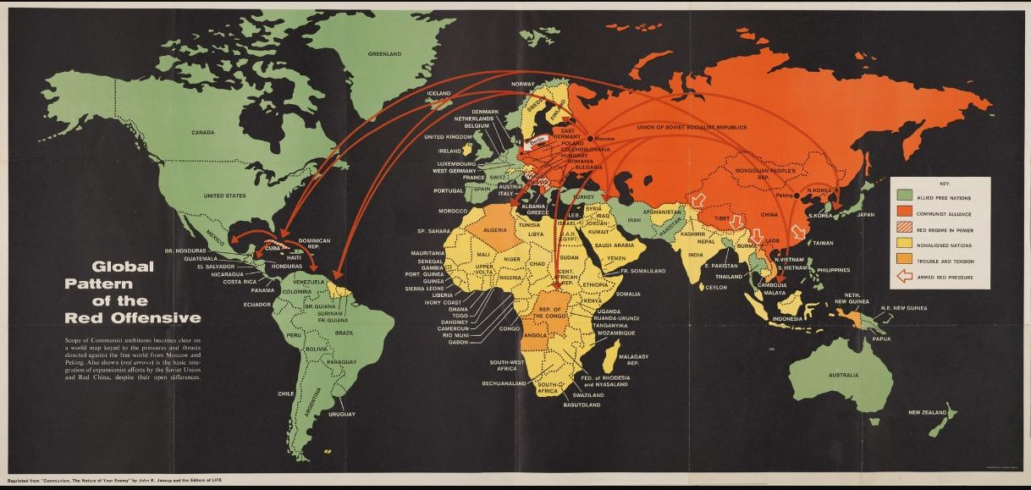
Color Psychology
Green for “us,” red for the threat
This 1962 Cold War map, reprinted from Life magazine, codes the world in two colors that carry pre-loaded emotional weight: green for “Allied Free Nations,” red and orange for the “Communist Alliance” and areas under pressure.
THE TECHNIQUE
Color alone does the persuading — no viewer needs to read a label to feel which side is “good” and which is expanding
THE ARROWS
Red arrows sweep outward from Soviet and Chinese territory toward the free world, visually staging an offensive
WHY IT WORKED
It reduced a complicated map of alliances and neutral states into a single, gut-level color read
Image: John Jessup (1962), public domain, via Cornell University — PJ Mode Collection
36/59

Slide 37
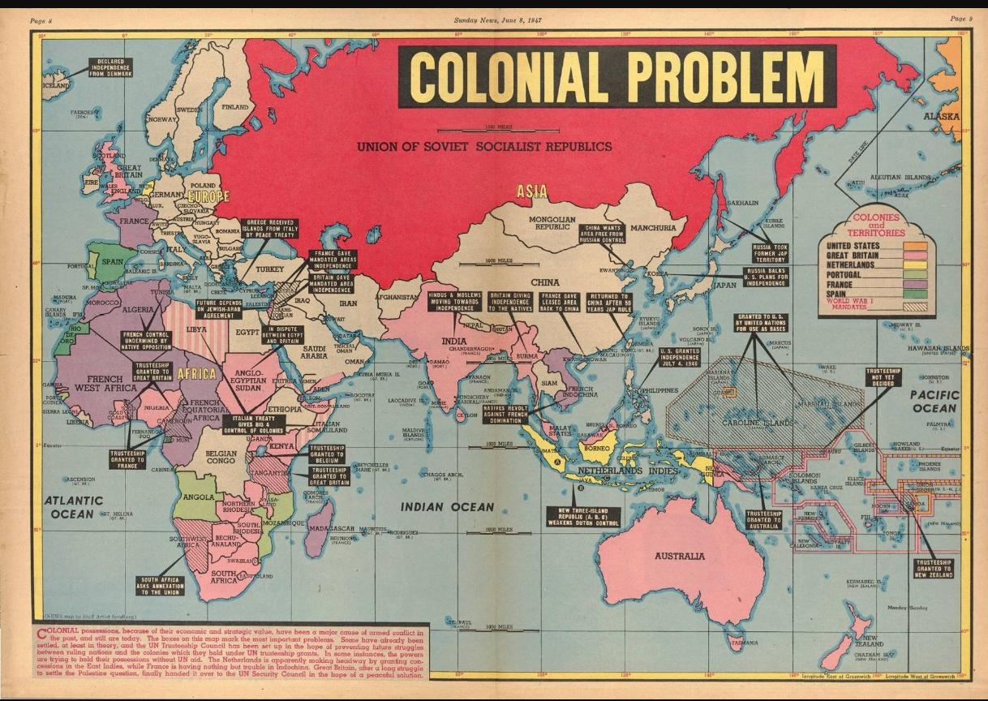
Omission
What the map leaves out shapes the argument
This 1947 newspaper map singles out the USSR's “colonial problem” in bold red — but the Americas and the Pacific, despite the United States and European powers holding colonies there at the same moment, simply don't appear on the map at all.
THE TECHNIQUE
Cropping the map's extent quietly removes every Western colonial holding from the conversation, leaving only one empire to judge
WHY IT WORKED
Readers can only weigh what's shown — counter-evidence never gets a chance to register once it's cropped out
THE MODERN VERSION
The same logic shows up whenever a briefing map or news graphic frames one actor's actions while cropping out everyone else's
Image: Edwin Sundberg (1947), public domain, via Cornell University — PJ Mode Collection
37/59

Slide 38
Mapping Techniques
Matching your data to the right visualization
01
Choropleth
Best for: Aggregated data per area unit (rates, percentages)
02
Isarithmic
Best for: Continuous surfaces (temperature, elevation, rainfall)
03
Proportional Symbol
Best for: Point magnitudes (total counts or totals by location)
04
Graduated Symbol
Best for: Classed point data (ranked categories at locations)
05
Dot Map
Best for: Non-uniform, unequally distributed point data
38/59

Slide 39
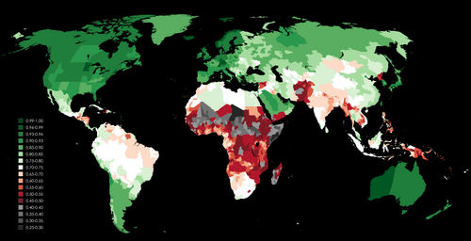
Choropleth Mapping
The most widely used thematic technique
Choropleth maps assign a fill color to each geographic unit (country, state, county) to represent a data value or value range.
[CHOROPLETH MAP IMAGE]
Example: UNDP Human
Development Index 2022
https://hdr.undp.org/
Key requirement:
Data must be rates or ratios, not raw counts — to avoid area-size bias
Color scheme:
Sequential for one-direction data; Diverging for data spanning a meaningful midpoint
Classification:
Equal interval, quantile, natural breaks (Jenks), or standard deviation
Example dataset:
Global Human Development Index by country — UNDP 2023
39/59
Image: Wikimedia Commons (Hdi2023map.png)

Slide 40
Choropleth — Limitations
What this technique cannot show
!
The MAUP Problem
!
Within-Unit Variation
The Modifiable Areal Unit Problem: results change depending on how boundaries are drawn. County-level data may look very different from state-level data for the same variable.
A single color fills an entire region, implying uniformity — but a state with 30% poverty still has wealthy urban cores and very poor rural zones.
!
Area Bias
!
Normalization Required
Large geographic units dominate visual weight. A sparsely populated but physically huge region draws more attention than a small, dense one.
Mapping raw totals (e.g., total COVID cases) is almost always misleading. You must normalize by population to show rates.
40/59

Slide 41
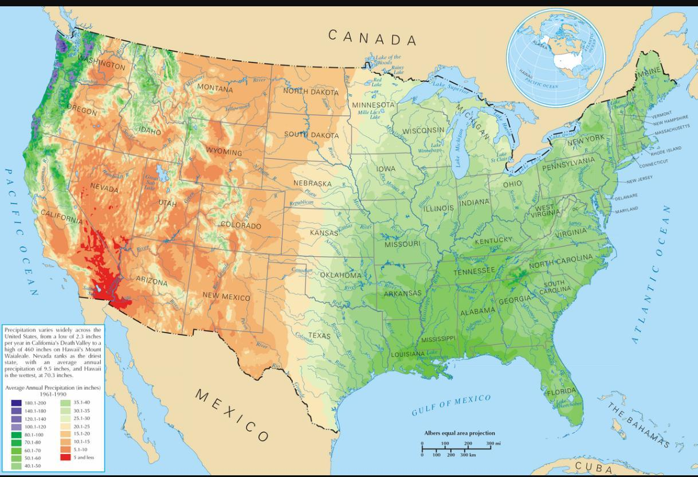
Isarithmic Mapping
Smooth surfaces for continuous phenomena
Isarithmic maps connect points of equal value with isolines, creating a smooth surface that shows gradual change across space. Best for phenomena that are continuous by nature.
Isohyet
Equal rainfall — NOAA US Precipitation Normals
Isotherm
Equal temperature — NOAA Climate Normals maps
Contour
Equal elevation — USGS topographic quadrangles
Isobar
Equal atmospheric pressure — NWS weather forecast maps
41/59
Image: National Atlas of the United States, public domain, via Wikimedia Commons

Slide 42
Isarithmic Mapping — Limitations
When smooth surfaces mislead
Isarithmic maps carry implicit assumptions that can mislead if the underlying phenomenon is not genuinely continuous.
⚠
Assumes Continuity:
The technique assumes the phenomenon exists everywhere between sample points. Valid for temperature — but not for, say, language spoken at home.
⚠
Interpolation Artifacts:
Values between known points are estimated, not measured. In data-sparse regions, interpolated surfaces can be highly uncertain.
⚠
Monitoring Station Bias:
Stations are often clustered in populated areas. Sparse rural coverage can significantly distort the interpolated surface.
⚠
Not for Discrete Data:
Never use isarithmic mapping for categorical or count data — it falsely implies a continuous gradient that does not exist.
42/59

Slide 43
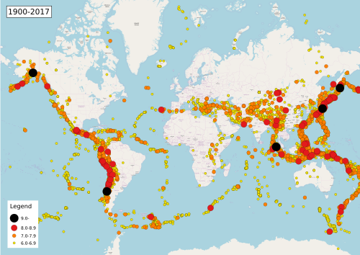
Proportional Symbol Mapping
Size encodes magnitude — continuously
Symbol area is scaled in direct proportion to the data value at each location. Larger symbol = larger value.
[PROPORTIONA L SYMBOL MAP]
Example: Global earthquake
magnitudes 2000–2023
USGS Earthquake Hazards
https://earthquake.usgs.gov/earthquakes/map/
Best for:
Totals and counts at point locations (e.g., city populations, earthquake magnitudes)
Symbol type:
Circles most common — area is easier to compare than other shapes
Scaling rule:
Symbol area (not radius or diameter) should be proportional to the data value
When to use:
When the range of values is large and you need to show raw magnitude
43/59
Image: Wikimedia Commons (Map of earthquakes 1900-)

Slide 44
Proportional Symbol — Limitations
Challenges in reading and interpreting
!
Symbol Overlap
!
Size Estimation Errors
In dense regions symbols pile up and obscure each other. Solutions include transparency, 3D stacking, or switching techniques.
Humans systematically underestimate area differences. A circle 4× the area is rarely perceived as 4× bigger.
!
Legend Design
!
Not for Rates
Without a well-designed legend viewers cannot decode values reliably. A nested-circle legend with labeled reference sizes helps significantly.
Proportional symbols encode totals, not rates. Mapping total cancer cases by county without normalizing by population is misleading.
44/59

Slide 45
Graduated Symbol Mapping
Symbols in discrete size classes
Unlike proportional symbols, graduated symbols group data into predefined classes — each class gets a fixed symbol size. Easier to read; some precision is sacrificed.
Proportional Symbol
Continuous scaling — symbol area ∝ data value
More precise; harder to read
Graduated Symbol
Discrete classes, e.g., small / medium / large / XL
Easier to read; some precision lost
ArcGIS Pro graduated symbols: https://pro.arcgis.com/en/pro-app/latest/help/mapping/layer-properties/graduated-symbols.htm
45/59

Slide 46
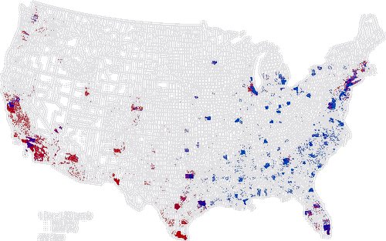
Dot Mapping
One dot = one unit of the phenomenon
Dot maps place dots to represent a fixed quantity of the mapped phenomenon. Dot density reveals spatial distribution — even in overlapping, dense areas.
[DOT MA P IMAGE]
Example: US Population
Dot Density Map
US Census Bureau
https://www.census.gov/library/visualizations/
Dot value:
Each dot = a fixed number of units (e.g., 1 dot = 1,000 people)
Dot placement:
Ideally placed using ancillary data (land use) to position dots realistically, not randomly
Use for:
Non-uniform distributions — population, livestock, crop fields
Strength:
Reveals density clustering and sparse zones better than choropleth for raw totals
46/59
Image: Wikimedia Commons (Dot map black hispanic)

Slide 47
Dot Mapping — Limitations
Design choices that change what viewers see
!
Dot Value Selection
!
Dot Size Selection
Too small a value → map saturates; too large → sparse and uninformative. Calibration requires testing.
Tiny dots are hard to see; oversized dots imply more data than present. Both mislead the viewer.
!
Dot Placement
!
Saturation in Dense Areas
Placing dots randomly within counties ignores known population concentrations in urban areas.
High-density zones coalesce into solid blobs, losing the ability to distinguish individual values.
47/59
Good reference: Axis Maps Thematic Cartography Guide — https://www.axismaps.com/guide

Slide 48
Flow Mapping
Visualizing movement and connections
Flow maps use lines or arrows to show movement of people, goods, or information between locations. Line width typically encodes volume.
✈️
Global Air Traffic
🦅
Wildlife Migration Routes
Origin-destination pairs for commercial flights — reveals hub-and-spoke networks
Tracked movement paths of bird and animal species across seasons
https://www.flightradar24.com/
https://www.movebank.org/
💱
International Trade Flows
🚶
Human Migration Patterns
Import/export volumes between country pairs — reveals economic dependency
Net inter-regional migration with proportional line widths encoding volume
https://oec.world/
https://www.un.org/en/global-issues/migration
48/59

Slide 49
Cartogram
When geography warps to reflect data
A cartogram deliberately distorts geographic area or distance to be proportional to a variable — making the data itself reshape the map.
Contiguous
Area Cartogram
Areas are resized while maintaining topology (shared borders). Visually striking but complex to build.
World population cartogram — WorldMapper.org
Dorling Cartogram
(Circles)
Each unit becomes a proportional circle. Topology is lost but patterns are immediately legible.
GDP by country — Our World in Data
Distance Cartogram
Distances warped by travel time or cost rather than physical distance.
NYC subway travel-time map from Times Square
49/59
WorldMapper: https://worldmapper.org/ | Our World in Data: https://ourworldindata.org/

Slide 50
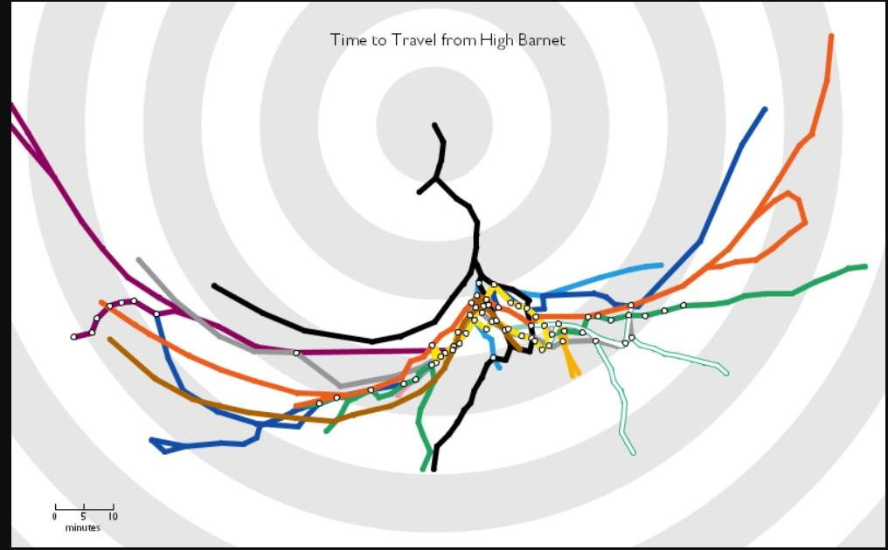
Distance Cartogram
Geography warped by minutes, not miles
Tom Carden's “Travel Time Tube Map” redraws the London Underground so that distance from a chosen starting station represents travel time, not physical distance — concentric rings mark each 5-minute band outward.
SHOWN HERE
Time to travel from High Barnet, at the north end of the Northern line, to every other station
WHAT'S WARPED
Stations reachable quickly cluster near the center regardless of physical distance; slow connections get pushed to the far edge
SAME IDEA
The NYC subway, Tokyo Metro, and mapping tools' own “isochrone” features all use the same time-not-space logic
Image: Tom Carden, CC BY 3.0, via Wikimedia Commons
50/59

Slide 51
Interactive Maps
Giving users control over the data they see
Interactive maps let users zoom, filter, query, and explore — turning a static product into a tool for personalized discovery.
🌊
Windy
🌍
NASA Worldview
Real-time global wind, wave, and weather patterns — live animated visualization
Browse 900+ Earth science data layers from NASA satellites, updated daily
https://www.windy.com/
https://worldview.earthdata.nasa.gov/
🏙
NYT 'Every Building'
🦠
CDC COVID Tracker
Interactive exploration of the entire US building footprint — every structure
Filterable choropleth and time-series maps of COVID-19 metrics by US county
https://www.nytimes.com/interactive/2018/10/12/us/map-of-every-building-in-the-united-states.html
https://covid.cdc.gov/covid-data-tracker/
51/59

Slide 52
Animated Maps
Adding the dimension of time
Animated maps add a temporal axis, showing how spatial patterns evolve. Most powerful when change is gradual and continuous.
Global Lightning Flash Density — Monthly Means
Shown here: 12 frames, looping every 12 seconds, showing global lightning flash density change month-by-month over the year.
Image: Wikimedia Commons (Cappelluti, NASA OTD/LIS)
Time step: The animation unit (hourly, daily, yearly) must match the scale of change in the data
Loop vs. play: Looping suits cyclical data (seasons, tides); linear playback suits historical sequences
Playback speed: Too fast obscures the pattern; too slow loses viewer attention. Always test with users.
52/59

Slide 53
Animated Maps — More Examples
Time-series data brought to life
Global Ocean Currents (live)
1
Earth.nullschool.net renders real-time ECMWF wind and ocean current data as a flowing animated globe
https://earth.nullschool.net/
Urban Heat Island Growth (NASA 1992–2022)
2
Time-lapse of land surface temperature as cities expand — shows urban heat growth over 30 years
https://earthobservatory.nasa.gov/
Bird Species Range Shifts
3
Animated movement of North American bird ranges northward under climate warming
https://www.audubon.org/climate/survivalbydegrees
53/59

Slide 54
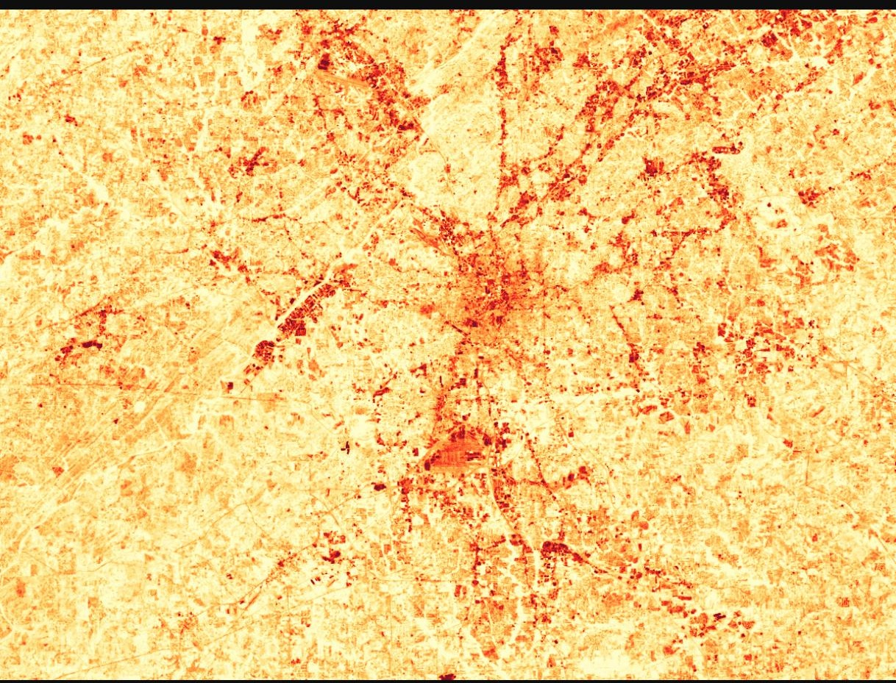
Urban Heat Island Growth
NASA Landsat: Atlanta's heat signature vs. its greenery
Landsat measures land-surface temperature from orbit — paired with a true-color image, it shows exactly how replacing vegetation with pavement and buildings raises local temperature.
SHOWN HERE
Atlanta, Georgia, September 28, 2000 — red/orange = hotter, pale yellow = cooler
PATTERN
Densest development (deep red) can run ~8°F warmer than nearby vegetated land
WHY IT MATTERS
Urban heat islands raise cooling costs and appear to intensify downwind rainfall
Image: NASA Earth Observatory (Marit Jentoft-Nilsen), public domain
54/59

Slide 55
Space-Time Maps
When and where, simultaneously
Space-time maps integrate geographic location and temporal change in a single static visualization — no animation required.
🚂
Space-Time Cube
A 3D visualization where the vertical axis is time. Daily commuter rail trips can be plotted as trajectories through the cube.
📱
GPS Track Maps
Individual movement paths plotted with timestamps — reveals daily rhythms, commuting patterns, and migration routes.
🏃
Activity Heat Maps
Strava’s global fitness heatmap overlays billions of GPS tracks to show where people run, bike, and hike — updated continuously.
55/59
Strava Heatmap: https://www.strava.com/heatmap | ArcGIS Space-Time Cube: https://pro.arcgis.com/en/pro-app/latest/tool-reference/space-time-pattern-mining/

Slide 56
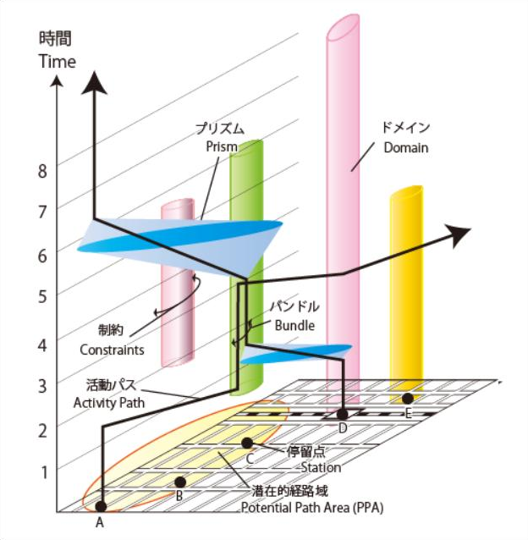
Space-Time Cube
Location + time, stacked into one 3D structure
This is Torsten Hägerstrand's own notation for time geography — the visual language every modern space-time cube descends from, shown here with a single person's real traced path (A→E) through space and time.
ACTIVITY PATH (A→E)
The bold traced line — an individual moving between locations and pausing ('stations') as time (vertical axis) advances
PRISM & POTENTIAL PATH AREA
The blue cone and yellow ellipse — everywhere the person could still reach given their time budget
BUNDLE / DOMAIN
Where paths join (bundle) or where authority limits access to a place (domain)
SAME IDEA, REAL DATA
ArcGIS Pro's Create Space Time Cube tool applies this exact logic at scale — e.g., binning Chicago crime incidents into 4-week slices
Image: Miyuki Meinaka, CC BY-SA 3.0, via Wikimedia Commons
56/59

Slide 57
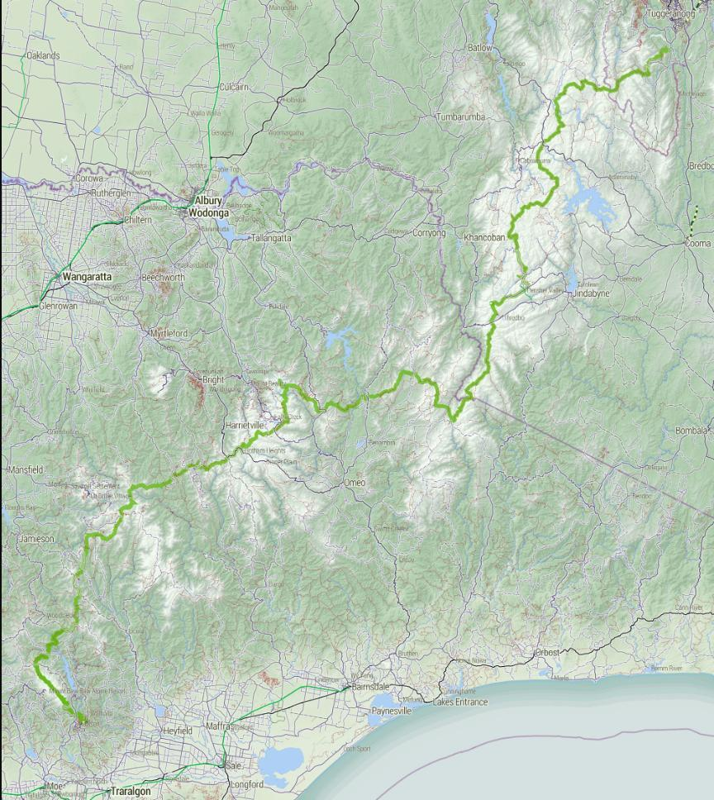
GPS Track Maps
One device, one path, one continuous line
A GPS track map plots a single device's recorded coordinates over time as a connected line — the same technique behind every hiking app, running watch, and fitness tracker.
SHOWN HERE
The Australian Alps Walking Track — a real ~650 km trail traced from GPS survey data
SAME TECHNIQUE, HIGHER STAKES
In 2018, Strava's aggregated GPS tracks accidentally revealed patrol routes at U.S. military bases overseas
BUILT FROM
OpenStreetMap trail data
57/59
Image: Stevage, CC BY-SA 4.0, via Wikimedia Commons

Slide 58
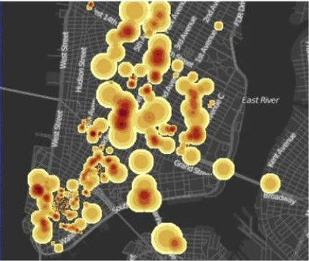
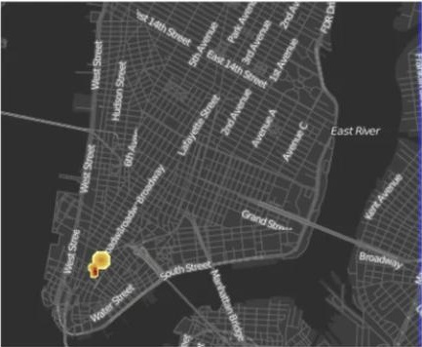
Activity Heat Maps
Where online attention clusters, in space and time
Researchers Kenett, Morstatter, Stanley & Liu (2014) mapped geotagged Twitter activity around the Occupy Wall Street protests — tweet density alone was enough to see a real-world event unfold.
SHOWN HERE
Two snapshots of the same Lower Manhattan blocks, eleven weeks apart
(a) Nov. 15, 2011
(b) Dec. 26, 2011
PANEL A — NOV 15, 2011
NYPD moves to clear Zuccotti Park — tweet density spikes across the area
Image: Kenett, Morstatter, Stanley & Liu (2014), PLOS ONE, CC BY 4.0
PANEL B — DEC 26, 2011
Protest activity has dwindled — geotagged tweets shrink to a single cluster
PUBLISHED IN
PLOS ONE, “Discovering Social Events through Online Attention” (2014)
58/59

Slide 59
Recap & What's Next
You've explored how maps persuade — next, the interface for building your own
Key Takeaways
Up Next: ArcGIS User Interface
Design choices are never neutral
A
Tour of the ArcGIS Pro workspace
Projection, color, and classification all shape the story a map tells.
B
Panes, ribbons, and project files
Visualization and communication differ
C
Adding and symbolizing data
Exploring data and presenting a conclusion call for different design choices.
D
Navigating maps and layouts
Maps have a taxonomy
Reference, thematic, pragmatic, and persuasive maps each serve a different purpose.
You've learned to read a map critically — next, the software you'll use to build one.
The 5-step framework guides design
Phenomenon, purpose, data, design, and evaluation — in that order.
59/59

