Slide 1
Two DBs
Openmrs and validation_linelist

Slide 2
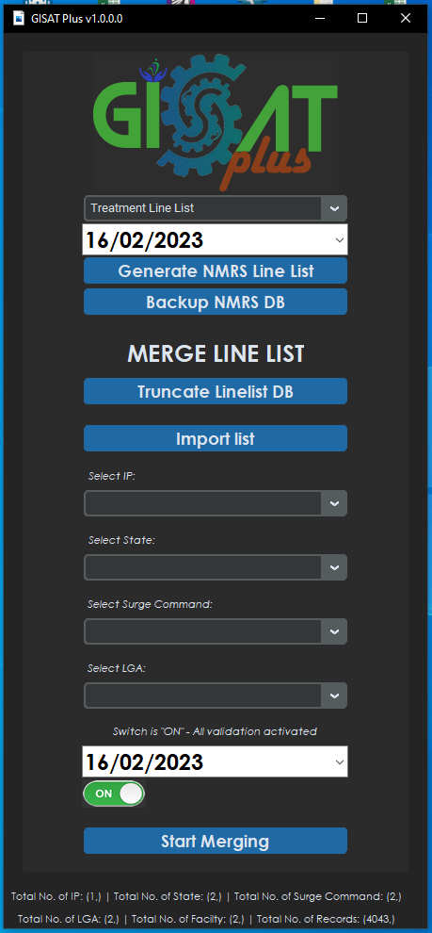
GISAT Plus Logo
DATABASE
List of NMRS Line list (Dropdown) Multi function
Reporting date field
Generate NMRS Line list
Backup NMRS Database
Database
Openmrs
Truncate Line list DB – validation_Linelist merging DB
Import Line list – Loading the Validation_Linelist DB
Database
Validation_linelist
Merge Line List
Select IP Dropdown
Select State Dropdown
Select Surge Command Dropdown
Select LGA Dropdown
Reporting Date validation “Date Field”
Validation Switch
Start Merging
Database
Validation_linelist
Line list Database Details Panel
Database
Validation_linelist

Slide 3




GISATPlus Flowchart (Overview)
No
START
MySQL Sever Connection
Check connection status
Yes
Database 1 & 2 Connection
Launch App
No
No
Close all existing threads
Yes
END

Slide 4
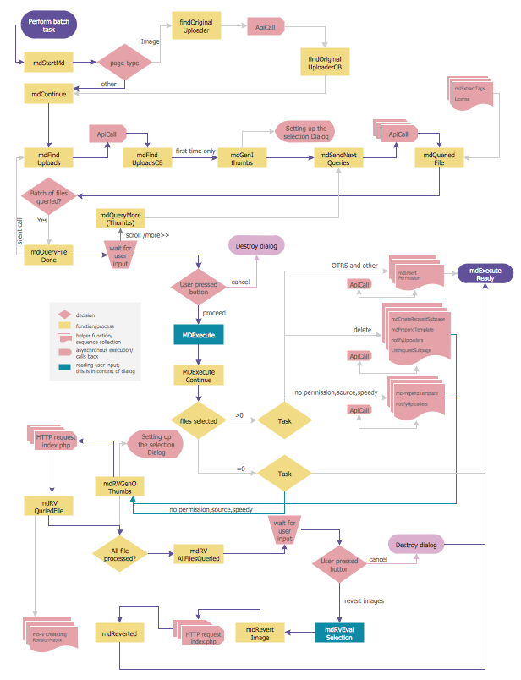

Slide 5
