Slide 1
Optimised Trajectories for the SpaceLiner using GPOPS-2
Mr. Sholto Forbes-Spyratos
Ph.D. Candidate, Centre for Hypersonics
The University of Queensland, Brisbane, Australia

Slide 2
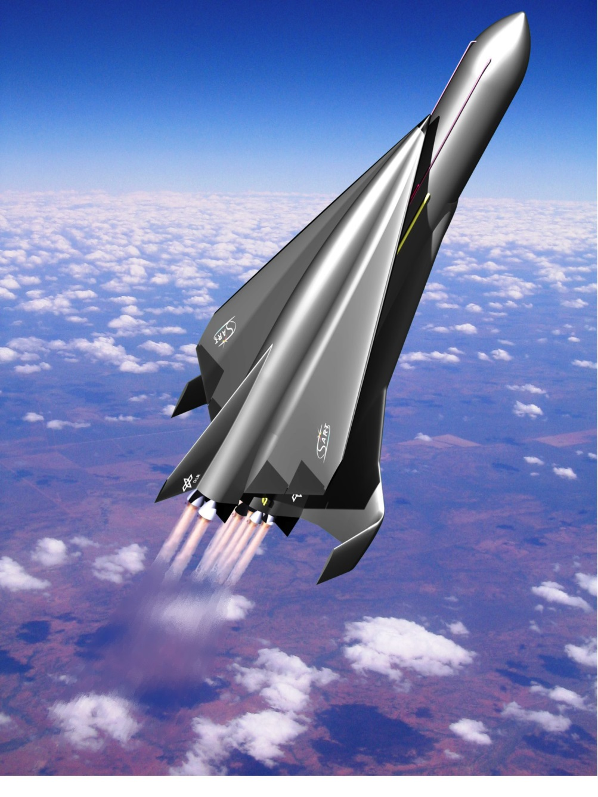
Introduction: The SpaceLiner
50 passengers
Long distance transport
Two-stage

Slide 3
Introduction
Trajectories to be simulated:
Asia-Europe
Australia-Florida
Sonic booms may create large overpressure causing:
Minor/major irritation
Structural damage to buildings
Actual bodily harm
Trajectory to be optimised towards:
Avoid significant population impact
Minimise heat loading

Slide 4

Constrained Optimisation
An general, automatic method of trajectory calculation
$$\min{J\left(t,x\right)=}\int_{t_{0}}^{t_{f}}{ℒ\left(\left.t,x\left(t\right),u(t\right)\right) dt }+Φ(t_{f},x\left(t_{f}\right))$$
$$subject to$$
$$g\left(t,x\right)=0$$
$$h\left(t,x\right)≥0$$

Slide 5
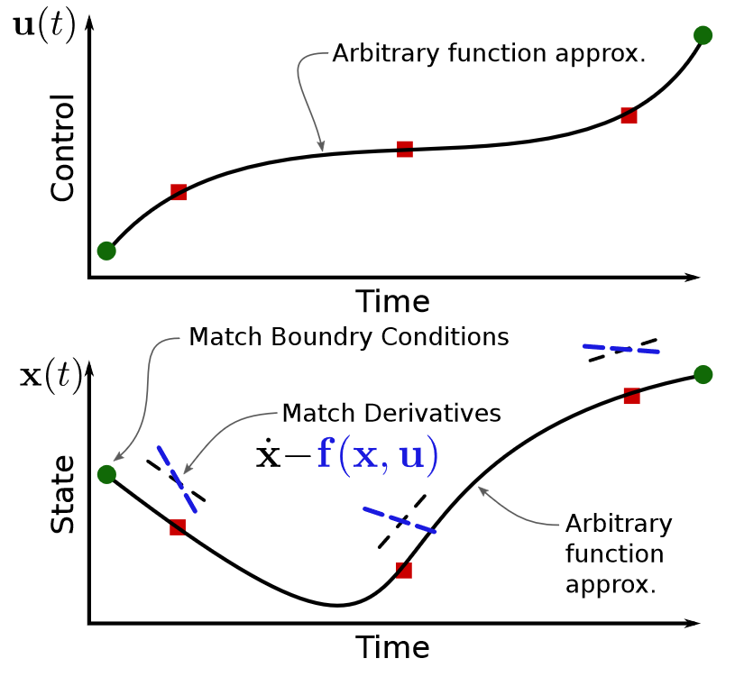
The Pseudospectral Method
A simultaneous method
A form of direct collocation
Accurate, efficient & robust
Used in GPOPS-2
[1]

Slide 6

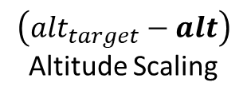


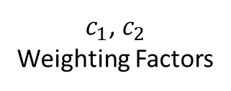

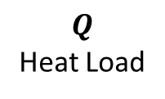

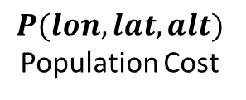

Problem Set-Up
Cost
$$\left({alt}_{target}−alt\right)$$
Altitude Scaling
$$J=\int_{t_{0}}^{t_{f}}{\frac{\left({alt}_{target}−alt\right)}{c_{1}}P(lon,lat,alt)+\frac{Q}{c_{2}} dt}$$
$$P(lon,lat,alt)$$
Population Cost
Bounds
$$Q$$
Heat Load
$$Q_{max}≤1.3 MW/m^{2}$$
$$γ_{descent}≤0°$$
$$a≤2.5 g$$
$c_{1}$, $c_{2}$
Weighting Factors
$$q≤40 kPa$$
${lon}_{0},$ ${lat}_{0},$ ${lon}_{f},$ ${lat}_{f}$

Slide 7
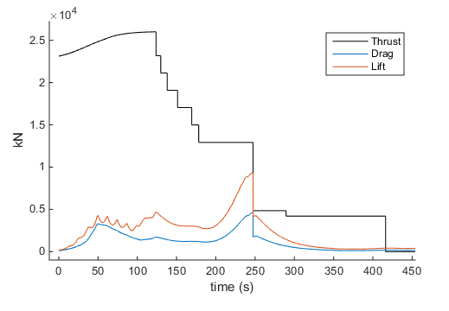
Problem Set-Up
Problem Separation:
8 Engines cut-offs, stage transition
Engine cut-offs
Staging

Slide 8
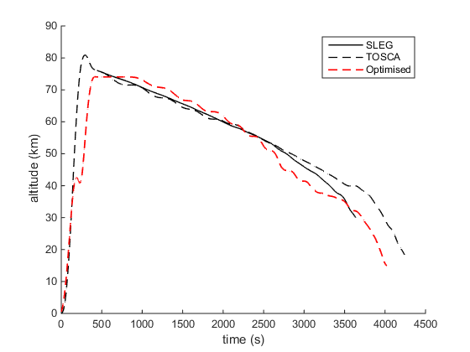
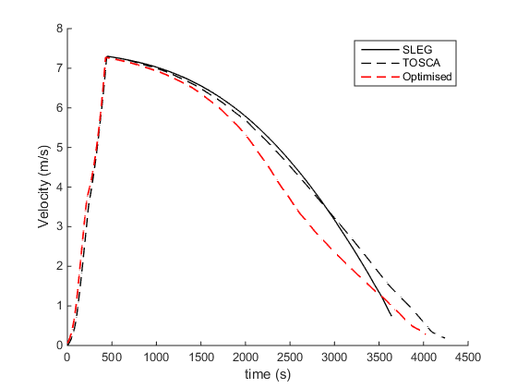
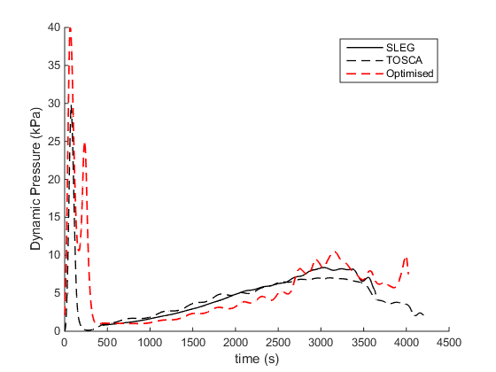
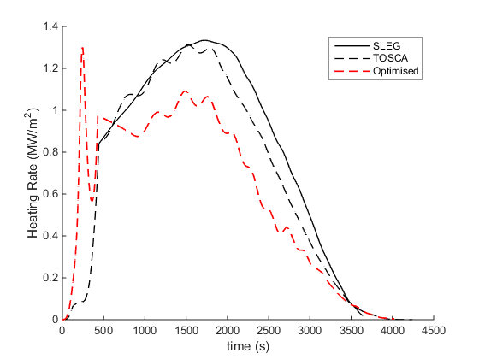
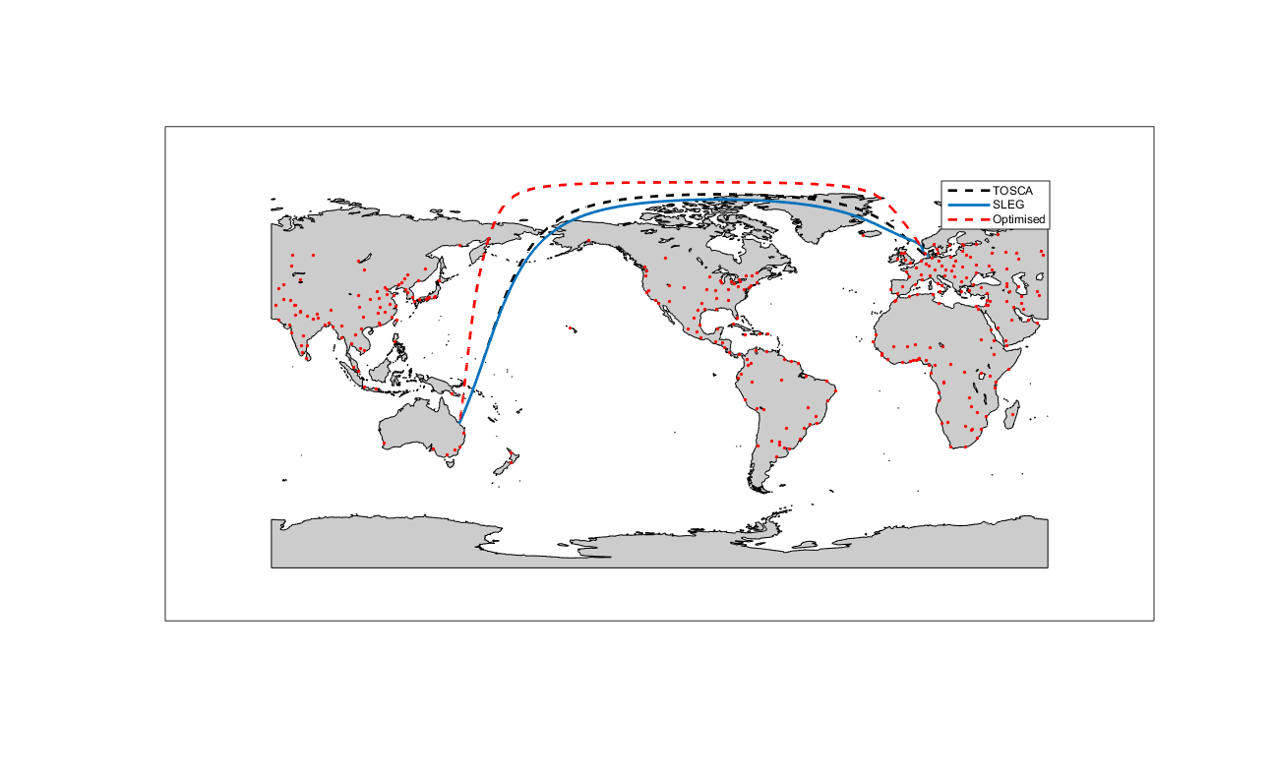
Optimised Trajectory Comparison: Australia-Germany
Integrated heat load
TOSCA: -12.8%
SLEG: -18.7%

Slide 9
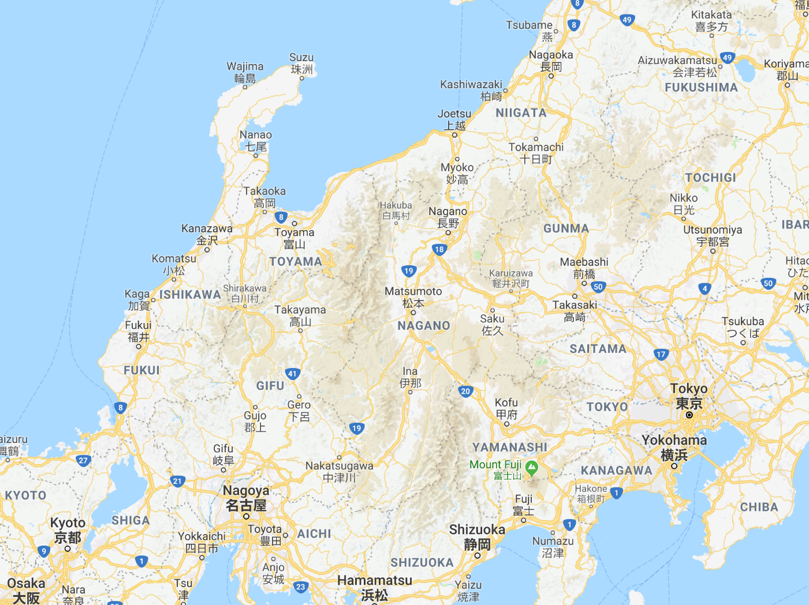
Japan-Germany

Slide 10
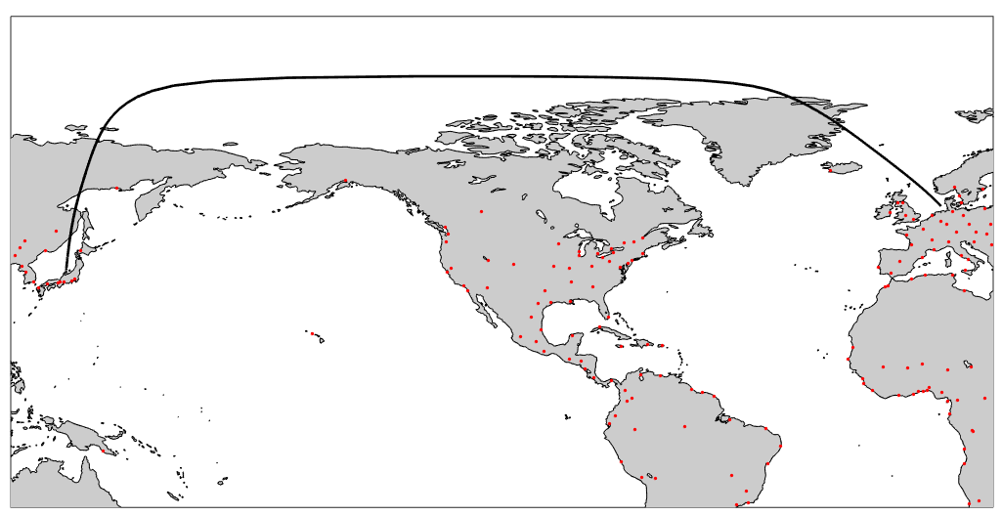
Japan-Germany
Maximum overpressure over inhabited areas: 10.59pa

Slide 11
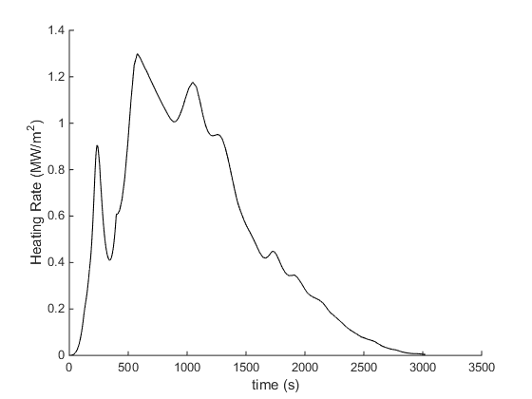
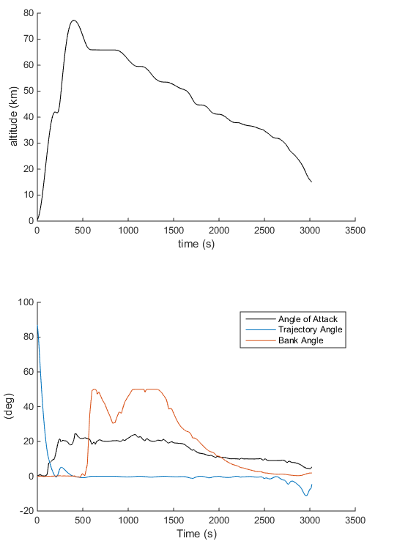
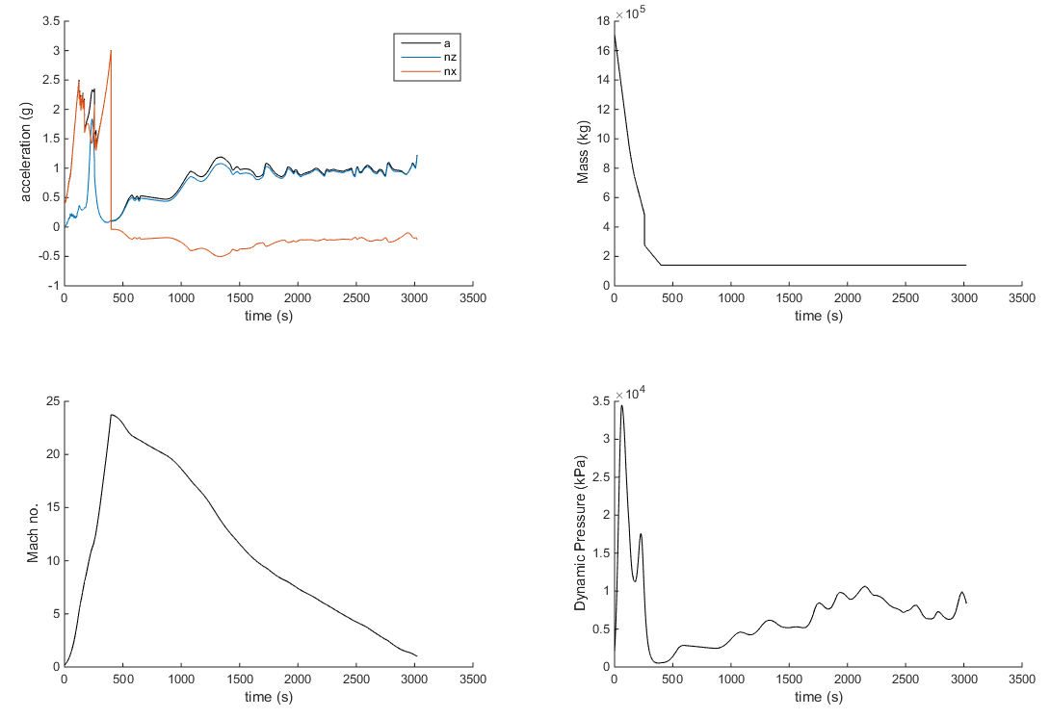
Japan-Germany

Slide 12
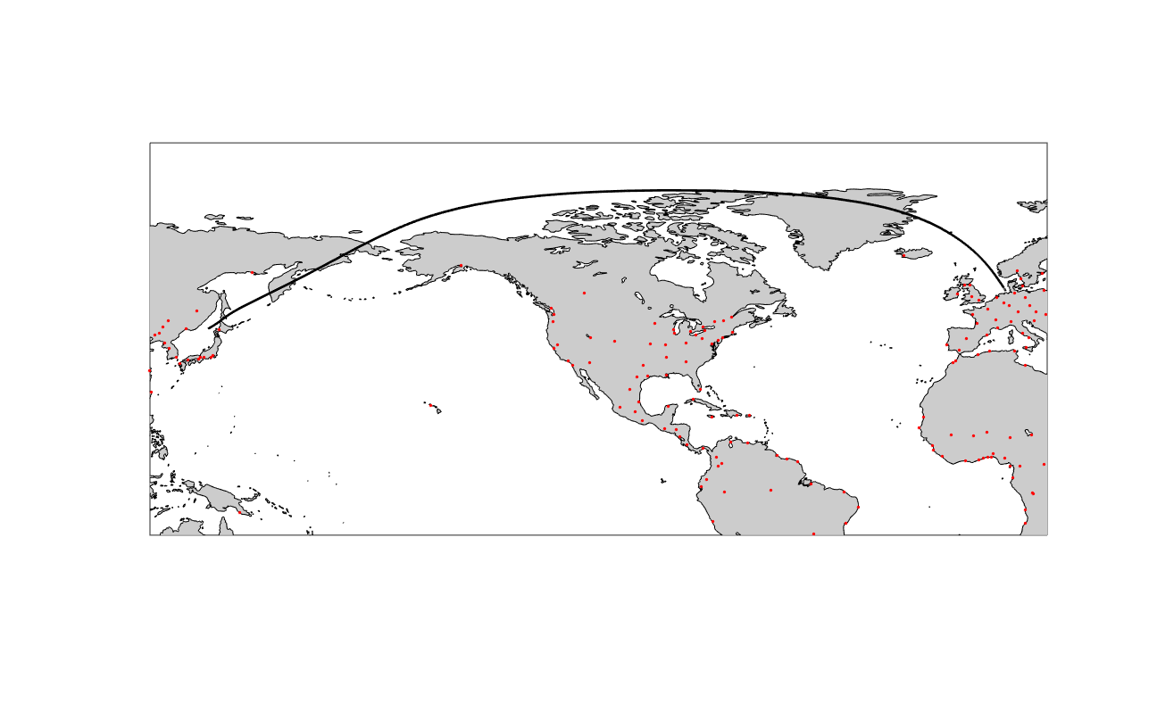
Germany-Japan
Overpressure over inhabited areas: 54.5pa

Slide 13
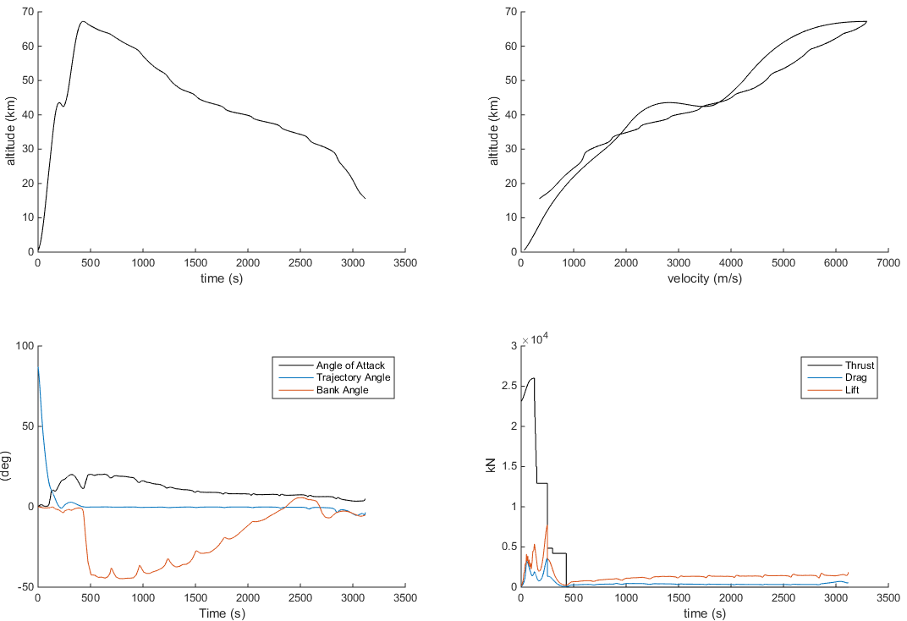
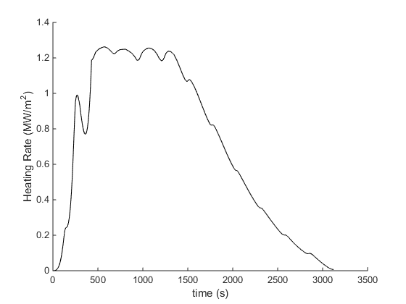
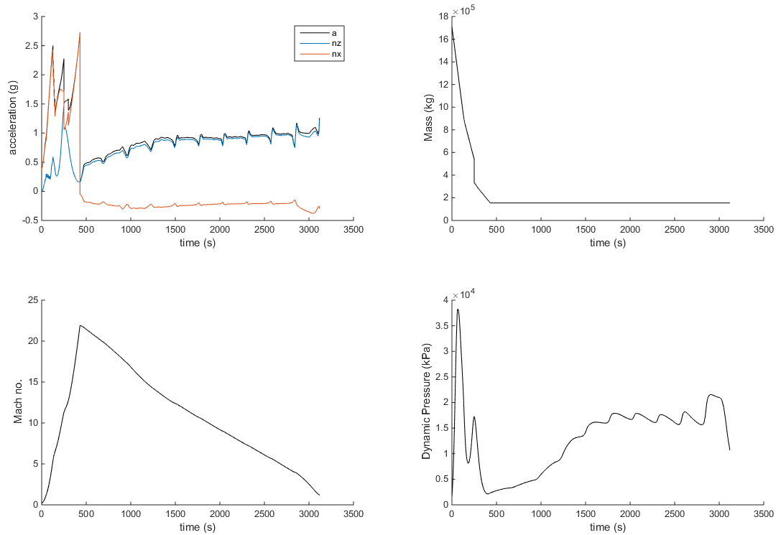
Germany-Japan

Slide 14
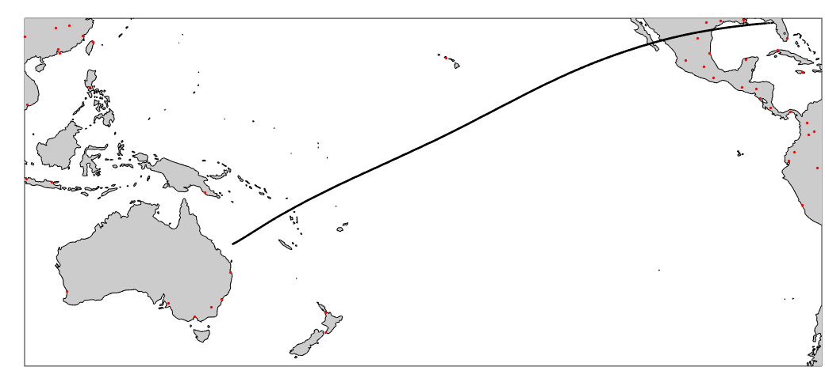
Florida-Australia
Maximum overpressure over inhabited areas: 18.3 pa

Slide 15
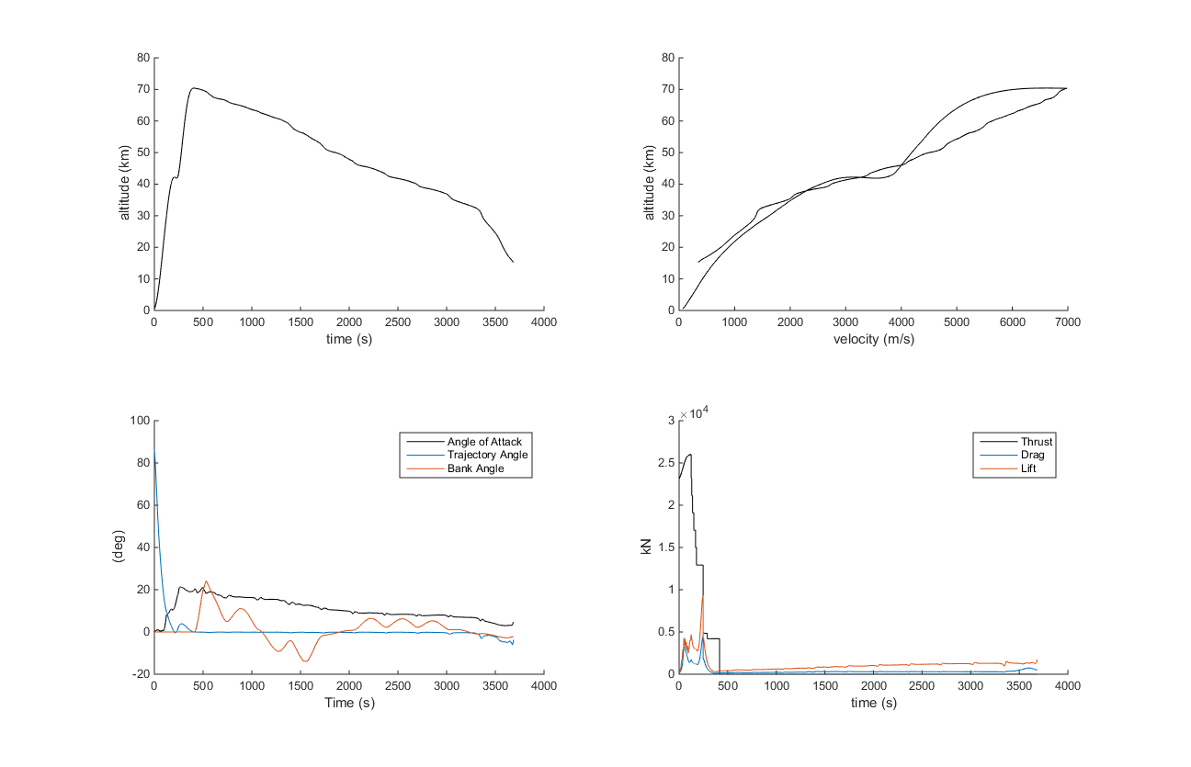
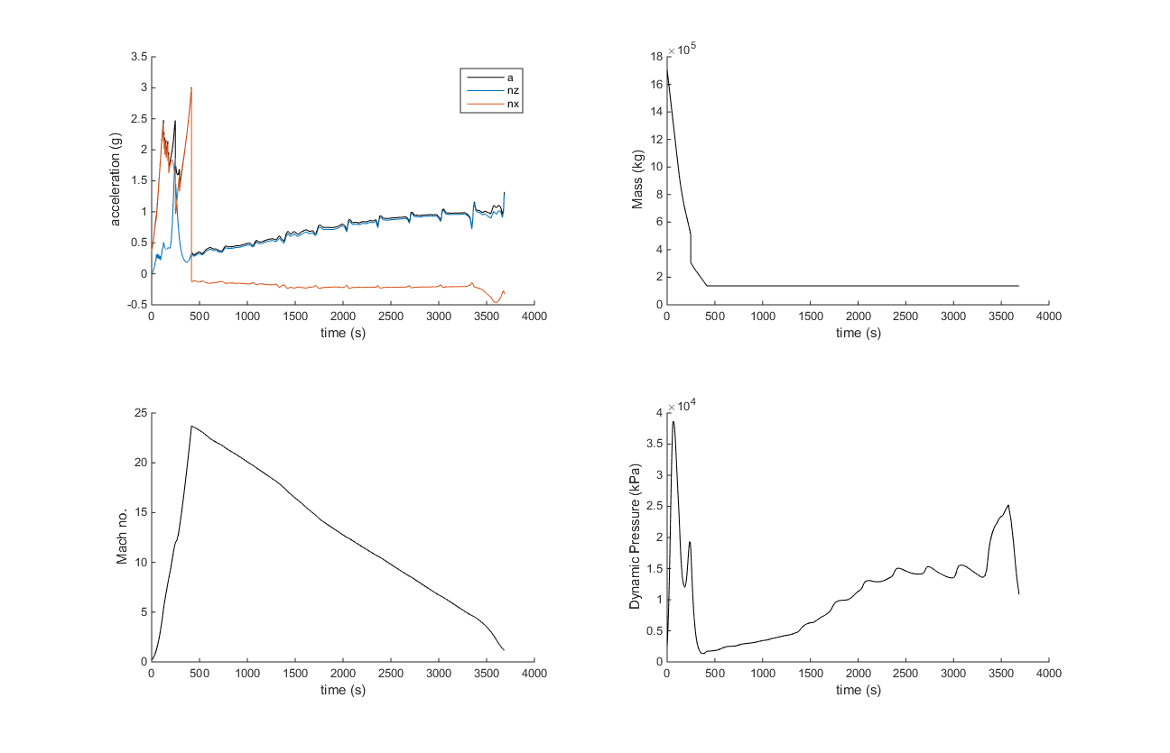
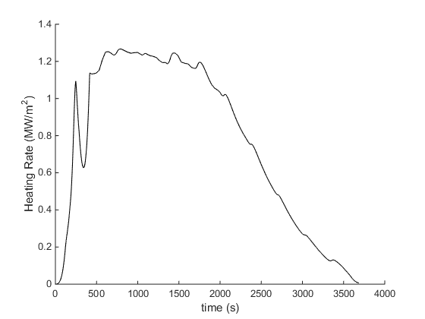
Florida-Australia

Slide 16
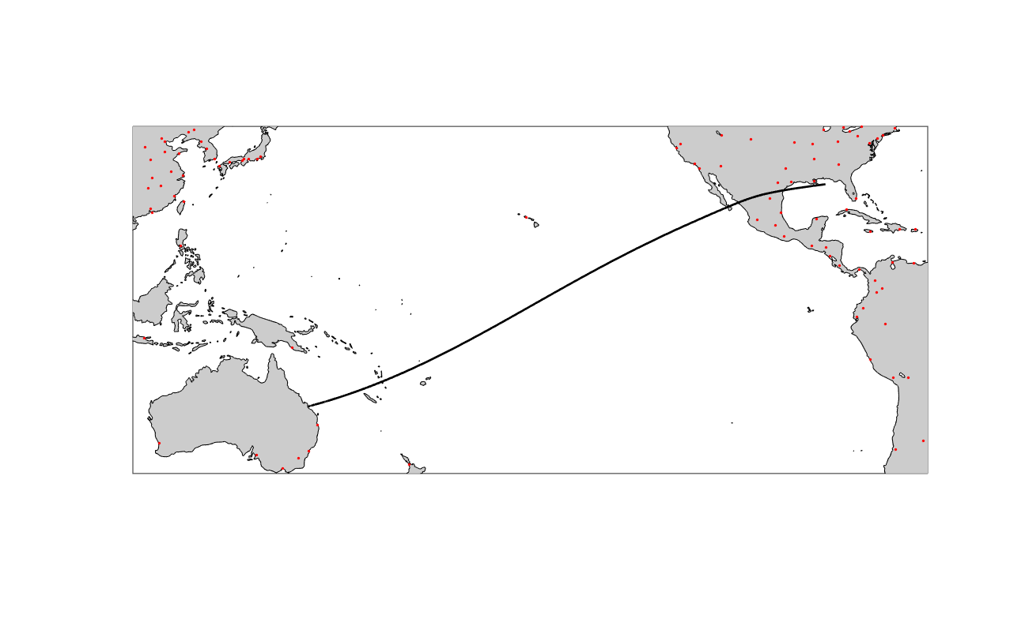
Australia-Florida
Maximum overpressure over inhabited areas: 74.7 pa

Slide 17
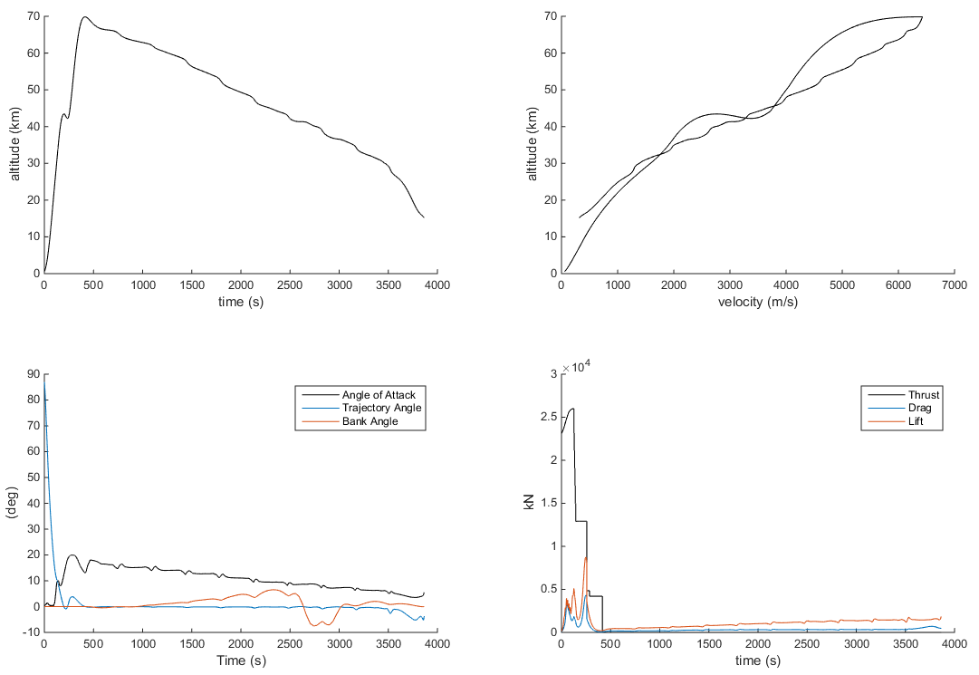
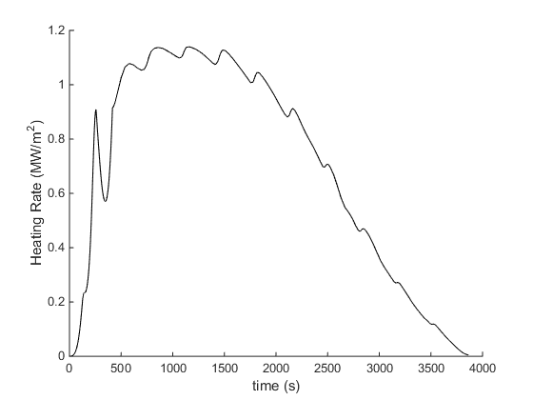
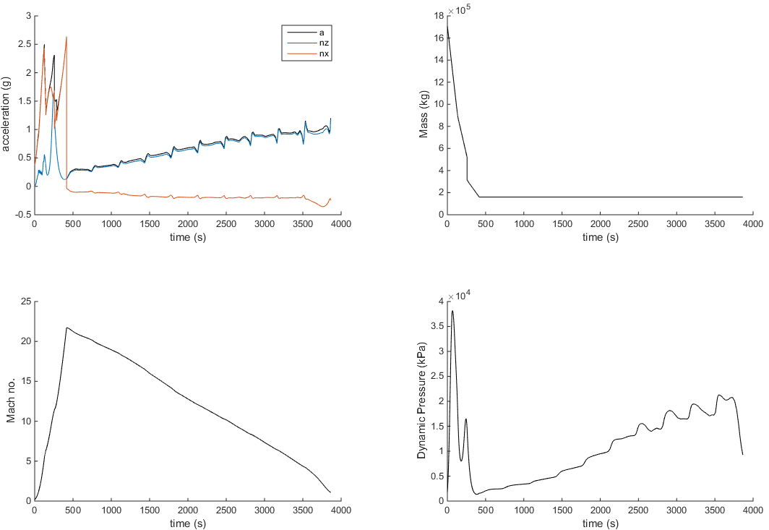
Australia-Florida

Slide 18
Conclusions
SpaceLiner trajectories successfully automated & optimised using GPOPS-2
Japan-Germany connection feasible
Florida-Australia feasible, Australia-Florida potentially infeasible

Slide 19
Thank You

Slide 20
References
[1] M. P. Kelly, Transcription Methods for Trajectory Optimization, Cornell University, 2015

