Slide 1
Optimised Trajectories for the SpaceLiner using GPOPS-2
Mr. Sholto Forbes-Spyratos
Ph.D. Candidate, Centre for Hypersonics
The University of Queensland, Brisbane, Australia

Slide 2
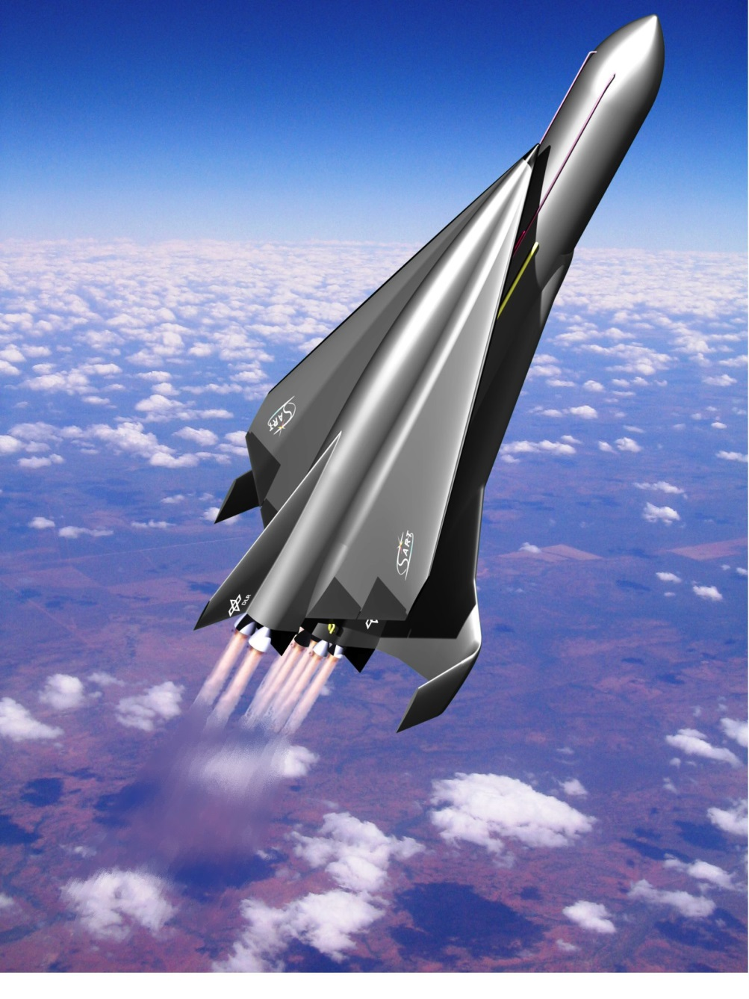
The SpaceLiner
50 passengers
Long distance transport
Two-stage

Slide 3
Introduction
Sonic booms may create large overpressure
Goals:
Avoid significant population annoyance
Minimise heat loading

Slide 4

Constrained Optimisation
$$\min{J\left(t,x\right)=}\int_{t_{0}}^{t_{f}}{ℒ\left(\left.t,x\left(t\right),u(t\right)\right) dt }+Φ(t_{f},x\left(t_{f}\right))$$
$$subject to$$
$$g\left(t,x\right)=0$$
$$h\left(t,x\right)≥0$$

Slide 5
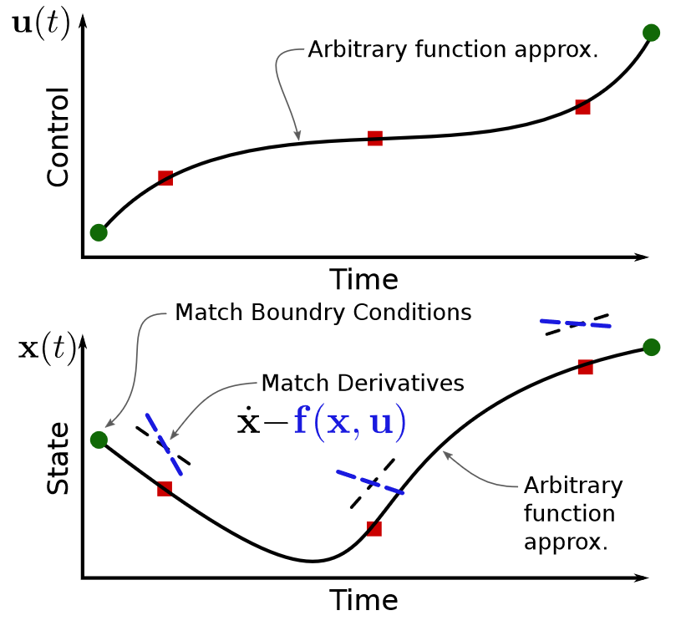
The Pseudospectral Method
A simultaneous method
A form of direct collocation
Accurate, efficient & robust
Used in GPOPS-2
[1]

Slide 6

Problem Set-Up
$$C=\int_{t_{0}}^{t_{f}}{\frac{\left({alt}_{target}−alt\right)}{c_{1}}P(lon,lat,alt)+\frac{Q}{c_{2}} dt}$$

Slide 7
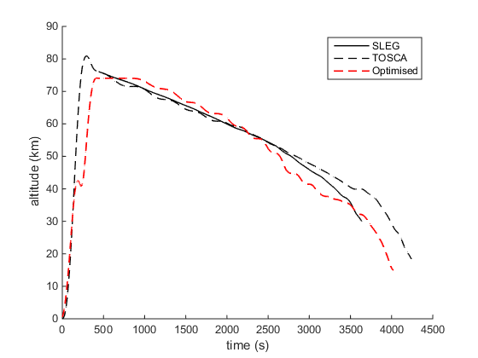
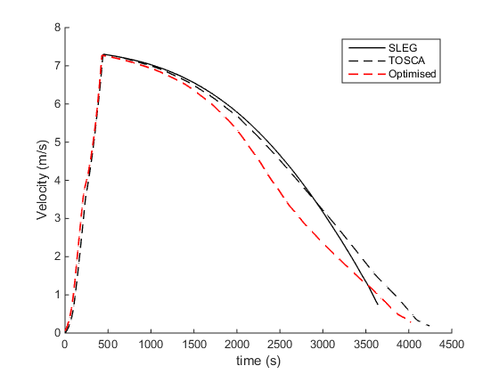
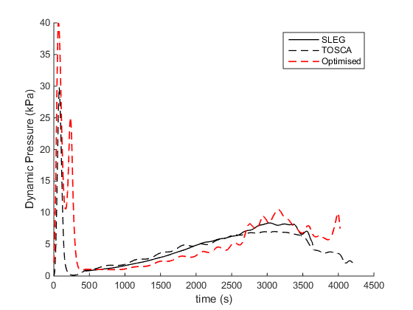
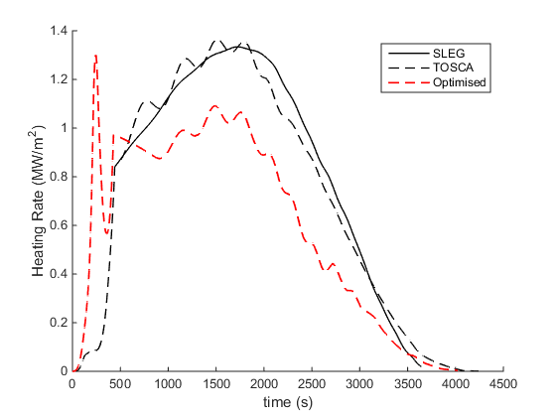
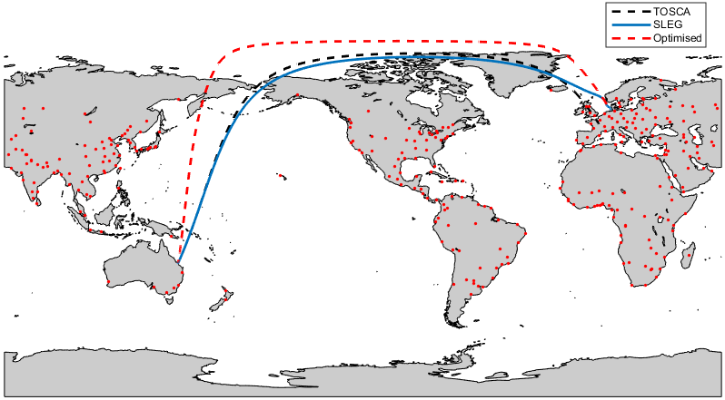
Optimised Trajectory Comparison: Australia-Germany
Integrated heat load -18.7%

Slide 8
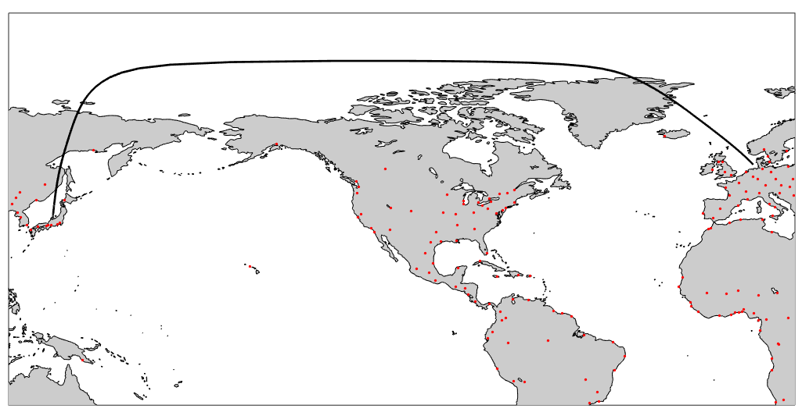
Japan-Germany
Maximum overpressure over inhabited areas: 10.59pa

Slide 9
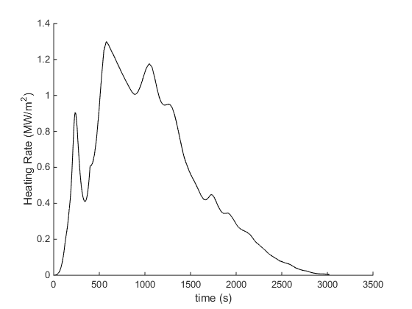
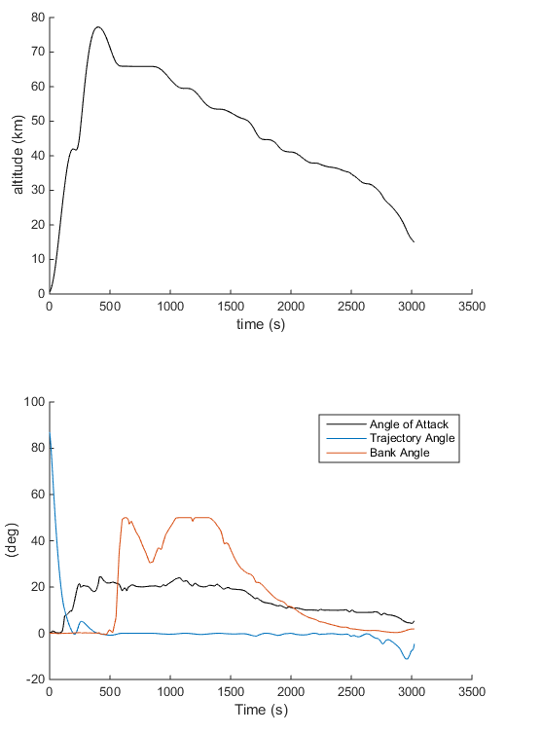
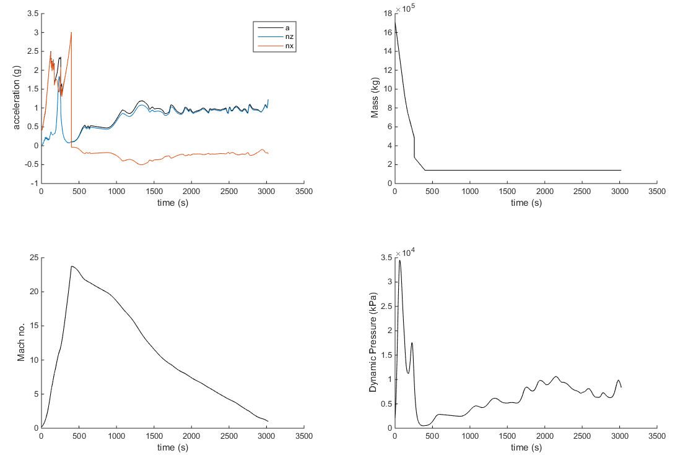
Japan-Germany

Slide 10
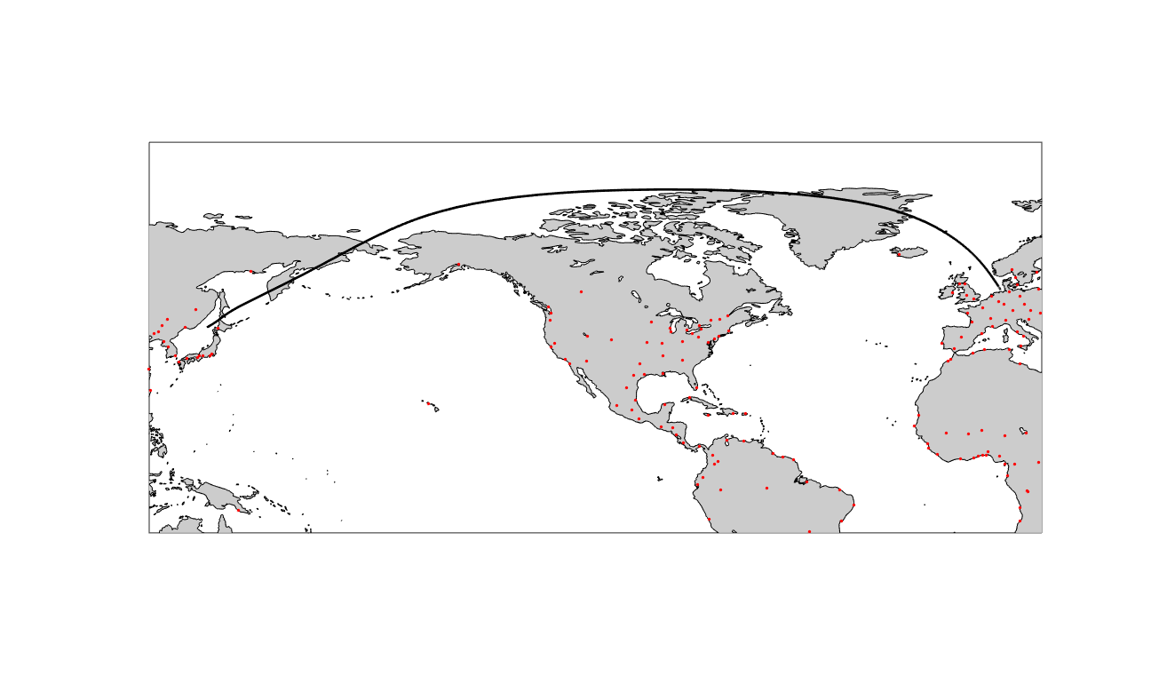
Germany-Japan

Slide 11
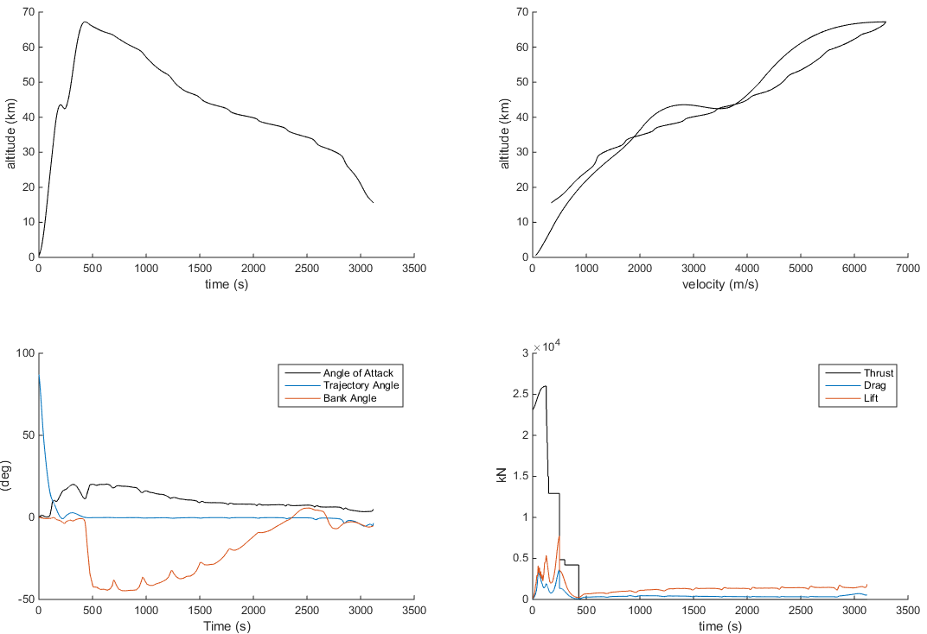
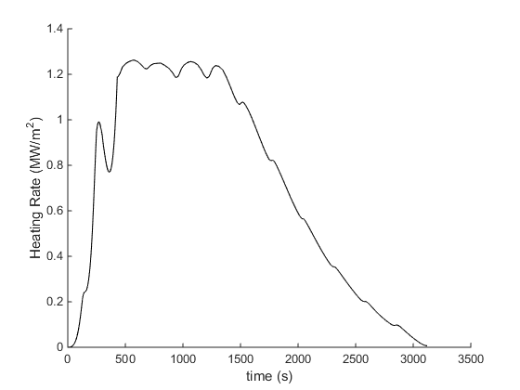
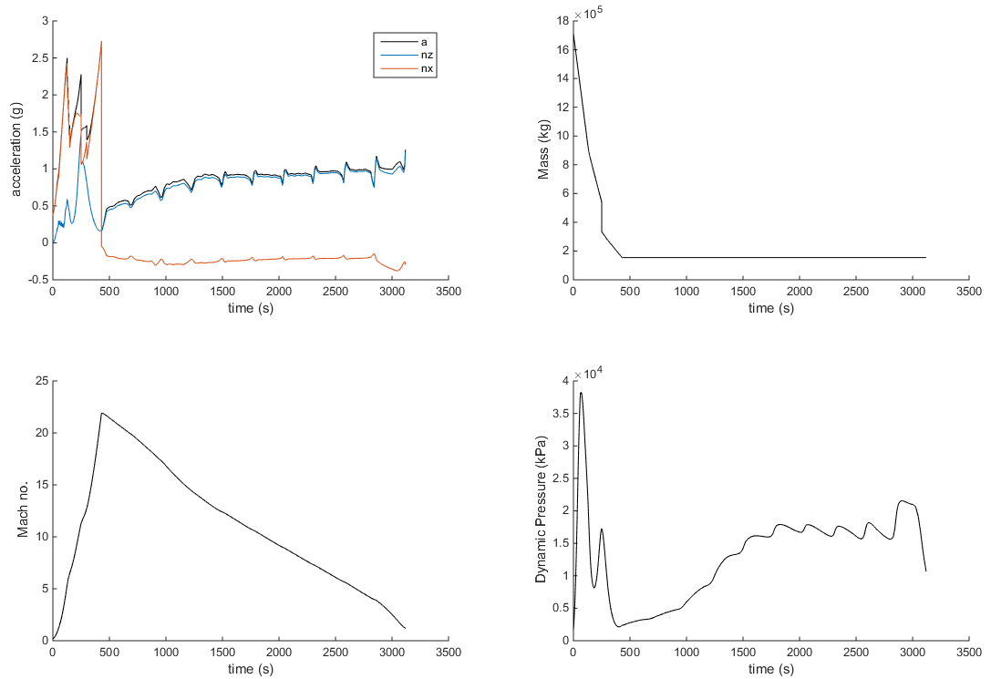
Germany-Japan

Slide 12
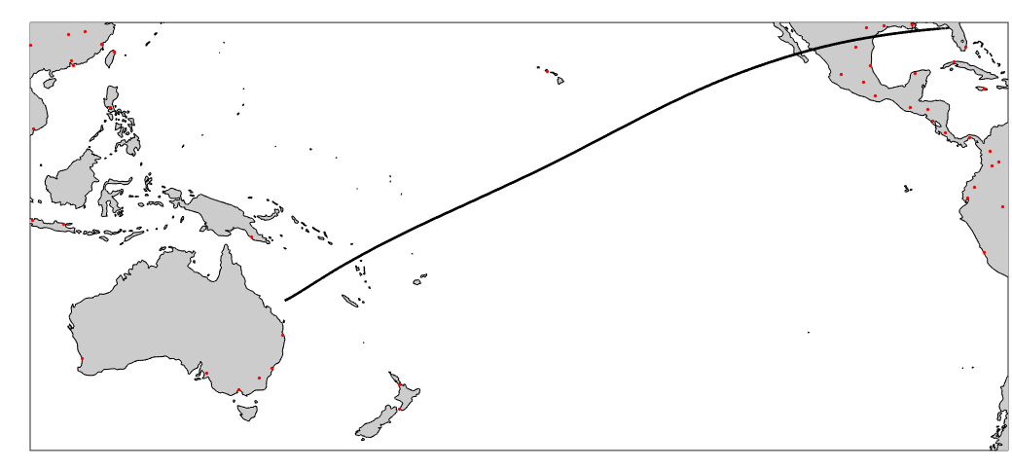
Florida-Australia

Slide 13
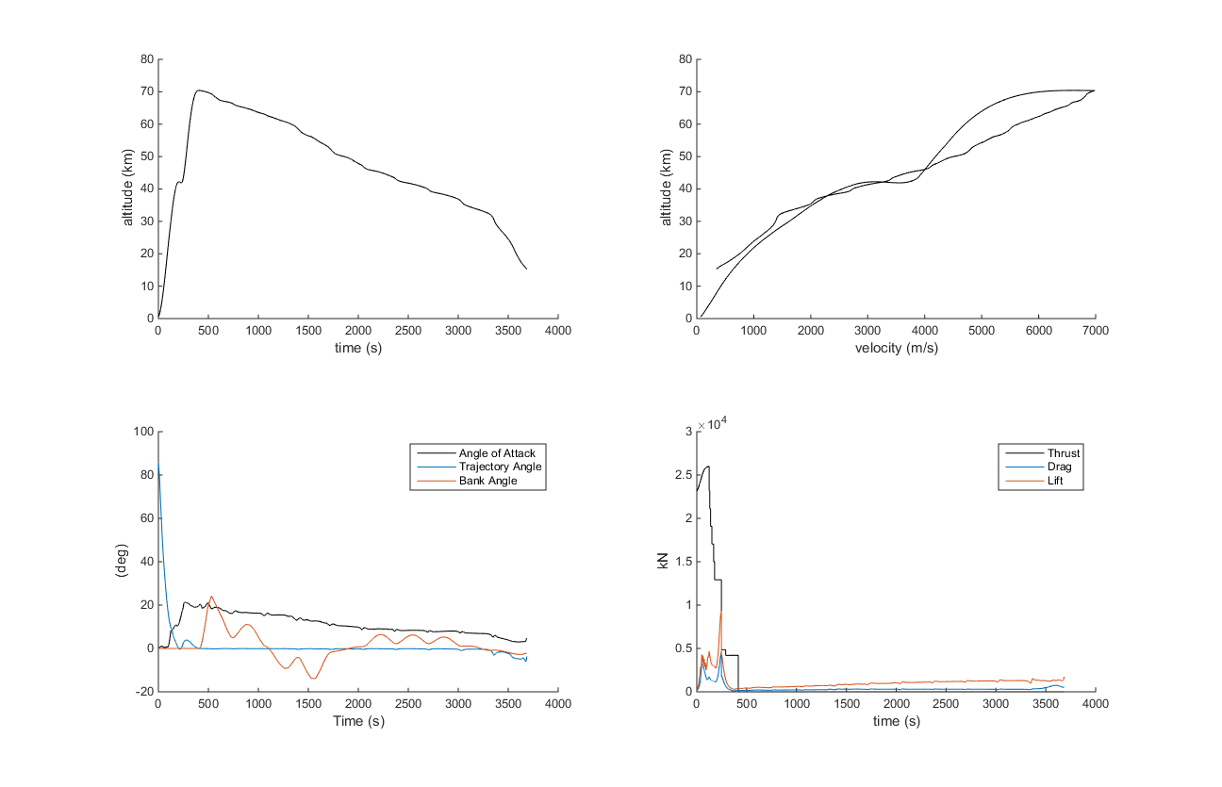
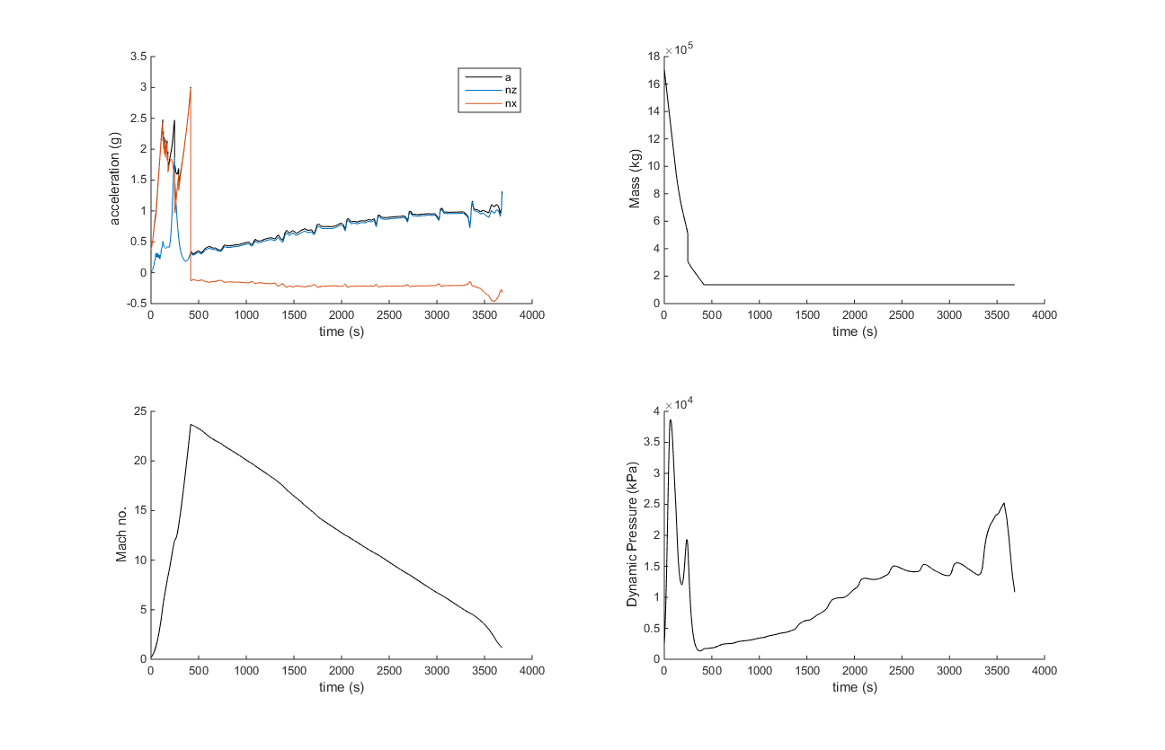
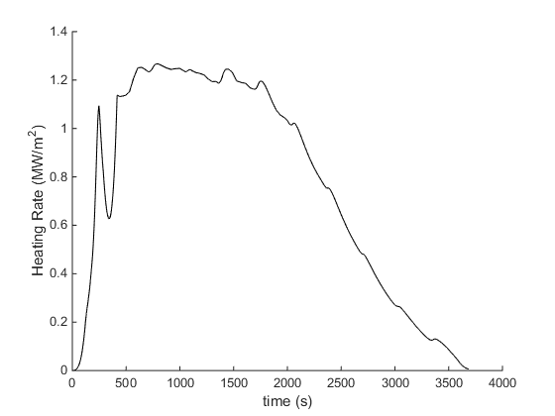
Florida-Australia

Slide 14
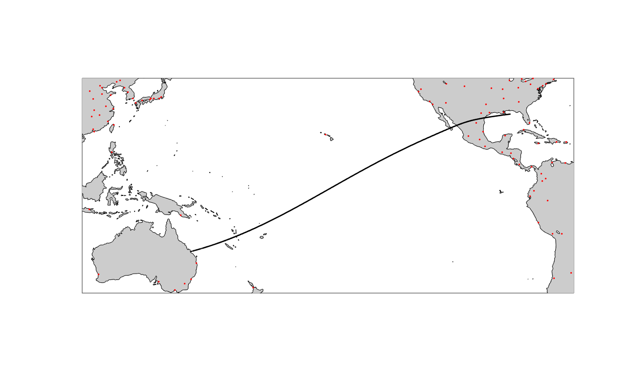
Australia-Florida

Slide 15
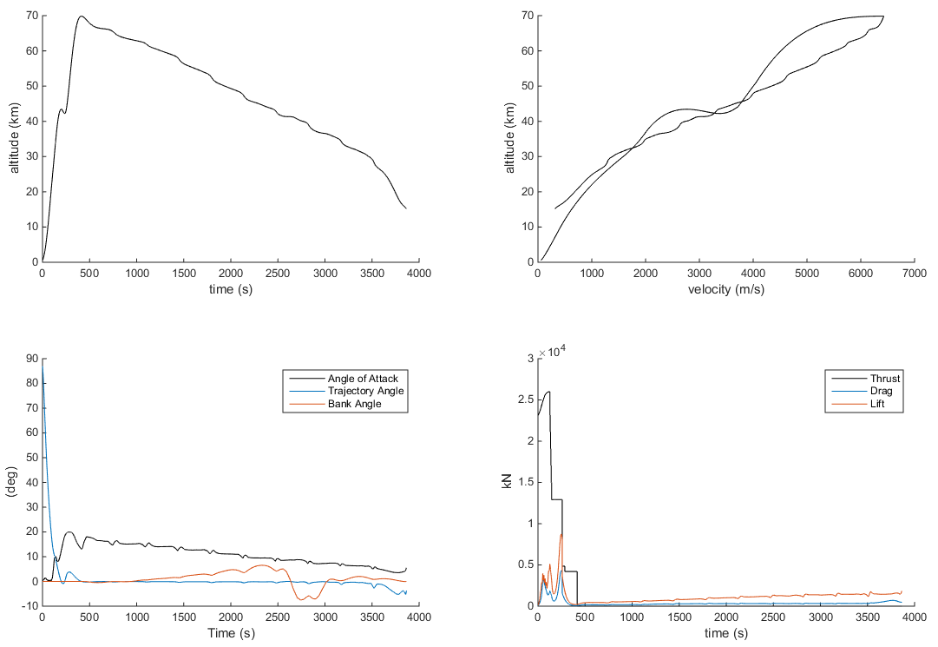
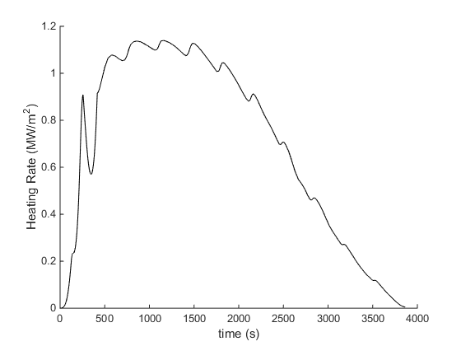
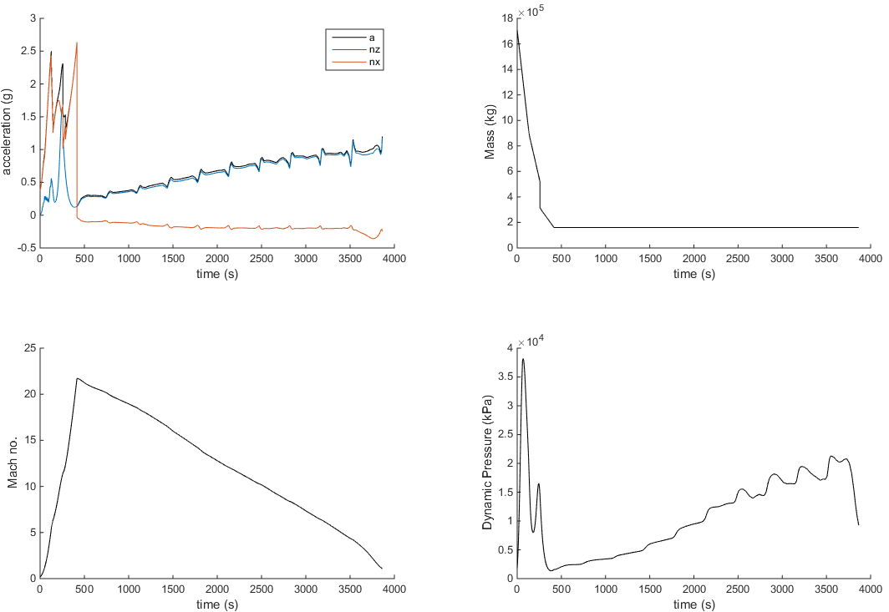
Australia-Florida

Slide 16
Conclusions

Slide 17
References
[1] M. P. Kelly, Transcription Methods for Trajectory Optimization, Cornell University, 2015

