Slide 1
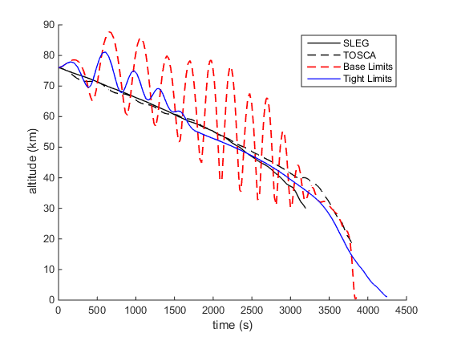
Aus-Germany Trajectory

Slide 2
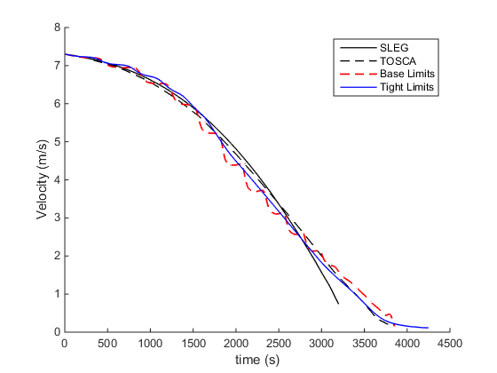
Aus-Germany Trajectory

Slide 3
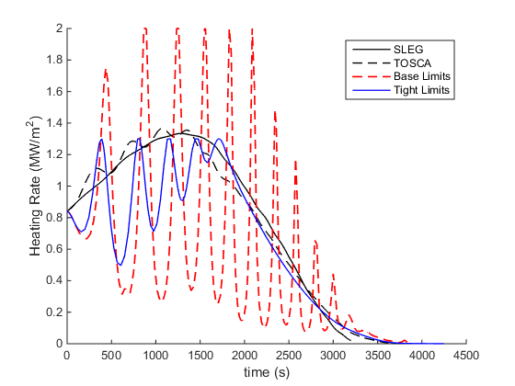
Aus-Germany Trajectory

Slide 4
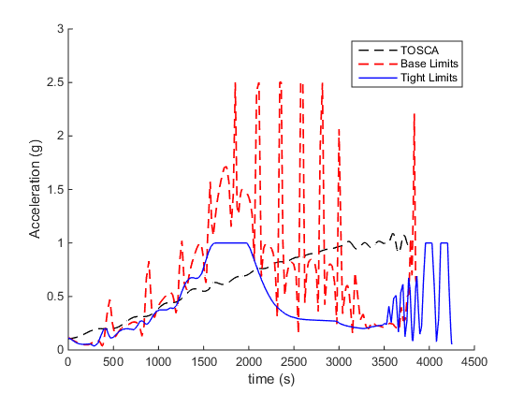
Aus-Germany Trajectory

Slide 5
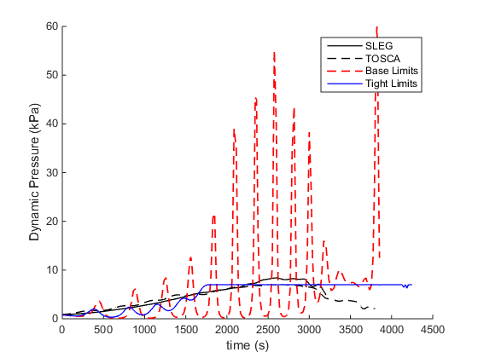
Aus-Germany Trajectory

Slide 6
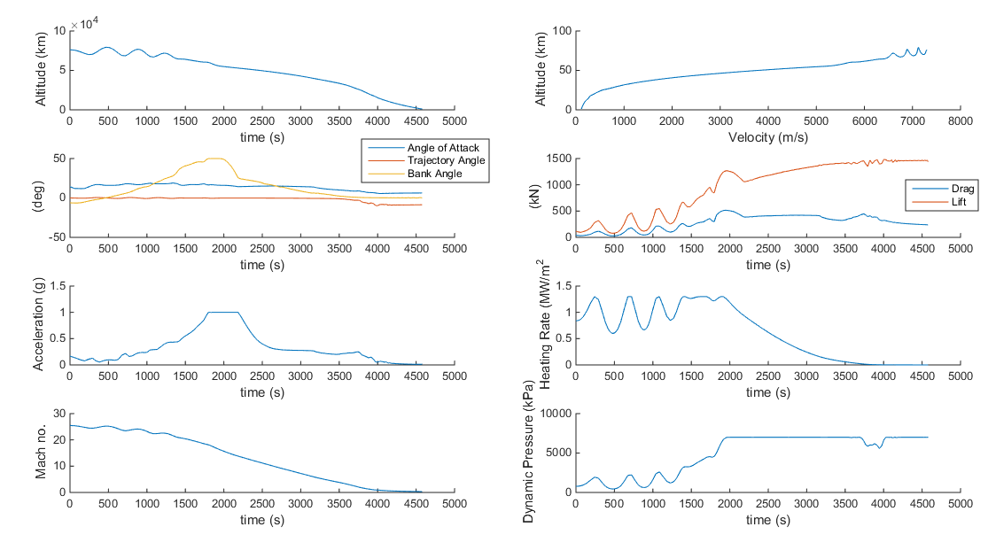
Aus-Germany Limited Trajectory

Slide 7
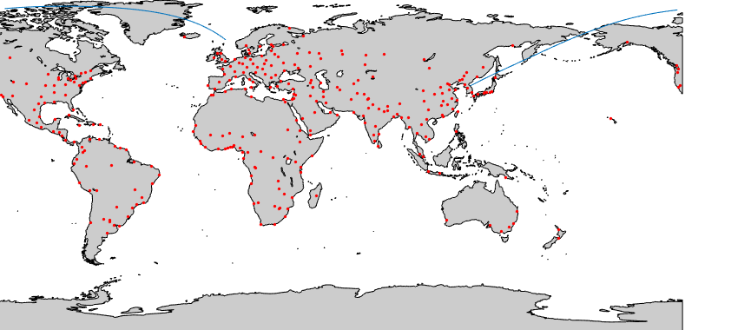
Germany-NKorea Trajectory

Slide 8
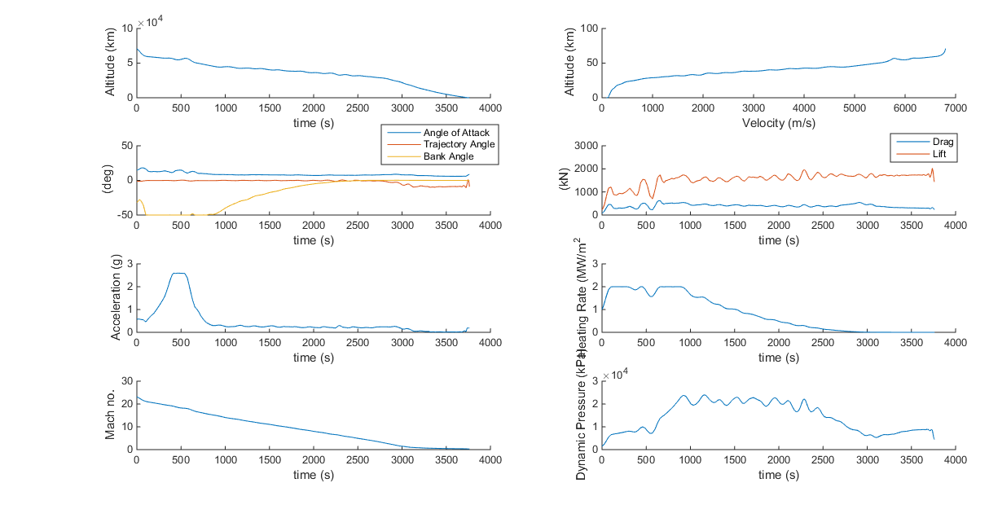
Germany-NKorea Trajectory - Descent

Slide 9
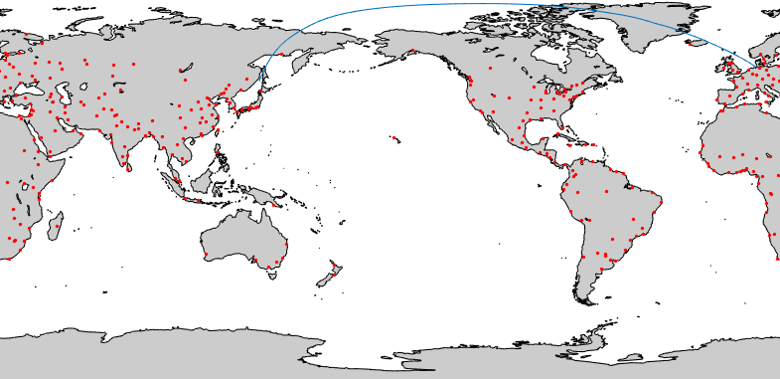
Japan-Germany Trajectory

Slide 10
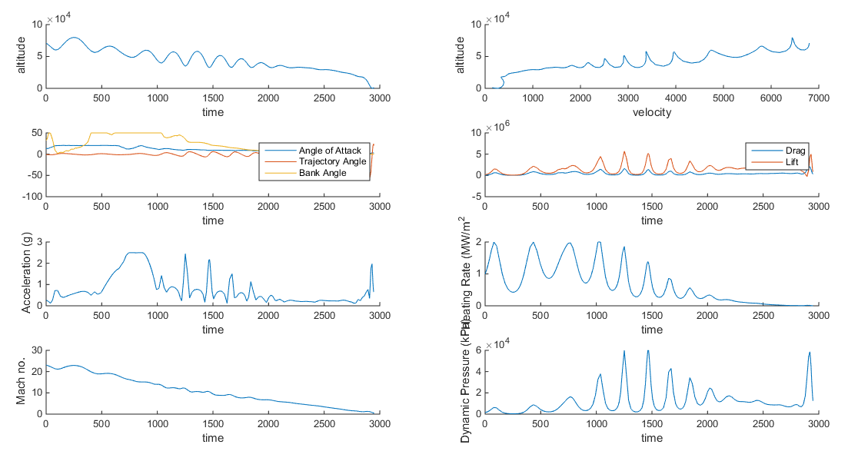
Japan-Germany Trajectory - Descent

Slide 11
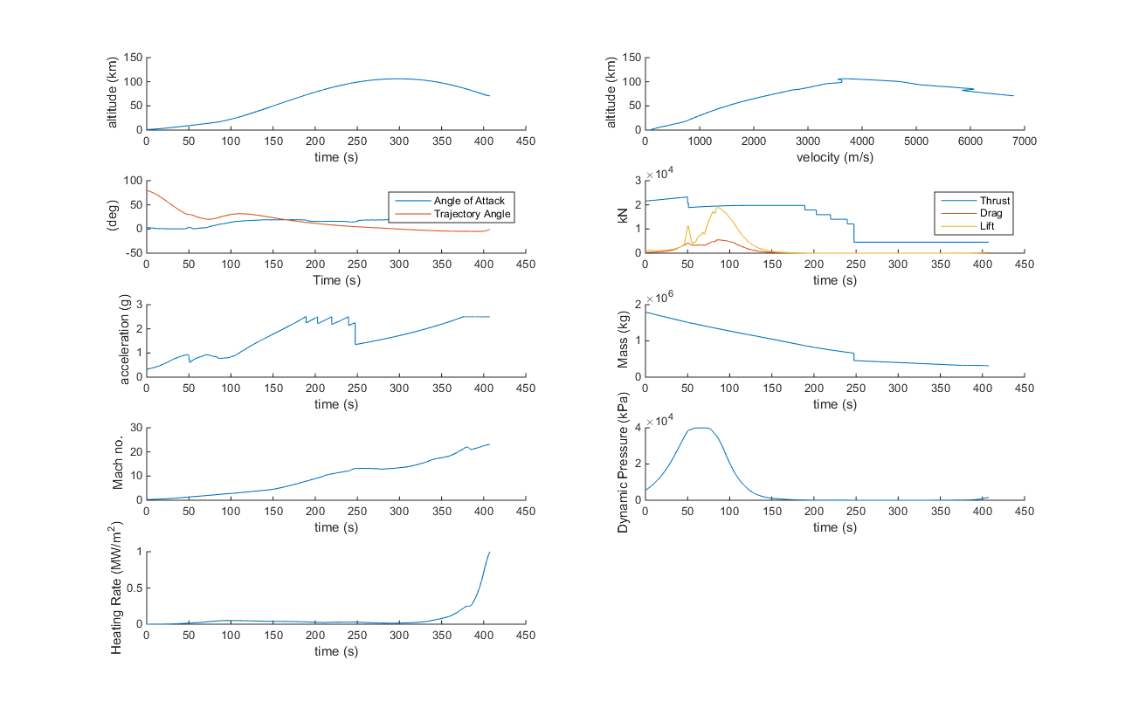
Japan-Germany Trajectory - Ascent

