Slide 1
Software Comprehensive exercise Final Report
2021/7/21 2nd,3rd,4th

Slide 2
Development environment
Team Name：MMHJ
Member：Issei Jozume・Shoma Hisano
Yusuke Matsushima・Yu Matsumura
Platform Mac , Windows
Language C language
Tool Github

Slide 3
Program Description 9 Database persistence <Requirements>：To find the score of a document using a database. <Implementation>：Created using sqlite . Persisted the words in the document, the name in the document, and the page score of the document . Used the words in the query to access the database and calculate the word score. 10 User interface implementation <Requirements> : Add, delete, and update users, books, and documents. <Implementation>: Additions expand the secondary array. Deleting initializes the evaluation value while keeping the information. 11 Strengthening Recommendation function and search engine <Requirements> : Recommendation function, enhancement of search engine <Implementation>: Query text search, use of wildcards, breadth-first search

Slide 4
Project9
if(strcmp(queries[0], "")!=0){
sql = sqlite3_mprintf("select rowid from Words where word='%q';", queries[0]);
sqlite3_exec(db, sql, callbackWord, 0, &err_msg);
//calculate word score
sql = sqlite3_mprintf("select urlid from Locations where wordid='%q';", word_id);
sqlite3_exec(db, sql, callbackQuery, 0, &err_msg);
}

Slide 5
Search with Text
for(int i=0; i<document_index; i++){
if(documents[i].wordScore==query_num) documents[i].wordScore = 1;
else documents[i].wordScore = 0;
}

Slide 6
Search with wildcard
if(strcmp(queries[0], "")!=0){
for(int i=0; i<strlen(queries[0]); i++) if (queries[0][i]=='*') queries[0][i]='%’;
sql = sqlite3_mprintf("select rowid from Words where word like '%q';", queries[0]);
sqlite3_exec(db, sql, callbackWord, 0, &err_msg);
//calculate word score
sql = sqlite3_mprintf("select urlid from Locations where wordid='%q';", word_id);
sqlite3_exec(db, sql, callbackQuery, 0, &err_msg);
}

Slide 7
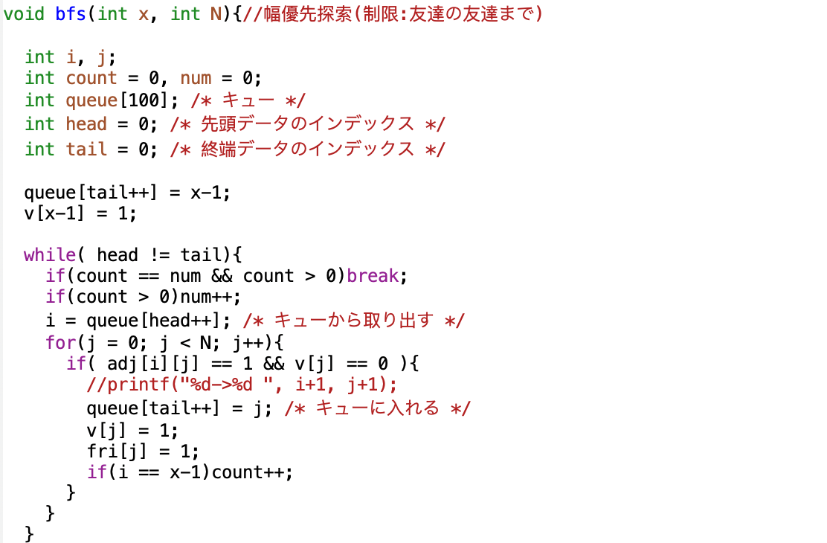
Project10
BFS

Slide 8
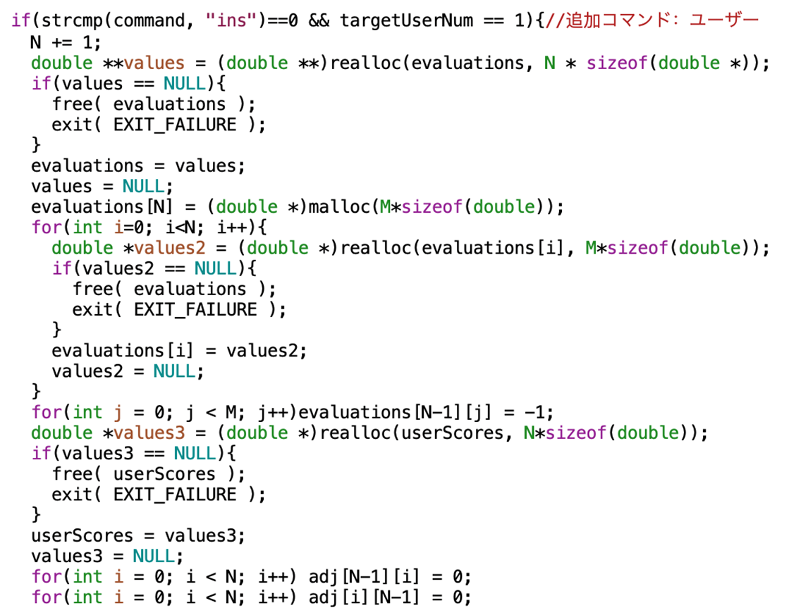
Add user command

Slide 9
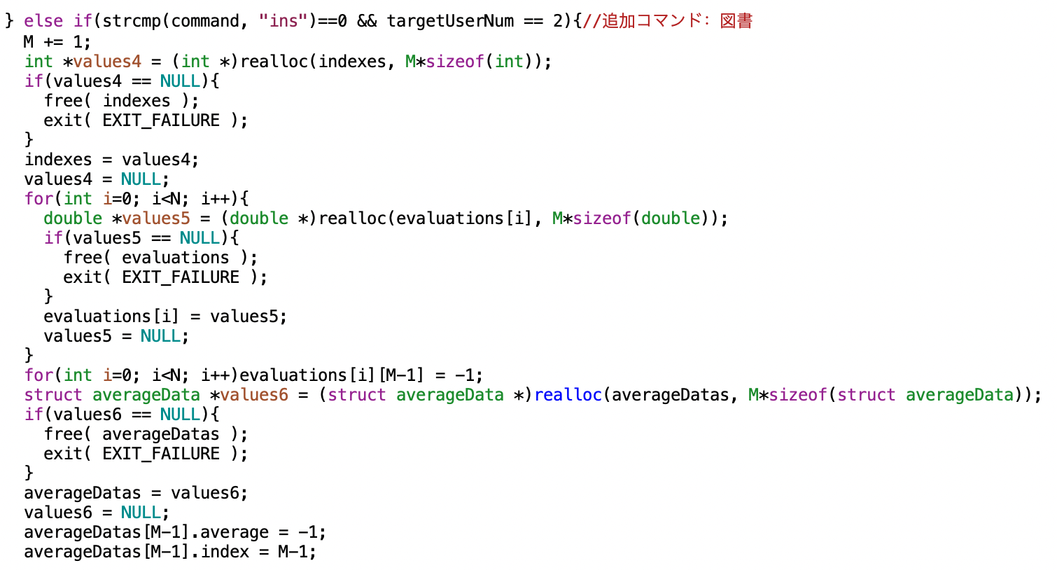
Add book command

Slide 10
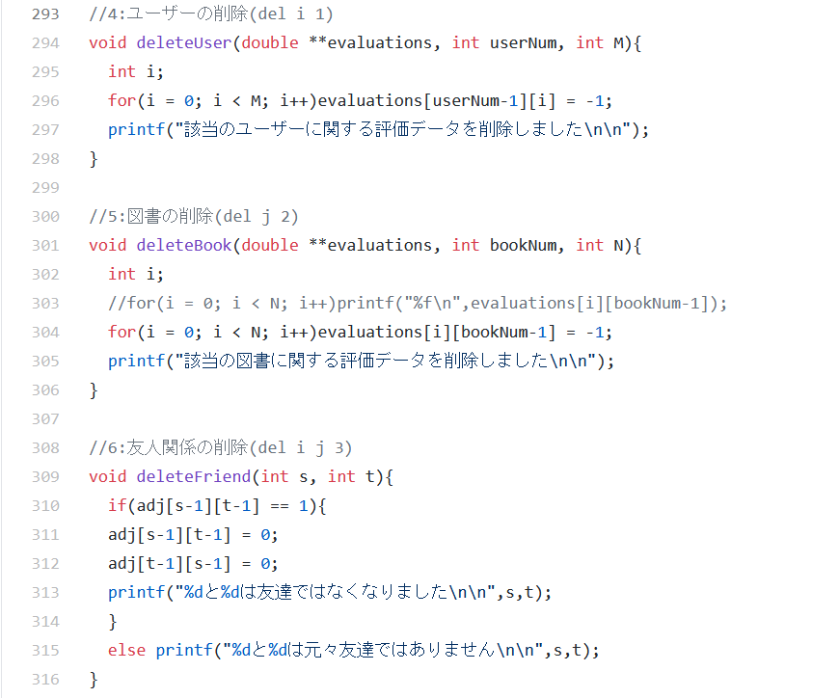
Delete command

Slide 11
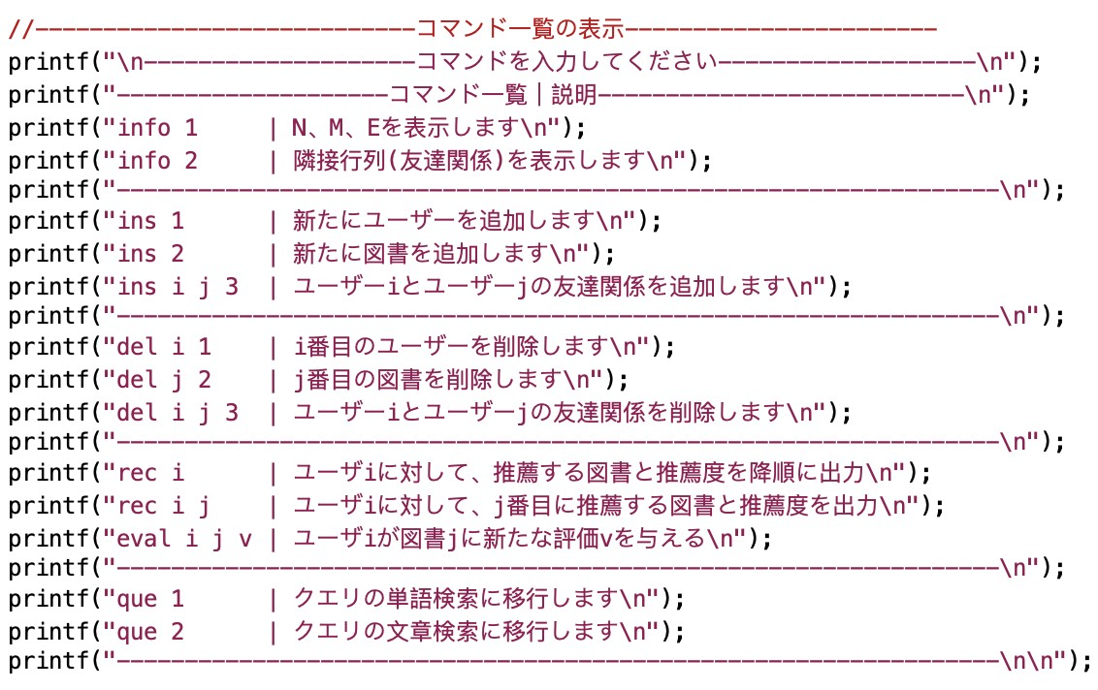
Command list

Slide 12
Degree of contribution
(The degree of contribution was determined by considering the number of lines in which the code was written, the time it took, and who's opinion was adopted when writing the code.)
Issei Jozume ex10 Integration/ex11(BFS)
Shoma Hisano ex10 (delete)
Yusuke Matsushima ex9 / ex11(query , wildCard)
Yu Matsumura. powerpoint
Member | Code(hour) | Other(hour) | All((hour)
Zyozume | 10 | 20 | 30
Hisano | 8 | 15 | 23
Matsushima | 15 | 10 | 25
Matsumura | 7 | 10 | 17

Slide 13
Consideration of whole project
Zyozume
We have learned that communication is important when developing with others. We should train ourselves to be able to use basic programming skills at any time.
Hisano
We found out that actually developing a program is very different from accomplishing a class assignment. I would like to acquire the necessary skills for development.
Matsushima
We learned the importance of understanding the correct usage of library functions.
Ｗe learned the importance of creating a program that can be understood by others.
Matsumura
Ｗe learned the importance of making programs that can be understood by others. Ｗe learned that it is important to set a firm deadline when making a joint program and to proceed with responsibility so as not to bother others. Ｗe also learned that it is important to share the programs created by others so that everyone can understand them.

