Slide 1
SOFTWARE ENGINEERING & PROJECT MANAGEMENT
CIA-III
Volcanic Image/Data Observatory
(VIDO)
A Lightweight Scientific Software System for Heterogeneous Terrestrial & Planetary Volcanology Exploration
By Tanisha Chhetri(2462160), Shomik Sahu(2462191), Paul Jestin Abhishek(2462192)
Software Engineering & Project Management (SEPM) • Final System Evaluation & Audit
Application Domain: Terrestrial (Earth WGS84) & Planetary Volcanology (Mars, Io, Venus)
Implementation Verification: Fully Verified Core MVP • 37 Passing Automated Tests

Slide 2
SOFTWARE ENGINEERING & PROJECT MANAGEMENT (SEPM)
SLIDE 2 / 15
1. Problem Definition: Heterogeneous Scientific Data Management
CORE ENGINEERING QUESTION
“How can heterogeneous scientific observations be represented, validated, related, and explored in a coherent and maintainable software system?”
• Heterogeneous Scientific Data: Multispectral imagery, thermal radiometry, orbital geometry, and point coordinates originating from diverse instruments.
• Application Domain Context: Scientific observation datasets across Earth, Mars, Io, and Venus introducing non-standard spatial and temporal constraints.
• Software Engineering Framing: Volcanology is the application domain; software design, architecture, data modeling, and verification are the primary subject.
PRIMARY SOFTWARE ENGINEERING CHALLENGES
• Coordinate Frame Disparities: Standard Earth WGS84 (-180° to +180°) vs. Planetary IAU (0° to 360° Positive East) conventions.
• Schema Rigidity & Bloat: Forcing multi-sensor attributes into flat relational SQL schemas causes sparse, brittle tables with excessive NULL columns.
• Observation / Event Conflation: Conflating observational snapshot evidence with physical eruptive events degrades domain modeling integrity.
• System Maintainability: Delivering strict domain validation and clean data access without heavy, complex framework dependencies.

Slide 3
SOFTWARE ENGINEERING & PROJECT MANAGEMENT (SEPM)
SLIDE 3 / 15
2. Requirements Engineering: Functional & Non-Functional Specifications
FUNCTIONAL REQUIREMENTS (FR)
• FR-01 Observation Management: Store and manage observation records across celestial bodies.
• FR-02 Multi-Criteria Retrieval: Query observations by date range, facet category, sensor source, and system.
• FR-03 Event Association: Relate observations to physical eruptive events using explicit relationship tags.
• FR-04 Spatial Exploration: Plot spatial markers on Earth Leaflet maps or 0°-360° planetary grids with fallback rules.
• FR-05 Timeline Exploration: Render synchronized dual-lane chronological timeline with ongoing event support.
• FR-06 Domain Validation: Enforce metadata facet validation and coordinate boundary rules prior to persistence.
NON-FUNCTIONAL REQUIREMENTS (NFR TARGETS)
• NFR-01 Maintainability: Layered 5-tier architecture enforcing separation of concerns across presentation, API, services, repos, and DB.
• NFR-02 Extensibility: Modular facet schemas allowing new observation types without database schema migrations.
• NFR-03 Testability: Decoupled domain service layer enabling isolated automated testing (core domain logic test suite).
• NFR-04 Data Integrity: Schema boundary validation (Pydantic) and database relational transaction safety.
• NFR-05 Performance & Modularity: Lightweight architecture with zero heavy build tool overhead and low query latencies.

Slide 4
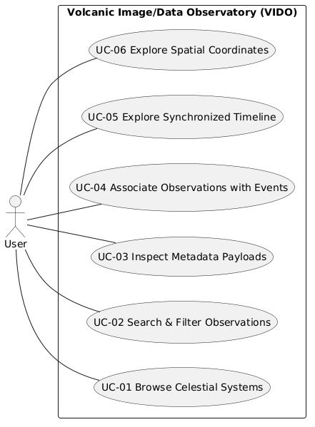
SOFTWARE ENGINEERING & PROJECT MANAGEMENT (SEPM)
SLIDE 4 / 15
3. Use Case Analysis & Mandatory UML Use Case Diagram
USE CASE MODEL & USER INTERACTIONS
“The use-case model translates functional requirements into observable interactions between the user and VIDO.”
• UC-01 Browse Celestial Systems: Select target body & explore system profiles.
• UC-02 Search & Filter Observations: Query by date, facet category, or source.
• UC-03 Inspect Metadata Payloads: View validated composite metadata facets.
• UC-04 Associate Observations with Events: Link evidence snapshots to eruptive events.
• UC-05 Explore Synchronized Timeline: Inspect dual-lane chronological feed.
• UC-06 Explore Spatial Coordinates: Render markers with spatial fallback rules.

Slide 5
SOFTWARE ENGINEERING & PROJECT MANAGEMENT (SEPM)
SLIDE 5 / 15
4. Requirements Traceability: FR → UC → API → Service → Test
END-TO-END SYSTEM TRACEABILITY PIPELINE
Requirement (FR) → Use Case (UC) → API Endpoint → Service Layer → Repository / DB → Pytest Verification
FR-01 Observation Management | Use Case: UC-02 / UC-03 | API: POST /api/v1/observations
Service: ValidationService • Repo: ObservationRepository • Verification: test_models.py, test_api.py
FR-02 Multi-Criteria Retrieval | Use Case: UC-02 | API: GET /api/v1/observations
Service: ValidationService • Repo: ObservationRepository • Verification: test_api.py
FR-03 Event Association | Use Case: UC-04 | API: POST /api/v1/observation-event-links
Service: EventService • Repo: ObservationEventLinkRepository • Verification: test_domain_rules.py, test_services.py
FR-04 Spatial Exploration | Use Case: UC-06 | API: GET /api/v1/systems/{id}/spatial
Service: SpatialService / CoordinateService • Repo: VolcanicSystemRepository / ObservationRepo • Verification: test_domain_rules.py, test_repositories.py
FR-05 Timeline Exploration | Use Case: UC-05 | API: GET /api/v1/systems/{id}/timeline
Service: TimelineService • Repo: VolcanicEventRepository / ObservationRepo • Verification: test_services.py, test_api.py
FR-06 Domain Validation | Use Case: UC-02 / UC-03 | API: Pydantic API Schemas
Service: ValidationService / CoordinateService • Persistence: Blocked until validation succeeds• Verification: test_models.py, test_domain_rules.py

Slide 6
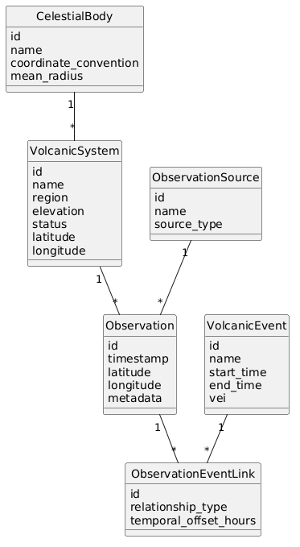
SOFTWARE ENGINEERING & PROJECT MANAGEMENT (SEPM)
SLIDE 6 / 15
5. Software Design & Mandatory UML Class Diagram
DOMAIN CLASS MODEL & RELATIONSHIPS
“Separating observations from physical events preserves distinct lifecycles and attributes while ObservationEventLink provides explicit association.”
• CelestialBody (1 → * VolcanicSystem): Planet/Moon container establishing coordinate convention.
• VolcanicSystem (1 → * Observation): Volcanic feature defining geographic base coordinates.
• ObservationSource (1 → * Observation): Sensor platform or operating scientific agency.
• Observation (1 → * Link): Point-in-time observational evidence snapshot with metadata.
• VolcanicEvent (1 → * Link): Physical eruptive episode with duration (start_time, end_time).
• ObservationEventLink: Explicit junction entity connecting observations to events.

Slide 7
SOFTWARE ENGINEERING & PROJECT MANAGEMENT (SEPM)
SLIDE 7 / 15
6. Composite Metadata Facet Architecture
REPRESENTATIVE COMPOSITE JSON PAYLOAD
{ "active_facets": [ "IMAGE", "THERMAL", "PLANETARY_ORBITAL" ], "image_metadata": { "spectral_band": "NEAR_INFRARED", "spatial_resolution_m": 10.0, "cloud_cover_percentage": 0.0 }, "thermal_metadata": { "brightness_temperature_kelvin": 245.5, "thermal_flux_mw": 12.4, "anomaly_flag": false }, "orbital_metadata": { "spacecraft_altitude_km": 310.5, "solar_incidence_angle_deg": 62.1, "target_planetary_datum": "IAU_MARS_2000" } }
MODULAR FACET COMPOSITION PATTERN
• Observation Facet Structure: Observation entity encapsulates non-mutually-exclusive metadata facets rather than rigid subclassing.
• IMAGE Facet: Spectral band, spatial resolution (m), cloud cover %, file format, sun elevation angle.
• THERMAL Facet: Brightness temperature (K), ambient temp (K), thermal flux (MW), anomaly flag.
• PLANETARY_ORBITAL Facet: Spacecraft altitude (km), solar incidence angle, emission angle, target planetary datum.
• Validation Guarantee: Pydantic v2 schemas reject malformed or out-of-bounds payloads at API boundaries.

Slide 8
SOFTWARE ENGINEERING & PROJECT MANAGEMENT (SEPM)
SLIDE 8 / 15
7. System Architecture: 5-Layer Software Pipeline
Presentation Layer
Vanilla HTML5 / CSS3 / ES6 JS
Renders responsive web UI, Leaflet Earth maps, Canvas 2D planetary grids, and interactive timeline visualizers without heavy frontend build tool overhead.
API Layer
Python FastAPI REST Server
Exposes REST endpoints (/api/v1), serializes request/response payloads, executes Pydantic schema boundary validation, handles HTTP status routing, and serves Swagger OpenAPI docs.
Service Layer — Business & Domain Logic
Domain & Business Services
Executes domain/business validation, coordinate resolution, spatial fallback rules, event rules, and timeline aggregation.
Repository Layer
Data Access Abstraction
Encapsulates database SQL operations, providing clean, decoupled interfaces for systems, observations, events, and association links.
Database Layer
SQLite 3 Relational Engine
Provides persistent, ACID-compliant storage with SQLite 3 JSON1 support for composite observation metadata facets.

Slide 9
SOFTWARE ENGINEERING & PROJECT MANAGEMENT (SEPM)
SLIDE 9 / 15
8. Design Decisions & Engineering Trade-offs
Relational Core + JSON Metadata
Combines SQL relational structure with SQLite JSON1 metadata fields. Prevents schema rigidity while retaining query capabilities.
Decoupled Obs & Event Entities
Models observations (evidence snapshots) separately from events (phenomena). Prevents data loss when linking multi-event observations.
Body-Specific Coordinate Handling
Enforces Earth WGS84 (-180°..+180°) vs. Planetary IAU (0°..360° Positive East) conventions. Prevents spatial projection errors.
Explicit Spatial Fallback Rules
Applies a 3-step fallback pipeline (Obs Coords → Volcano Coords → UNLOCATED). Prevents coordinate fabrication.
Service / Repository Abstraction
Decouples business logic from persistence logic. Prevents SQL leaks into API controllers and enables unit test isolation.
Conservative MVP Scope Boundary
Focuses on robust core domain modeling, API, and validation rather than unverified complex modules. Prevents scope creep.

Slide 10
SOFTWARE ENGINEERING & PROJECT MANAGEMENT (SEPM)
SLIDE 10 / 15
9. Validation & Business Rules Architecture
TIER 1: API SCHEMA VALIDATION (PYDANTIC)
• Boundary Schema Enforcement: Validates request JSON payloads at API entry points before database invocation.
• Attribute Type Checking: Guarantees correct string, float, integer, and datetime field formatting.
• Facet Payload Validation: Validates nested image_metadata, thermal_metadata, and orbital_metadata objects.
• Value Range Rules: Rejects negative Kelvin temperatures, out-of-range sensor angles, or invalid file extensions.
TIER 2: DOMAIN & BUSINESS RULE VALIDATION
→ Body Coordinate Boundary Checks: Enforces Earth WGS84 (-180°..+180°) vs. Planetary IAU (0°..360° Positive East) bounds.
→ Temporal Event Sequence Rules: Ensures event end_time cannot precede start_time (when end_time is provided).
→ Relationship Classification Rules: Enforces valid Observation ↔ Event tags (PRE_ERUPTIVE, CO_ERUPTIVE, POST_ERUPTIVE, UNRELATED).
→ Spatial Fallback Resolution: Classifies coordinates into OBSERVATION, VOLCANO_FALLBACK, or UNLOCATED states cleanly.

Slide 11
SOFTWARE ENGINEERING & PROJECT MANAGEMENT (SEPM)
SLIDE 11 / 15
10. Development Process: Phased SDLC Workflow
1. Problem Definition & SRS
Formalized engineering problem statement and compiled Software Requirements Specification.
2. Requirements Audit
Audited domain parameters and mapped functional vs. non-functional requirement targets.
3. Data Layer & Entities
Designed SQLite relational tables, JSON metadata fields, and Pydantic validation schemas.
4. Business Logic Services
Implemented coordinate resolution, spatial fallback rules, event rules, and timeline aggregation.
5. API Layer
Exposed REST endpoints (/api/v1) with OpenAPI Swagger docs and robust HTTP error routing.
6. Frontend Interface
Built responsive web UI with Leaflet maps, Canvas 2D planetary grid, and timeline visualizers.
7. Automated Verification
Developed pytest test suite covering API routes, domain rules, schemas, and repositories.
8. Presentation & QC
Audited implementation claims against codebase evidence and prepared evaluation materials.

Slide 12
SOFTWARE ENGINEERING & PROJECT MANAGEMENT (SEPM)
SLIDE 12 / 15
11. Scope Control & Risk Management Strategy
DELIBERATE SCOPE CONTROL
• Implemented Core MVP Scope: Unified domain model, multi-body CRS, composite facet validation, 5-layer pipeline, dual-lane timeline, spatial fallback visualizer, REST API, 37 automated tests.
• Explicit Non-Implemented Future Scope: Streaming satellite telemetry pipelines, computer vision thermal anomaly workers, GeoServer WMS integration, user authentication/authorization.
• Scope Boundary Principle: Maintaining strict boundaries prevented unfinished features from degrading core software quality.
RISK MITIGATION MATRIX
⚙ Heterogeneous Data Distortion Risk: Mitigated by Composite Metadata Facet validation pattern.
⚙ Coordinate Frame Mismatch Risk: Mitigated by CelestialBody explicit CRS conventions (WGS84 vs. IAU).
⚙ Observation/Event Ambiguity Risk: Mitigated by explicit ObservationEventLink junction modeling.
⚙ Scope Creep Risk: Mitigated by strict SRS specification and phase verification.
⚙ Regression & Code Fragility Risk: Mitigated by 37 passing automated pytest unit/integration tests.

Slide 13
SOFTWARE ENGINEERING & PROJECT MANAGEMENT (SEPM)
SLIDE 13 / 15
12. Testing & System Verification Results
✓ 37 / 37 AUTOMATED TESTS PASSED
Fully verified core MVP implementation across API endpoints, domain rules, metadata schemas, repositories, and services.
API Endpoint Integration (15 tests)
API integration tests covering catalog, observation, event, spatial, and timeline REST endpoints.
Domain Rules & Boundaries (5 tests)
Validates coordinate boundary enforcement (Earth vs. Mars/Io) and temporal sequence validity.
Model & Facet Schemas (6 tests)
Tests Pydantic metadata facet validation (IMAGE, THERMAL, PLANETARY_ORBITAL) rejecting illegal payloads.
Repository & Persistence (5 tests)
Verifies SQLite 3 SQL/JSON data access, insertion transactions, and complex query filtering.
Business Service Logic (5 tests)
Verifies timeline aggregation logic, ongoing event handling (NULL end_time), and spatial fallback resolution.
Seed Data Verification (1 test)
Ensures initial seed dataset across Earth, Mars, Io, and Venus populates without relational errors.

Slide 14
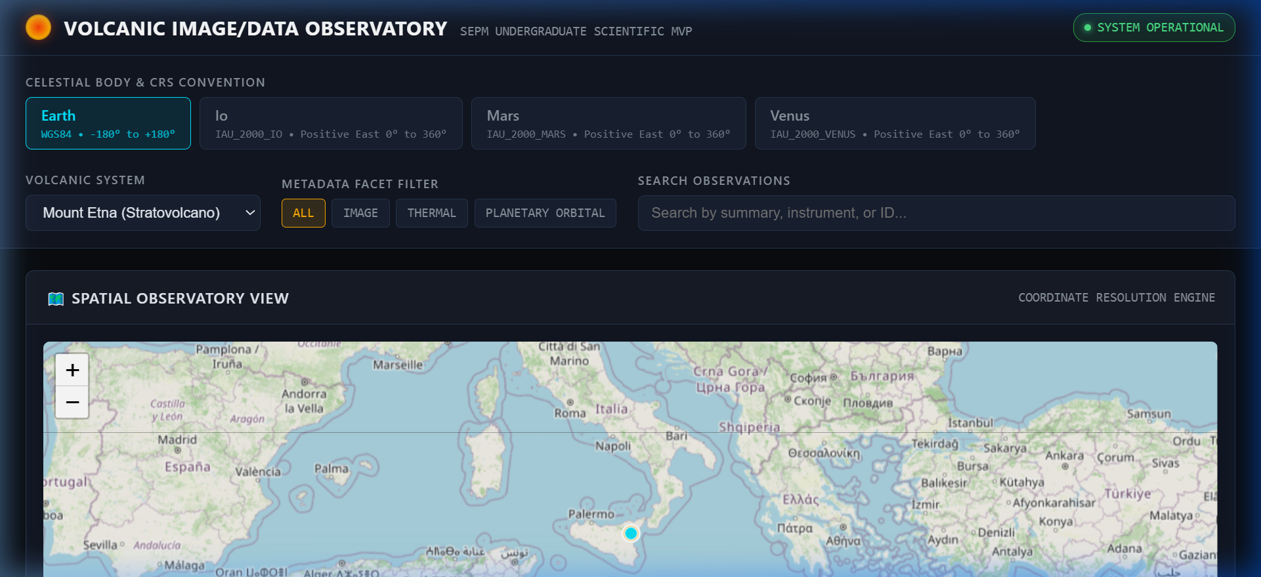
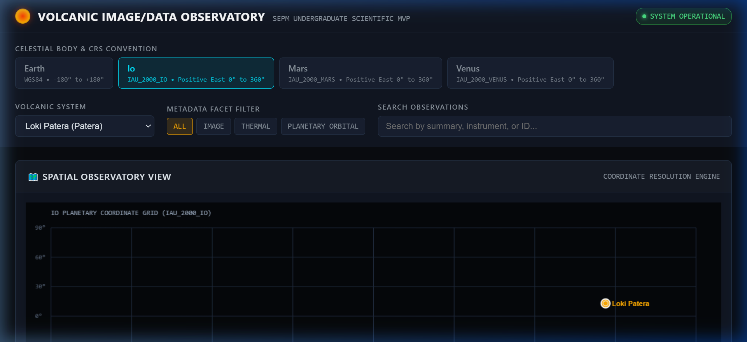
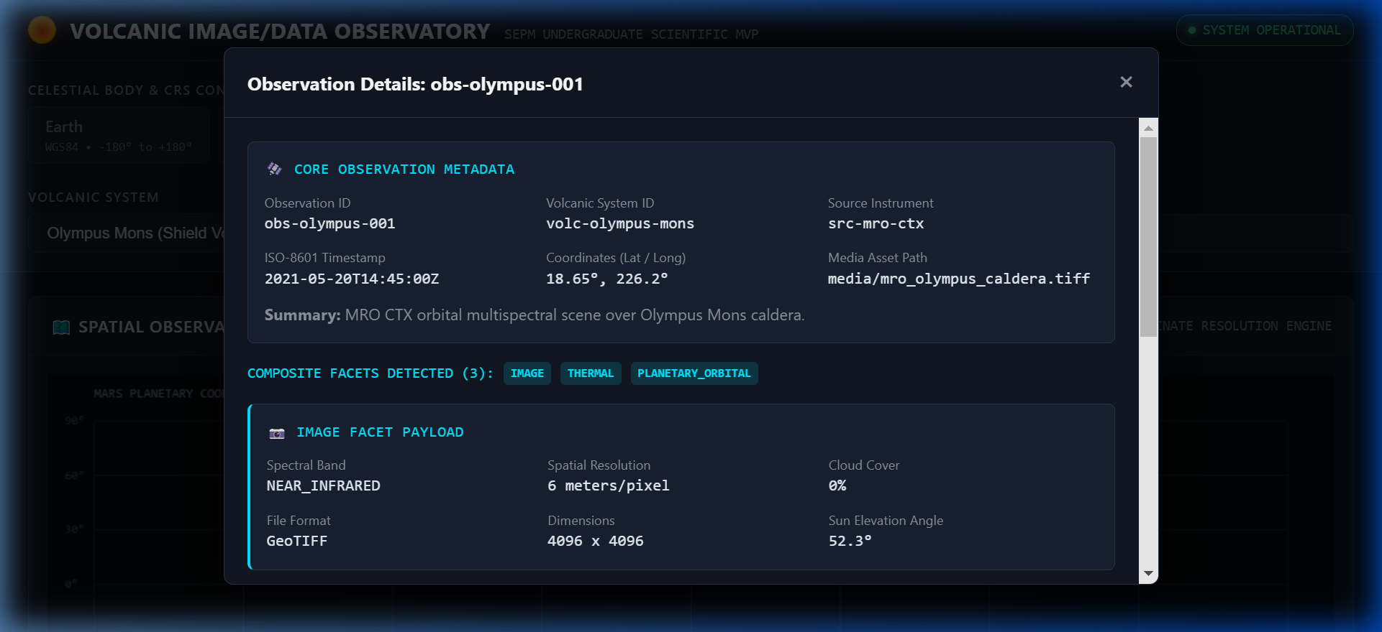
SOFTWARE ENGINEERING & PROJECT MANAGEMENT (SEPM)
SLIDE 14 / 15
13. Implementation Demonstration: Software Evidence
Mount Etna / Earth
Loki Patera / Io
Olympus Mons / Mars
Leaflet Earth Map view rendering geographic spatial representation & eruptive timeline feed.
Canvas 2D Planetary Grid plotting Io thermal observations in 0°-360° Positive East CRS.
Composite Metadata Inspector modal rendering active IMAGE, THERMAL & PLANETARY_ORBITAL facets.

Slide 15
SOFTWARE ENGINEERING & PROJECT MANAGEMENT (SEPM)
SLIDE 15 / 15
14. Team Contributions, Limitations & SEPM Conclusion
TEAM CONTRIBUTIONS & LIMITATIONS
• Technical Implementation: Architecture, database schema, FastAPI backend, business validation services, frontend UI, and pytest test suite.
• Documentation & SRS: Software Requirements Specification (SRS), domain requirements audit, system documentation, and architecture specifications.
• Presentation & QC Audit: Presentation deck, visual alignment, speaker notes, and quality audit.
• Current Scope Limitations: Manual dataset seeding; non-automated satellite ingestion; local SQLite storage rather than distributed database.
SEPM CONCLUSION
“VIDO demonstrates the design and implementation of a modular scientific information system capable of representing heterogeneous observations, enforcing domain rules, relating observations to events, exposing functionality through a layered API, and supporting interactive exploration with automated verification.”
✓ Layered Architecture: Layered pipeline enforces separation of concerns and supports data integrity and testability.
✓ Automated Verification: 37 / 37 automated tests verify core domain rules, APIs, and repositories.
✓ Future Scope Roadmap: Telemetry streaming pipelines, CV anomaly detection workers, GeoServer WMS integration, and user authorization.

