Slide 1
WEALTH · LONGEVITY · CARBON
Wealth, longevity & carbon
Can economies live longer
without emitting more?
A historical comparison using worlddata.csv · BUDT704
2011
182 economies
171 economies
Common comparison year
Main descriptive sample
Complete model sample
Source: worlddata.csv | Historical data | AI-assisted analysis & slides
01 / 09
Notes:
Slide 1: Wealth, longevity & carbon
Imagine two economies with similar incomes, but very different life expectancies. Now imagine that the economy where people live longer also emits less carbon per person. What would that tell us about development? This project investigates the relationship between wealth, longevity, and carbon emissions using only the supplied worlddata dataset. We will first examine differences across economies in a common historical year. Then we will follow the same economies over time. Finally, we will ask whether a predictive model can explain longevity more accurately than income alone. The central message is that wealth and health are strongly associated, but income does not capture the whole picture. Throughout the presentation, prediction and correlation are treated as evidence about patterns, rather than proof of causes.
Before interpreting a chart, we need a defensible sample. The file contains about five point six six million rows and thirteen hundred forty four indicators, recorded in long format. Following the course merging example, I selected exact names from IndicatorName and pivoted them into one row per economy and year. I checked for duplicate keys before pivoting. Thirty three regional and income aggregates were removed, because including the world or an income group alongside its member economies would double count information. I chose twenty eleven using a coverage rule fixed before examining relationships. Carbon observations stop after that year. The main comparison includes one hundred eighty two economies, while the model requires one hundred seventy one complete cases. Missing values were never filled with zeros.

Slide 2
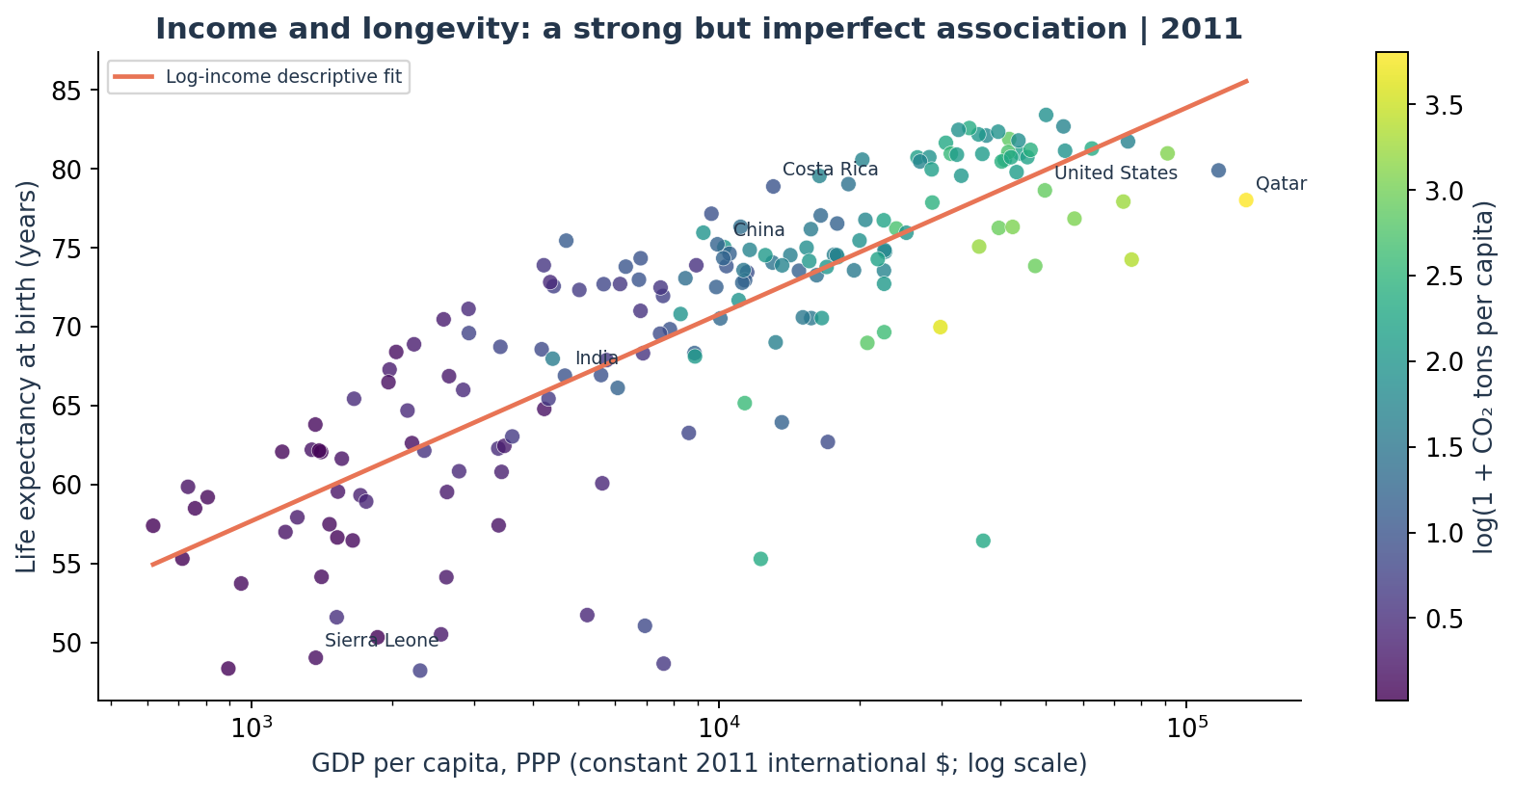
WEALTH · LONGEVITY · CARBON
Higher income, longer lives
0.842
Income–longevity rank
correlation
182 economies · 2011
Income shown on a log scale
Color shows CO₂ per person
Source: worlddata.csv | Historical data | AI-assisted analysis & slides
02 / 09
Notes:
Slide 2: Higher income, longer lives
This chart places income per person on the horizontal axis and life expectancy on the vertical axis. The income axis is logarithmic, so moving the same distance means the same proportional increase in income. Each dot has equal size, preventing large populations from dominating the picture. Color represents carbon emissions per person. The rank correlation between income and longevity is zero point eight four two, indicating a strong positive association. However, the vertical spread is substantial. Economies at similar income levels can have quite different life expectancy. The fitted logarithmic curve is a descriptive summary rather than a causal law. It suggests that proportional income comparisons are more informative here than a straight line through raw dollar values.

Slide 3
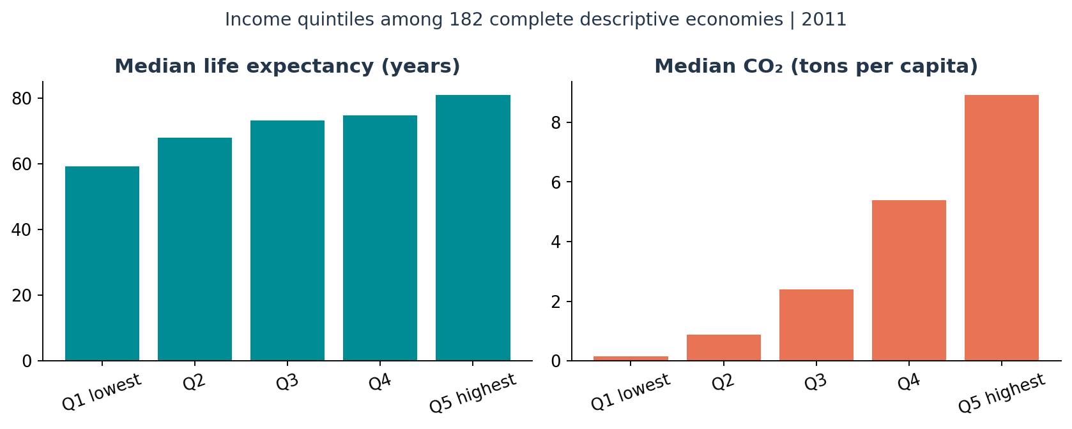
WEALTH · LONGEVITY · CARBON
Longer lives, higher emissions
59.2 → 81.0
Median life expectancy, years
Lowest → highest income fifth
Median CO₂: 0.16 → 8.92
tons per person
Source: worlddata.csv | Historical data | AI-assisted analysis & slides
03 / 09
Notes:
Slide 3: Longer lives, higher emissions
To make the pattern easier to compare, I divided the same one hundred eighty two economies into five equally sized income groups. These are sample quintiles, rather than official income classifications. Median life expectancy rises from fifty nine point two years in the lowest group to eighty one years in the highest. Median carbon emissions rise from zero point one six to eight point nine two tons per person. Using the unrounded values, that is approximately fifty four times as much carbon. These are separate group medians, so they do not describe a single representative economy. The comparison shows why development should be evaluated using more than one outcome. Longer lives are valuable, but emissions tell a different part of the story.

Slide 4
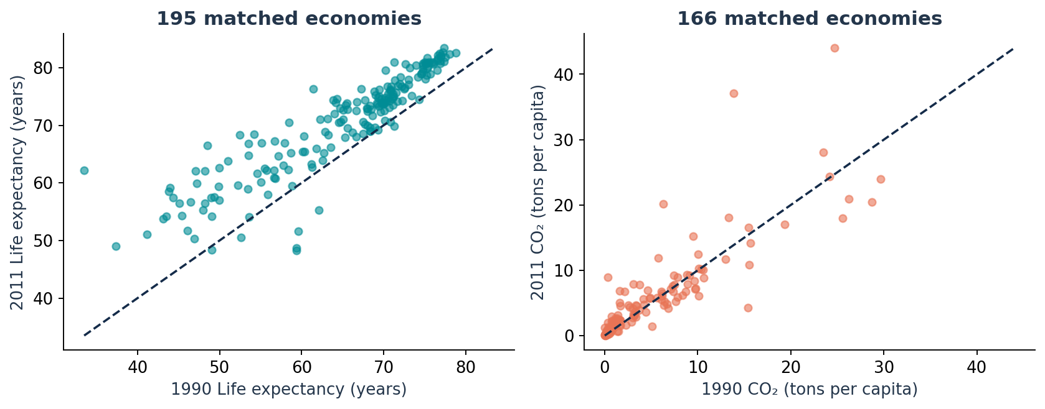
WEALTH · LONGEVITY · CARBON
Longevity improved; emissions often rose
+5.58 years
Mean longevity gain,
1990–2011
195 matched economies
CO₂ rose in 70.5% of a
separate
166-economy sample.
Source: worlddata.csv | Historical data | AI-assisted analysis & slides
04 / 09
Notes:
Slide 4: Longevity improved; emissions often rose
A cross section cannot show whether individual economies improved. For that, I matched exact observations from nineteen ninety and twenty eleven using economy codes. In the left chart, points above the diagonal indicate longer life expectancy. Across one hundred ninety five matched economies, the average gain was five point five eight years, and ninety five point four percent improved. Resampling economies gives an interval from about five to six point two years for the mean gain. The right chart repeats the exercise for emissions, using a different matched sample of one hundred sixty six economies. Carbon emissions per person rose in seventy point five percent of those cases. Because the samples differ, those two percentages should not be combined as if they described the same economies.

Slide 5
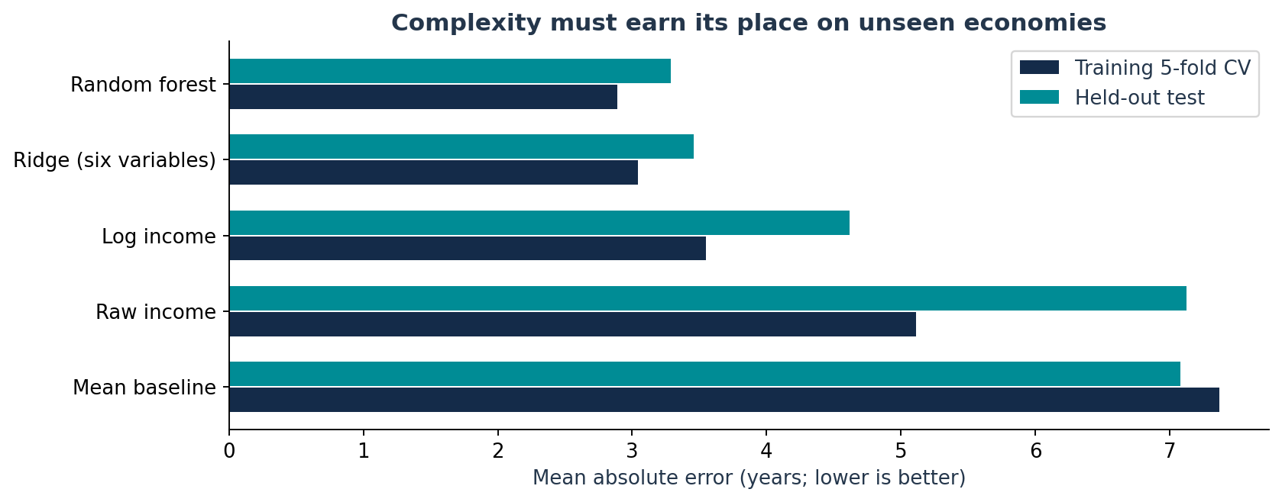
WEALTH · LONGEVITY · CARBON
More than income improves prediction
29% less error
Forest vs. log-income model
Test MAE: 3.29 vs. 4.62 years
128 train / 43 test economies
Five-fold selection within
training
Source: worlddata.csv | Historical data | AI-assisted analysis & slides
05 / 09
Notes:
Slide 5: More than income improves prediction
Next, I tested whether additional development indicators improve prediction. The outcome is life expectancy in twenty eleven. Predictors include income, carbon emissions, access to sanitation, access to drinking water, health expenditure as a share of GDP, and urbanization. I excluded infant mortality because it is closely connected to the construction of life expectancy and could make the task too mechanical. All models use the same complete sample. One hundred twenty eight economies form the training set, and forty three are held out. Five fold cross validation inside training selects model settings using average absolute error. The test set is evaluated only after that selection. This design asks whether a model works on unseen economies, instead of rewarding a more complicated fit to familiar observations.
The random forest had the lowest cross validation error in training and was selected before examining the test results. On the forty three held out economies, its average absolute error was three point two nine years. The log income model missed by four point six two years on average. That is an improvement of one point three three years, or about twenty nine percent. Paired resampling of the same test economies gives an improvement interval from roughly half a year to two point two years. The ridge model performs almost as well as the forest, while raw income regression performs poorly. This supports using transformed income and additional development indicators. However, one small test split cannot establish that the forest will always be the best model.

Slide 6
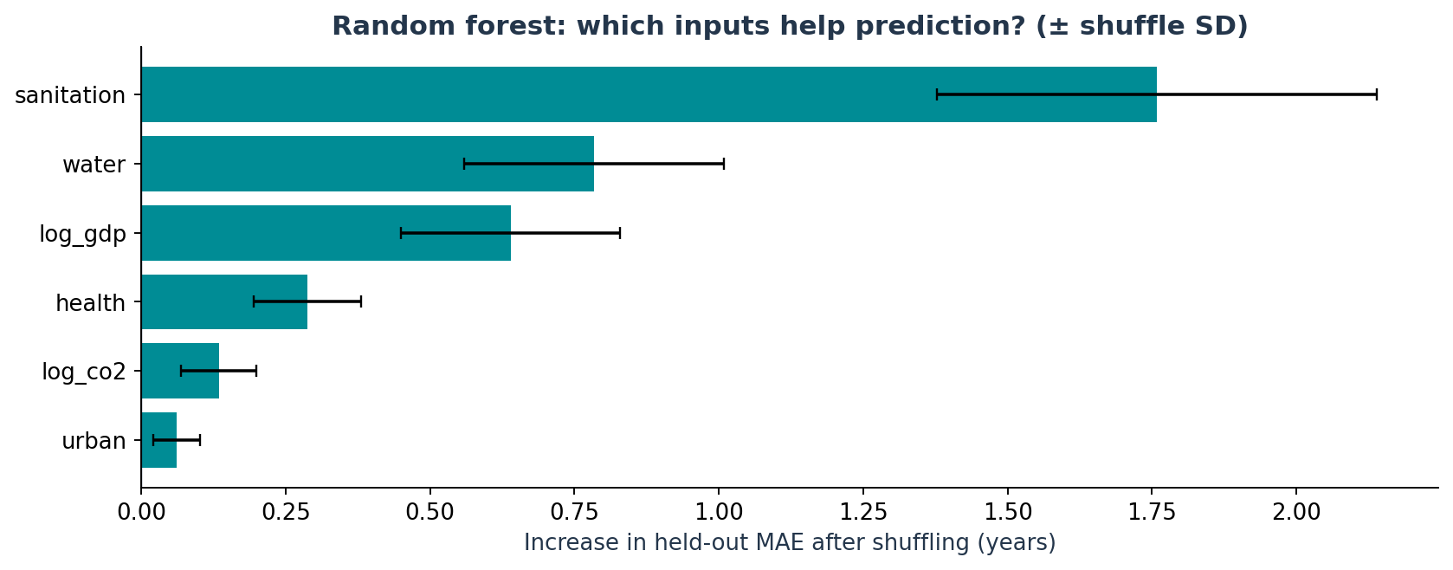
WEALTH · LONGEVITY · CARBON
Sanitation is the strongest model signal
+1.76 years
Extra test error when
sanitation is shuffled
Water and income also help.
Predictive importance ≠
causation.
Source: worlddata.csv | Historical data | AI-assisted analysis & slides
06 / 09
Notes:
Slide 6: Sanitation is the strongest model signal
Which inputs actually help the forest predict? I shuffled one predictor at a time in the held out test sample and measured the increase in prediction error. Shuffling sanitation access increased average absolute error by about one point seven six years, the largest change among these variables. Water access and income also contributed useful information. Carbon and urbanization had smaller incremental contributions in this model. The error bars show variation across repeated shuffles; they are not confidence intervals for causal effects. If two variables contain overlapping information, either can appear less important because the other remains available. Sanitation is therefore the strongest predictive signal in this fitted model, but this result does not quantify how much life expectancy would change after a sanitation intervention.

Slide 7
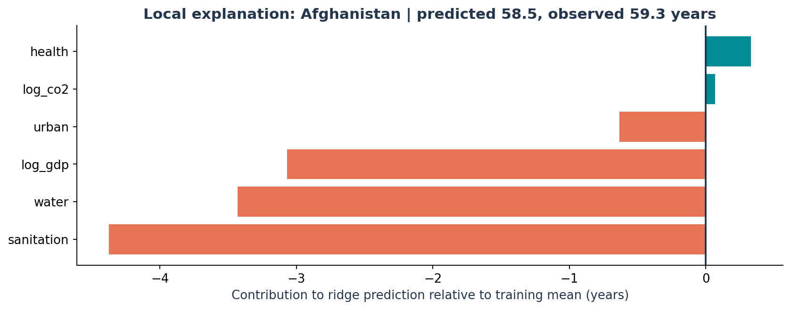
WEALTH · LONGEVITY · CARBON
One prediction, explained
58.5 years
Ridge prediction: Afghanistan
Observed: 59.3 years
Lower sanitation, water and
income
pull the prediction below
baseline.
Source: worlddata.csv | Historical data | AI-assisted analysis & slides
07 / 09
Notes:
Slide 7: One prediction, explained
A global ranking does not explain an individual prediction. For a transparent local example, I used the ridge regression and chose the alphabetically first economy in the test set, Afghanistan. This selection avoids choosing a case simply because the model looks impressive. The ridge prediction is fifty eight point five years, compared with an observed value of fifty nine point three. Its starting value is the training mean, about sixty nine point six years. Standardized feature contributions add to that baseline exactly. Lower sanitation access, water access, and income account for the largest downward contributions. These bars explain the arithmetic of the ridge prediction. They are relative to training averages, and they do not estimate what a particular policy would achieve.

Slide 8
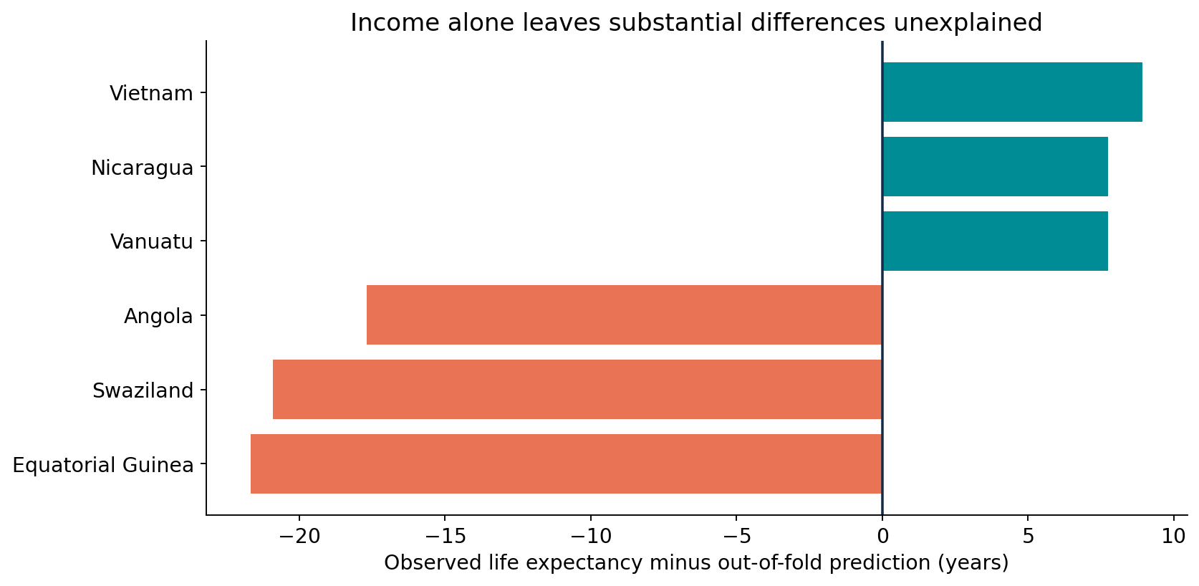
WEALTH · LONGEVITY · CARBON
Some economies broke the pattern
29 of 140
Income and longevity rose
while CO₂ per person fell.
Joint sample · 1990–2011
Endpoint changes do not
explain why.
Source: worlddata.csv | Historical data | AI-assisted analysis & slides
08 / 09
Notes:
Slide 8: Some economies broke the pattern
The remaining differences are informative. I generated out of fold predictions using only log income, so each economy was predicted by a model that had not trained on it. Vietnam's life expectancy was about eight point nine years above that prediction, while Equatorial Guinea was about twenty one point seven years below it. Those gaps are descriptive exceptions, not rankings of policy quality. I also matched all three outcomes at both historical endpoints. Among 140 economies with complete joint observations, 29 increased income and longevity while reducing carbon emissions per person. This establishes that the combination occurred in this dataset. It does not explain the mechanism, imply a continuous trend, or show that total or consumption based emissions also fell.
The chart shows out-of-fold income-model residuals; the 29-of-140 statistic is a separate matched endpoint analysis. It refers to emissions per person, not total emissions.

Slide 9
WEALTH · LONGEVITY · CARBON
Measure progress beyond income
Wealth tracks longevity.
Development has more than one outcome.
Income alone misses important differences.
Track health and carbon together.
Selection
Uncertainty
Causality
Missingness changes the sample
Only 43 test economies
Associations do not prove effects
Source: worlddata.csv | Historical data | AI-assisted analysis & slides
09 / 09
Notes:
Slide 9: Measure progress beyond income
Several checks help bound these conclusions. Removing the richest five percent barely changes the income and longevity rank correlation, from zero point eight four two to zero point eight three zero. The broad association is therefore not driven only by the wealthiest economies. Still, complete cases differ from excluded observations, so the model sample is not automatically representative. Average longevity across economies is about seventy point three years, versus seventy point eight when weighted by population, answering a different question. Important omitted factors include education, institutions, conflict, and disease. Health spending share is not spending per person. Finally, the carbon measure does not represent the entire environmental footprint. All results describe historical observations, and none should be interpreted as current country conditions.
The main takeaways are that income and longevity are strongly associated, additional development indicators improve held-out prediction, and health and carbon deserve separate attention. Some economies increased income and longevity while reducing carbon emissions per person. These historical patterns do not identify policy mechanisms. All data come from worlddata.csv. AI assisted with analysis code, slide preparation and the original narration.

