Slide 1
WELCOME

Slide 2


MAHATMA PHULE KRISHRI VIDYAPEETH, RAHURI COLLEGE OF AGRICULTURE ,DHULE
RAWE & AIA PROGRAM 2022 – 23
AGRO – INDUSTRIAL ATTACHMENT
NAME –PRANALI PRAMOD PATIL.
REG NO – 086/2019
CENTRE – [A ]

Slide 4


COLLEGE OF AGRICULTURE , DHULE AGRO – INDUSTRIAL TRAINING AT
OASIS IZRO –TECH AGRO INDUSTRIES

Slide 5
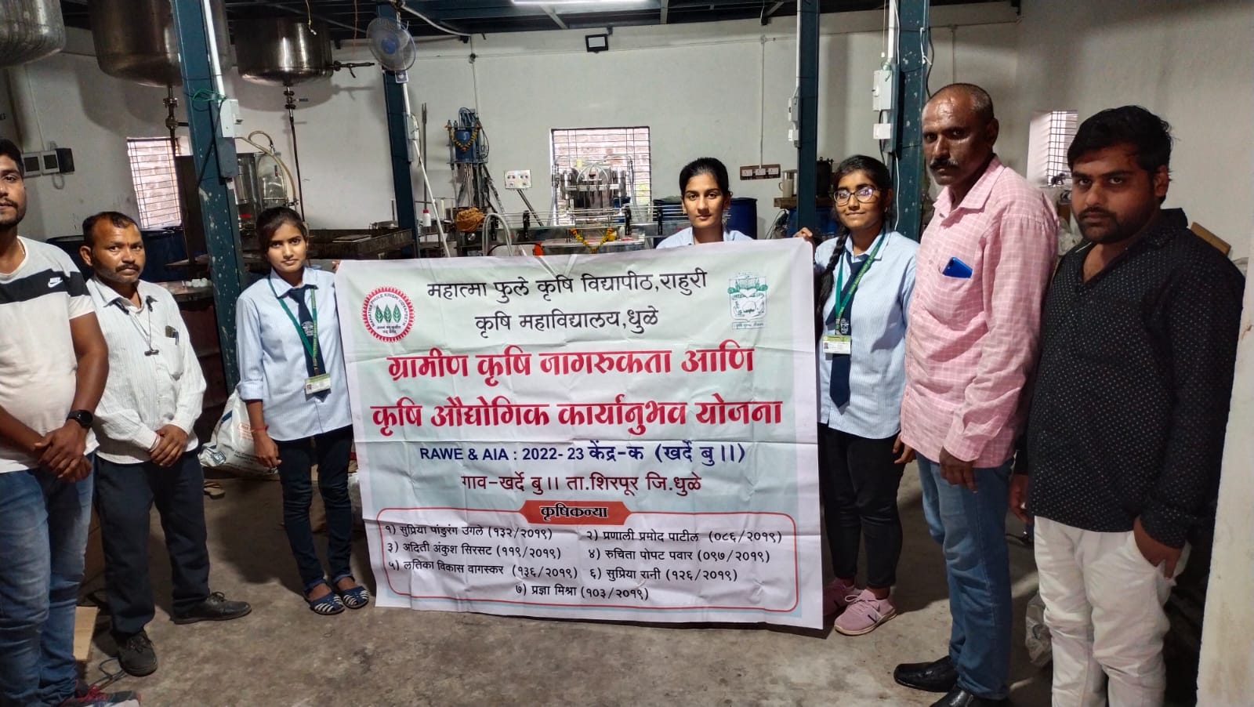
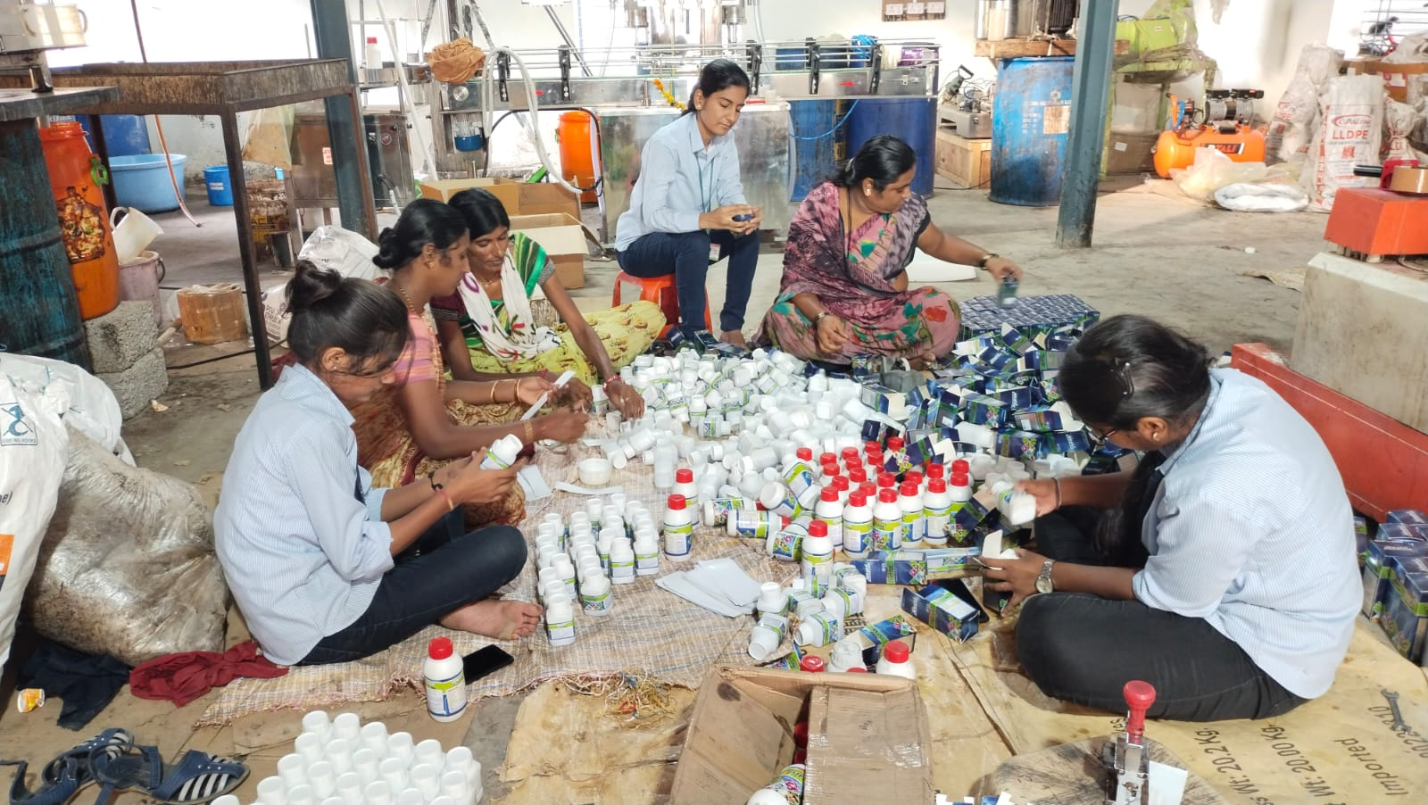
GROUP PHOTO

Slide 7
INTRODUCTION
Agriculture is back bone of India economy where more than 65% people depends upon agriculture & allied sector for there income so the growth of agriculture sector is necessary to income level of rural people.
In India more than 90% of farmer doesn’t go for soil testing so the application of fertilizer by them effect soil Health & cultivation cost , so it is very important they should use Fertilizer as per soil requirement

Slide 8
Name – Oasis Izro – Tech Agro Industries
Vision :
Oasis Izro – Tech with strive for customer Delight by continuous Innovation & integrity of purpose in all our action.
Oasis Izro – Tech with provide innovative solution to improve farm output through high quality organic production
Establishment/ History
Oasis Izro Tech Agro Industry is a private incorporated on 12 November 2015
Company is working in west zone & central zone of India .

Slide 9
Plant Location :
D – 130 Street no .10 , MIDC ,Awadhan , Mumbai Agra National Highway , Dhule .424006
Nature of Busines :
Manufacturing & Trading
Management Structure :
Management :
1 ) Owner : Mr . Madhukar Mali.
2) Production Manager ; Mr .Nitin
3) Worker
Employees :
Total 23 employees are working in Industry.

Slide 10
PRODUCTION #Production Process
Bio –Captain
Bio _ Captain is a ( botanical extract ) sea weed extract based innovative product for inhancing the yield of Agriculture , Horticulture & Plantation Crops.
BENEFITS ;
Improves rate of absorption of fertilizers & nutrients by plants
Helps to withstand stress conditions like drought ,frost & attack of insects by improving immunity.
Helps growth retarded plants to spring into its full potency and yielding level.
Faster growth of plant.
Reduces Flower & Fruit drop.
Improve yieild and shelf life of fruits & vegetables.
Promotes cell division and cell elongation , protein , synthesis ,rot initiation and development .

Slide 11
Bio -Captain

Slide 12
B) Tufan Gold
A Wonder Bio Stimulant
When to use
8 to 10 days before flowing
After flowing at regular interval of 10 to 15 days
DOSE
0.3 to 0.5 ml per litre ( 5 to 7.5 ml per 15 ltr .Pump )
for all crops , vegetables , flowers & fruits
Application
Induces Flowering
Minimizes flower drop
Improve fruit quality
Increases yield
COMPOSITION
Amino Acid - 30% w/w
Fulvic Acid – 2% w/w
Preservative - 1.5% w/w
Other Organic Matter – 66.5 % w/w Total - 100% w/w

Slide 13
TUFAN GOLD

Slide 14
Root Heart
Root Heart is used by foliar spray , soil application ( with chemical fertilizer) , drip irrigation . Beneficial for all crops of agriculture and horticulture crops .
Crops :
For Cotton , paddy , soybean , maize ,wheat , sunflower , safflower , mustard , vegetables like tomoato , chilli , onion , garlic , brinjal , cauliflower , cabbage & pulses crops,
ground nut ,tobacco etc .
BENEFITS :
Addition of organic matter to organically deficient soil .
Increase root development.
Improve nutrient uptake .
Better seed germination .
Increase chlorophyll synthesis .
Stimulate beneficial microbial activity.
Helps to provide availability of fertilizer from soil .

Slide 15
ROOT HEART

Slide 16
PLANT MACHINERIES

Slide 18
Assessment of business segment of Firm
Strength
Brand awareness
Distribution network
Law cost manufacturing
Weakness
Capital intensive
Dependance on mansoon
Opportunities
Export potential
Focus on sustainable & organic farming
Production & Invention of new bio production
Threats
IPM rising demand for inorganic pesticide

Slide 19
Thank You…

