Slide 1
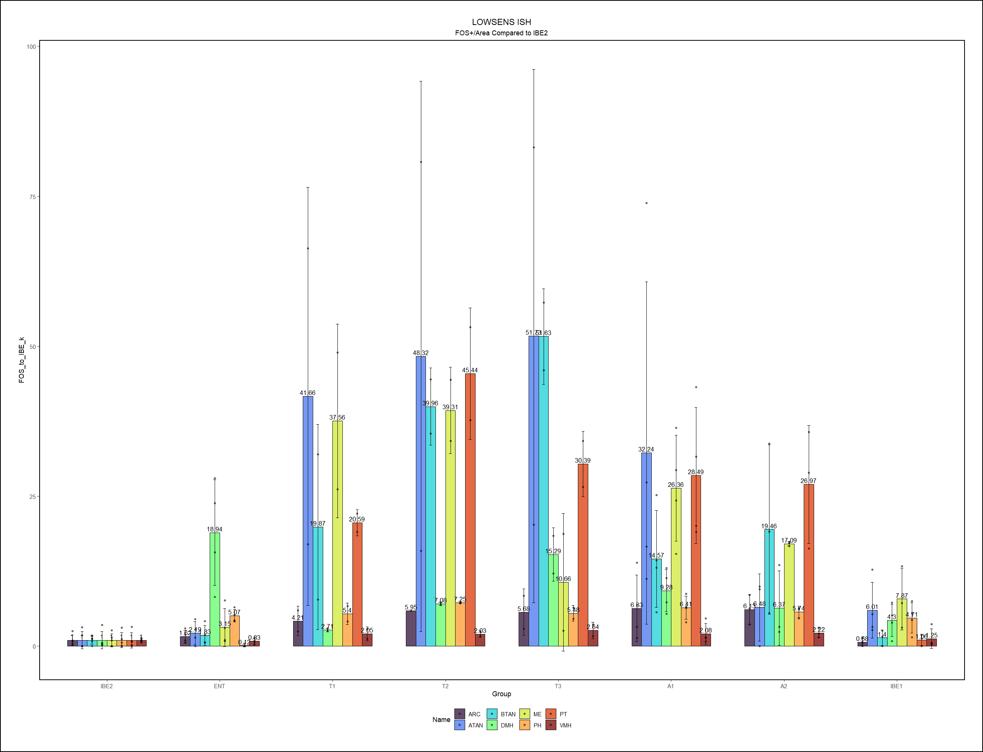
LOW SENSITIVETY MODEL
counts

Slide 2
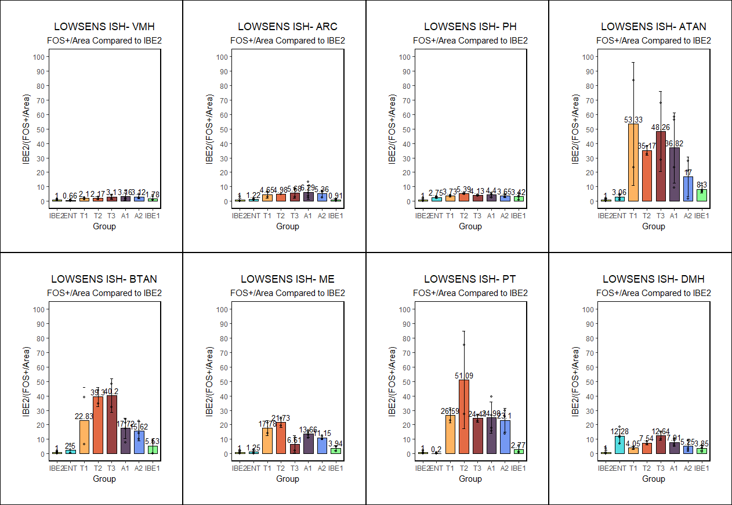
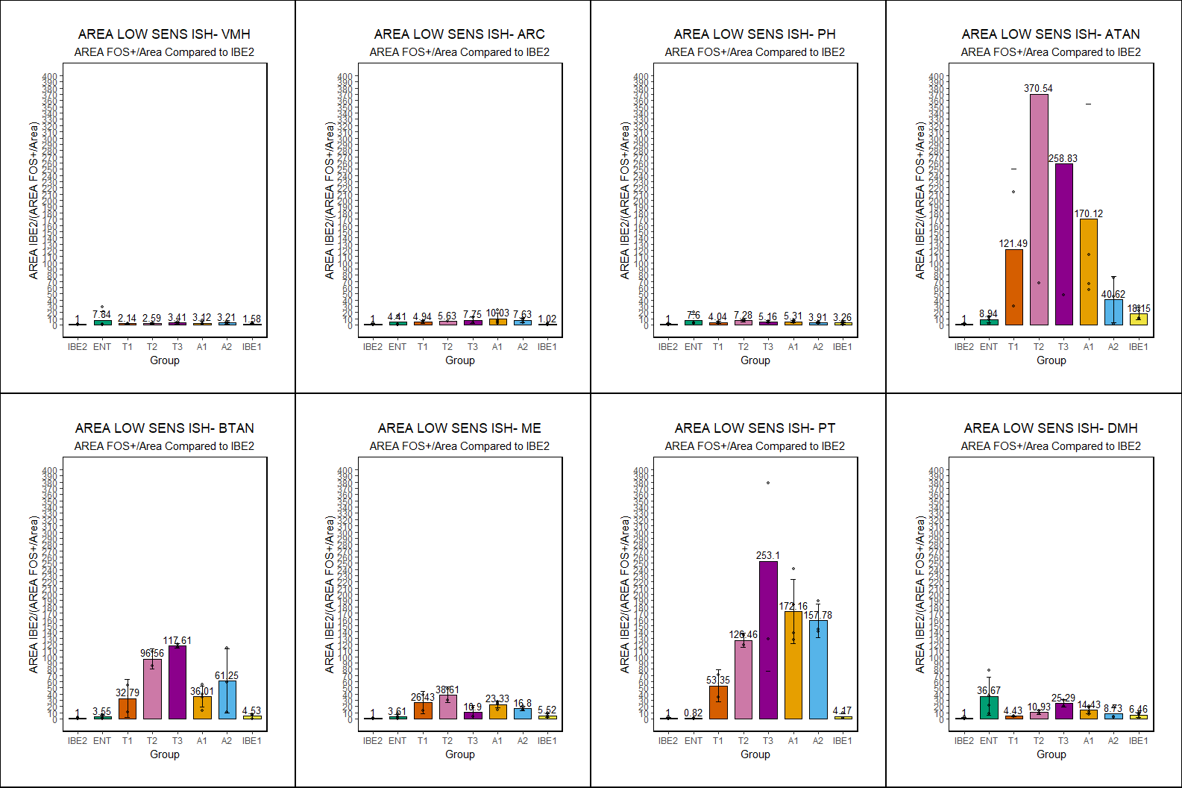
LOW SENSITIVETY MODEL
counts
LOW SENSITIVETY MODEL
Area

Slide 3
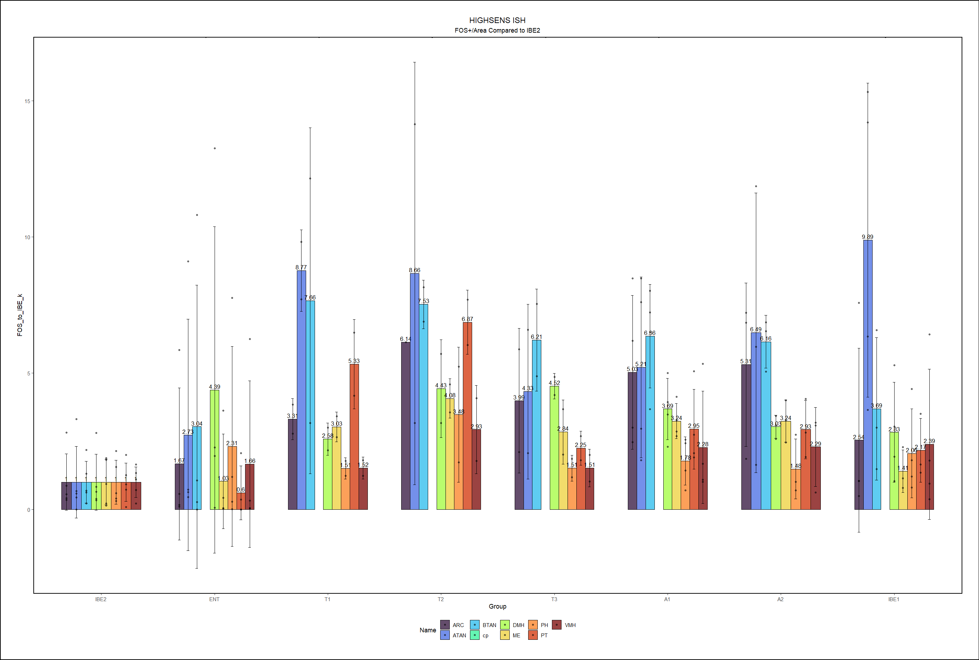
HIGH SENSITIVETY MODEL

Slide 4
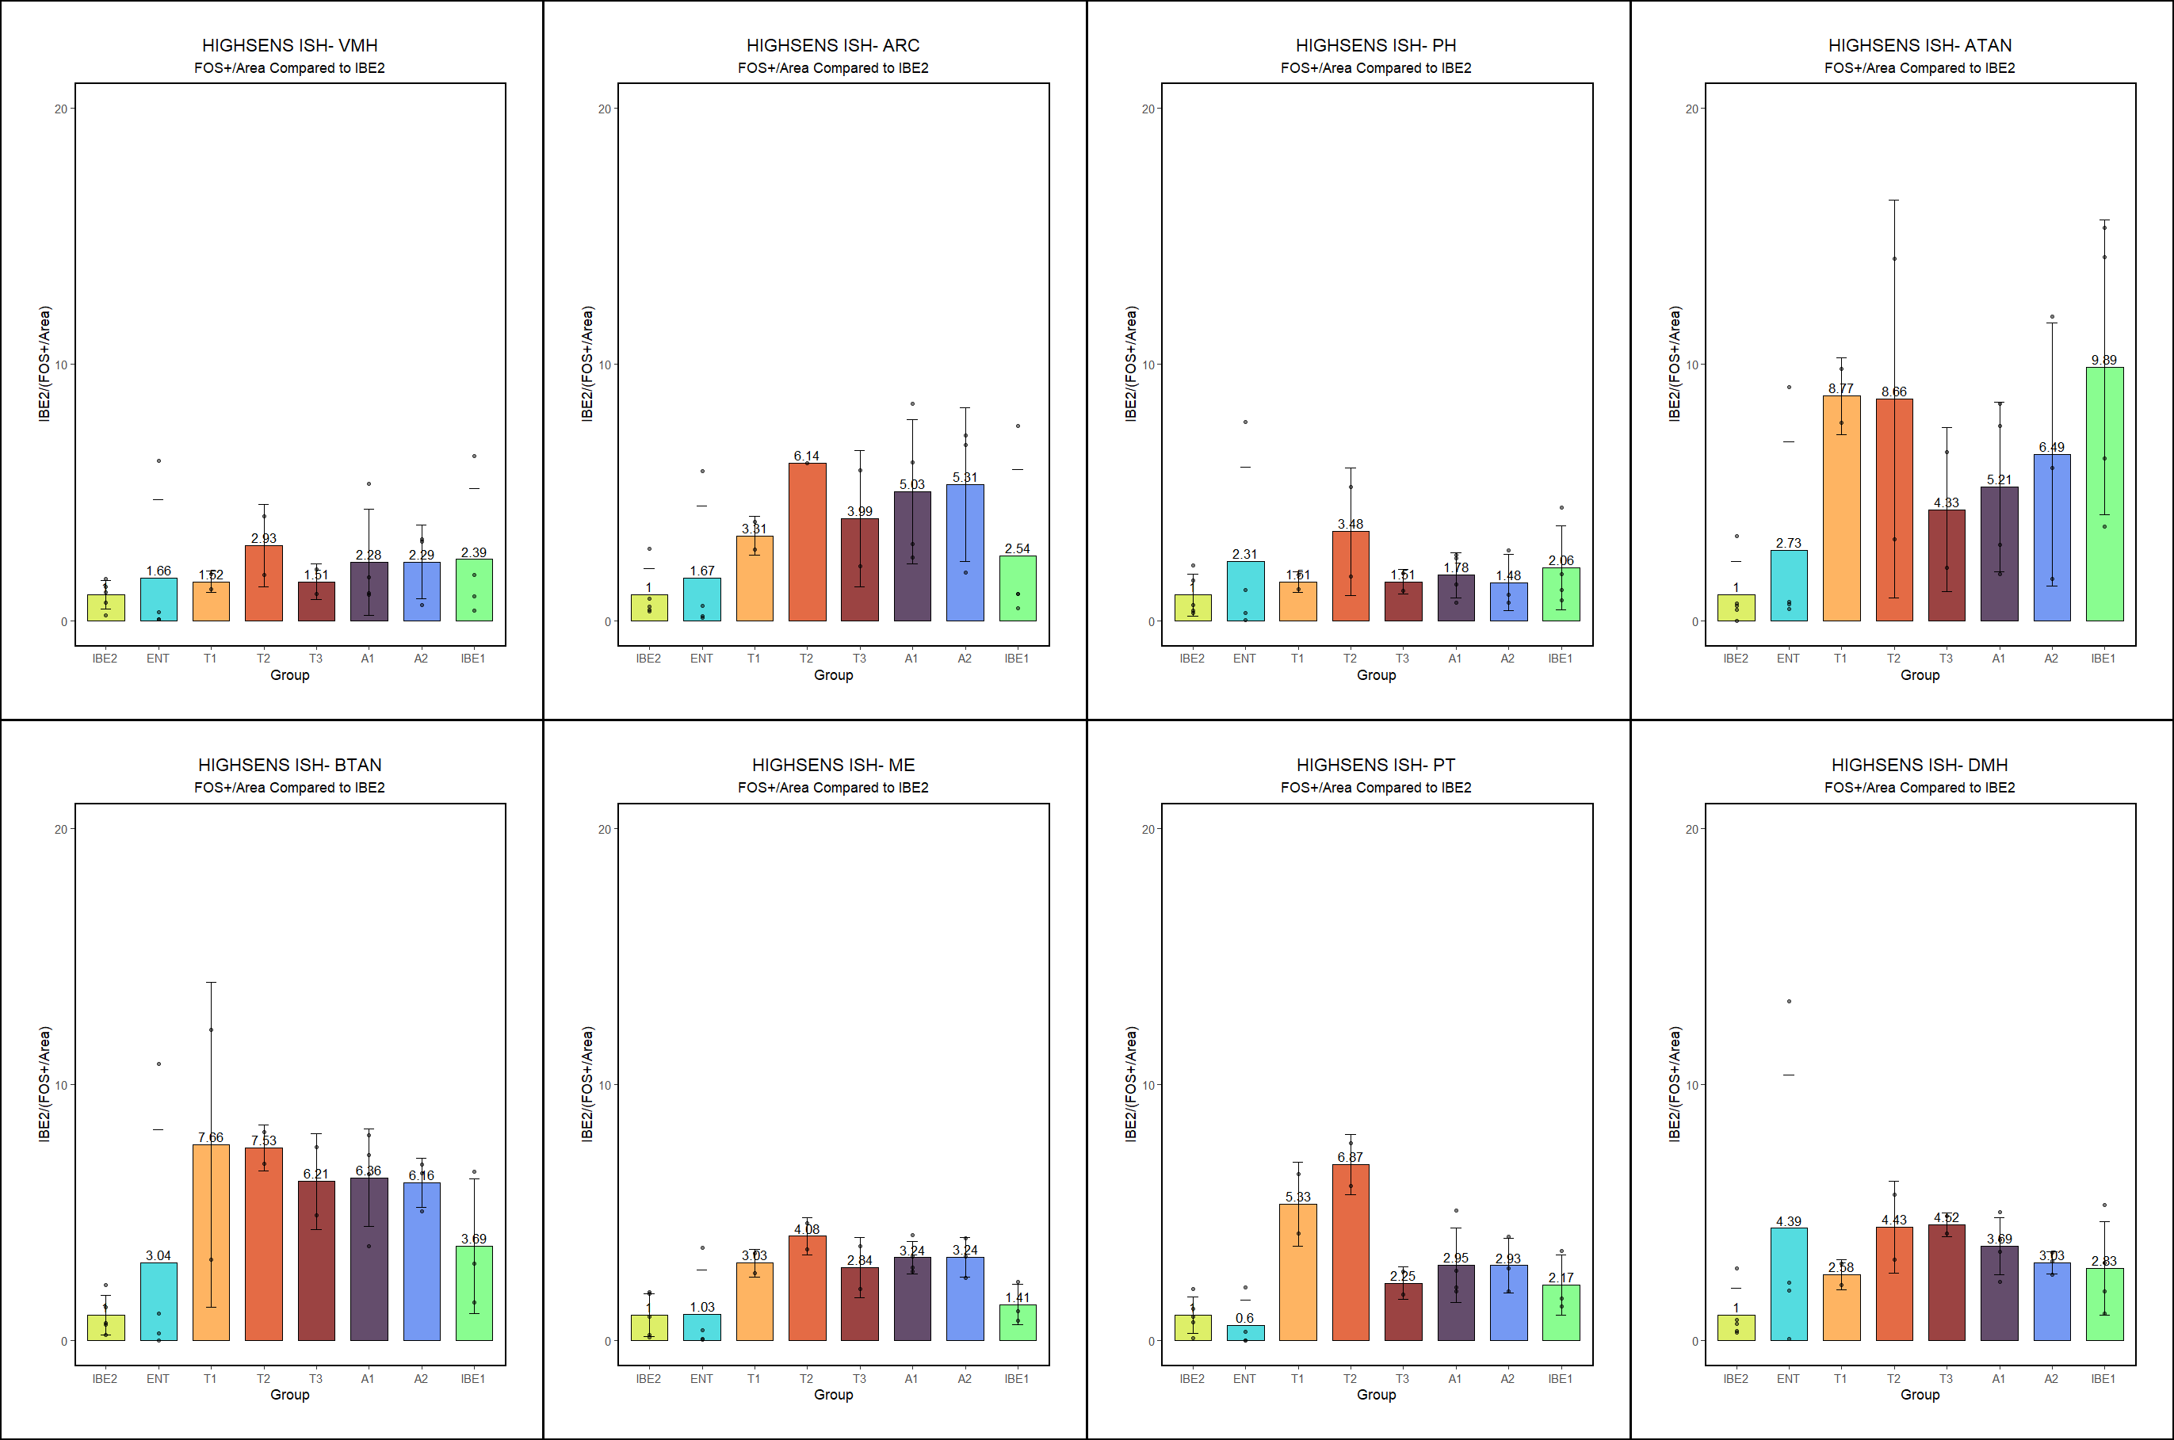
HIGH SENSITIVETY MODEL

Slide 5
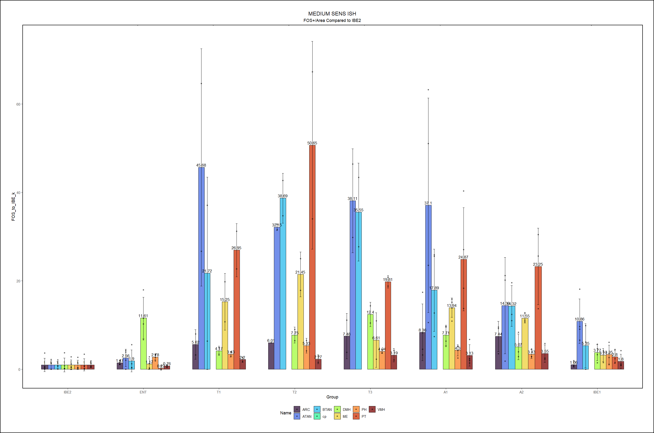
MEDIUM SENSITIVETY MODEL

Slide 6
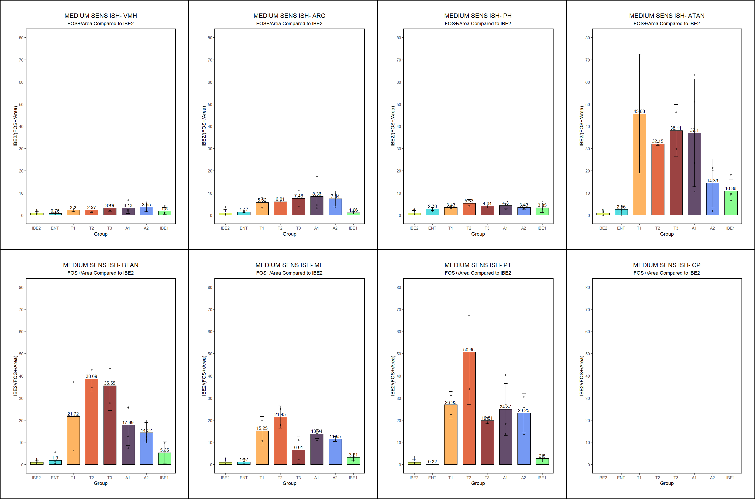
MEDIUM SENSITIVETY MODEL

Slide 7
AREA FOS+/AREA Normalized to IBE2

Slide 8
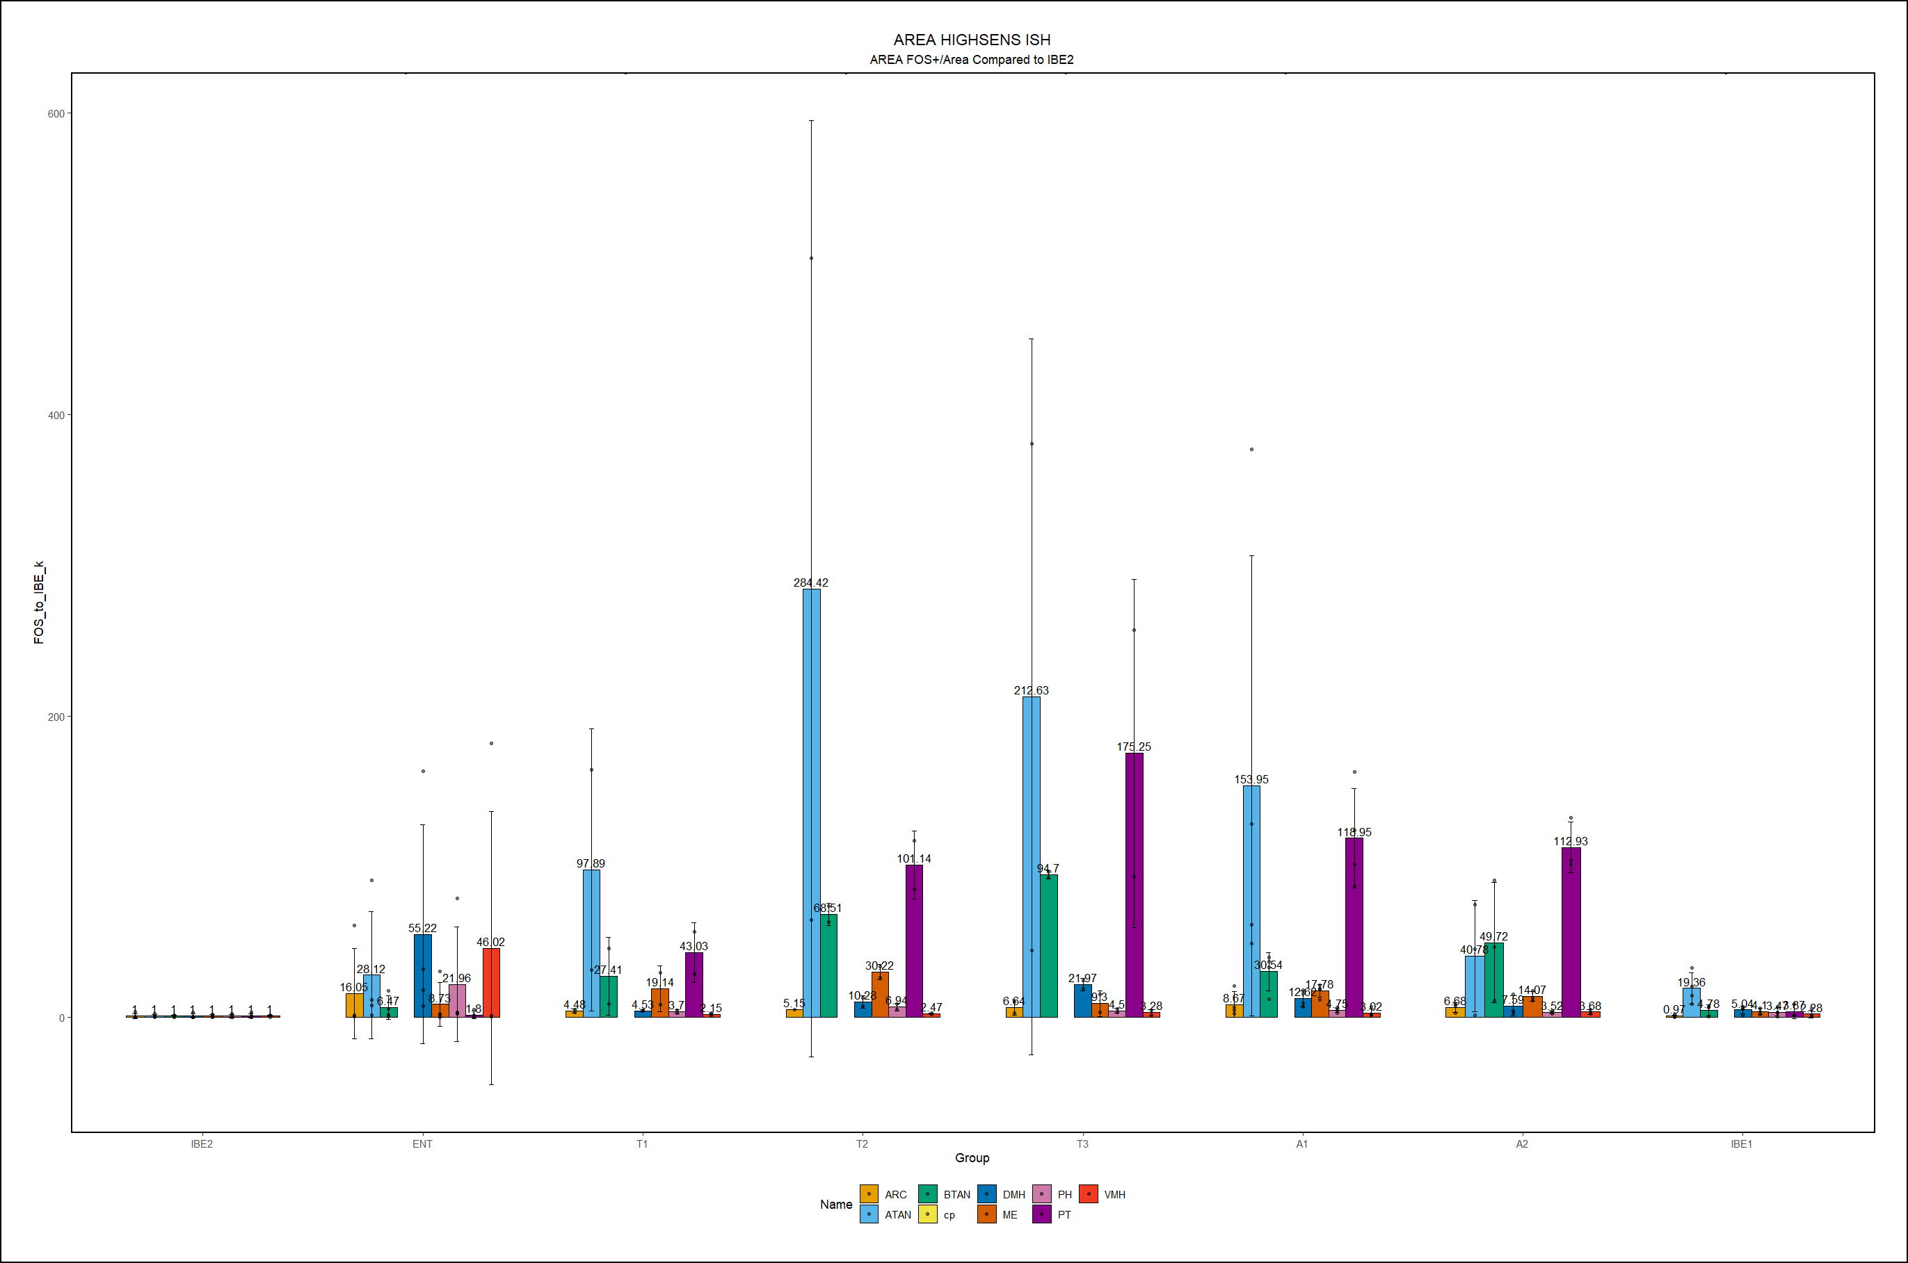
HIGH SENSITIVETY MODEL

Slide 9
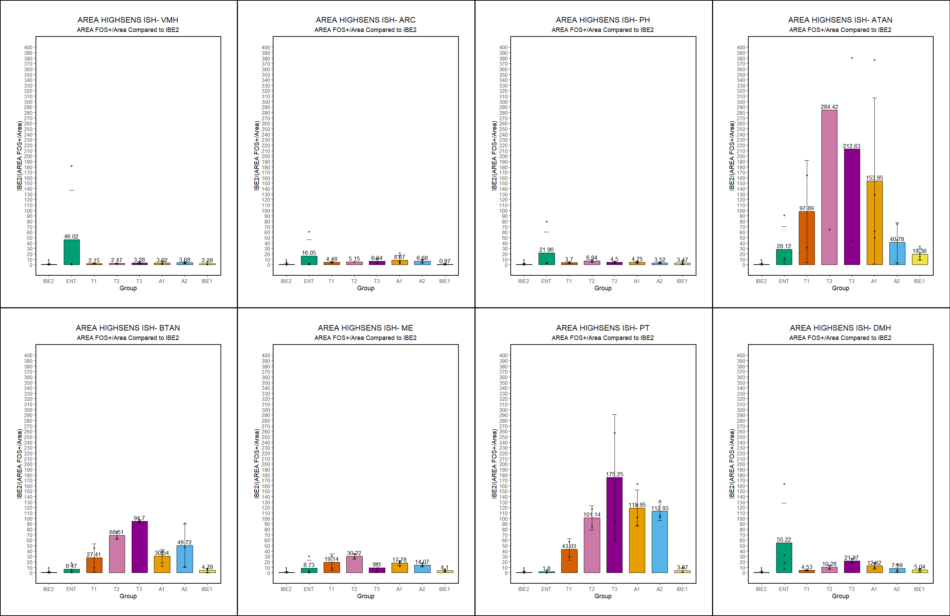
HIGH SENSITIVETY MODEL

Slide 10

LOW SENSITIVETY MODEL

Slide 11
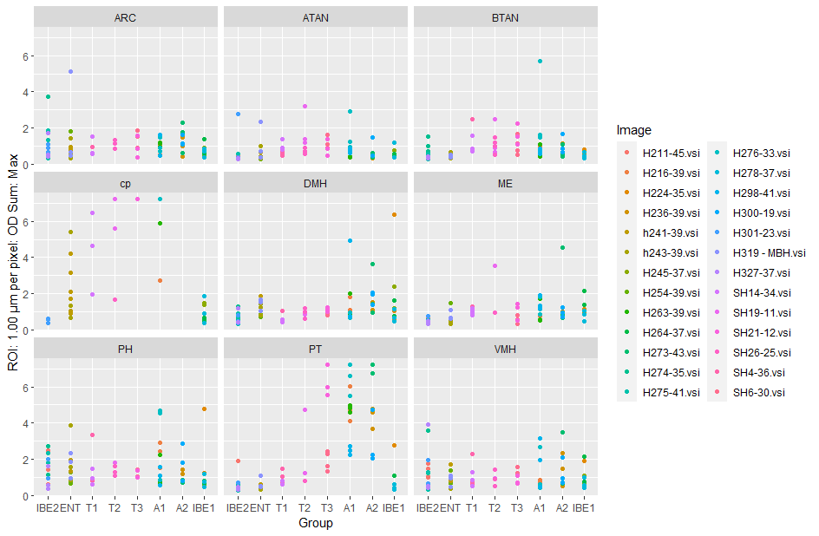
LOW SENSITIVETY MODEL
area
Individual points intensity

Slide 12

Medium SENSITIVETY MODEL

Slide 13

Medium SENSITIVETY MODEL

