Slide 1

GNG 5125
Text Classification
300254157 Manjie Hou
8795048 Yuting Cao
300151213 Yunzhou Wang
300250954 Haiwei Nan

Slide 2
 | KNN | XGboots | DT | SVM.SVC | LinearSVC | SGD
BOW | 0.54 | 0.83 | 0.60 | 0.85 | 0.89 | 0.84
TF-IDF | 0.85 | 0.81 | 0.59 | 0.90 | 0.92 | 0.91
N-gram | 0.15 | 0.58 | 0.31 | 0.20 | 0.75 | 0.70
The accuracy of N-gram is poor and lowest in each algorithm model

Slide 3
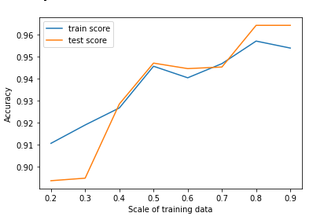
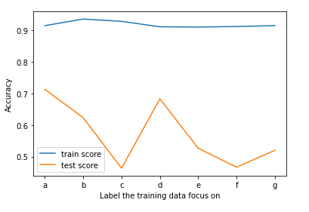
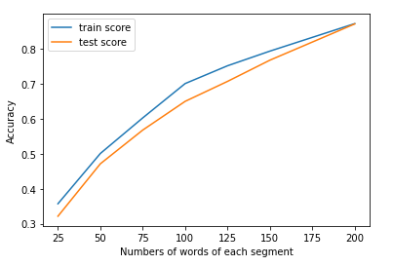
Change the train test split ratio.
Change the distribution of each label segment on training and test set to make the data unbalanced.
Change the number of words of each segment from 200 to 20.
The golden data is the most important thing!

