Slide 1


WATER LEVEL INDICATOR
Group no 11
Presented By
B.HARI KIRAN– Roll No 12
K.HARINI– Roll No 25
K.CHARITHA REDDY– Roll No 28
IoT Hackathon 2019

Slide 2
Problem Statement
To reduce the overflow of water in watertanks
Need of this project is to save water
People often forget to turn off the motor when tank is filled completely which causes overflow of water and because of this water gets wasted
IoT Hackathon 2019

Slide 3
Customer Survey
In people’s point of view this might seem to be a small issue but knowing the water level is always important inorder to save water
It is very widely used in industrial purpose and distribution of water purpose ,agriculture sector
Coming to its domestic usage ..their might be 50 % of people stating its useful even for domestic household purpose
IoT Hackathon 2019

Slide 4
Existing Solutions
Water level indicators are already in use .people are using it for various purposes .but the product which is already existing is much more complicated in installation as it needs measurements of tank depth , and compiling the firmware and connecting to ultersonic sensors which costs high.
When tank is filled with water by using hydrostatic force and and sensors it indicates through led light that tank is filled with water and can overflow
IoT Hackathon 2019

Slide 5
Our Solution
Our device which we are constructing is of user-friendly device it is a simple device which indicates the waterlevel through led(light emitting diode)
It costs very low compared to existing solution
it is easier to install , it is simple model of water level indicator which can indicate the wate rin overhead tank by colour leds such as it indicates red when the tank is filled and it indicates yellow and green accordingly
IoT Hackathon 2019

Slide 6
Value Proposition
Our solution is much more simpler in installation and costs much less compared to existing model
It is saves a lot of energy and time of the user .it is so simple to use that even children can accurately use this project
When the tank is filled it indicates red ,when it is in middle level it indicates yellow ,and green at the bottom level
IoT Hackathon 2019

Slide 7
Customers & Consumers
The main customers and consumer of this product would be the farmer as it is very useful in agriculture field ,overhead tanks industrial sector
We have noticed that the product is also very useful in food manufacturing industrial purpose as it needs a proper water distribution
IoT Hackathon 2019

Slide 8
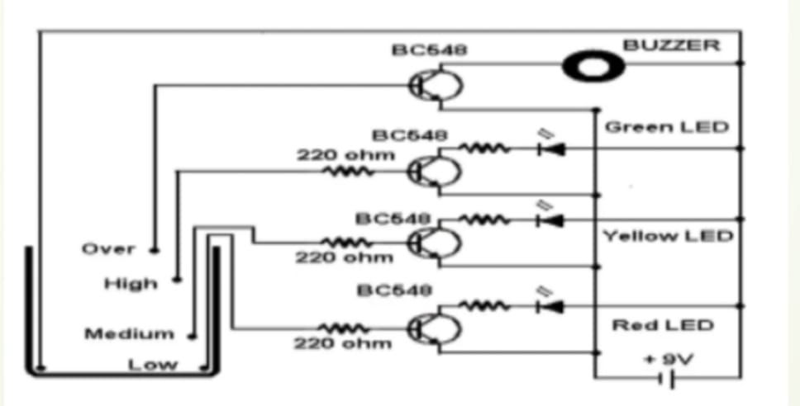
Design - Blueprint
This is the exact plan of constructing circuit of the water level indicator.
IoT Hackathon 2019

Slide 9
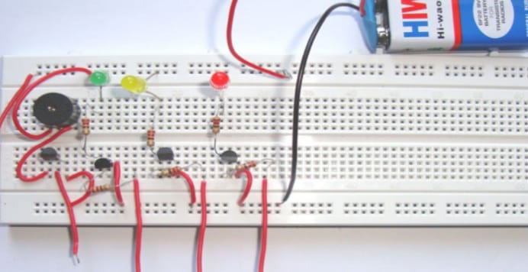
Output – Screen Shots
our output screen shots of prototype
IoT Hackathon 2019

Slide 10
Thank You! We are happy to hear your feedback as well, we would come back stronger!
IoT Hackathon 2019

