Slide 1


LASER SECURITY SYSTEM
Team No: 5
Team Name:
Presented By
B.KEERTHI – 21R21A6707
D.ASHRITH REDDY – 21R21A6716
K.PRASHANTH – 21R21A6732
IoT Hackathon 2019

Slide 2

Problem Statement
Poor security at our places can lead to disastrous results.
IoT Hackathon 2019

Slide 3
Customer Survey
It’s the responsibility of a business to protect and safeguard not only its employees, but also its assets and valuable information from any kind of theft, damage, or loss.
Small Biz Trends conducted a recent survey and discovered that a 5% retention of customers could increase a company’s profit margins from between 25% and 95%.
Effective and reliable workplace security is very important to any business because it reduces insurance, compensation, liabilities, and other expenses that the company must pay to its stakeholders, ultimately leading to increased business revenue and a reduction in operational charges incurred.
FOR MORE INFO VISIT :https://www.buildingsecurity.com/blog/importance-of-the-security-industry/
IoT Hackathon 2019

Slide 4
Existing Solutions
The most common type of surveillance is closed circuit television (CCTV) cameras that record the activity of a combination of areas. The benefit of these surveillance cameras is that they are as valuable in capturing criminal behavior as they are in preventing it. Threat actors who see a CCTV camera are less inclined to break in or vandalize a building out of fear of having their identity recorded. Similarly, if a particular asset or piece of equipment is stolen, surveillance can provide the visual evidence one needs to identify the culprit and their tactics.
IoT Hackathon 2019

Slide 5
Our Solution
Laser security system:
When a person crosses the laser ,the electronics will put the warning signal.
If used with a battery, the laser security system can work even when there is a power outage.
The circuit, construction and setup for the Laser Security System is very simple.
IoT Hackathon 2019

Slide 6
Value Proposition
If used with a battery, the laser security system can work even when there is a power outage.
The circuit, construction and setup for the Laser Security System is very simple.
Affordable price.
Installation of this product easy and cost efficient.
IoT Hackathon 2019

Slide 7
Customers & Consumers
This can be used by business owners ,banks, security needed places like museums.
Mostly security providers(suppliers).
It can be used in jail to prevent prison break.
Used as automatic indicator.
It can be used in mines area to indicate restricted place.
Helps to keep you tabs on kids & notifies you.
IoT Hackathon 2019

Slide 8
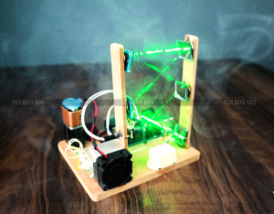
Design - Blueprint
we have scope for development , We try to develop it in sending a message to rescue when the sensor detects the intrusion.
IoT Hackathon 2019

Slide 9
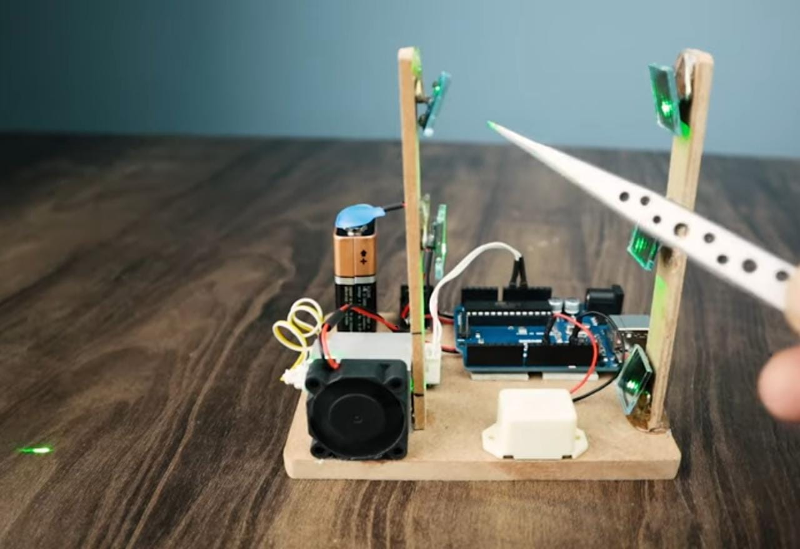
Output – Screen Shots
IoT Hackathon 2019

Slide 10
Thank You! We are happy to hear your feedback as well, we would come back stronger!
IoT Hackathon 2019

