Slide 1


HOMEMADE VACUUM CLENER
Group no 10
Presented By
B.ABHINAY– Roll No 05
G.ASRITHA– Roll No 20
K.SAI SOHAN– Roll No 33
IoT Hackathon 2019

Slide 2
Problem Statement
Minute places can’t be cleaned by using large vacuum cleaner so,how this problem can be solved.
IoT Hackathon 2019

Slide 3
Customer Survey
In the people view this is a good idea for in our daily life uses
Some people said that it is will be difficult to hold the vacuum cleaner everytime for cleaning
Coming to the design some times motor may subjected to failures.
IoT Hackathon 2019

Slide 4
Existing Solutions
Vacuum cleaner are already in use.people are using it in various places for cleaning and they are mainly used for cleaning purpose
now-a days some many types of vacuum cleaner like robotic cleaners are there and current many people are using them
problem with those vacuum cleaners are they are costly,and with them we were anable clean small or minute areas
IoT Hackathon 2019

Slide 5
Our Solution
Our device which we are constructing is of user-friendly device it is a simple device which can easily clean the small areas which will be difficult to large vacuum cleaner to clean.
Vacuum Cleaners which is homemade with the material which are available in our home and this homemade vaccum apparatus that remove and clean many kinds of surfaces by means of sucking and removing dust and small particles, and it is powered by using 9v battery
It is very useful to clean the small areas easily,we can use this to clean shelfs,cars ,steps etc …
IoT Hackathon 2019

Slide 6
Value Proposition
Construction of Homemade vacuum cleaner is very simple.
Affordable price and any one can easily operate this.
If we connect the motor directly to the power supply ,we can use this product for very long time.
We can easily collect and dust ,after collecting we can easily remove dust form the vacuum cleaner.
IoT Hackathon 2019

Slide 7
Customers & Consumers
The main customers and consumer of this product householders and cleaners in malls,factories ,industries.
IoT Hackathon 2019

Slide 8
Working principle
Materials flow from one location to another when a pressure difference is created between two locations.
This phenomenon is the basic working principle of an ideal vacuum cleaner.
When a centrifugal fan rotates it makes the air to flow by adding it external kinetic energy.
Air is sucked from behind and pushed forward with pressure and so negative pressure it creates behind the fan.
An ideal vacuum cleaner has such centrifugal fan in it connected to a motor.

Slide 9
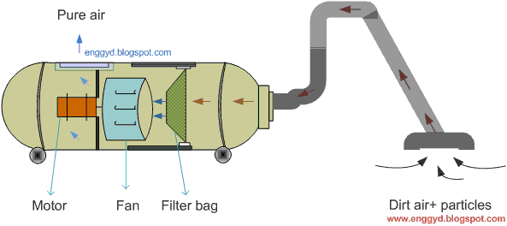
Design - Blueprint
This is the exact plan of constructing a Homemade vacuum cleaner.
IoT Hackathon 2019

Slide 10
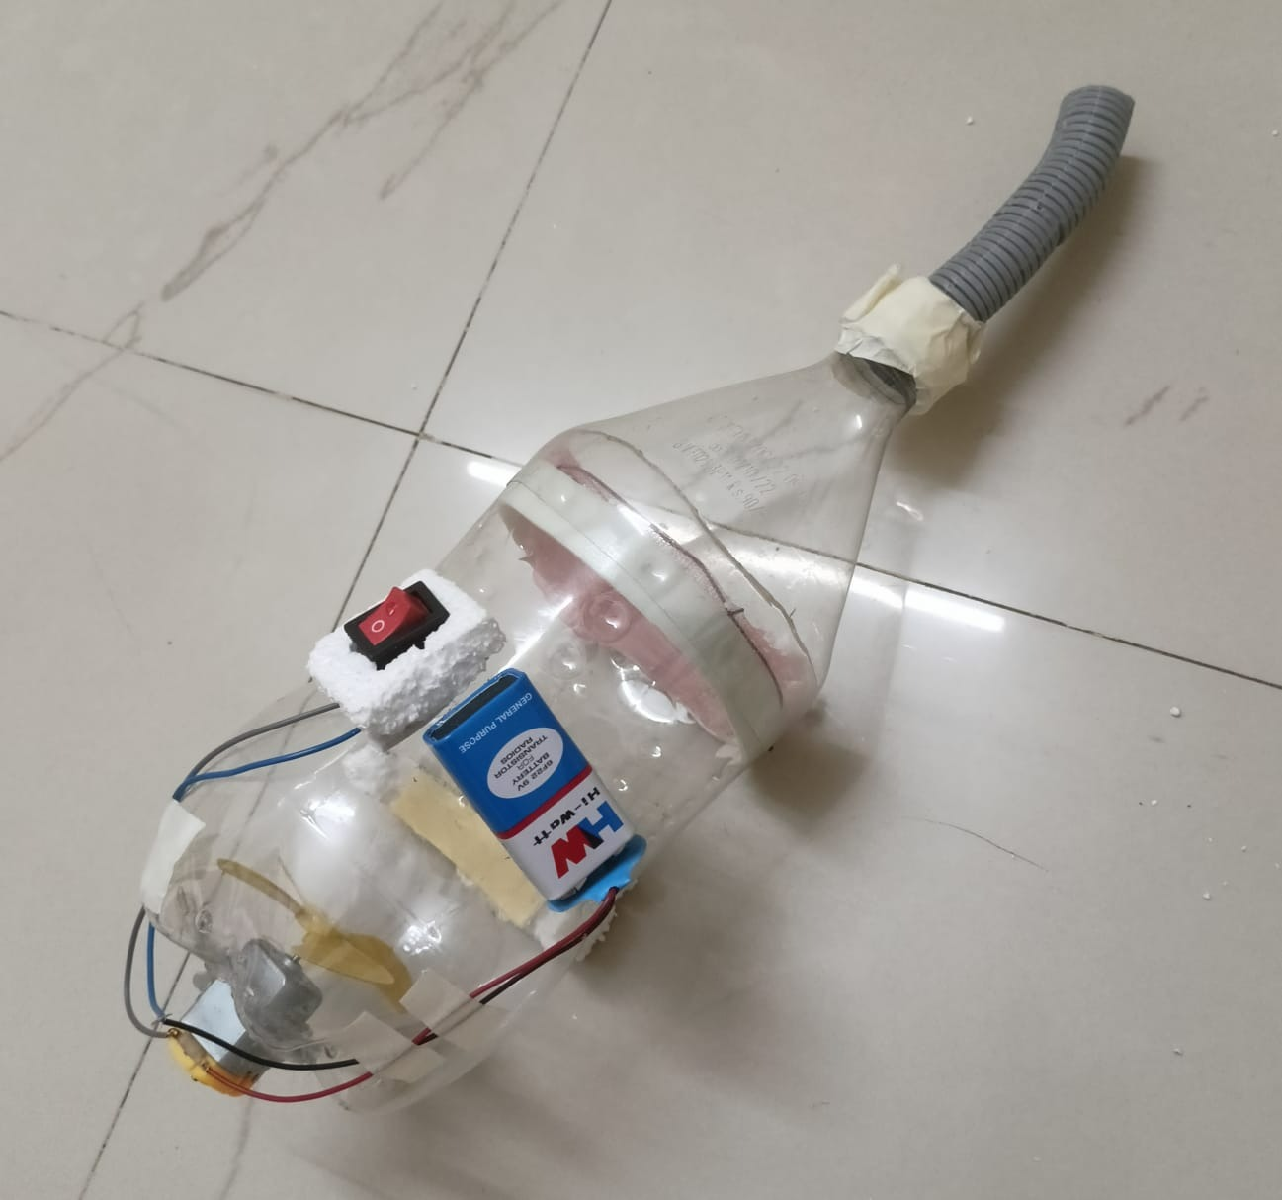
Output – Screen Shots
our output screen shots of prototype
IoT Hackathon 2019

Slide 11
Thank You! We are happy to hear your feedback as well, we would come back stronger!
IoT Hackathon 2019

