Slide 1


AUTO IRRIGATION SYSTEM USING IOT
Team No: 05
Presented By
Bhavya Reddy.k – 21R21A6708
Aman likith- 21r21a6710
Rewanth -21r21a6724
IoT Hackathon 2019

Slide 2

Problem Statement
over irrigated and unirrigated
Big lands requires more manpower
Farm Lands and fields situated miles undergo irregular watering/irrigation involving much time for transport and crops lead to get destroy –as few need frequent watering.
IoT Hackathon 2019

Slide 3
Existing Solutions
SMART IRRIGATION SYSTEM: We are into a development of a market based system that can help in an automated irrigation system by analyzing the moisture level of the ground,temperature.
The smart irrigation system proves to be a useful system as it automates and regulates the watering without any manual intervention.
Cannot be operated by farmers who are uneducated.
Does not work if there is no internet.
IoT Hackathon 2019

Slide 4
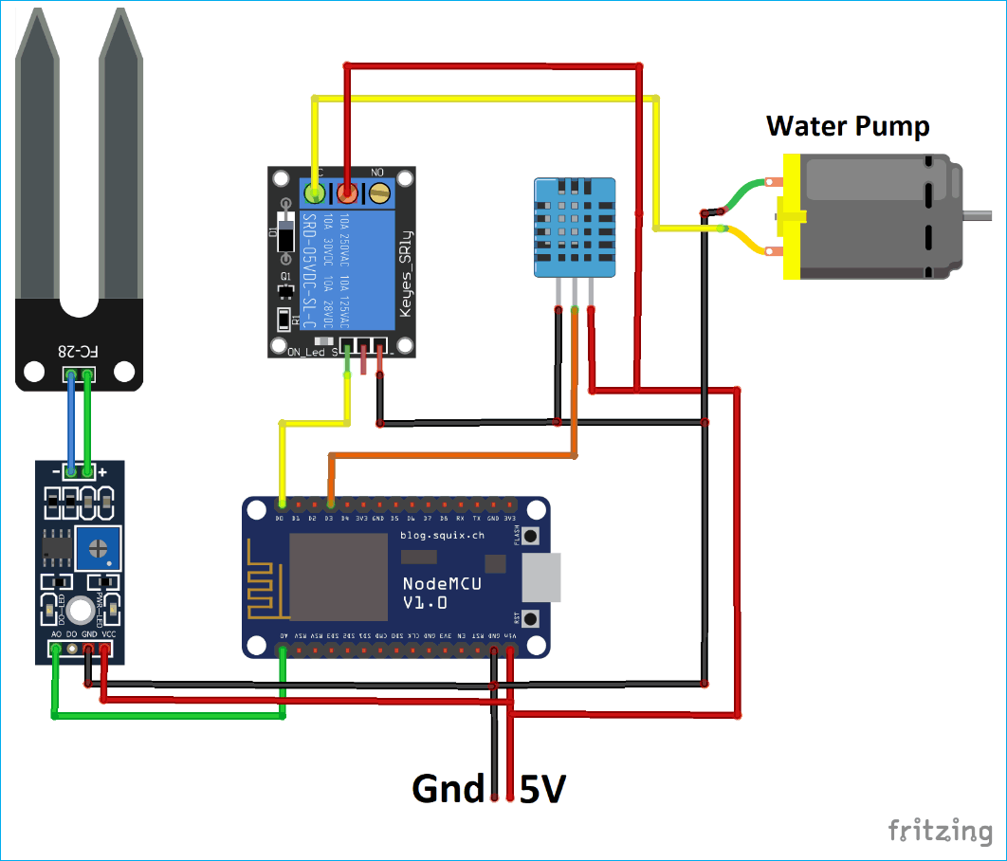
Our Solution
AUTO IRRIGATION SYSTEM USING IOT: WE HAVE A SET-UP WHICH CONSISTS OF A SOIL-MOISTURE SENSOR.
BASED ON MOISTURE CONTENT, IT SENDS A MESSAGE TO THE FARMER.
WHEN THE FARMER IS ILL HE CAN OPERATE THIS METHOD FROM THEIR HOME
IT IS EASY TO SET-UP.
IoT Hackathon 2019

Slide 5
Value Proposition
IT IS EASY TO SET-UP.
THE SET-UP CONSISTS OF FEW COMPONENTS SO IT HAS HIGH COST.
BY USING THIS METHOD WE CAN AVOID THE WASTE OF WATER.
FARMERS CAN EASILY OPERATE WITH LITTLE BIT OF TRAINING.
THIS SYSTEM IS INSTALLED AND MANAGED ABOVE GROUND.
IT’S MAINTENANCE IS EASY.
IoT Hackathon 2019

Slide 6
Customers & Consumers
IT IS VERY USEFUL FOR THE PEOPLE WHO ARE BUSY IN THEIR DAY-TO-DAY LIFE AND CANNOT WATER PLANTS REGULARLY.
IT IS USED BY THE FARMERS IN THE FIELD TO AVOID OVER WATERING THE CROP AS IT REDUCES WATER WASTAGE.
IoT Hackathon 2019

Slide 7
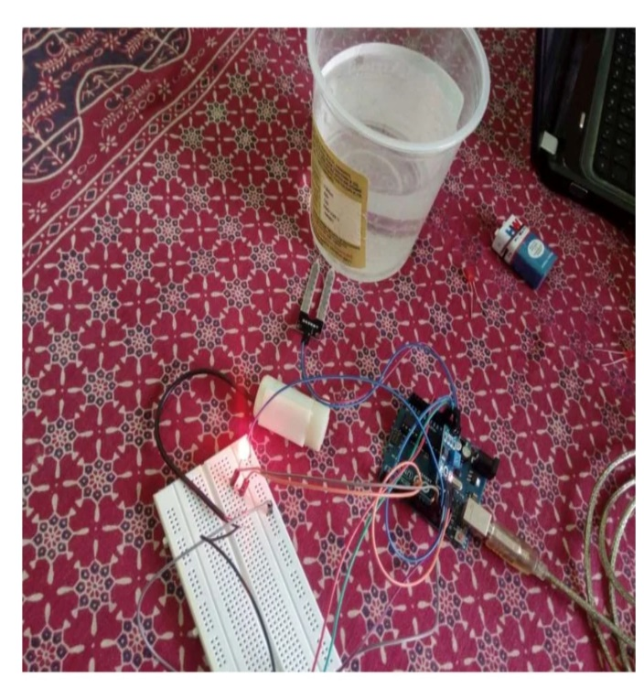
Design - Blueprint
POWER SUPPLY
RELAY DRIVER
ARDUINO BOARD
SOIL MOISTURE SENSOR
MOISTURE CONTENT DISPLAY
WATER PUMP CONTROLL
IoT Hackathon 2019

Slide 8
Output – Screen Shots
Place your output screen shots of your prototype.
IoT Hackathon 2019

Slide 9
Thank You! We are happy to hear your feedback as well, we would come back stronger!
IoT Hackathon 2019

