Slide 1


MLRIT STUDENT APP
Team No : 9
Team Name : Appify
Presented By
Amulya gangula – 21R21A6719
G.Yasasvi – 21R21A6722
Atishay Reddy – 21R21A6731
IoT Hackathon 2019

Slide 2
Problem Statement
To create an application or a tool that would help us keep track of our attendance, marks, giving feedbacks and also make any required payments.
These helps us (the students) on how well we are performing in our exams, how many classes we have attended and what issues you have been facing with a particular faculty.
IoT Hackathon 2019

Slide 3
Existing Solutions
There is an existing solution for this problem
There are Two websites that help us keep track of all the things
links are below :-
1. https://erp.mlrinstitutions.ac.in/Login.aspx?ReturnUrl=%2fBeesERP%2fLogin.aspx
2. https://exams.mlrinstitutions.ac.in/
But, They aren't designed in a user friendly manner especially for mobile devices.

Slide 4
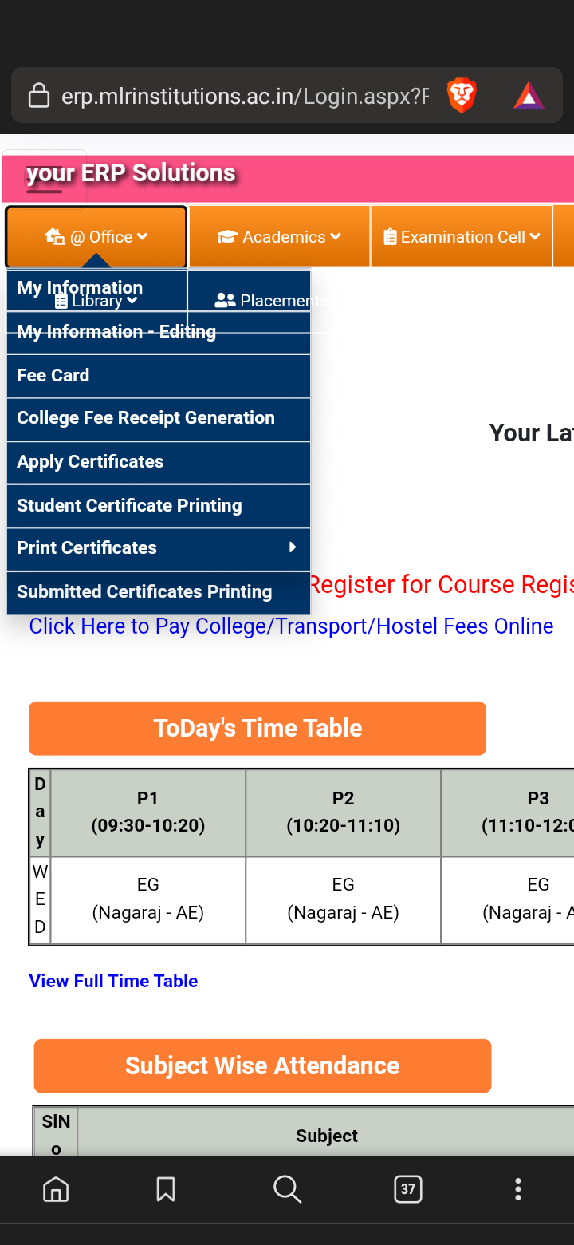
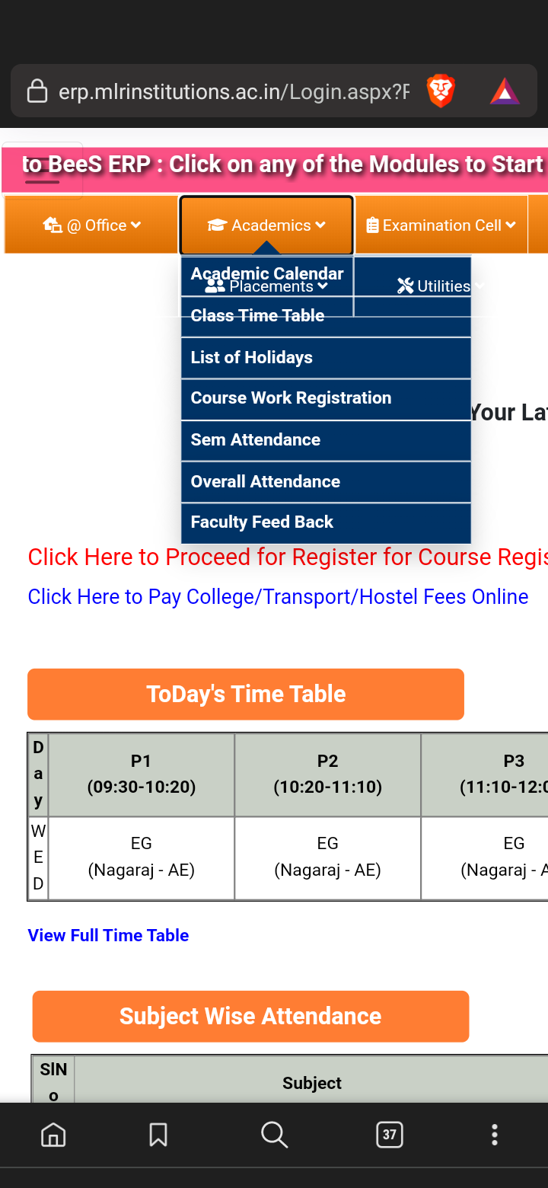

Slide 5
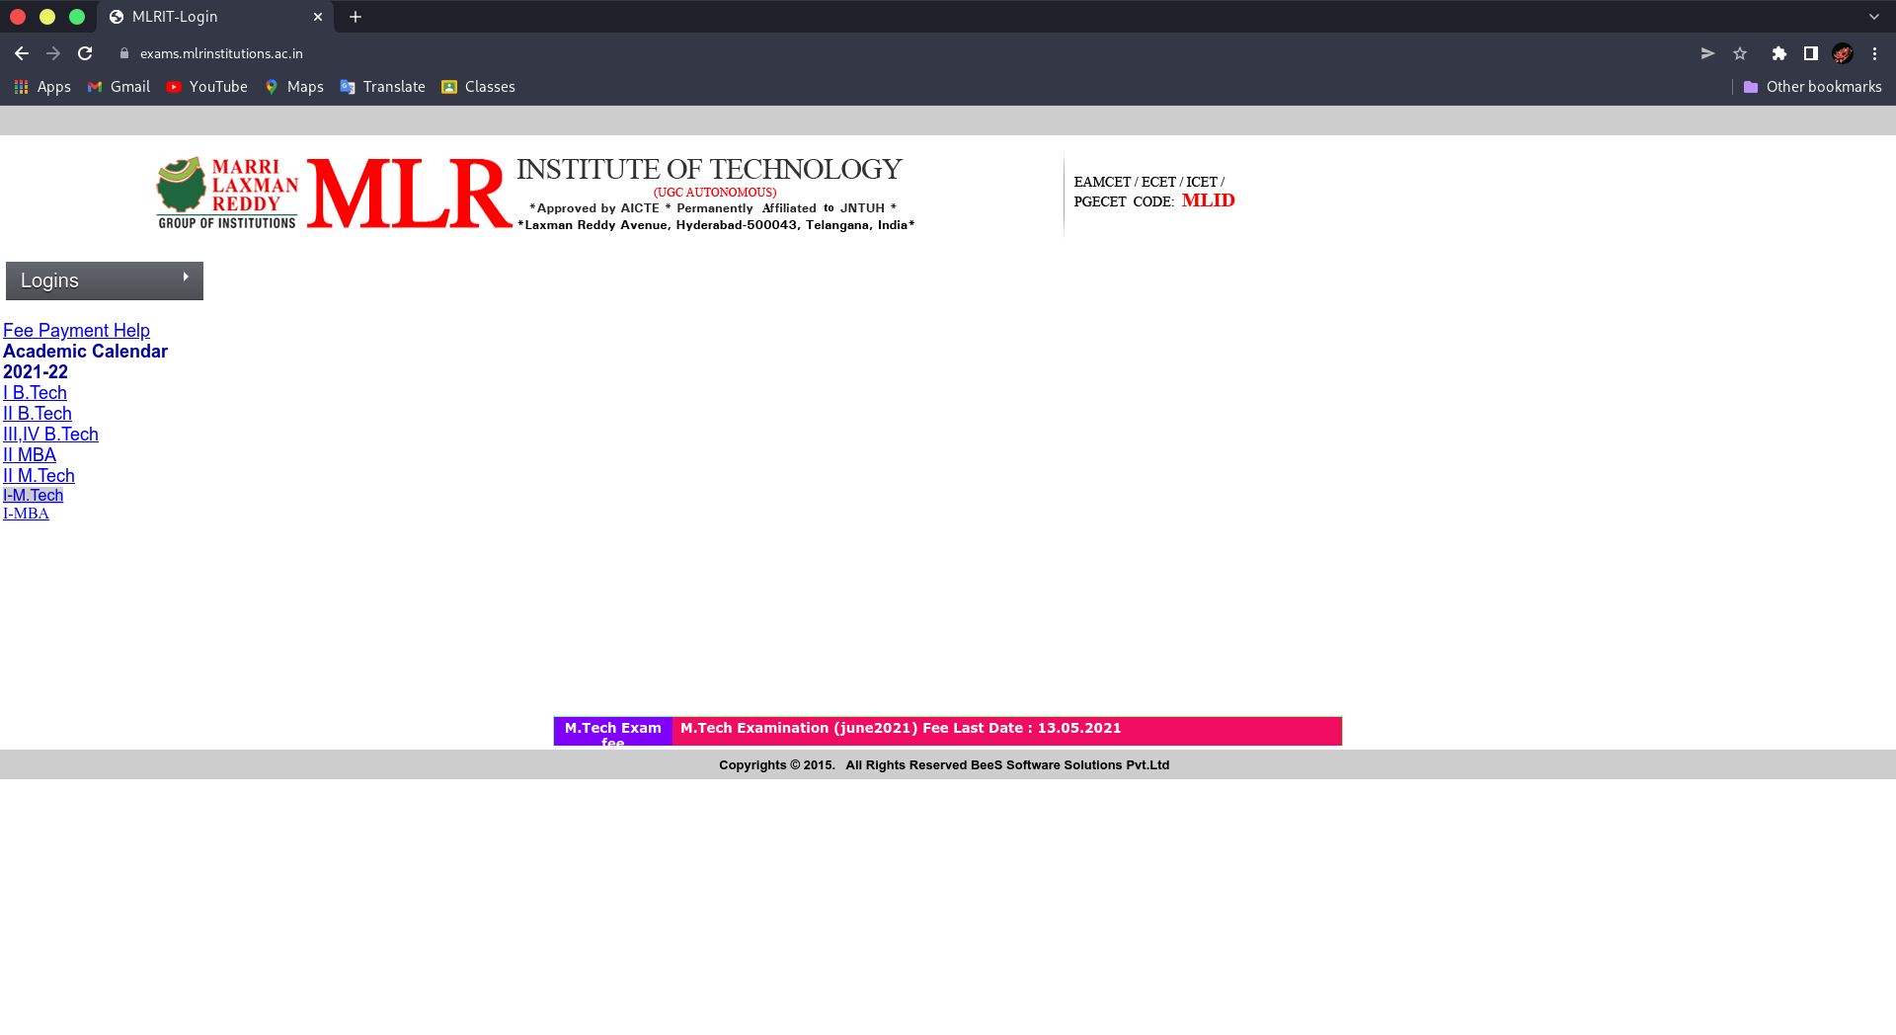

Slide 6


Our Solution
Based on our analysis, we can say that the user interface is one of the most important things in an application and has a vital role in our modern society.
So, Our solution is to create an app that would help us in keeping track of our details.

Slide 7
Value Proposition
When we have a better user interface People get addicted to its usability
For example think of using bing or yahoo or any other search engine
Instead of Google.
You wouldn't use any other because Google is easy to use.
Similarly Our app will make you use other apps less.

Slide 8
Design - Blueprint
There are Two way to build this app :-
> (primary option) :- is to create an app from scratch with both teacher and student login.
> (backup plain):- is to convert the website to an app.

Slide 9
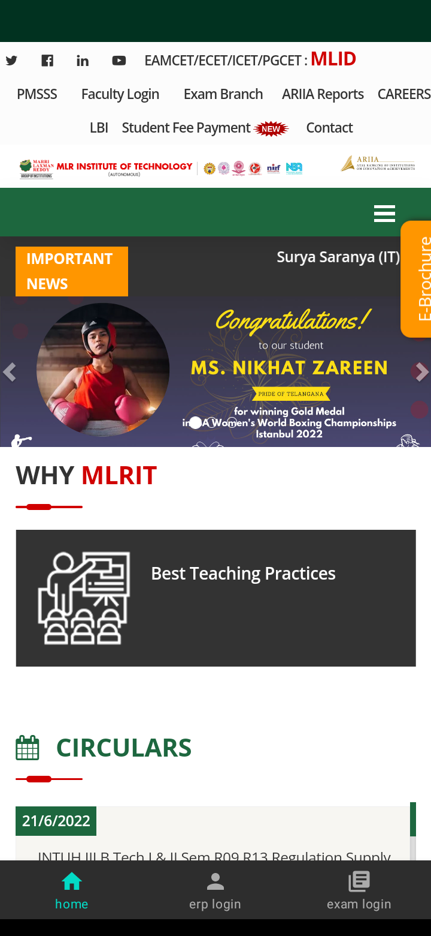
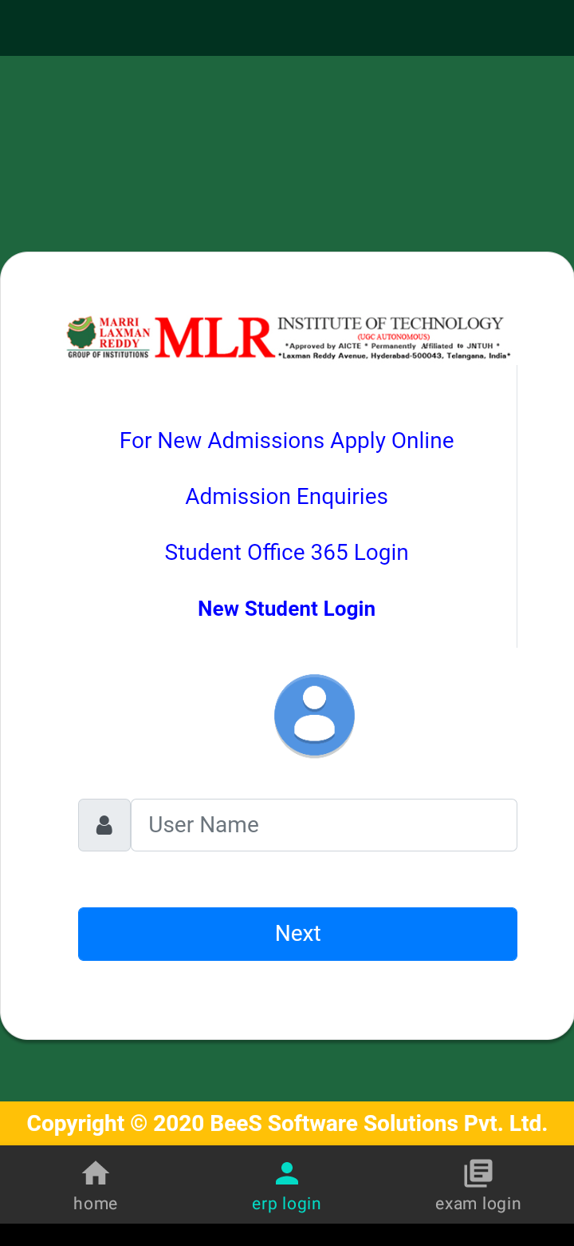
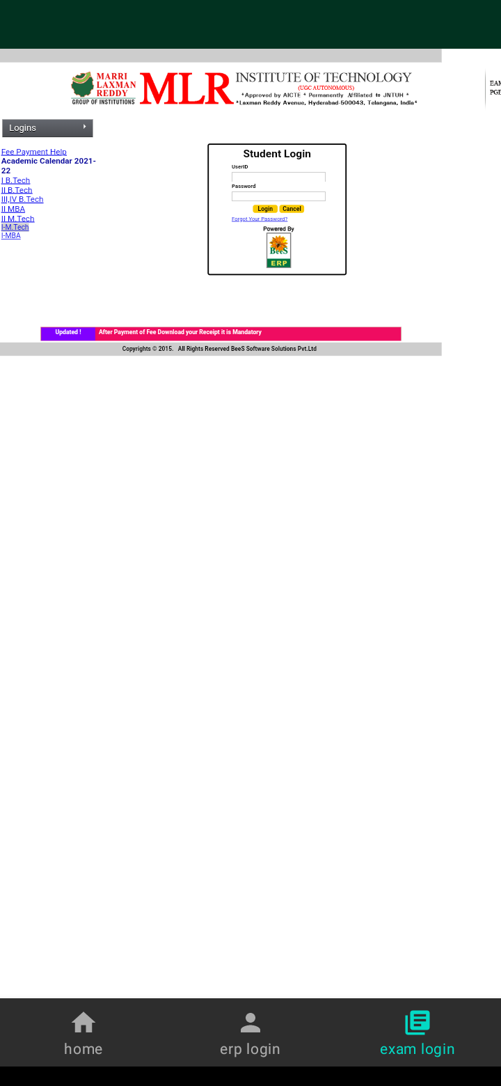

Slide 10

IoT Hackathon 2019

