Slide 1


HOME MADE VACUM CLEANER
Presented by :
21R21A6705 – B.ABHINAY
21R21A6720- ARSHITHA
21R21A6733 – SAI SOHAN

Slide 2
INTRODUCTION
Vacuum Cleaners are apparatus that remove and clean many kinds of surfaces by means of sucking and removing dust and small particles, and it is powered by electricity.
The removed dust particles and materials are deposited into a dust bag or cyclone inside the cleaner.
IoT Hackathon 2019

Slide 3
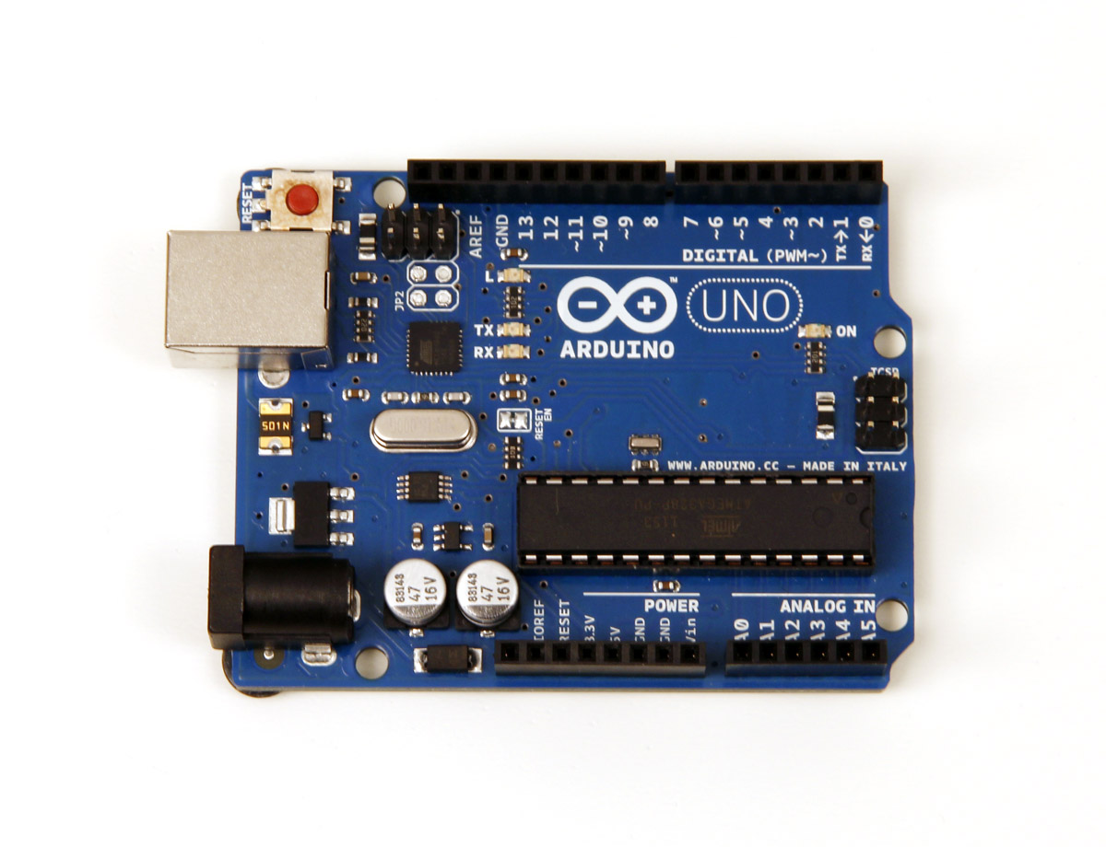
How to Make Vacuum Cleaner Using Plastic Bottle at Home
Step 1: Cutting the Plastic Bottle and Deodrant Bottle. ...
Step 2: Making the Fan. ...
Step 3: Attaching the Fan to Motor. ...
Step 4: Placing the Fan in the Plastic Bottle Bottom Portion. ...
Step 5: Fixing Bottle and Attaching Using Plaster. ...
Step 6: Making Suction Pipe.

Slide 4
WORKING PRINCIPLE
Materials flow from one location to another when a pressure difference is created between two locations.
This phenomenon is the basic working principle of an ideal vacuum cleaner.
When a centrifugal fan rotates it makes the air to flow by adding it external kinetic energy.
Air is sucked from behind and pushed forward with pressure and so negative pressure it creates behind the fan.
An ideal vacuum cleaner has such centrifugal fan in it connected to a motor.
IoT Hackathon 2019

Slide 5
ADVANTAGES
Vacuum Cleaner Saves Time and Energy. ...
Easy to use. ...
Removes allergen from breathing air. ...
Removes pet hair. ...
Vacuum cleaner comes with advanced features. ...
Vacuum cleaner is a low cost tool. ...
IoT Hackathon 2019

Slide 6
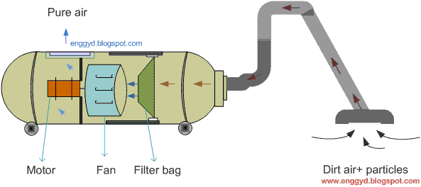
Design - Blueprint
IoT Hackathon 2019

Slide 7
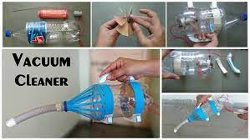
Output – Screen Shots
Place your output screen shots of your prototype.
IoT Hackathon 2019

Slide 8
Conclusion
The vacuum cleaner for home use is the best tool replacement for traditional methods of cleaning.
The impact that the vacuum cleaner has had in society is significant, as electricity was becoming available.
It was designed to blow out air in the hope of raising the dust from the carpet and into the collecting bag.
It is conveinent for cleaning dust and dirt from the floors of every room.so,for the quick,effective and conveinent cleaning,bring Home made vaccum cleaner

Slide 9
Thank You!
IoT Hackathon 2019

