Slide 1


SMART STICK
Team No:6
Presented By
B.Harika – 21R21A6709
G.Varun krishna– 21R21A6721
Umar Farooq – 21R21A6729
IoT Hackathon 2019

Slide 2
CONTENTS
Problem statement
Customer survey
Solution’s
History
Value proportion
Customers & Consumers
Blueprint
Conclusion
Output

Slide 3
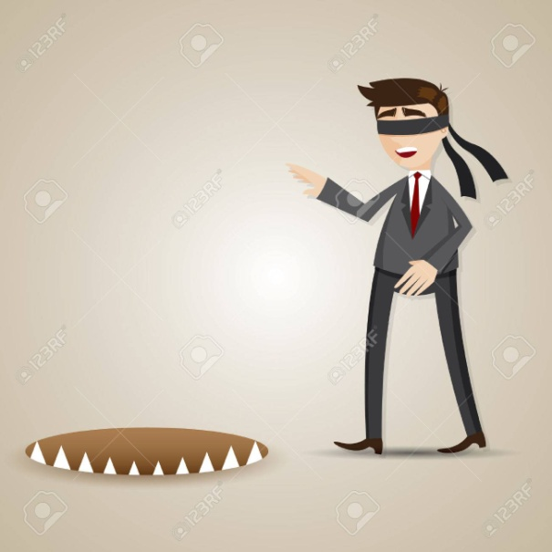
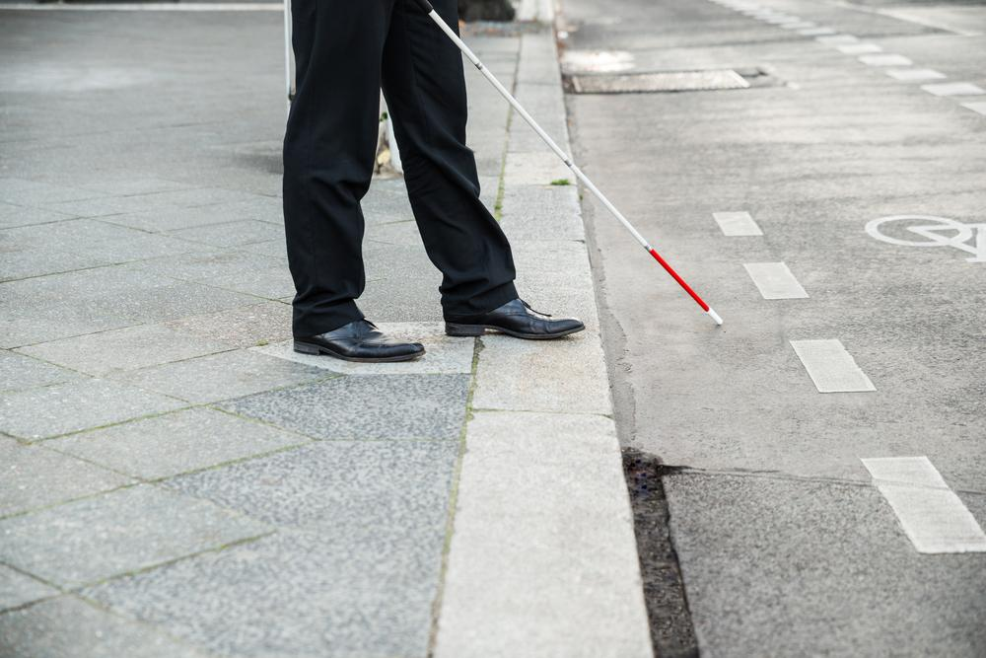
Problem Statement
Without vision it can be challenging for visually impaired people to navigate and to move around without bumping into obstacles !!
IoT Hackathon 2019

Slide 4
Customer Survey
One of the consequences of vision loss is being uncomfortable about safety while moving around or traveling independently
Many blind people had experienced some sort of
difficulty in outdoor environments like unsafe sidewalks, existence of obstacles on sidewalks, fear of falling, walking into glass doors, crossing streets etc..
So this problem is stated as the most common and need to be focused and solved topic.
IoT Hackathon 2019

Slide 5
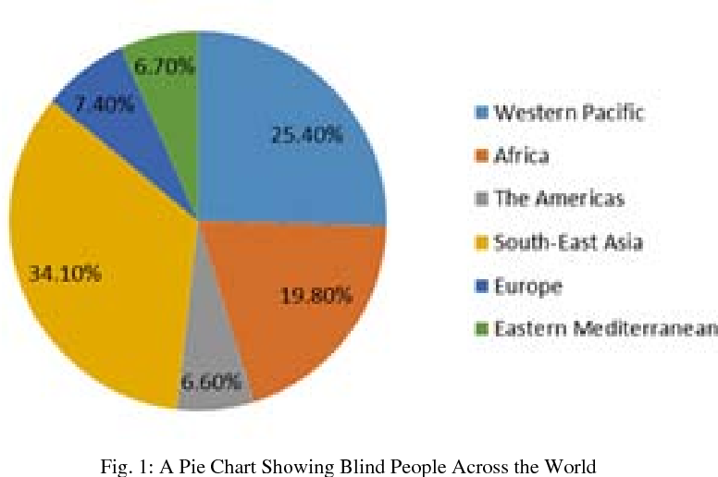
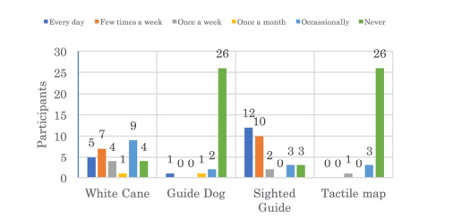
Existing Solutions
Existing solutions for helping blind people are like-
Smart Glasses
Electric vehicles
3-D Sound Maps – They are quit useful and friendly to use but they don’t indicate any obstacles.
These devices are in use but not in wide range.
The existing solutions are not satisfactory due to high cost
and low availability in the developing countries
IoT Hackathon 2019

Slide 6
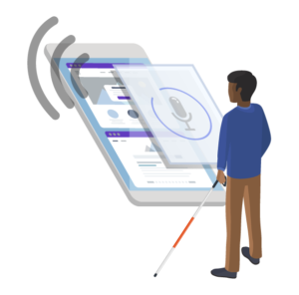
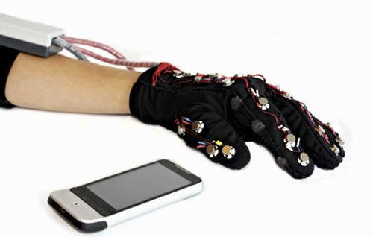
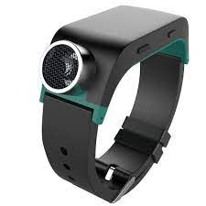
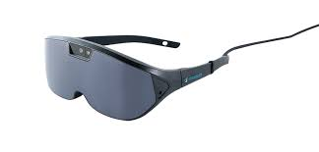
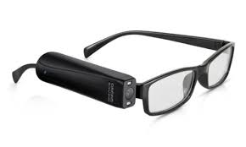
Blind devices
.
Low vision-

Slide 7
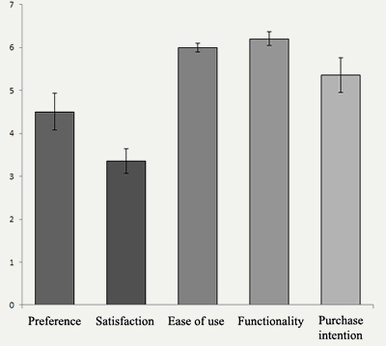
Our Solution
Blind stick is an innovative stick designed for visually
disabled people for improved navigation while walking.
We here propose an advanced blind stick that allow visually
challenged people to navigate with ease using advanced
technology.
People prefer to use smart stick often.
IoT Hackathon 2019

Slide 8
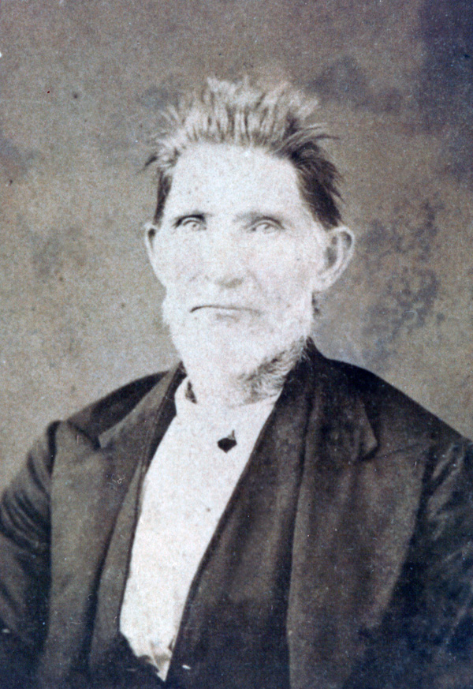
History
James Biggs of Bristol claimed to have
invented the smart stick in 1921.
After an accident claimed his sight, the
artist had to readjust to his environment.
Feeling threatened by increased motor
vehicle traffic around his home, Biggs decided
to paint his walking stick white to make himself
more visible to motorists

Slide 9
Value Proposition
This will assist the blind persons during the walk and
provides an alarm if any hurdle is detected with-In the
set range.
The smart stick for the blind as the name suggests is a device
for the visually impaired to guide the user to move by avoiding
to collide with the obstacles.
As comparing to other devices smart stick allows them to detect objects fast.
IoT Hackathon 2019

Slide 10
Customers & Consumers
This project can be successfully used in the market as it have many advantages comparingly and very easy to use and with a reasonable cost, depending on the ranges of cost the level of comfort changes to more.
It will be surely helpful for the blind people and a person having a knowledge of darkness and humanity can gift there blind friends smart stick as it wont only make them feel happy ,rather it gives the person hope that he can be normal
IoT Hackathon 2019

Slide 11
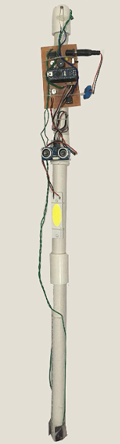
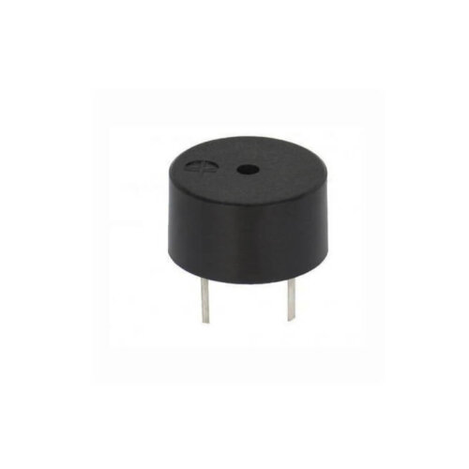
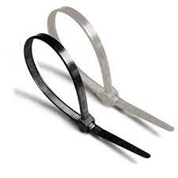
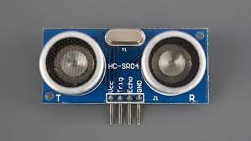
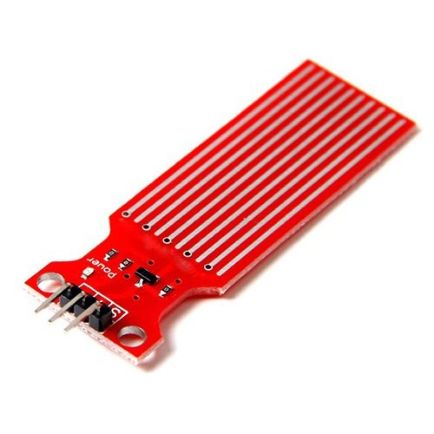

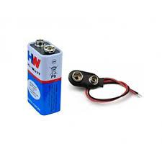
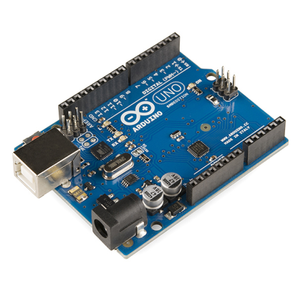
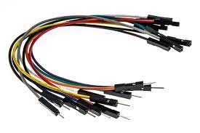
components

Slide 12
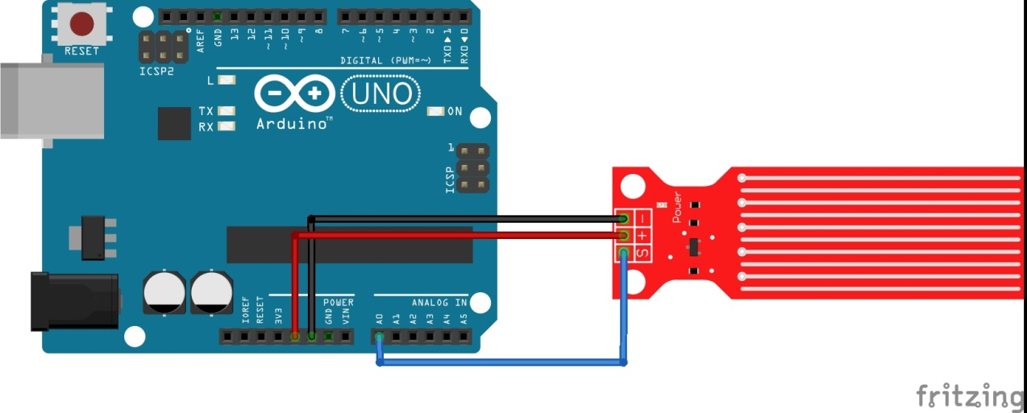
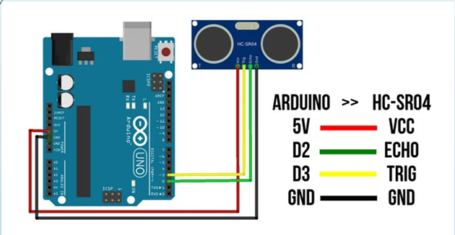
Design - Blueprint
.
IoT Hackathon 2019

Slide 13
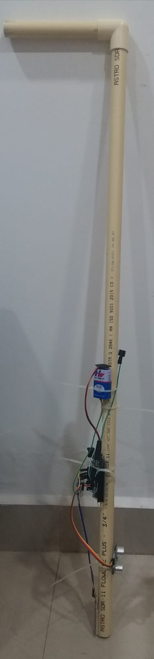
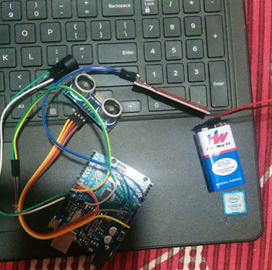
Output – Screen Shots
.
IoT Hackathon 2019

Slide 14
conclusion
Without the help of any other person
the blind people can walk easily.
Overall, the use of technology provides much more benefits and has taken a great leap towards improving the lives of the visually impaired.

Slide 15
Thank You! We are happy to hear your feedback as well, we would come back stronger!
IoT Hackathon 2019

