Slide 1


CRICKET ALERTS USING PYTHON
Team No: 02
Presented By:
MAHESH
VINOD
SHIVANI
IoT Hackathon 2019

Slide 2
Problem Statement
Problem statement : facing problems while using cricket websites !!
Sports websites do offer live scores on their page which is what
the majority of the people will follow ,to stay updated on live updates if they are not watching the match .
But the thing with these websites is that you have to keep staring at the page or refreshing it to get the latest score which can be quite unproductive while we are in the middle of important work ,moreover every time we want to share the joy of a six or a wicket with our friend , you have to manually share it via a messaging app.
IoT Hackathon 2019

Slide 3
Existing Solutions
. By creating a project cricket scorecard developed in PHP is used to provide user with an update of the cricket even when they are not watching the match .
IoT Hackathon 2019

Slide 4
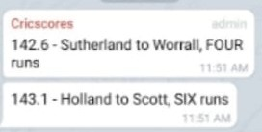
Our Solution
By building an application using python ,and share live updates of cricket in telegram groups
Fetch live scores from cricinfo website.
Data parser to extract critical events
Notification mechanism
To send data to telegram
IoT Hackathon 2019

Slide 5
Process:
Task 1: fetch live scores from websites and parsing the data.
>>use the API from the cricinfo website and fetch the lives scores of the match
>>to understand more about the API , complete hyperlink and rest bytes from cric bytes section
>>parse the data to extract meaningful data such as balls , wickets , target score etc.
IoT Hackathon 2019

Slide 6
Task 2: notifying the users
>>use the hyperlink API to send notification in a group or to an individual on telegram .
>> the notification should consist of all the necessary information parsed from the data obtained from the live scores websites
IoT Hackathon 2019

Slide 7
Output:
By the end of this application , the core implementation of your application should be complete . Application should be able to call the API , fetch and parse the required information and should able send recurring updates on telegram .
Notification to telegram : This is the output which is the result of this project .
IoT Hackathon 2019

Slide 8
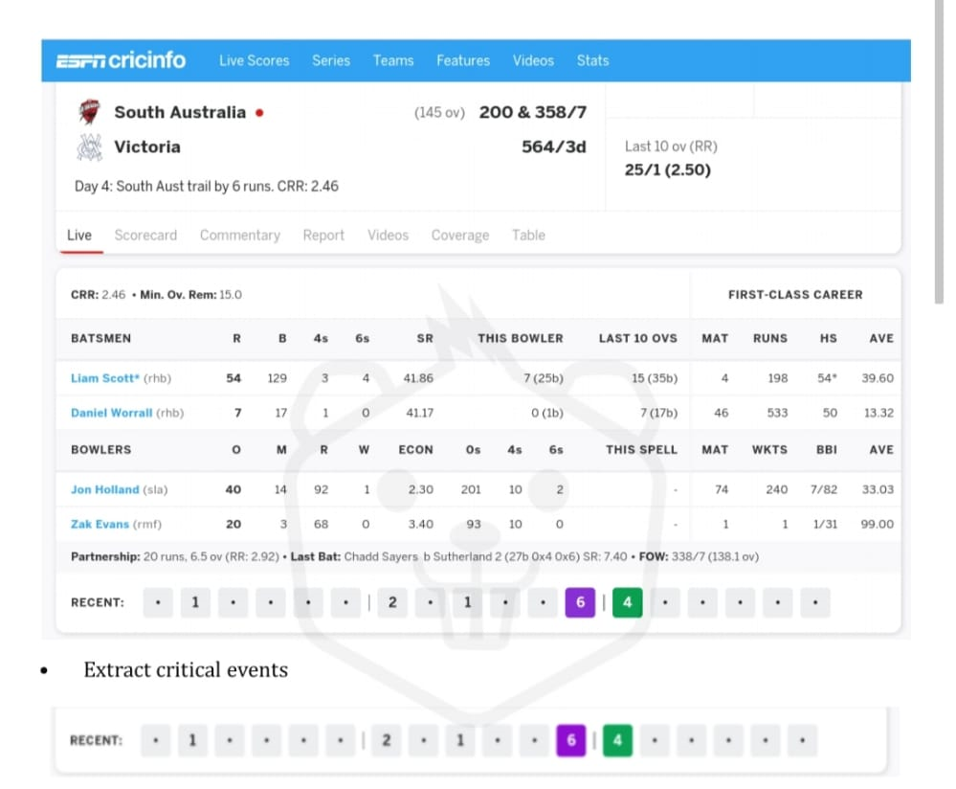
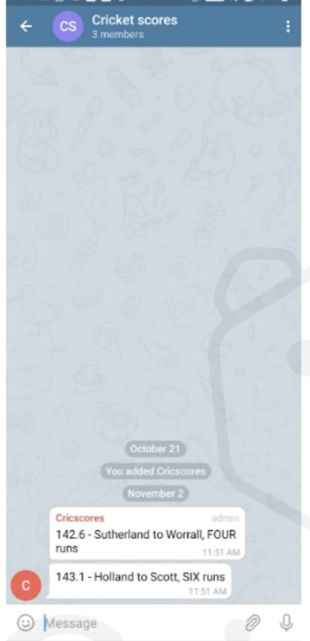
Output – Screen Shots
IoT Hackathon 2019

Slide 9
Thank You!
IoT Hackathon 2019

