Slide 1
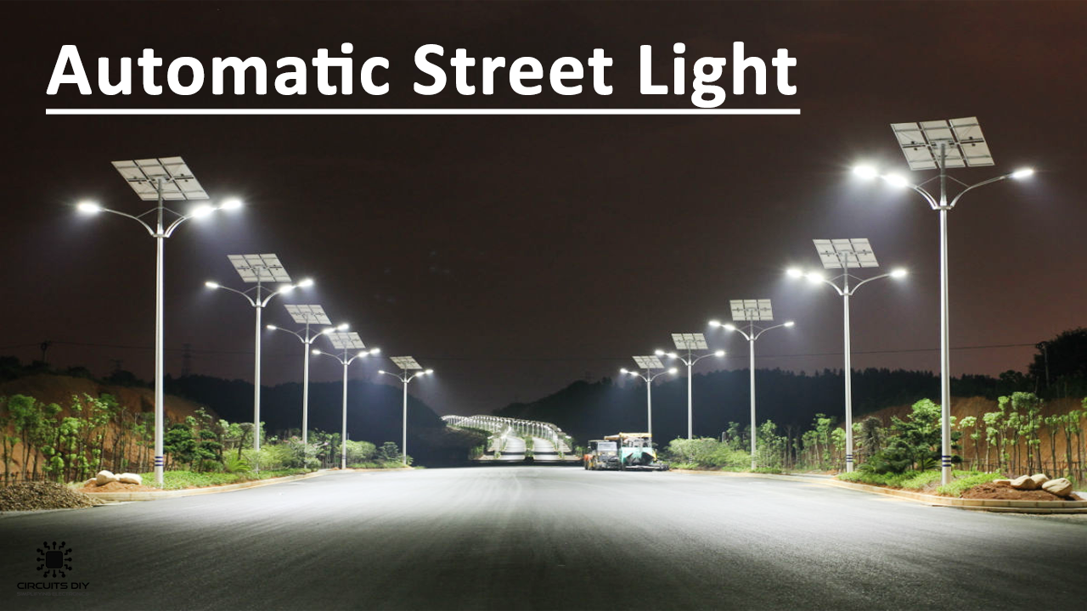
AUTOMATIC STREET LIGHT USING LDR team members: MADHAVI DHANUJ RAKESH

Slide 2
CONTENTS
INTRODUCTION
MAIN COMPONENTS
ABOUT THE COMPONENTS
HOW IT WORKS
CIRCUIT
ADVANTAGES
APPLICATIONS
CONCLUSION

Slide 3
INTRODUCTION :
Solar powered automatic street light controller is a very efficient device that is used to control the street light working.
It automatically turns on when there is dark and turns off when the sun is out.
This turning ON and OFF of the street lights is controlled by a device called LDR(Light dependent resistor)
This device actually senses the light.

Slide 4
MAIN COMPONENTS:
TRANSISTOR BC548
LDR (LIGHT DEPENDENT RESISTOR)
RESISTORS
BATTERY
LED

Slide 5
ABOUT THE COMPONENTS:
LDR (LIGHT DEPENDENT RESISTOR) :
An electronic component whose resistance changes when the light intensity falls upon it.
The resistance decreases when the intensity of the light increases and vice-versa.
The LDR may typically have the following resistances:
DAY LIGHT – 5000 Ohm.
NIGHT-2*10^7 Ohm.
These resistors are mainly used to sense the presence of the light

Slide 6
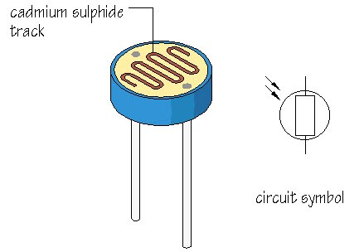
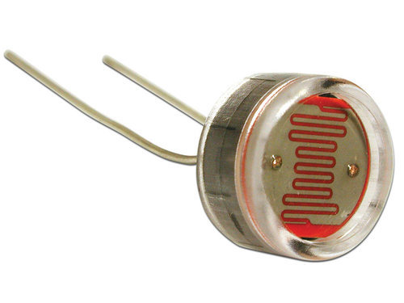
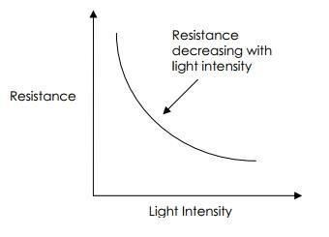
LDR:

Slide 7
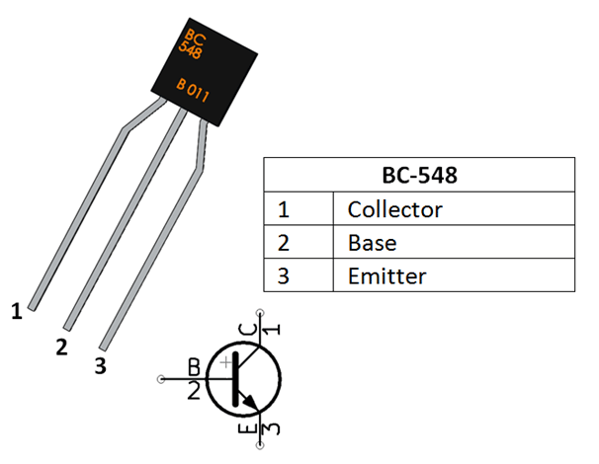
Transistor BC548 :
The device mainly consists of three major parts :
EMMITER
BASE
COLLECTROR
COLLECTOR- The current flows in through the collector
BASE-Controls the biasing of transistor
EMITTER-Current drains out through the emitter
The main function of this device to switch ON and OFF

Slide 8
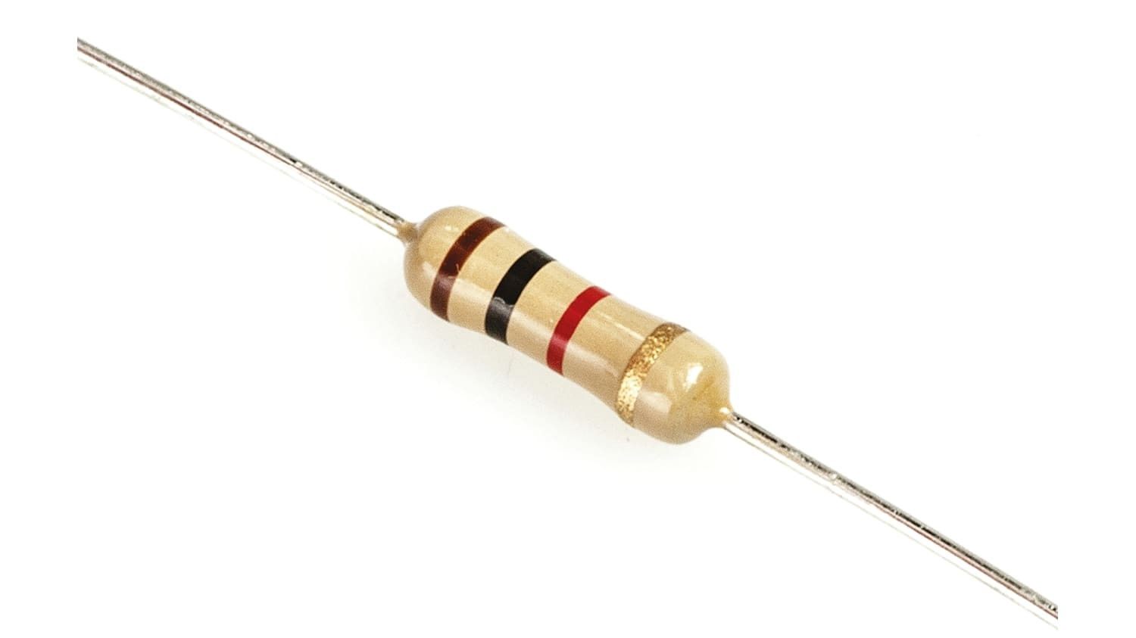
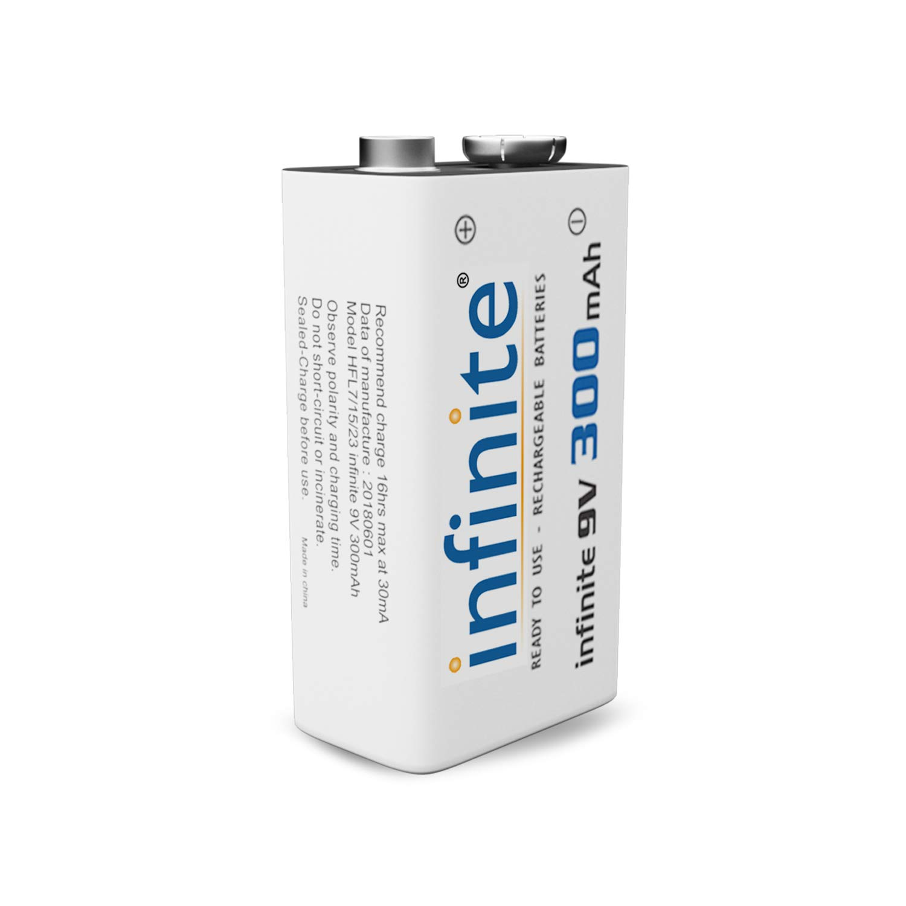
RESISTOR :
It is a component having two terminals that
are used to manage the current flow in the
circuit.
The flow of the current is directly proportional
to the appeared voltage.
BATTERY :
It is a device that is used to store the energy.
HOW IT WORKS :
When light falls on the LDR it shows its minimum resistance and the voltage drop across the LDR is less .
So, no current will go from the collector to the emitter and it remains turned OFF,

Slide 9
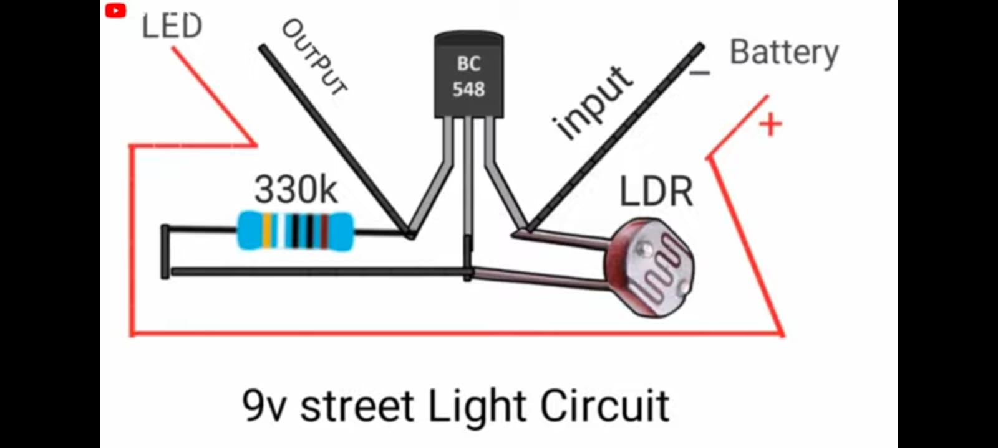
No light falls on the LDR its shows the maximum resistance and the voltage is greater now int hr circuit.
Now the transistor enters into ON state the current will flow through the LED and the LED gets turned ON now.
CIRCUIT DIAGRAM :

Slide 10
ADVANTAGES:
No man power is required –Automated operation
Efficient method
Less consumption of electrical energy
Less maintenance
Energy is saved
DISADVANTAGES:
LED gets turned on when shadow falls on LDR
LDR should be more sensitive for better results
LDR should be so adjusted that it should not get light from sunlight itself.

Slide 11
CONCLUSION :
In coming days ,this is very useful to the world since it will save lots of electricity .
As the conventional sources are depleting fast this type of alternatives are very much useful.

Slide 12


