Slide 1
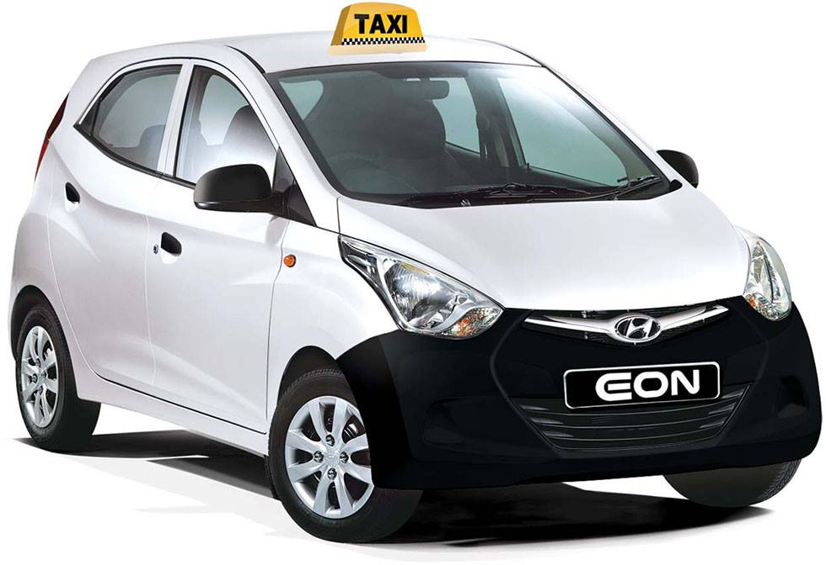
Taxi booking System
Aayush GC Bhujel (3143)
Angeena Chawal (3144)
Ravi Kandel (3171)
Sujan Maharjan (3187)

Slide 2
Problem Statement
Difficult to get transportation mediums as per people’s convenience.
At many times it may be difficult for people to get taxis from their desired locations, especially at the night.
During night, people who are travelling alone, may face some security issues.
Getting at the right time at right destination.

Slide 3
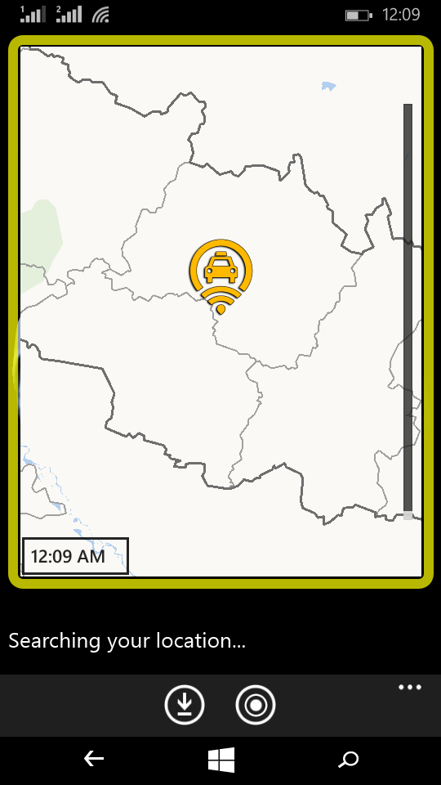
Taxi Booking System
A windows mobile phone application.
Allows booking of the taxi and calling it to the desired location.

Slide 4
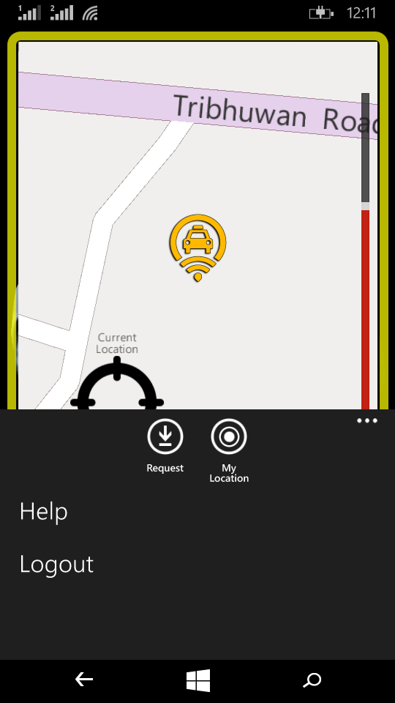
Features:
Easy to understand and use.
Simple and easy user interface.
Dynamic system.
Provides quick and easy way to book and excess taxi.

Slide 5
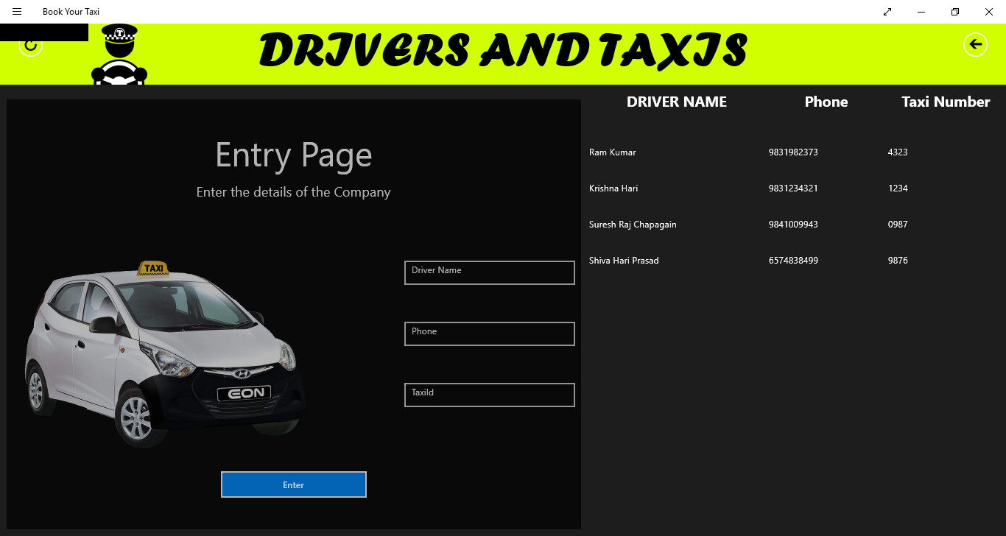
Objectives
The main objective of our project is to help people easily get access to taxi during regular transit or during emergencies.
Other objectives are:
To ease taxi access for transit.
To save time during transit.
To help taxi companies expand their business.

Slide 6
Scope and Limitations:
Our project has a very good scope with the growing use of technology; the problem is access to taxi at desired time and location.
The major scope of our project is in the urban areas rather than the rural areas. Urban areas are well equipped to provide the facilities that we want to provide.
Our project suits in the area where there is availability of taxi services and no issues of internet access.
Since almost every person now owns a smart phone and our project is an application, it has a very good scope. This application will help fill the gap between the passenger and the taxi company. It will also help the taxi companies to expand their business.
Our project can provide reservation and access to the taxi only in those areas where the taxi services and internet services are available. That is, it cannot provide the services in the remote areas.

Slide 7
System Analysis
System Requirements:
Hardware requirements
Platform: Windows Phone with Windows 8.1 OS.
Software requirements
Development Tools: Visual Studio 2015, Azure Mobile App service
Programming Languages: C#
Database System: Azure SQL Database
Hosting Server: Microsoft Azure
User Requirements
Windows Phone with Window OS 8.1.
Internet access on mobile.

Slide 8
Feasibility Study
Taxi Booking System is developed for Windows phone.
The Windows Phone is now taking a good market
This Application is more feasible than before when there was a majority of Android smart phones
Technical Feasibility
The technical issues related with developing ‘Taxi Booking System’ were
Does the technology exist to implement the proposed system?
If the system can solve the problem of people seeking easy commute?

Slide 9
Operational Feasibility
For this, the following factors are to be considered:
Are the current work practices and procedures adequate to support the purposed system?
How well the purposed system solves the problem?
To what extent the application fits in the existing problems?
Can the operating characteristics be engineered into design?

Slide 10
Economic Feasibility
Some of the aspects to be considered for determining the economic feasibility are:
Are the operational and maintenance costs of the system manageable and affordable?
Can the economic expenses of the prevailing system be reduced later after development of the system?
Can the existing investment support the project development?
Can the target group of your system afford your system?

Slide 11
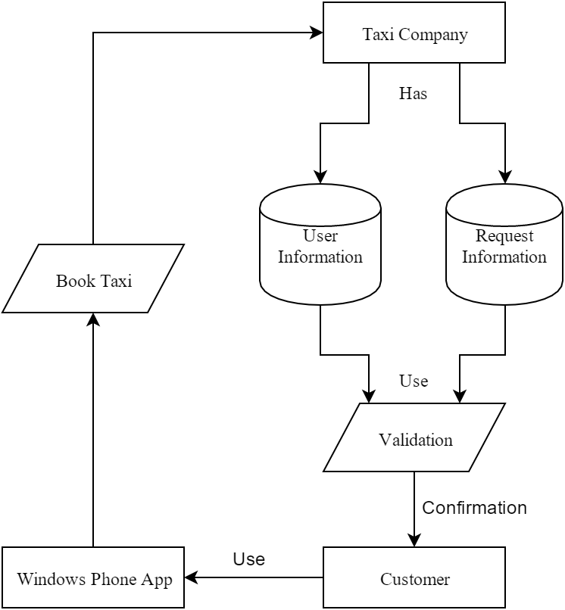
System Design
System Flow Chart

Slide 12
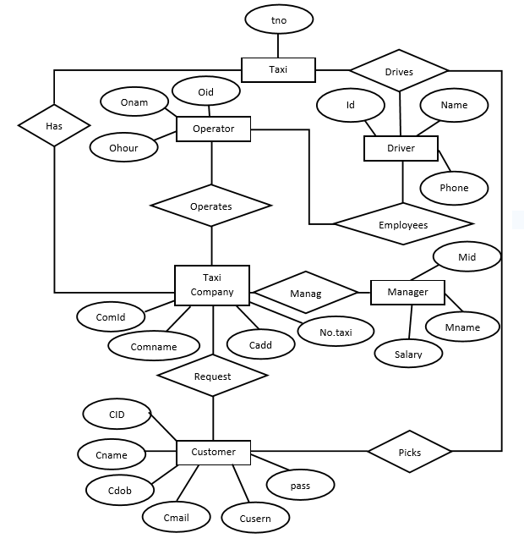
ER Diagram

Slide 13
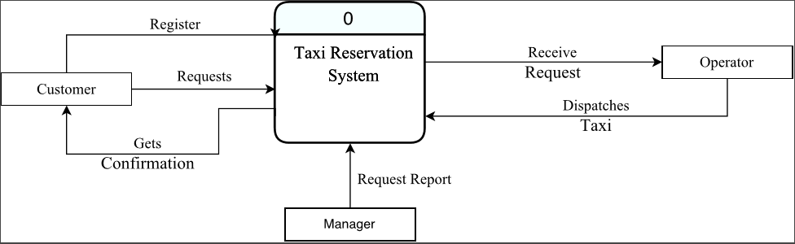
Context Diagram

Slide 14
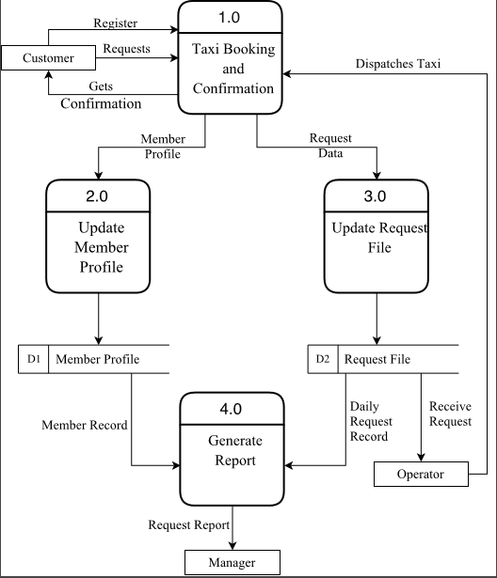
Level – 0 DFD Diagram

Slide 15
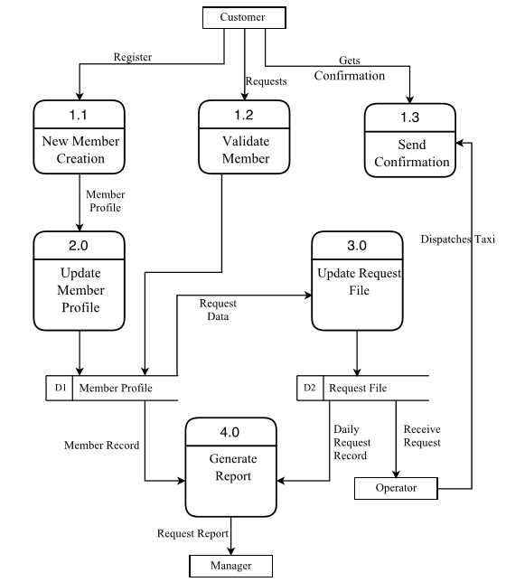
Level – 1 DFD Diagram

Slide 16
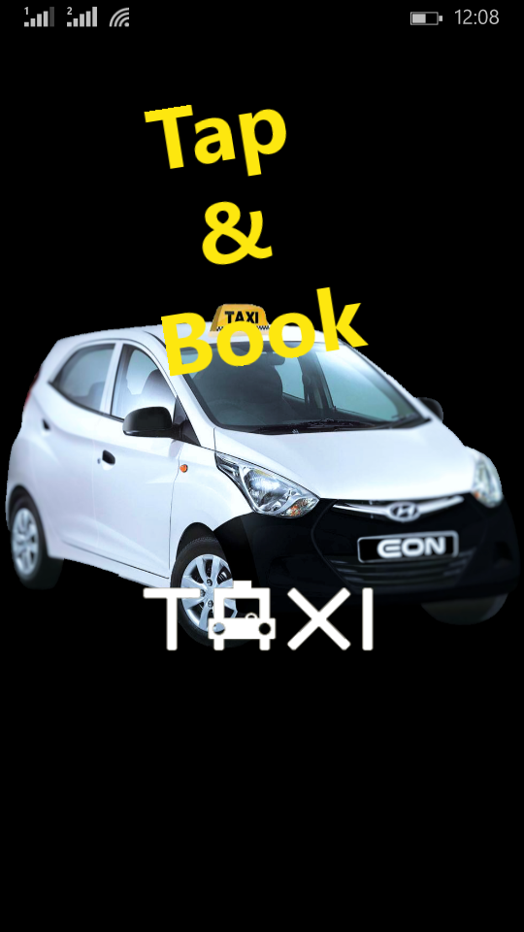
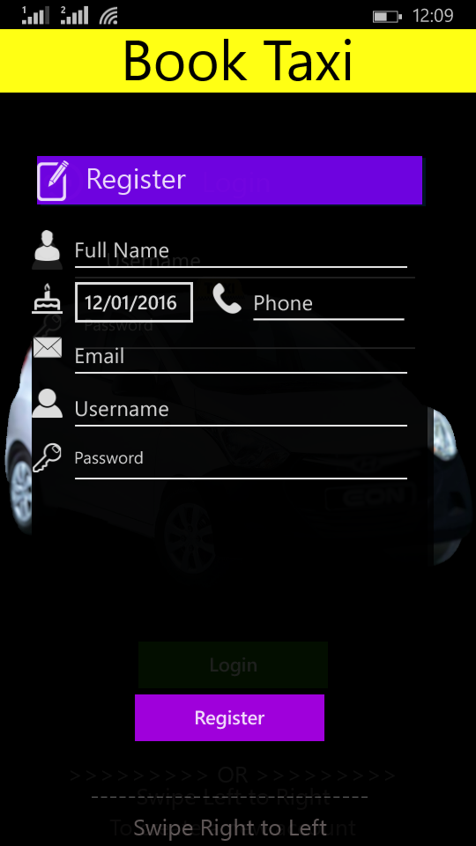
Screen Shots of Application
Windows Phone

Slide 17
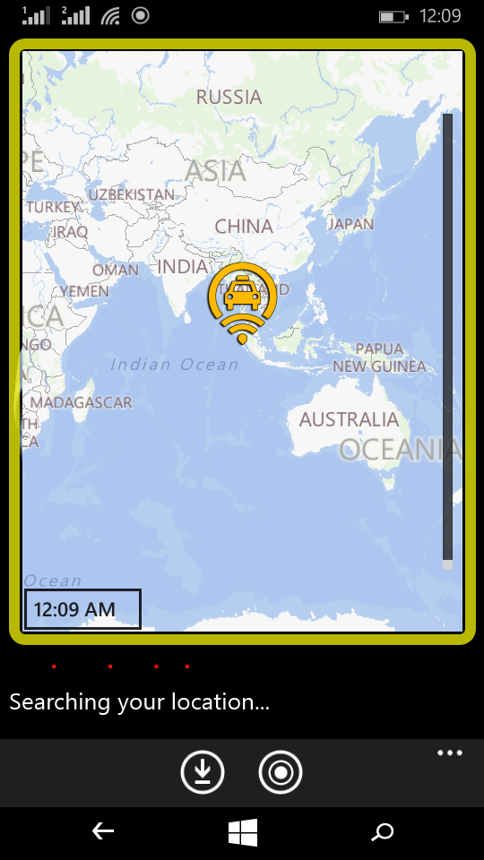
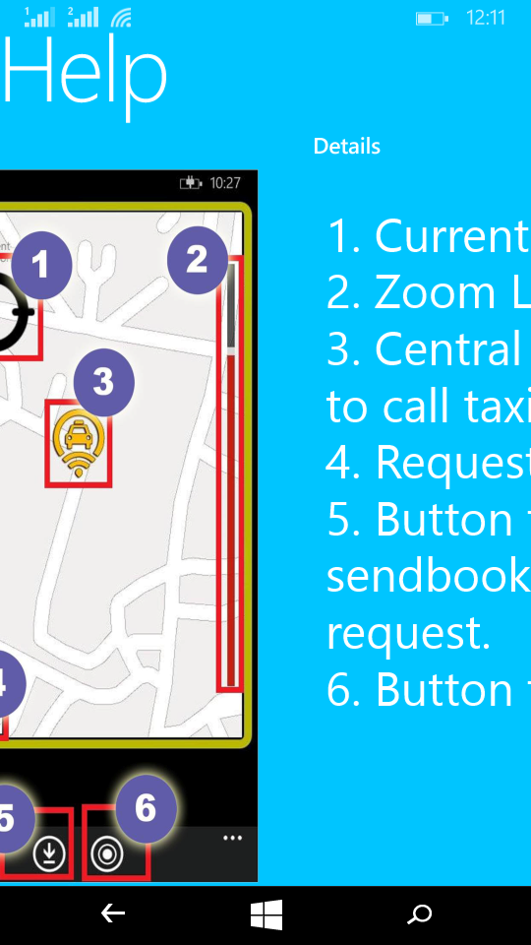

Slide 18
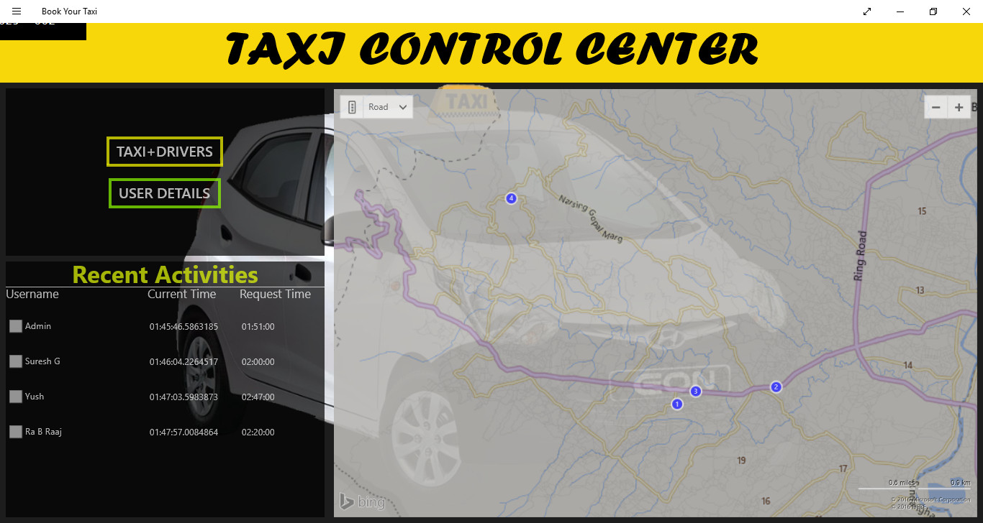
Windows

Slide 19
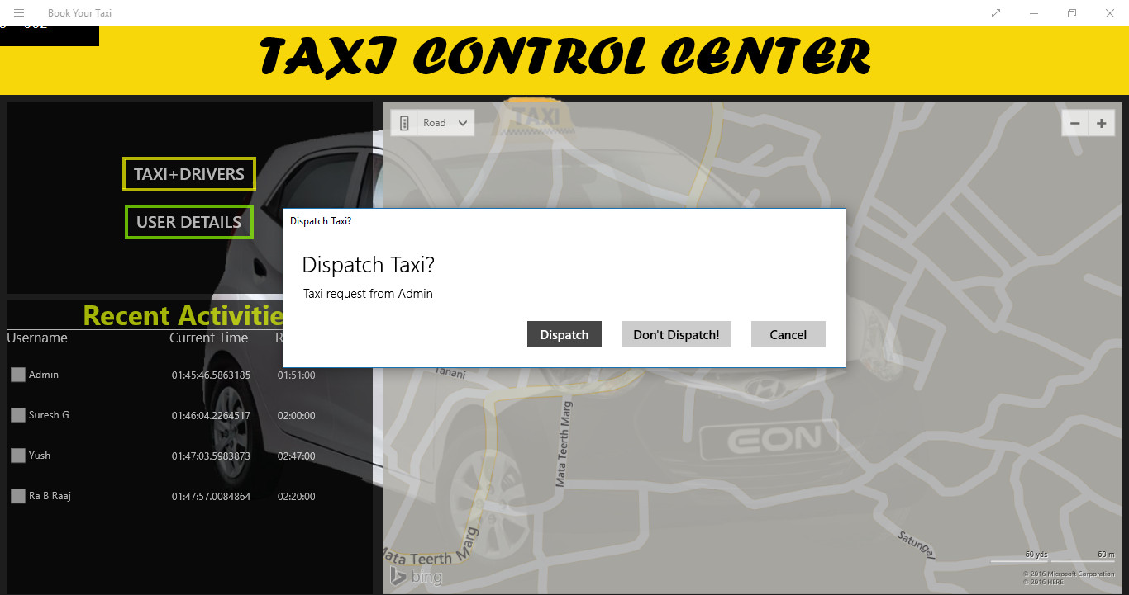

Slide 20
TESTING:
Process of executing a program or application with the intent of finding the software bugs.
Process of validating and verifying that a software program or application or product meets the business and technical requirements that guided its design and development.

Slide 21
CONCLUSION AND FUTURE ENHANCEMENT:
Conclusion
The mobile phone application has been successfully developed to provide the people with easy and quick access to the taxi services.
The system focuses on the creation of a taxi reservation service(system) for any taxi organization so that the taxi organization provide services to its customers in an effective and an efficient way.
To conclude, we can say that this project will be very beneficiary to the peoples during their transit.
Our project is developed to help people get to their destination easily and without wasting time.
Future Enhancement
To improve and enhance the developed system following could be done.
Comments and feedbacks from users to state their level of satisfaction
User ranking and rating can be implemented.
Push Notification system can be added as a new feature.

