Slide 1
QCodes
Alex Johnson
18 Dec 2015
The goal: to create a common data acquisition framework for all experiments in the Copenhagen/ Delft/ Sydney Station Q consortium… and beyond

Slide 2
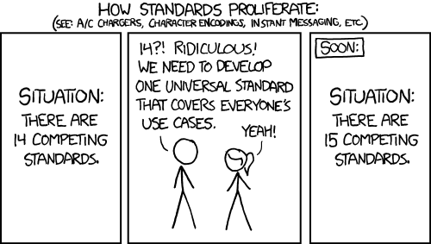
Where we are now:
Igor (based on my code circa 2002)
QTLab (Delft Python package circa 2008?)
LabVIEW + Mathematica
MATLAB (various ad-hoc efforts)
Some other lightweight Python code

Slide 3
Project plan:
Roadmap – Set at a meeting in Copenhagen in May
Phase 1 – Core features, roll out to early adopters (August – now)
Phase 2 – Improve usability and functionality, roll out to rest of Station Q (spring)
Phase 3 – More features to help new users and improve workflow (summer)
Phase 4 – If all goes well, public open source release (fall?)

Slide 4
Philosophy:
Python3 – Widespread, clear, expressive, rich, long-term
Modular – Use only what you need, easily plug in your own pieces
Portable – will be pip-installable anywhere
Tested – only fix a bug once
Collaborative – contributions are encouraged, with review

Slide 5
Measurement syntax
data = Loop(c0[-20:20:0.1], 0.1).run()
data2 = Loop(c1[-15:15:1], 0.1).each(
Task(c0.set, -10),
qubit1.t1,
fridge.mc_temp,
Loop(c0[-15:15:1], 0.01).each(meter.amplitude),
Task(c0.set, -10),
Wait(0.1),
Loop(c2[-10:10:0.2], 0.01),
Task(c2.set, 5)
).run()

Slide 6
Code Structure
Spread tasks over a multi-core CPU
Keep the main process free for analysis and setting up the next task while a measurement is running
Keep the measurement process as light as possible
Simplify as much as possible – minimize processes and persistent state

Slide 7
Define your system
Main Process
Station
Instrument
Instrument
Parameter
Parameter
Parameter
Parameter
Parameter
Parameter
Parameter
Parameter
Loop

Slide 8
Monitor runs in a separate process
Main Process
Station
Instrument
Instrument
Parameter
Parameter
DataServer Process
Parameter
Parameter
DataServer
Monitor
Parameter
Parameter
Parameter
Parameter
Loop
Disk
Cloud

Slide 9
Start a measurement loop
Measurement
Process
Main Process
Loop
Station
DataSet
Instrument
Instrument
DataArray
Parameter
Parameter
DataServer Process
DataArray
Parameter
Parameter
Formatter
DataServer
IOManager
Monitor
Parameter
Parameter
Parameter
Parameter
Loop
Disk
Cloud

Slide 10
Different DataSet Modes
Measurement
Process
Main Process
Loop
Station
DataSet
Instrument
Instrument
DataArray
Parameter
Parameter
DataServer Process
DataArray
Parameter
Parameter
Formatter
DataServer
IOManager
DataSet
Monitor
Parameter
DataArray
DataSet
Parameter
DataArray
DataArray
Formatter
Parameter
DataArray
Parameter
IOManager
Formatter
Loop
IOManager
Disk
Cloud

Slide 11
Measurement process just talks to DataServer
Measurement
Process
Main Process
Loop
Station
DataSet
Instrument
Instrument
DataArray
Parameter
Parameter
DataServer Process
DataArray
Parameter
Parameter
Formatter
DataServer
IOManager
DataSet
Monitor
Parameter
DataArray
DataSet
Parameter
DataArray
DataArray
Formatter
Parameter
DataArray
Parameter
IOManager
Formatter
Loop
IOManager
Disk
Cloud

Slide 12
Measurement loop finishes
Main Process
Station
Instrument
Instrument
Parameter
Parameter
DataServer Process
Parameter
Parameter
DataServer
Monitor
Parameter
DataSet
Parameter
DataArray
Parameter
DataArray
Parameter
Formatter
Loop
IOManager
Disk
Cloud

