Slide 1

Splitwise Clone
Product presentation

Slide 2
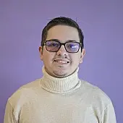
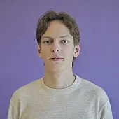
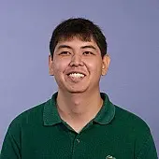
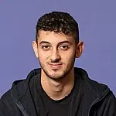
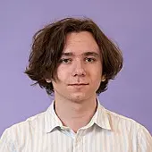
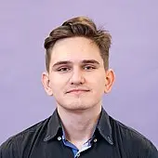
The Team
Daniel Vetencourt
Aliaksandr Dudzinski
Dias Sarkytbayev
Project Manager
Backend Developer
QA Engineer
Hamza Jaebak Ida
Mikita Voitsik
Aliaksandr Dudzinski
Backend Developer
Frontend Developer
Backend & DevOps

Slide 3


Original Idea
We want an application that…
Tracks share expenses
Manage private groups
Simplify debt settlement
Provides a fast and intuitive UI
Split the Cost, keep the Friendships!

Slide 4
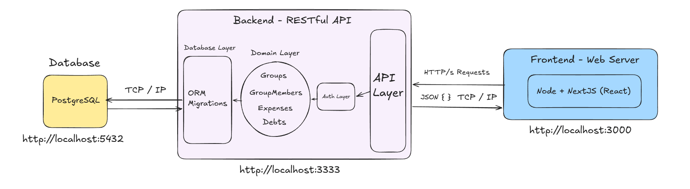
Architecture Overview

Slide 5






Stack Chosen
Backend
Frontend

