Slide 1


Slide 2
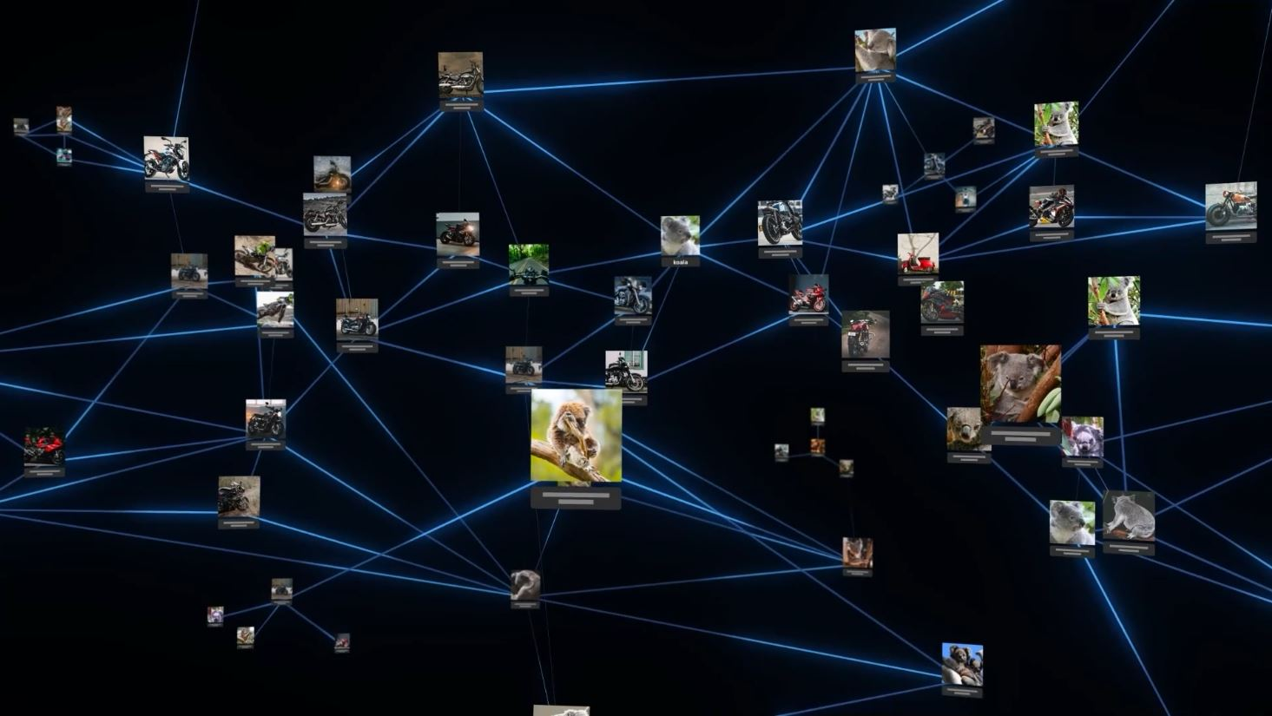

Slide 3
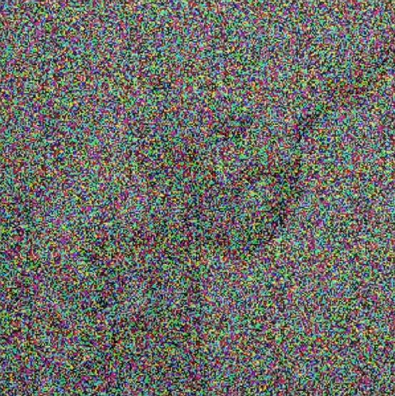

Slide 4
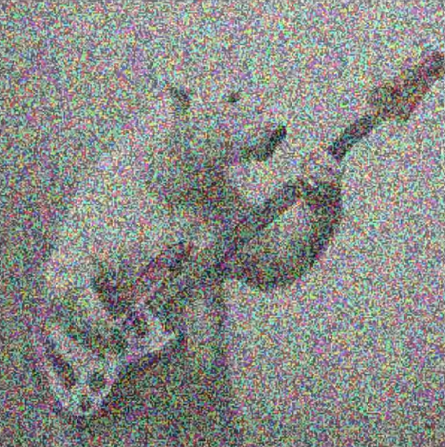

Slide 5
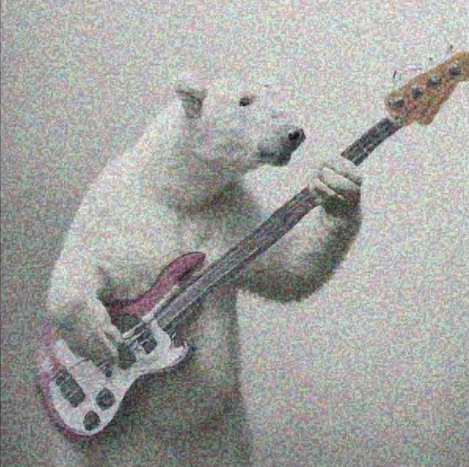

Slide 6
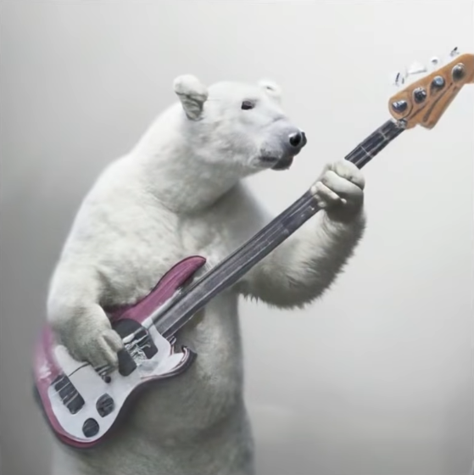

Slide 7
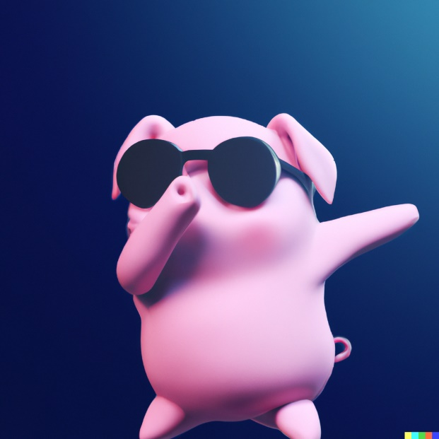
3D render of a cute pig with sunglasses doing a dab on a dark blue background, digital art

Slide 8
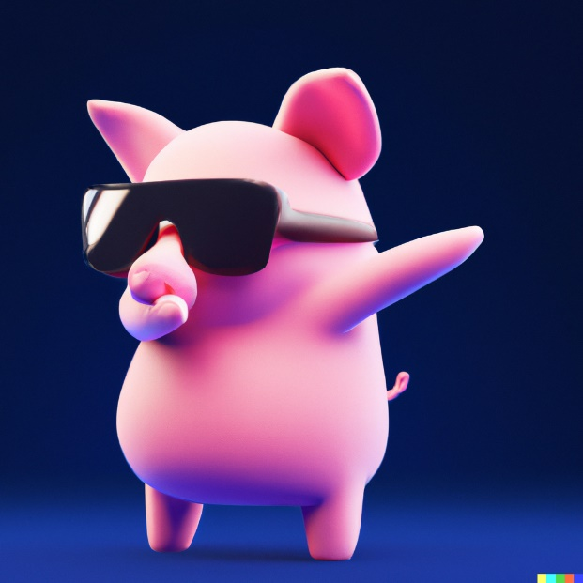
3D render of a cute pig with sunglasses doing a dab on a dark blue background, digital art

Slide 9
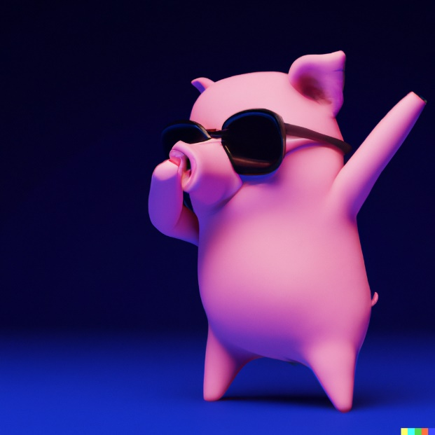
3D render of a cute pig with sunglasses doing a dab on a dark blue background, digital art

Slide 10
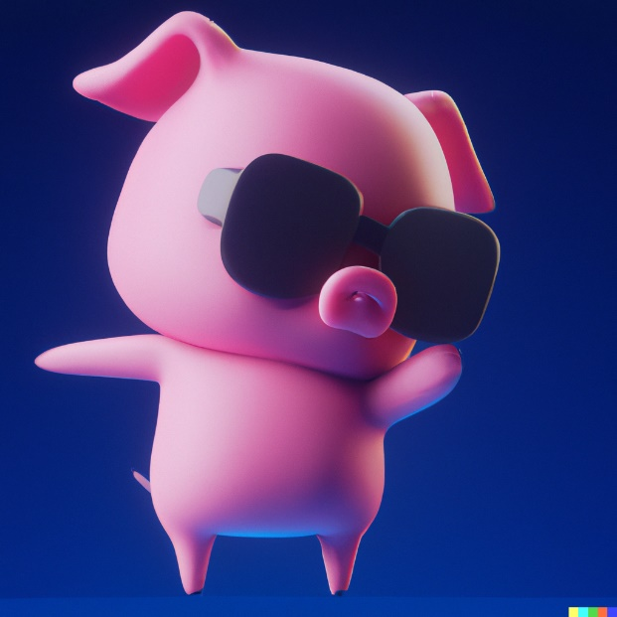
3D render of a cute pig with sunglasses doing a dab on a dark blue background, digital art

Slide 11
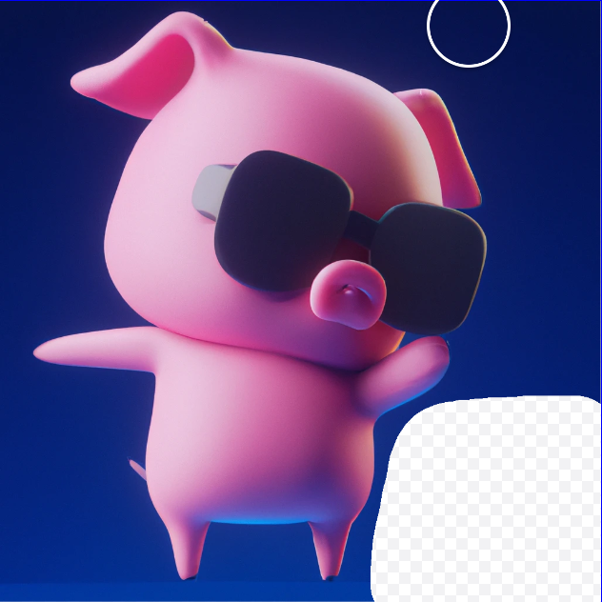
Add a cute 3D penguin

Slide 12
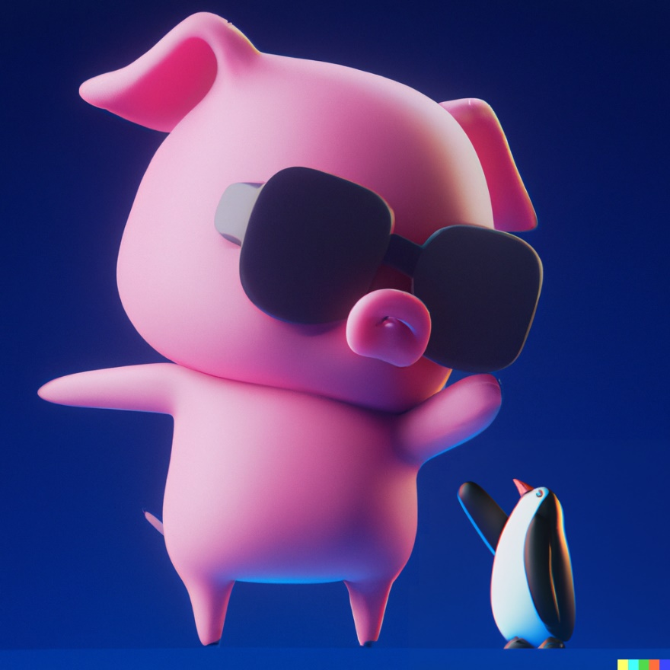
Add a cute 3D penguin

