Slide 1

OpenAI Video PreTraining

Slide 2
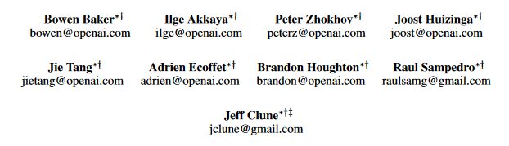
About This Research Paper
Video PreTraining
Minecraft
A.I

Slide 3
Introduction
Unlabeled Videos
Datasets
Chess, Starcraft…
Robotics, Games Playing …
No Informations
Strategy : RL
Upgrade this into something better : VPT

Slide 4
Introduction
VPT
Why
Minecraft
Why
Most Played
Wide Variety
20 FPS
Gathering a single wooden log while
already facing a tree takes 60consecutive attack actions

Slide 5
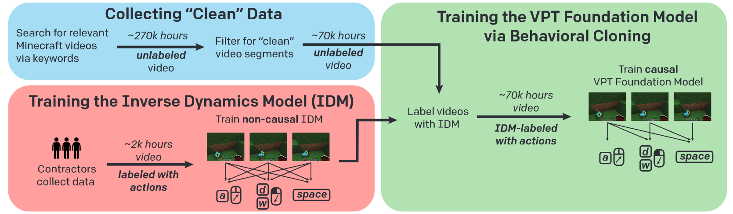
Setup

Slide 6

Methods Used
Overlaid Artifacts
Other Platform Than Computer
Not Survival

Slide 7
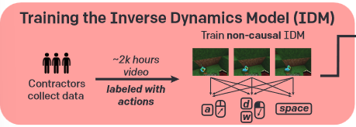
Methods Used
Labeled Contractor Data
Train the IDM
Can be used to label online videos

Slide 8
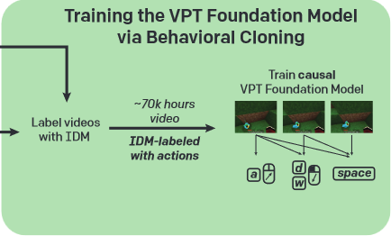
Methods Used
Have Unlabeled to Labeled Videos in Entry
Training by Watching Videos
Model can Play Minecraft

Slide 9
Results

