Slide 1

OpenAI Video PreTraining

Slide 2
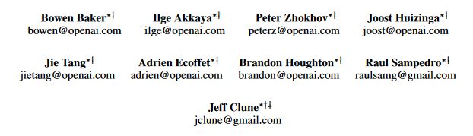
About This Research Paper
Video PreTraining
Minecraft
A.I

Slide 3
Introduction
Unlabeled Videos
Datasets
Chess, Starcraft…
Robotics, Games Playing …
No Informations
Strategy : RL
Upgrade this into something better : VPT

Slide 4
Introduction
VPT
Why
Minecraft
Why
Most Played
Wide Variety
20 FPS
Gathering a single wooden log while
already facing a tree takes 60consecutive attack actions

Slide 5
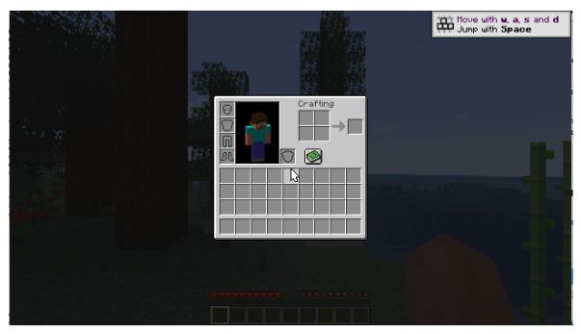
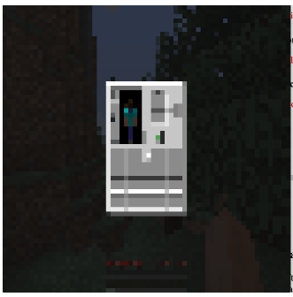
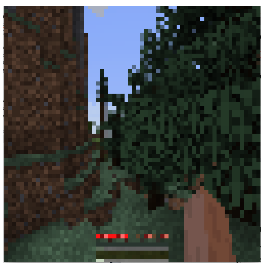
Minecraft environment details
MCP-Reborn Minecraft modding package

Slide 6
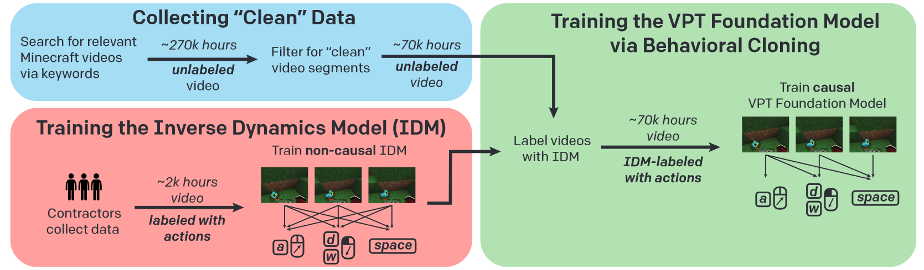
Setup

Slide 7
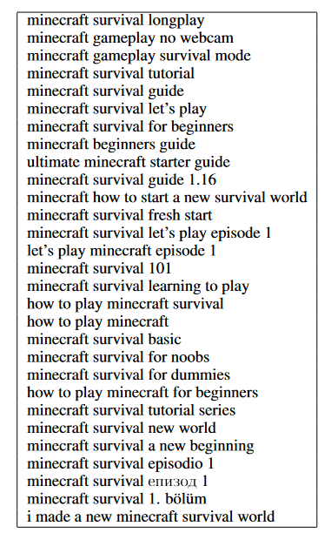
Collecting Internet Data
Minecraft Survival Mode - No Artifacts
Minecraft Survival Mode - With Artifacts
None of the
Above

Slide 8
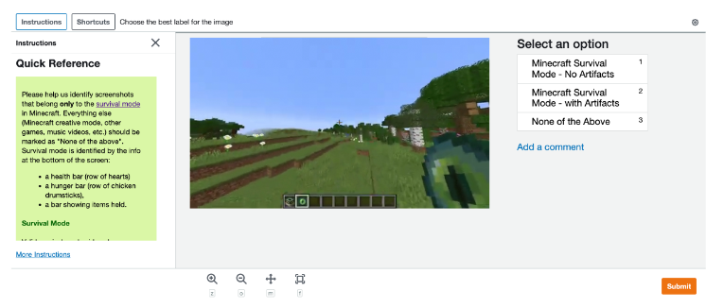
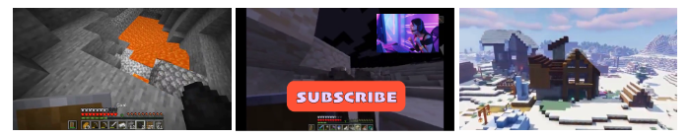
Collecting Internet Data
Amazon Mechanical Turk worker interface showing an example labeling task

Slide 9

Methods Used
Overlaid Artifacts
Other Platform Than Computer
Not Survival

Slide 10
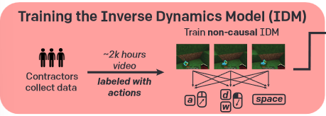
Methods Used
Labeled Contractor Data
Train the IDM
Can be used to label online videos

Slide 11
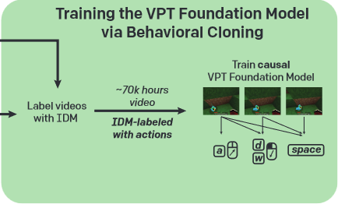
Methods Used
Have Unlabeled to Labeled Videos in Entry
Training by Watching Videos
Model can Play Minecraft

Slide 12
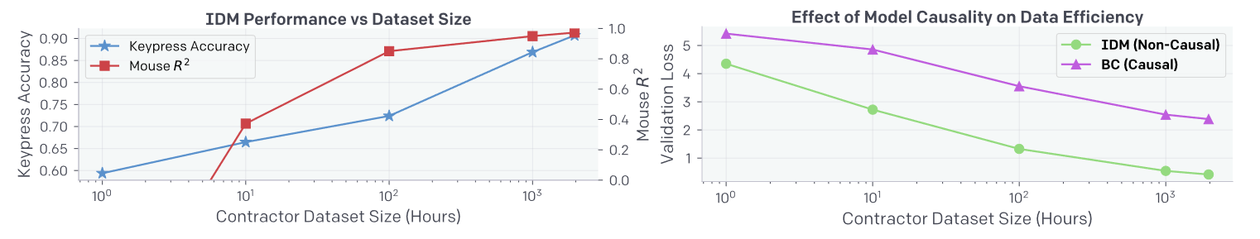
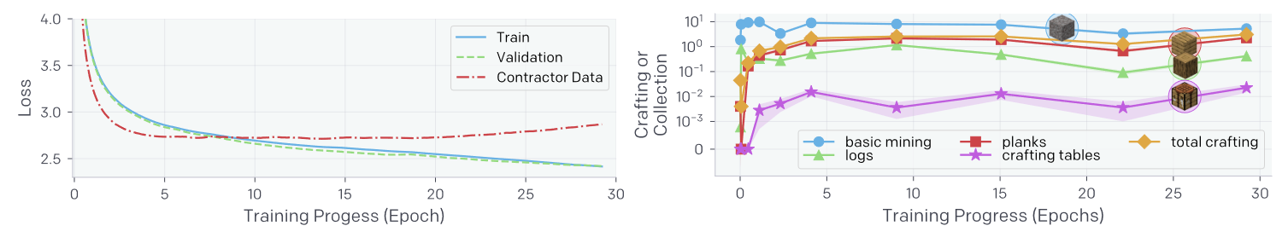
Results
(Left) IDM keypress accuracy and mouse movement R^2 as a function of dataset size.
(Right) IDM vs. behavioral cloning data efficiency
(Left) Training and validation loss on the web_clean internet dataset with IDM pseudo-labels
(Right) Amount a given item was collected per episode averaged over 2500 60-minute survival episodes

Slide 13
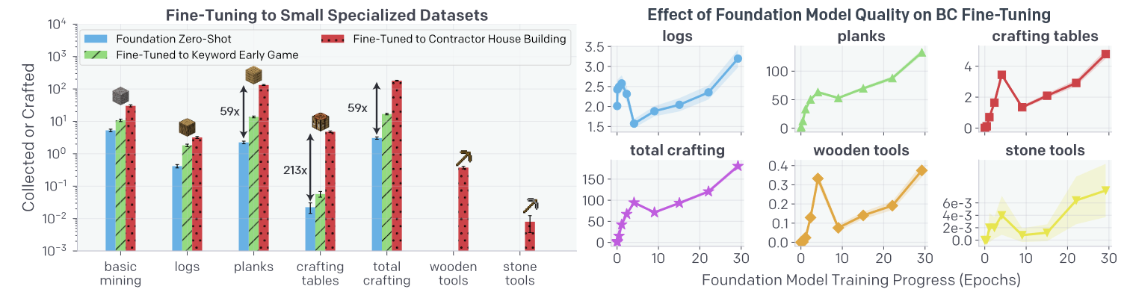
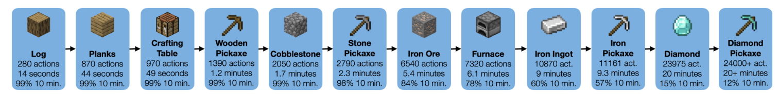
Results
(Left) Collection and crafting rates for three policies
(Right) Collection and crafting rates for VPT foundation model snapshots throughout training
Typical sequence of items for obtaining a diamond pickaxe.

Slide 14
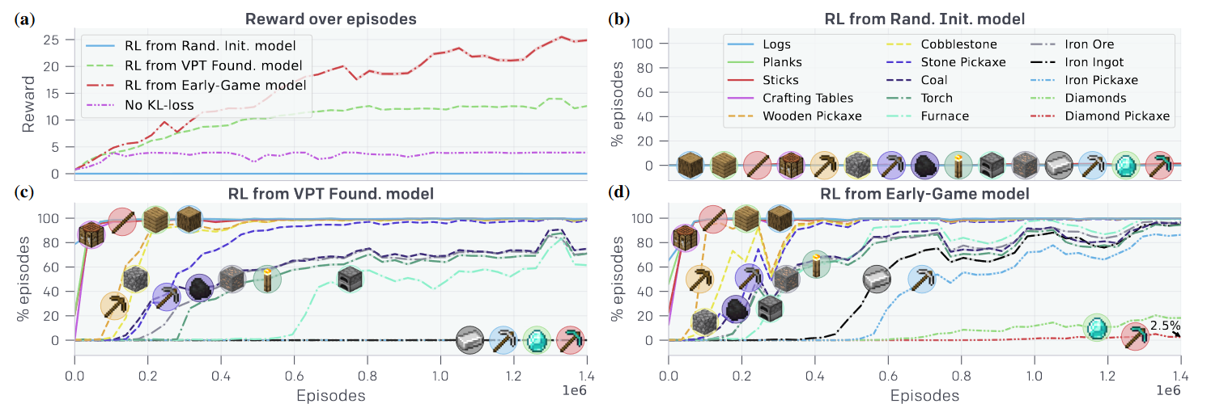
Results
RL Fine-tuning results
(b) RL from a randomly initialized model occasionally collects sticks by breaking leaves and never learns to reliably collect logs
(c) RL fine-tuning from the VPT Foundation model learns everything in the curriculum up to iron ore and making furnaces, but fails to learn to use the furnace to smelt iron ingots
(d) RL fine-tuning from the early-game model learns to obtain (at human-level)

