Slide 1


Slide 2
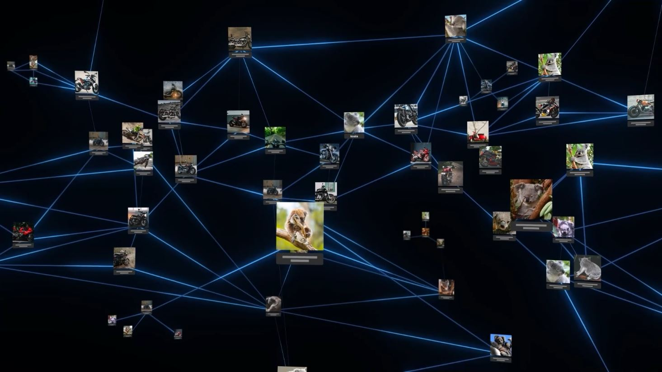

Slide 3
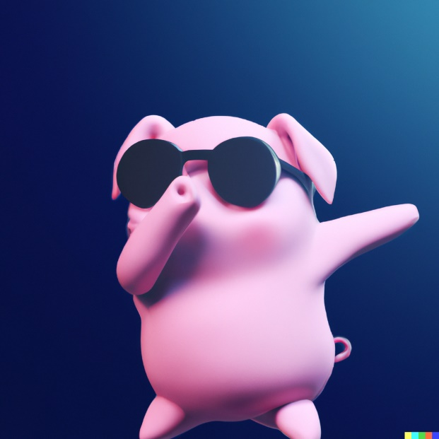
3D render of a cute pig with sunglasses doing a dab on a dark blue background, digital art

Slide 4
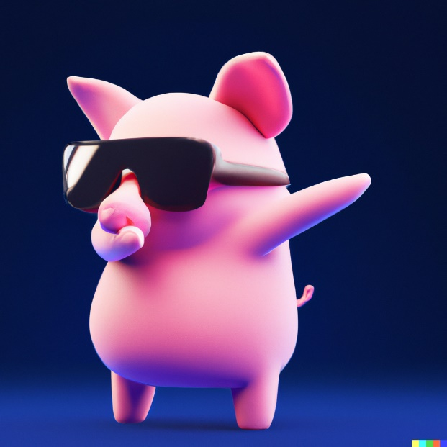
3D render of a cute pig with sunglasses doing a dab on a dark blue background, digital art

Slide 5
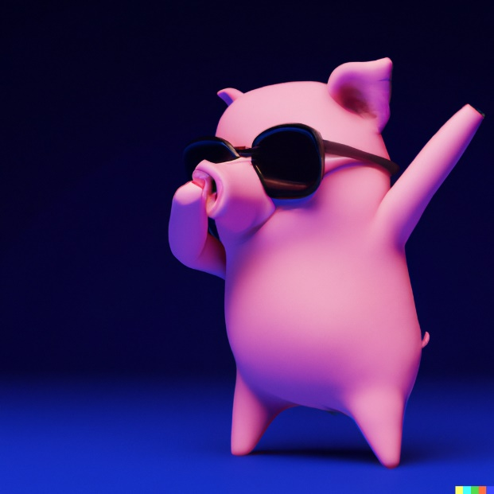
3D render of a cute pig with sunglasses doing a dab on a dark blue background, digital art

Slide 6
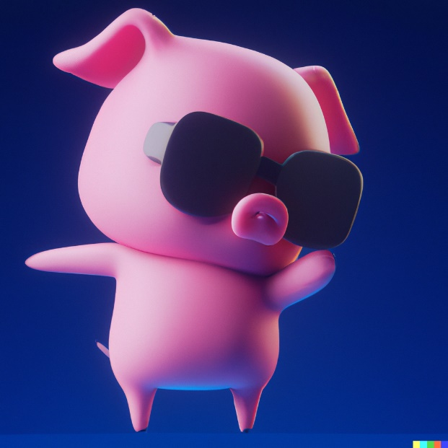
3D render of a cute pig with sunglasses doing a dab on a dark blue background, digital art

Slide 7
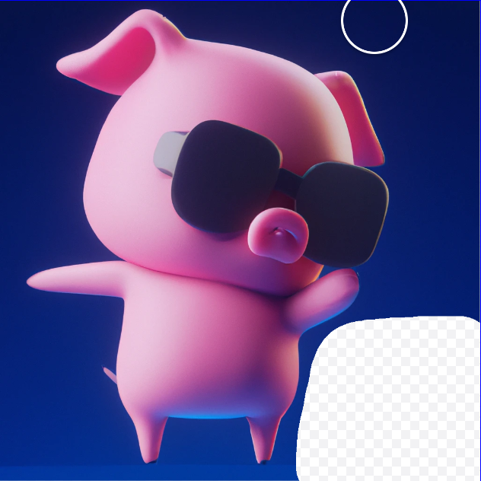
Add a cute 3D penguin

Slide 8
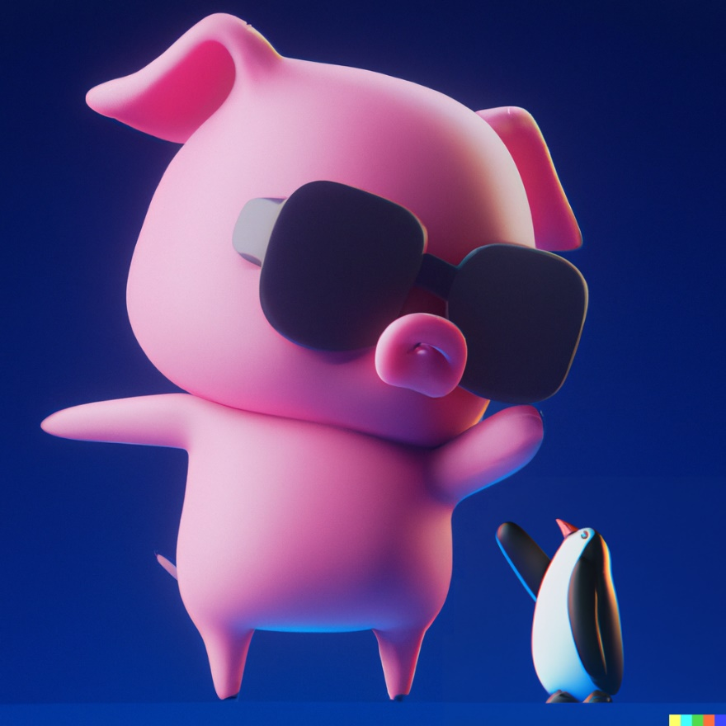
Add a cute 3D penguin

