Slide 1

COLLABORATIVE REASONING
AI-augmented technical work for small teams
Quinn Morley, Unleashed Robotics, Inc.
Toolkit included as attachment

Slide 2
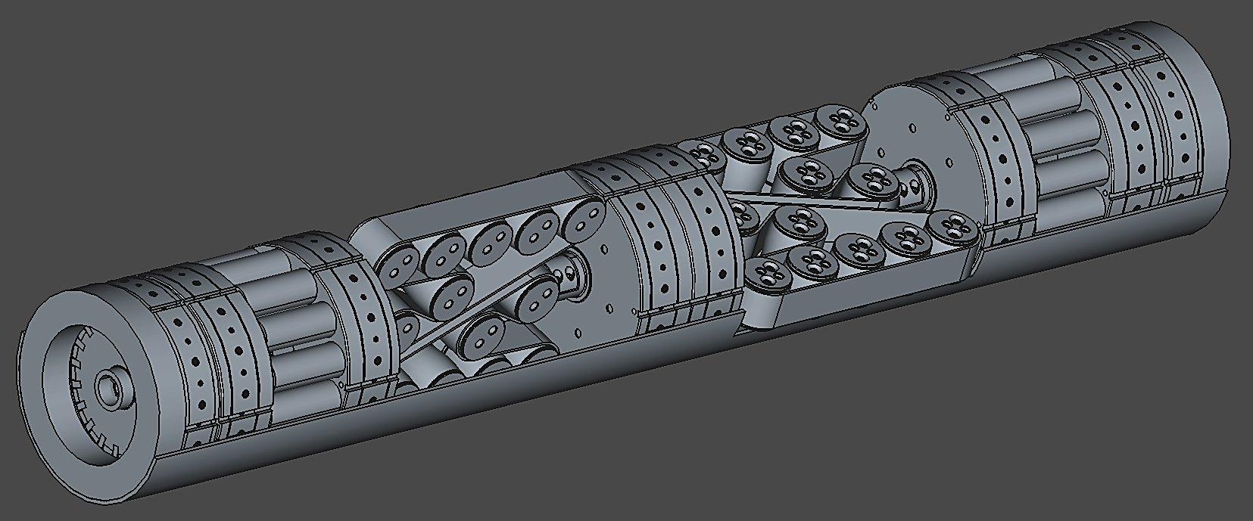
Work product: FractalMining Borebot
12

Slide 3

The Problem
Washington State University (WSU) will play a critical role in advancing the cutting-edge Titan Laker project. In collaboration with the Principal Investigator, WSU will conduct thorough research and development efforts to bring this innovative project to life. With a focus on evaluating the most effective collection and coalescence methods, determining the feasibility of the concept, and investigating the impact of precipitation in atmospheric cleaning events, WSU's expertise and research capabilities will drive the success of the Titan Laker project. By leveraging the strengths of an academic research institution like WSU, the Titan Laker project will be poised for breakthrough discoveries and advancements in planetary science.
3

Slide 4
AI What the World
"Critical role in advancing"
Significance sandwich opener
Superficial
"thorough R&D efforts"
What R&D? Says zero.
AI Puffery
"cutting-edge"
Means nothing. Which edge?
The Problem
RO3/Tricolon
Tricolon! Three gerund phrases.
3rd item weakest = padding to three.
Washington State University (WSU) will play a critical role in advancing the cutting-edge Titan Laker project. In collaboration with the Principal Investigator, WSU will conduct thorough research and development efforts to bring this innovative project to life. With a focus on evaluating the most effective collection and coalescence methods, determining the feasibility of the concept, and investigating the impact of precipitation in atmospheric cleaning events, WSU's expertise and research capabilities will drive the success of the Titan Laker project. By leveraging the strengths of an academic research institution like WSU, the Titan Laker project will be poised for breakthrough discoveries and advancements in planetary science.
AI Vocab
"leveraging the strengths of"
WP:AISIGNS top-10 phrase.
AI What the World
"poised for breakthroughs"
Significance sandwich closer.
AI Puffery
"innovative project to life"
Cliché. Zero information.
Superficial
"expertise will drive success"
Circular. Says nothing new.

Slide 5
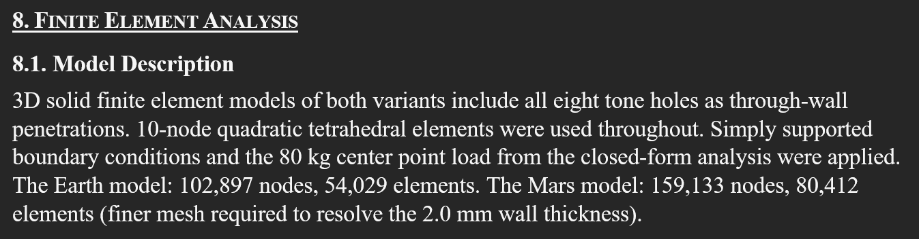
Killing AI slop
“Just the facts, ma’am.” – The Joe Friday approach to narrative.
Combined with the Wikipedia article “Signs of AI writing” (for editing).
9

Slide 6
The solution
Collaborative Reasoning (CR) in Claude Code with Persona Agents
Collaborative Reasoning Agents
Named expert team with distinct roles and an orchestrator. Each specialist gets a clean context window with deep domain-specific instructions.
Test-Driven Documentation
Define acceptance criteria before building. Every deliverable is validated against a test suite. This becomes the contract between human intent and AI output.
LLM-PLM
The LLM manages a full product lifecycle. Parametric design files, per-part scripts, and STEP export. Basically, CAD without a GUI.
Skills
Prompt modules pulled from Claude on the web to “skill-up” Claude code. Each skill carries its own instructions, test cases, and evaluation criteria. Activated by prompt0.md.
4

Slide 7

What's in the box
CLAUDE.md Claude Code reads this first
README.md Human overview
prompt0.md Skills and self-checks
method/
operational_guide.md How to run the method
technical_note.md Architecture and rationale (deeper dive)
tdd_method.md Test-driven documentation writing method
supplements/
llm_plm_cad.md CAD/geometry lifecycle managed by the LLM
signs_of_ai_writing.md 7-category AI-writing-detection framework
freecad_api_reference.md FreeCAD scripting reference
templates/
accumulator.md Blank per-persona history
gameplan.md Blank session plan
work_order_drafter.md Prompt for drafting work orders
claude-docx-bundle/ Document production toolkit (docx, pdf).
CR_Agents_Toolkit/
2

Slide 8
Named expert teams
Based on Nelson (2026), "Activating Expertise: Human-AI Teams for Collaborative Reasoning."
The Manager
Scope and planning
The Engineer
Builds, tests, verifies
Orchestrator
Claude Code main session
The Loftsman
Analytical geometry & surfacing
The Designer
Consistency, design critique
The Software Eng.
TDD, workflow architecture
The Systems Eng.
Conceptual integrity
+5 more specialists. Each gets a clean context window. The orchestrator local filesystem holds the full state.
4

Slide 9
The standing roster
Role | Domain
The Manager | Scope discipline and deliverable accountability. Manages by enabling.
The Loftsman | Analytical lofting, conic geometry, surface definition.
The Software Engineer | Test-driven workflow, test suite design, simplicity gate.
The Engineer | Code, mechanical design, hardware interfaces, empirical verification.
The Topologist | B-rep topology, Euler operators, catches geometry bugs.
The Motor Designer | EM design, magnetic circuits, winding, loss analysis.
The Space Resources Engineer | ISRU domain accuracy, TRL assessment, evidence gates.
The Editor | AI-ism detection, sentence revision, prose tightening.
The Designer | Document and product design, echo-site tracking, compliance maps.
The Systems Engineer | Conceptual integrity, architecture coherence.
The Recruiter | Fills gaps when the roster doesn't cover a domain.
5

Slide 10
Designed conflict & the “pseudo ego”
Designed tensions
The pseudo ego
The “accumulator” is a file-based working history of contributions accepted, corrections received, and positions taken by each persona.
The effect: personas develop calibrated voices which accumulate project-specific knowledge across spawns.
Manager
vs.
Systems
Engineer
Space Resources Engineer
vs.
Engineer
Loftsman
vs.
Topologist
Designer
vs.
Engineer
Editor
vs.
Designer
6

Slide 11
Work product: Flute Test-Case
“Design a bass recorder in F with Earth and Mars structural variants, full 3D FEM solver in Python, and CadQuery parametric CAD.”
“… Oh, by the way, it needs to support an 80 kg human when used to bridge a crevasse.”
Session A — Quinn method
Session B — Stuart method
Technical depth
Tet10 quadratic elements, Gmsh mesh (4 hrs)
5 verification cases
Mesh convergence study (3 densities)
Caught acoustic-structural coupling
Mars Factor of Safety 2.35 (near 2.0 target)
Cost
11.5 hrs active, 7 compactions
35 MB context, 325 LOC/hr (5,246 LOC total)
Technical depth
Tet4 linear elements, hand-built mesh
No verification suite or convergence
Missed acoustic-structural coupling
Mars FoS 10.17 (5× over-designed)
20 min to find J_inv.T Jacobian bug
Cost
83 min, zero compactions
3 MB context, 1,440 LOC/hr (1,999 total)
10

Slide 12
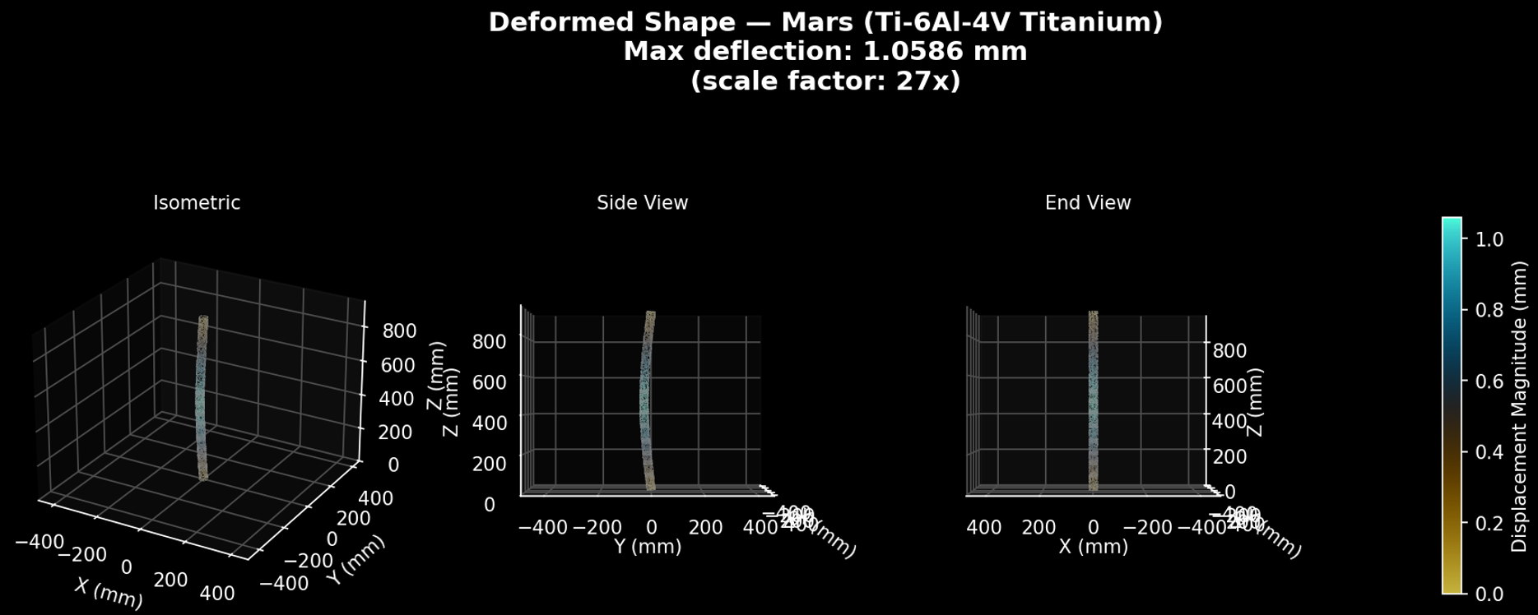
Work product: Flute Test-Case (Stuart’s Method)
https://activating-expertise-proxy.asdfstuart.workers.dev/
10

Slide 13
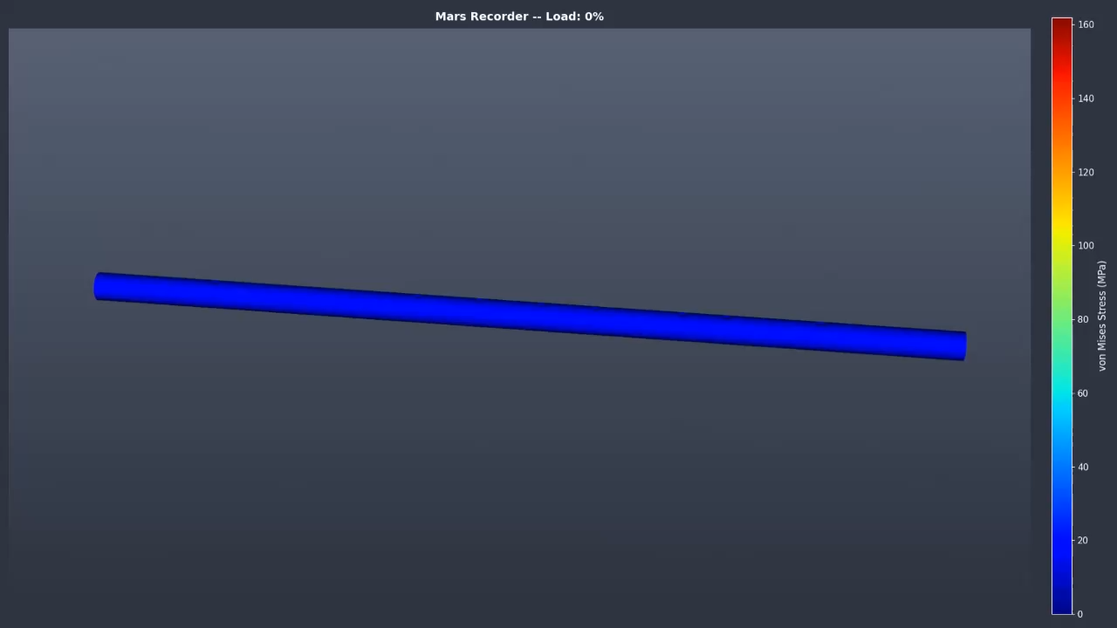
Work product: Flute Test-Case (Quinn’s Method)
10

Slide 14
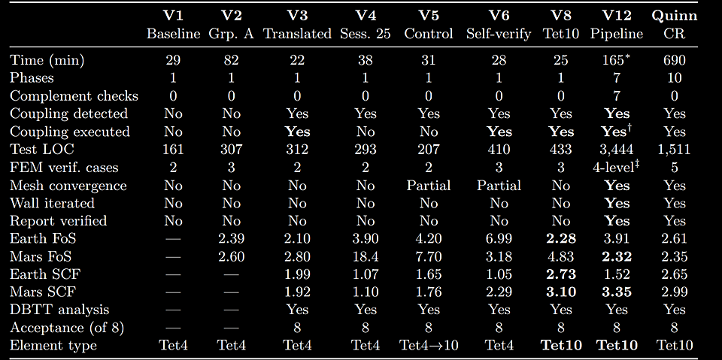
Work product: Flute Test-Case
10
Notes:
SCF = Stress Concentration Factor

Slide 15
Work product: FractalMining Borebot
Second-generation self-propelled mining Borebot™, designed for terrestrial critical mineral prospecting using our FractalMining™ approach.
Heritage
Borebots™ was funded by a 2021 NASA Innovative Advanced Concepts (NIAC) Phase I study for autonomous deep drilling on Mars.
v2 Design
New more energy-dense Borebots™ will link into trains and create a FractalBore™ network from landers on the surface.
12

Slide 16
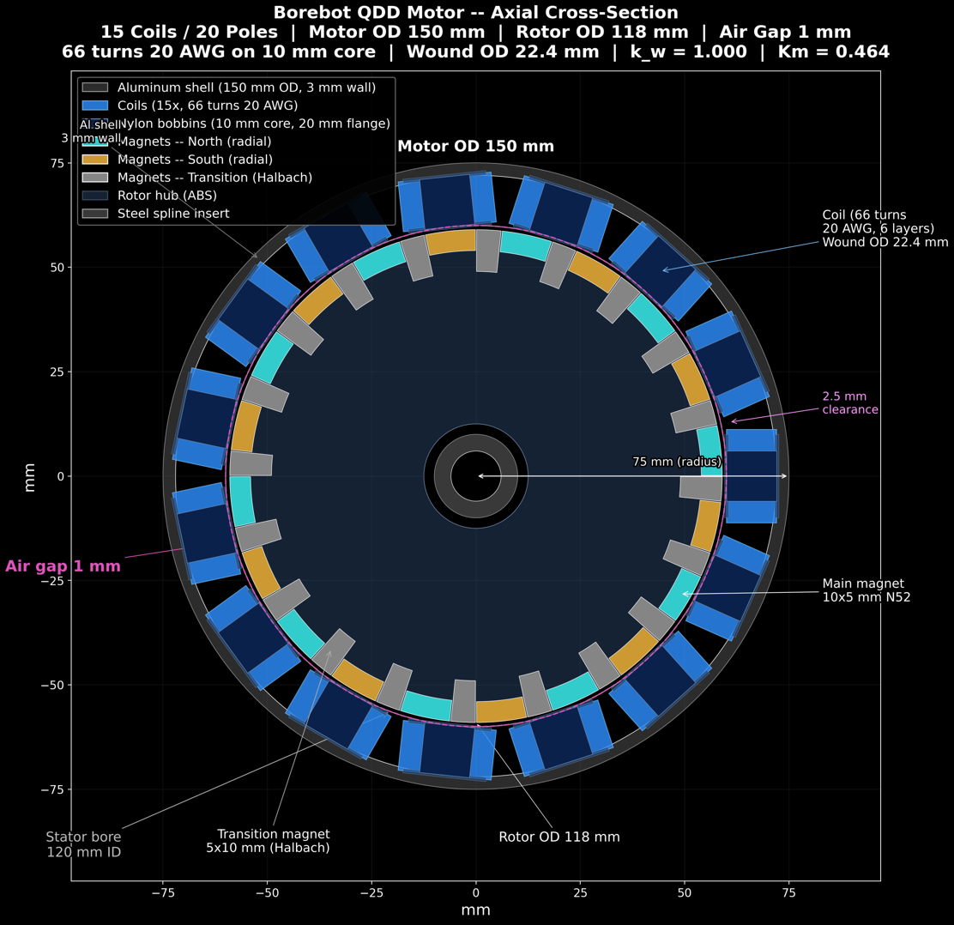
12

Slide 17
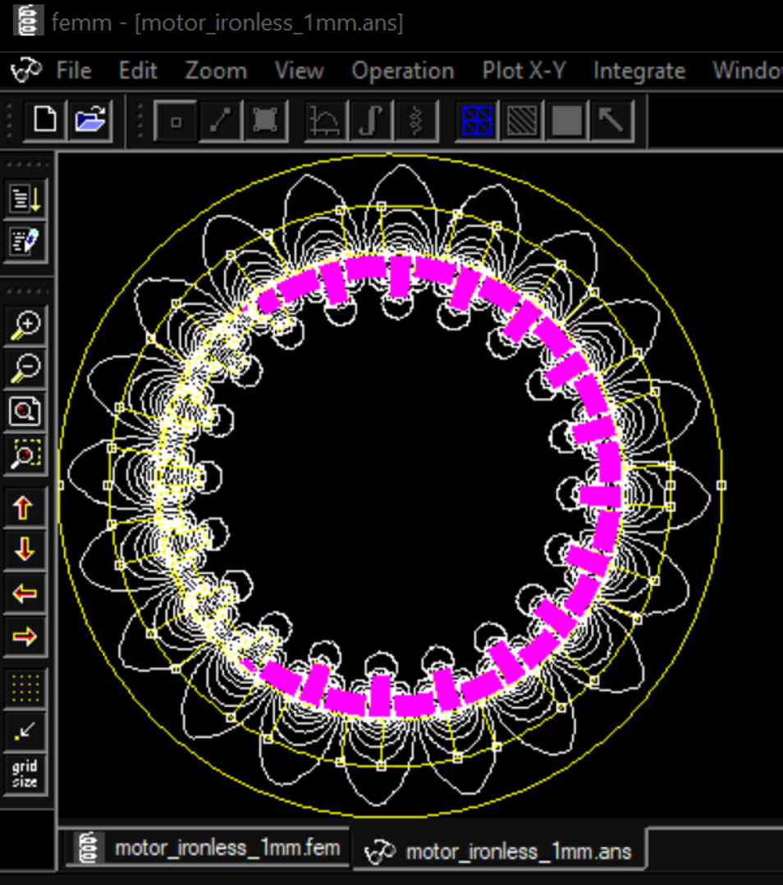
12

Slide 18
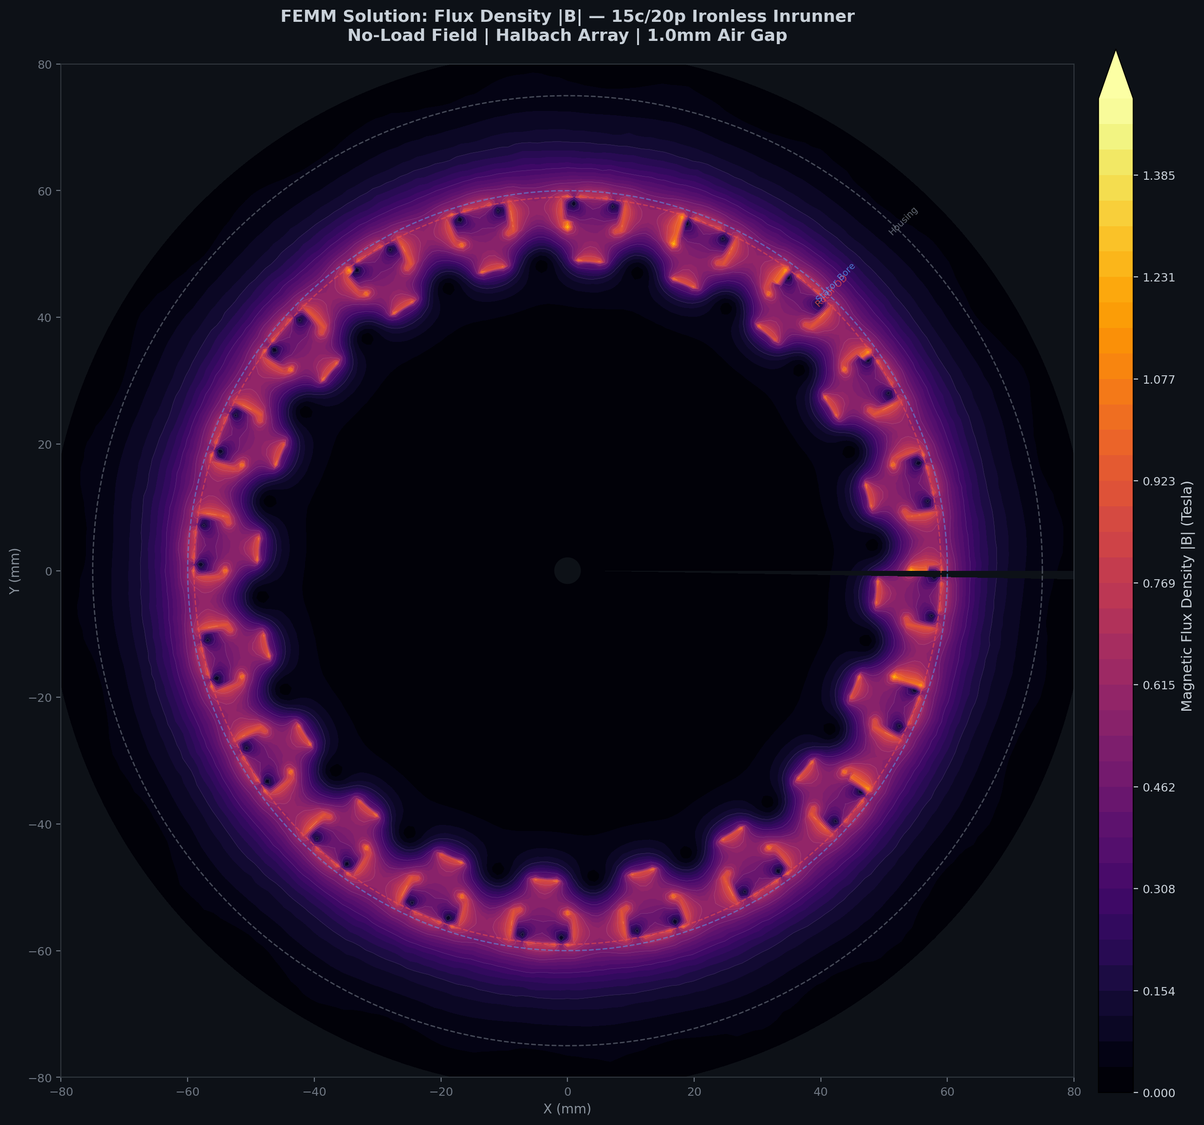
12

Slide 19
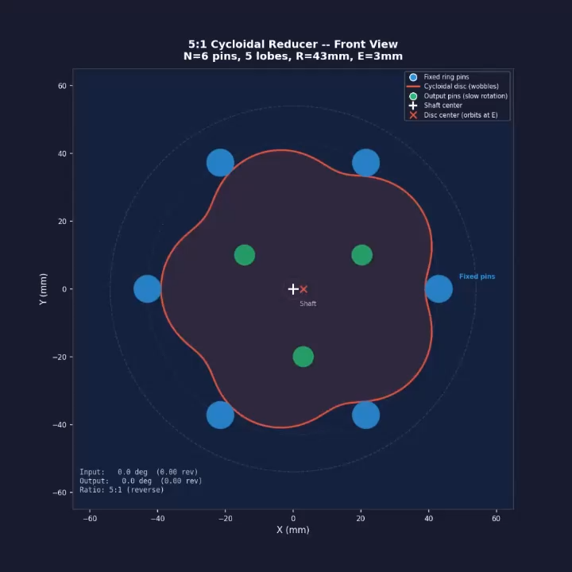
12

Slide 20
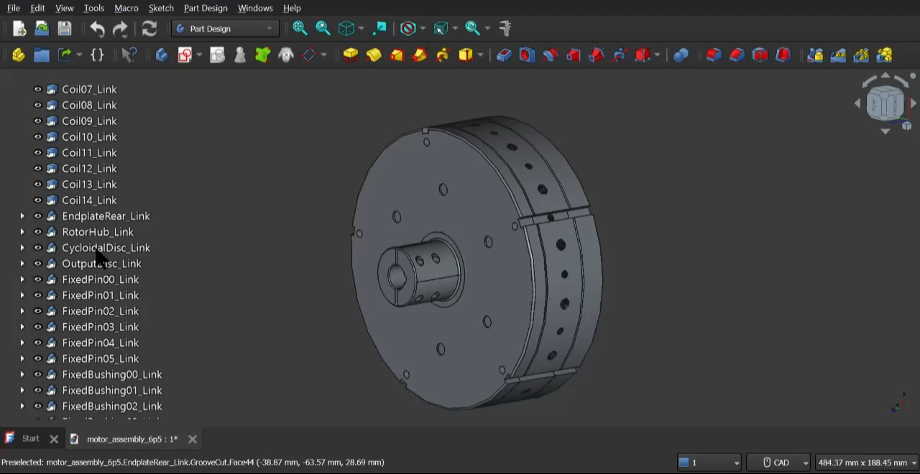
Work product: FractalMining Borebot
Screenshot / video placeholder
12

Slide 21
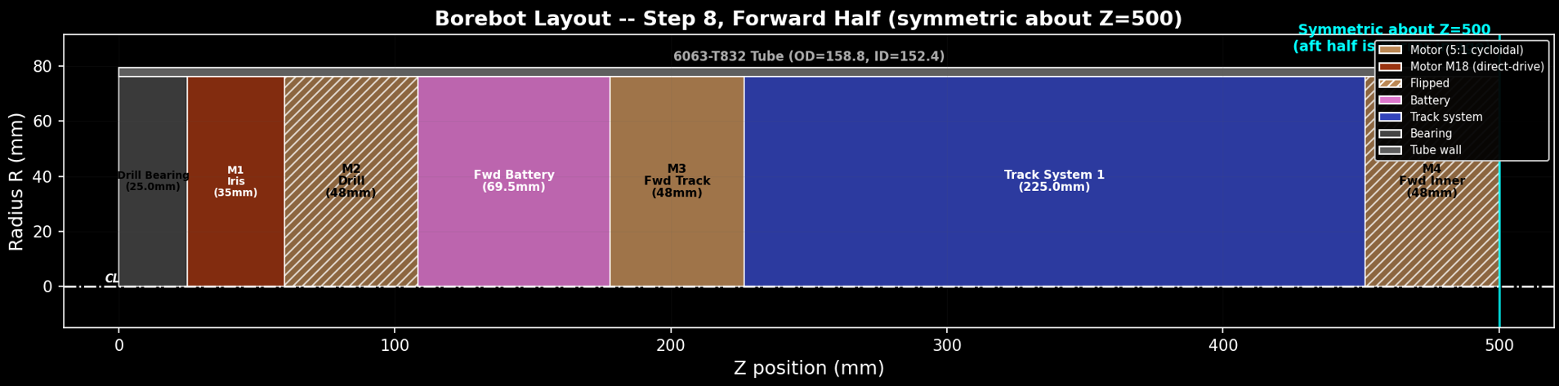
12

Slide 22
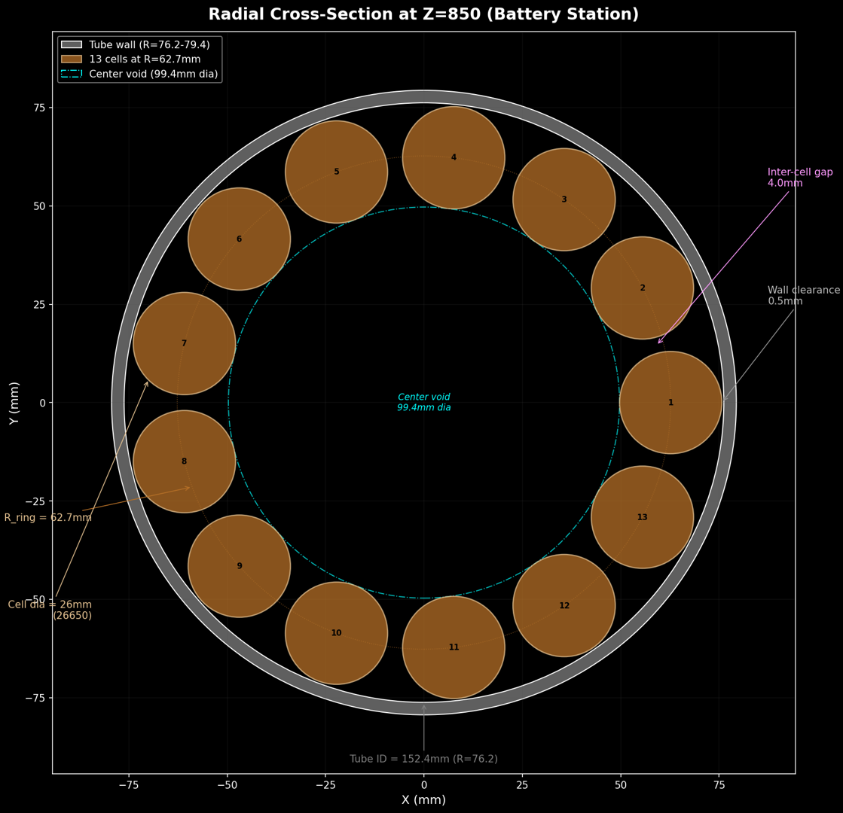
12

Slide 23
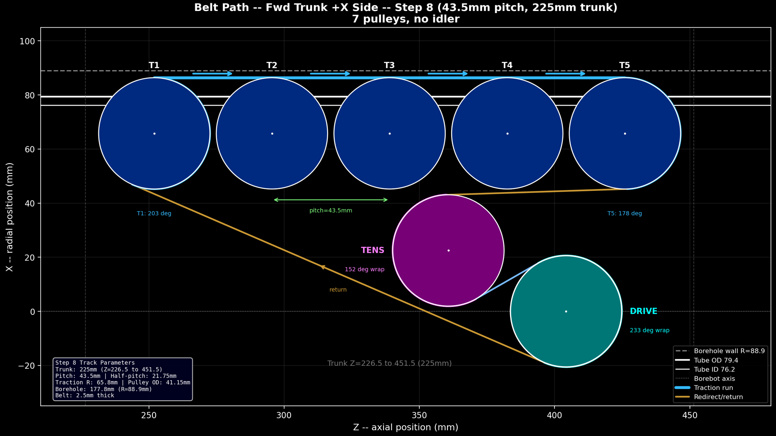
12

Slide 24
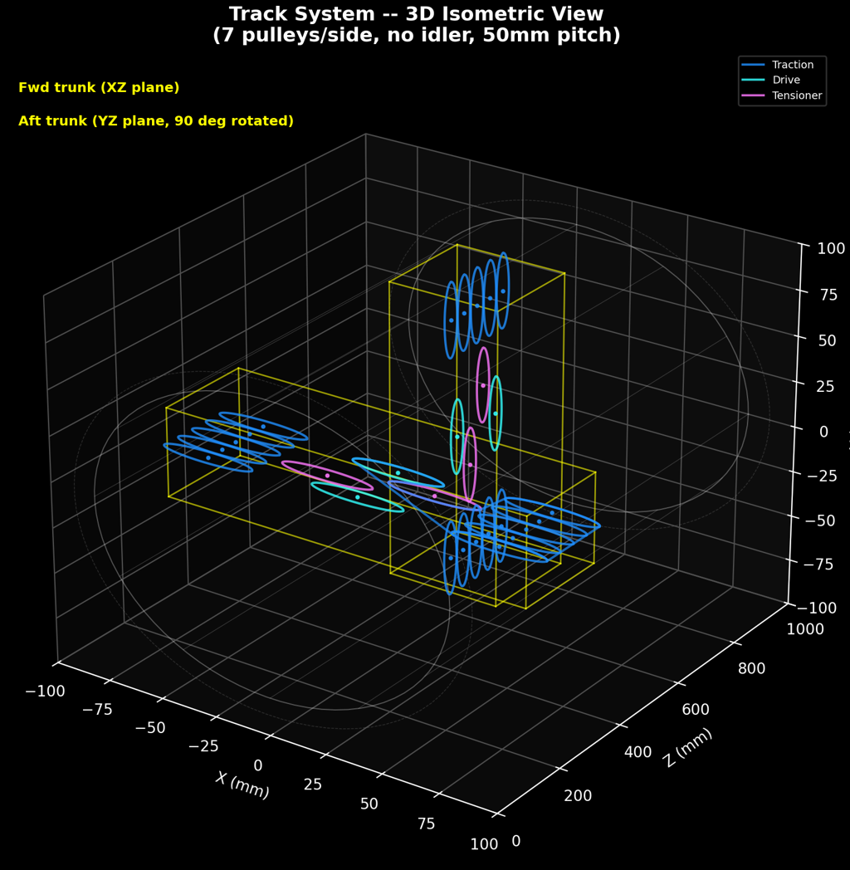
12

Slide 25
Work product: FractalMining Borebot
12

Slide 26
Work product: GPR Antenna Design
GPR antenna designed for integration into the articulating coupler (the flexible linkage connecting Borebots™ together into a train).
Antenna & Capability
VHF antenna (~50 MHz) embedded in the coupler’s central leadscrew. Coordinated Borebots in different FractalBore™ branches combine signals for large-baseline, phased-array cross-borehole tomography, mapping tens to hundreds of meters between boreholes.
Effectively a Telescope into the Underground.
11

Slide 27
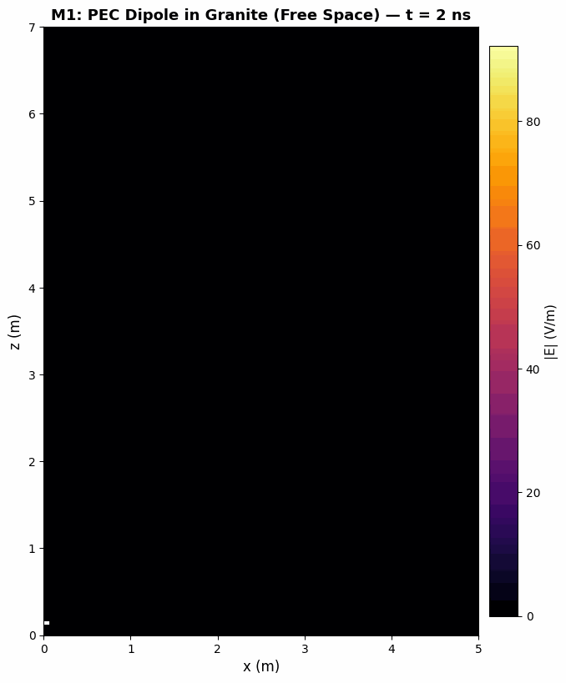
Screenshot / video placeholder
11

Slide 28
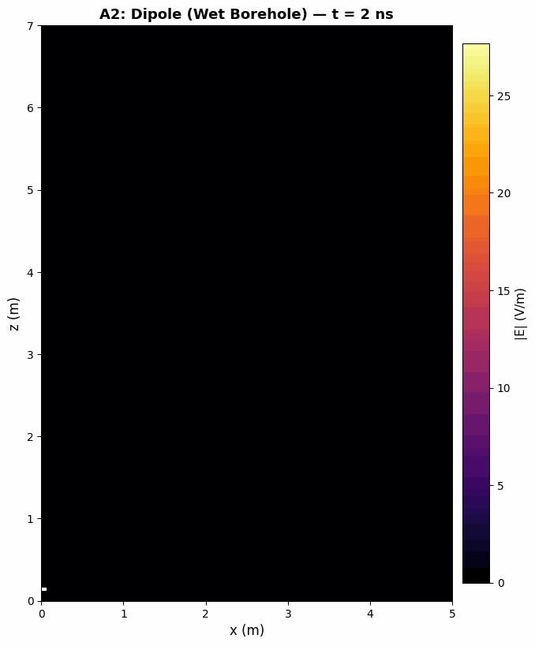
11

Slide 29
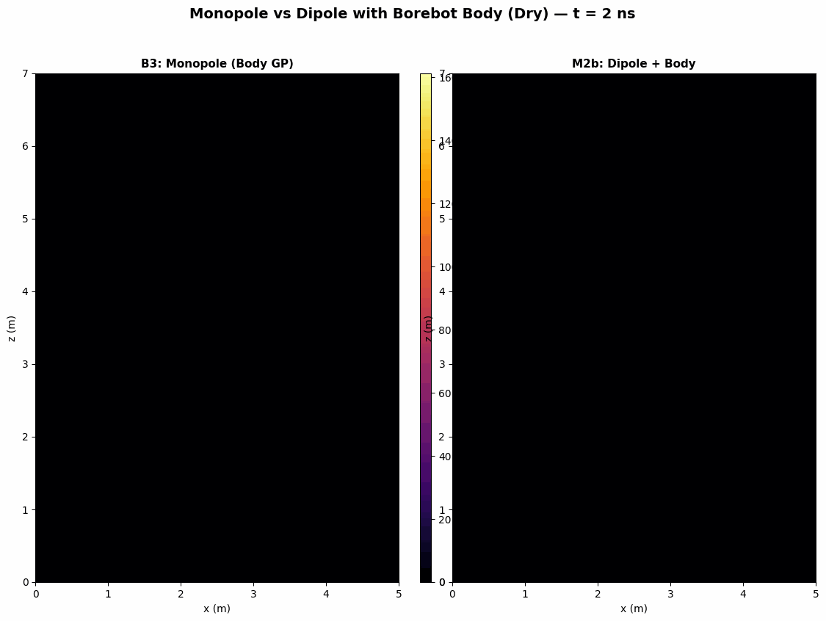
11

Slide 30

11

Slide 31
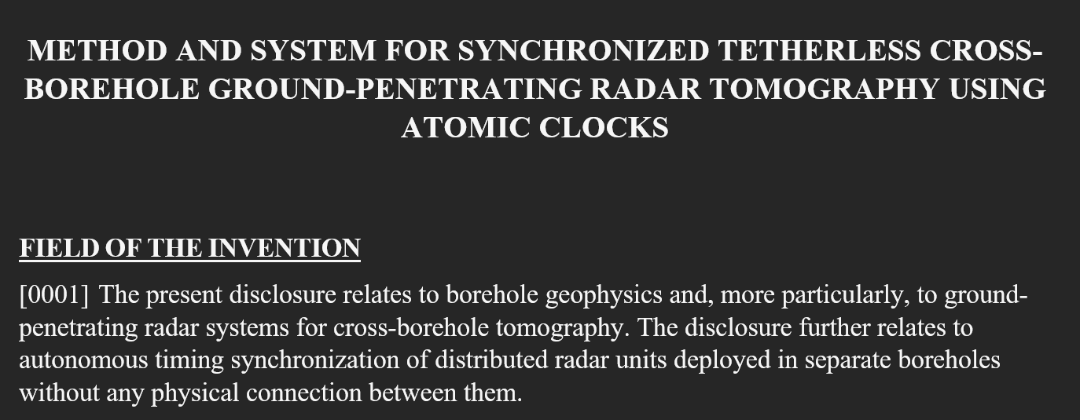
Work product: GPR Antenna Design
11

Slide 32
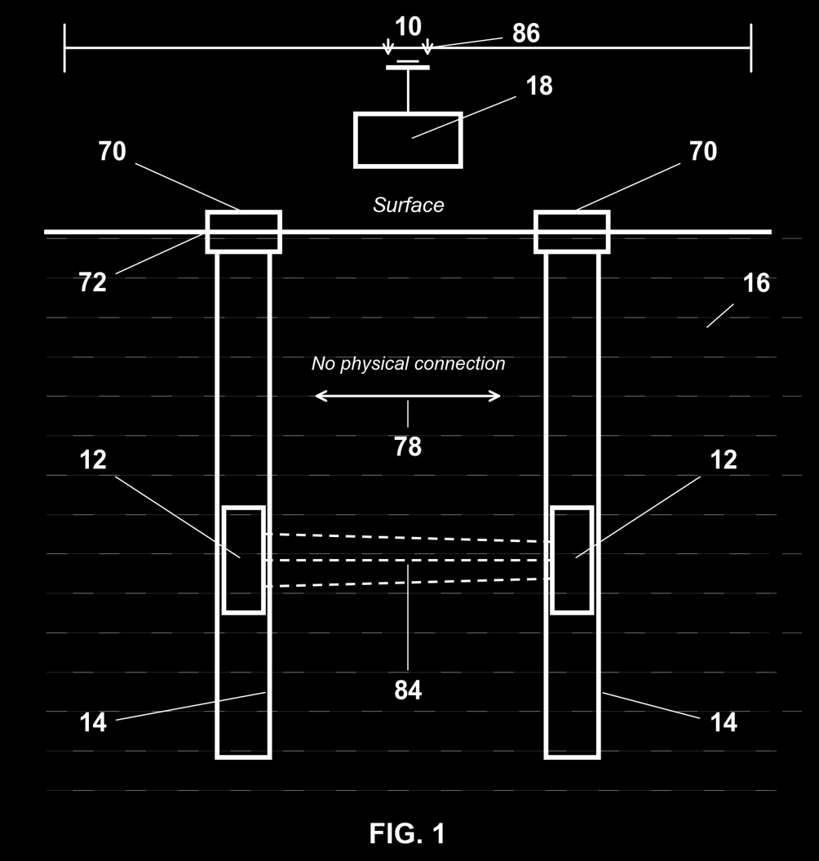
11

Slide 33
Questions?
Quinn Morley
CEO, Unleashed Robotics, Inc.
Gig Harbor, Washington
Method based on Nelson (2026). Implementation by Unleashed Robotics.

Slide 34
Backup Slides

Slide 35

How to start
Read CLAUDE.md.
Work through prompt0.
Hand it a work order.
1
Gameplan
2
Test suite
3
Execute
The team builds a plan
for your review.
Define done before
building anything.
Wave 1 builds. Wave 2
reviews. You approve.
13

Slide 36
Test-driven documentation
Define what "done" looks like before building. Write acceptance tests for a document
the same way you write tests for code. The test suite is the contract.
1
Define tests
2
Build draft
3
Validate & iterate
Write acceptance criteria upfront: structure, technical accuracy, tone, completeness. The test suite is the spec.
Specialist agents produce content independently. Each section written by the domain expert, not a generalist.
Run every section against the test suite. Failures trigger targeted rewrites—not full regeneration.
Result: First-draft quality jumps from ~40% to ~85%. Review cycles drop from 5+ rounds to 1–2.
The test suite becomes institutional memory—reusable across projects.
7

