Slide 1
Sensitivities to BSM physics with SuperNEMO
Maros Petro, Collaboration meeting 2026, UK
Notes:
Click to add Notes

Slide 2
OUTLINE
Simulation Setup
Background model
Sensitivities – 1D ROI
Sensitivities – ND ROI
Notes:
Click to add Notes

Slide 3
Simulation Setup
Falaise 5.1.7 version
12% FWHM for all main wall OMs
No simRC at this point (I did not remove faulty OMs)
Use of Cimrman Module for tracking [1]
Magnetic field off
Realistic flat source foil
Aegir module used for generation of BSM not in Decay0
[1] https://github.com/SuperNEMO-DBD/CimrmanModule/tree/main
Notes:
Click to add Notes

Slide 4
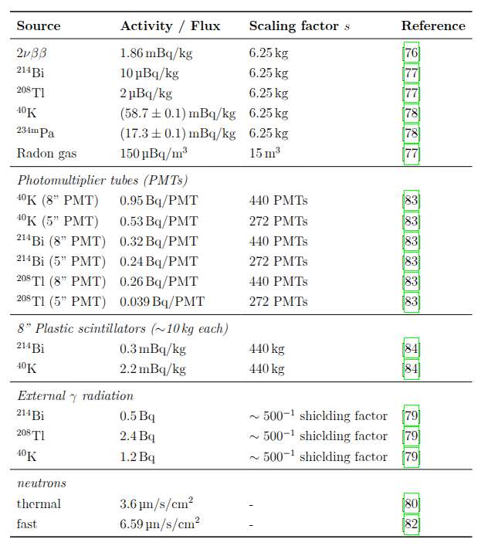
Background model
Estimated background for 17.5 kgyr exposure
Using the following activities
What is the weight of 5’’ PMT? 5’’ Scintilator?
External gammas from Xalbat (measurements before iron shielding so I added extra factor of 500)
Neutrons should be 1/3rd according to Sam’s new measurements
6.11kg
1.2
2.2
Notes:
Click to add Notes

Slide 5
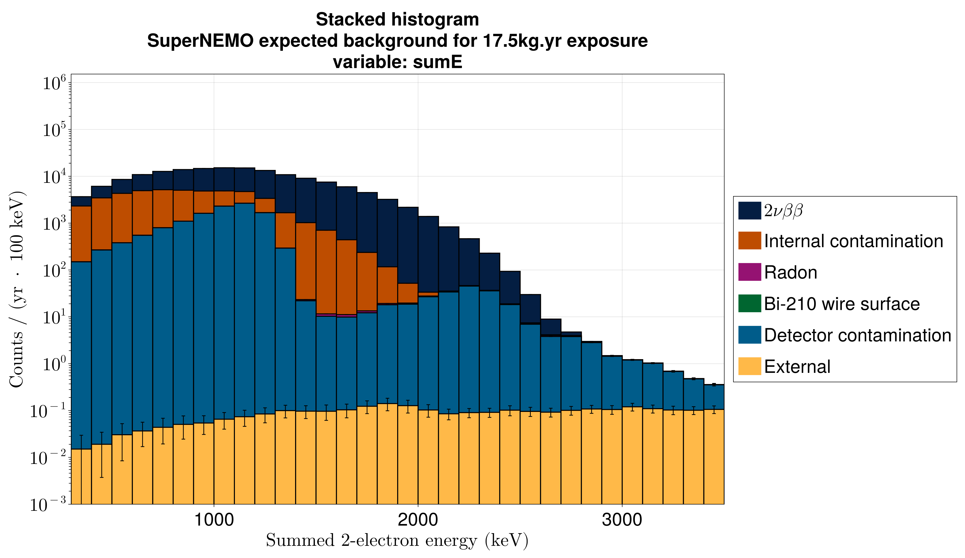
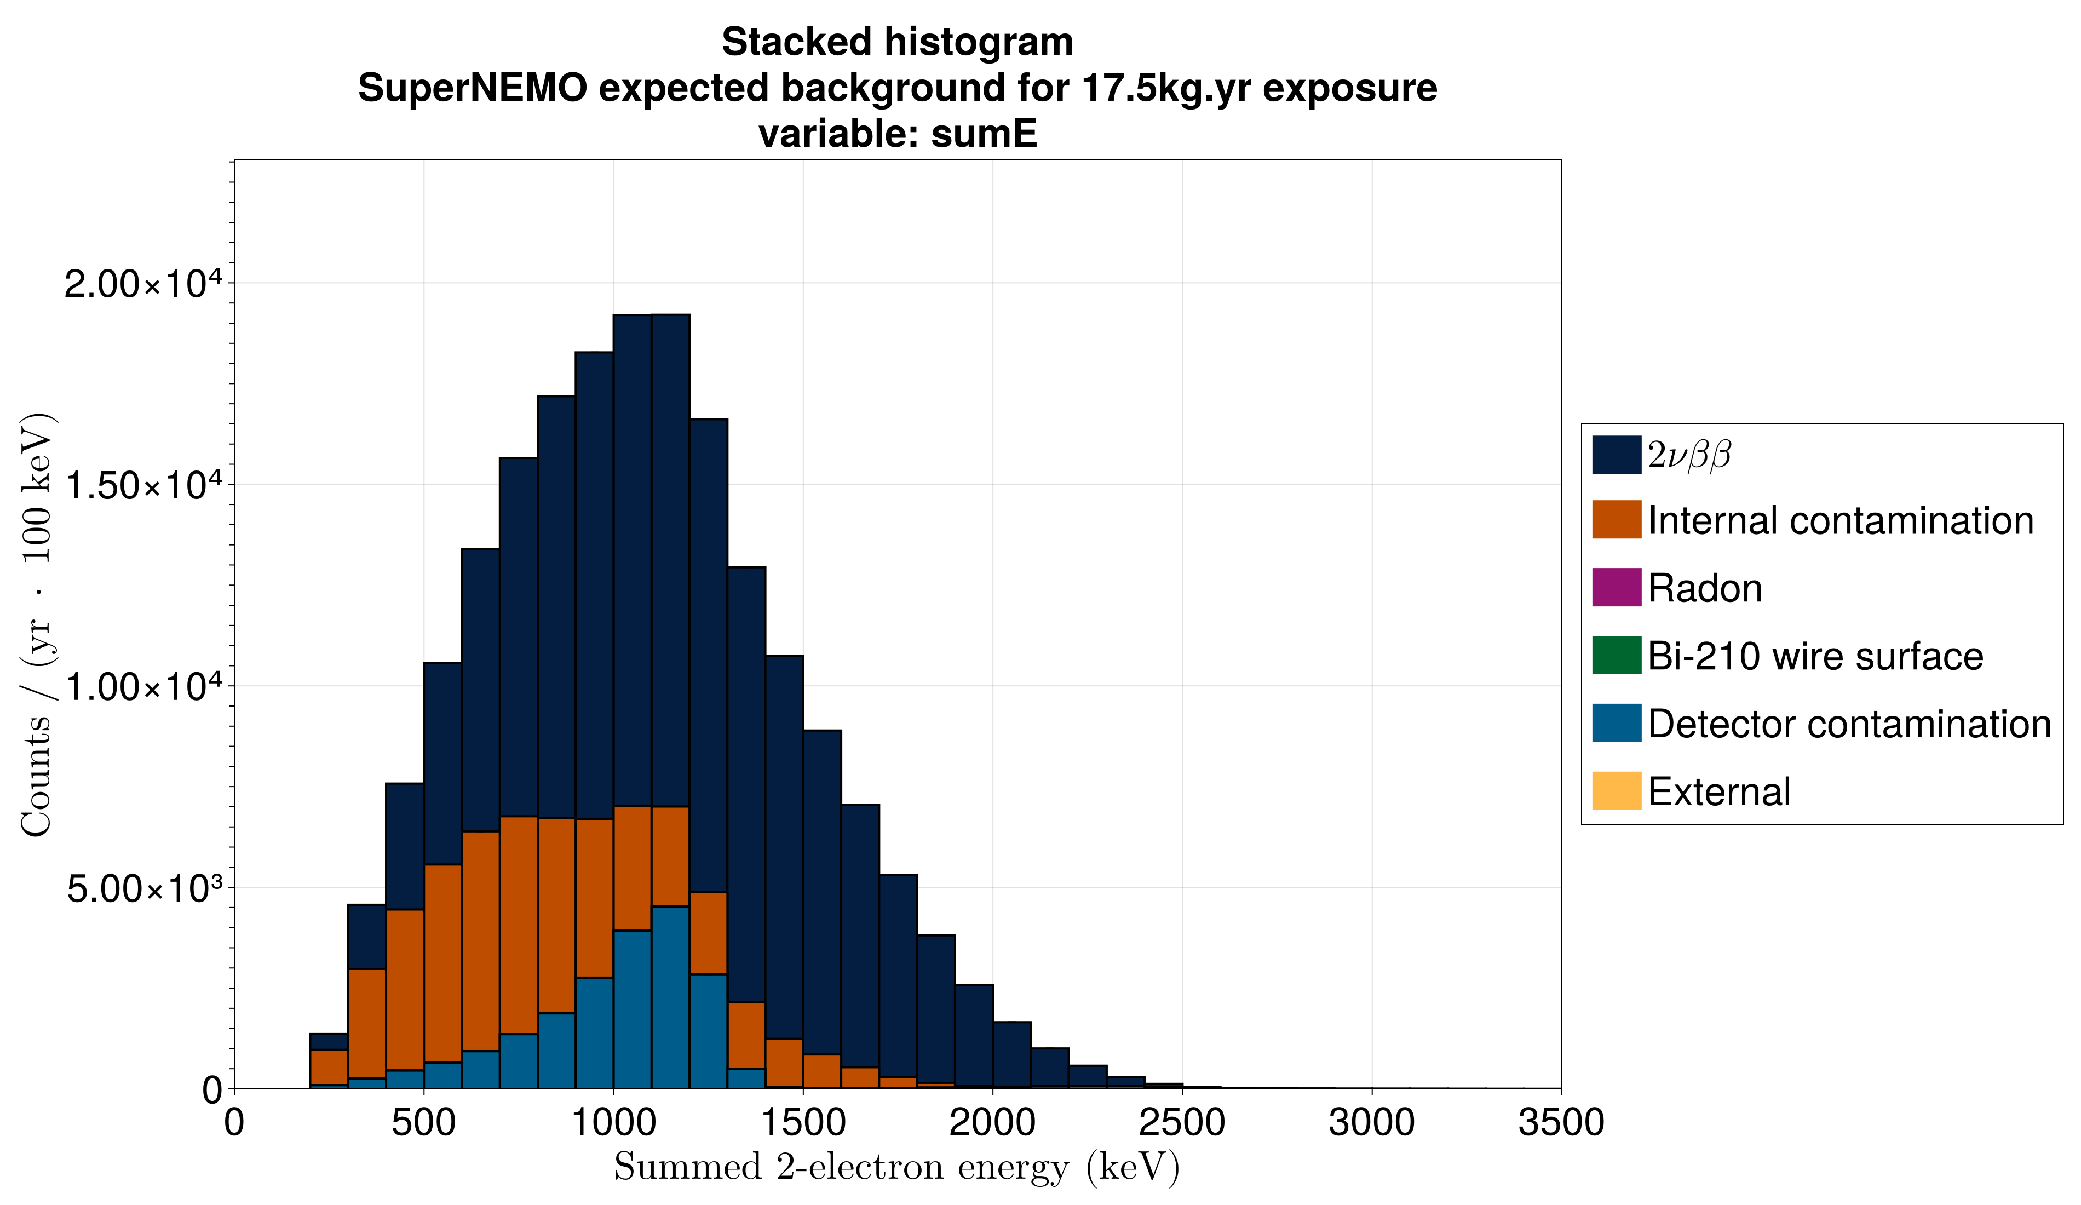
Background model
Notes:
Click to add Notes

Slide 6
Background model
Data cuts used:
2 charged tracks + 2 foil vertices + 2 associated calohits
+ Pint > 4% + Pext < 1% + vertex < 100mm
Notes:
Click to add Notes

Slide 7

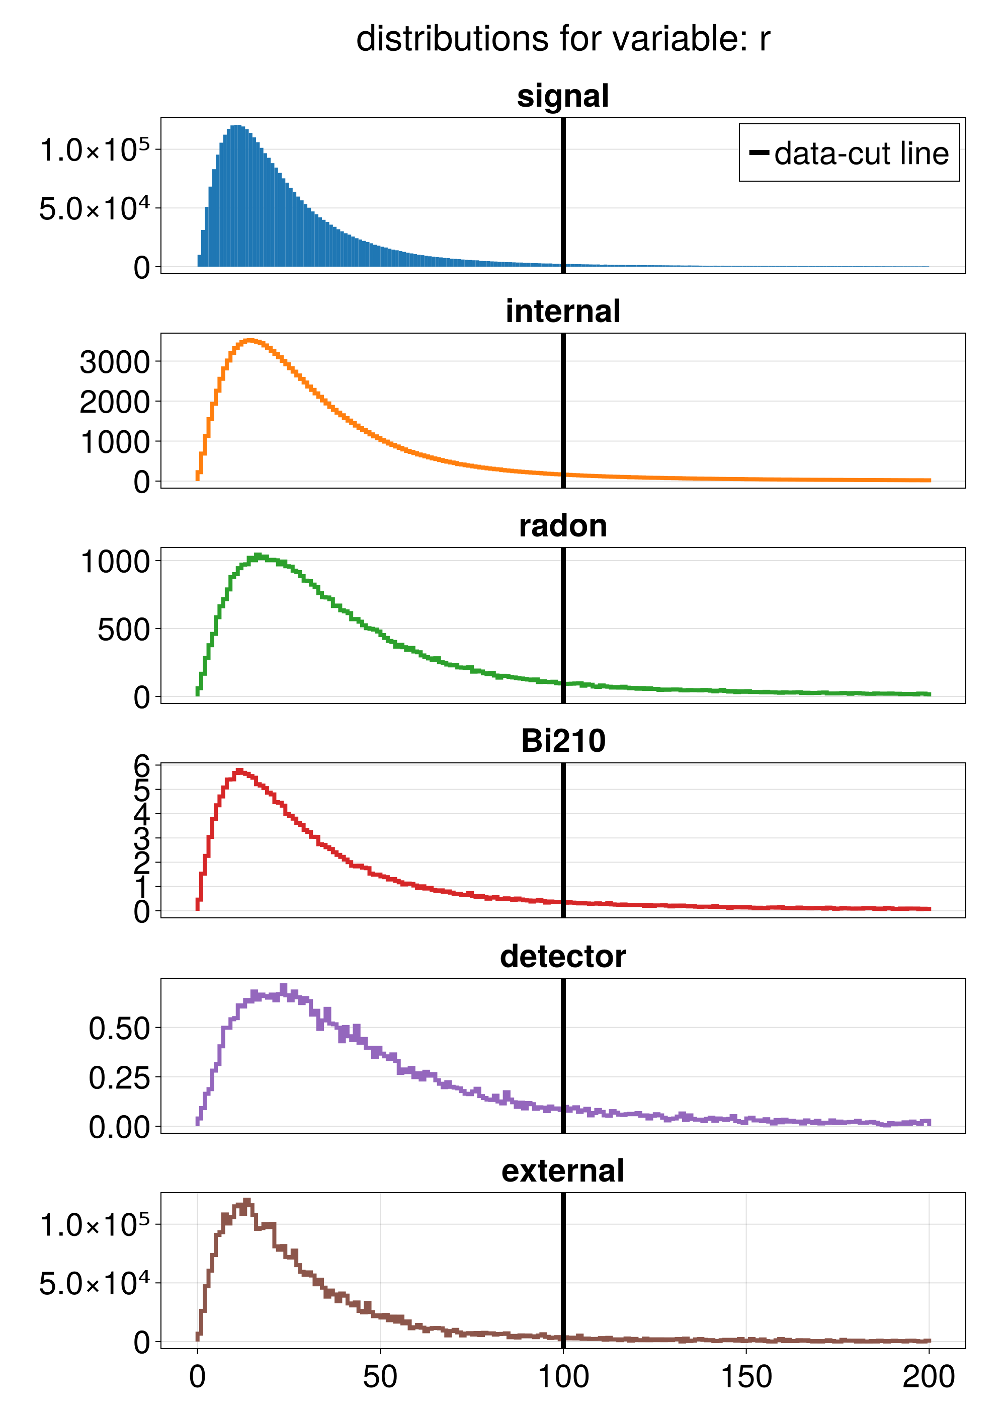
Sensitivities 1D
Distributions of 2D vertex distance
take
remove
In traditional sensitivity approach we look at the individual distributions of each measurable and try to find a data-cut that maximizes signal-to-background
Notes:
Click to add Notes

Slide 8
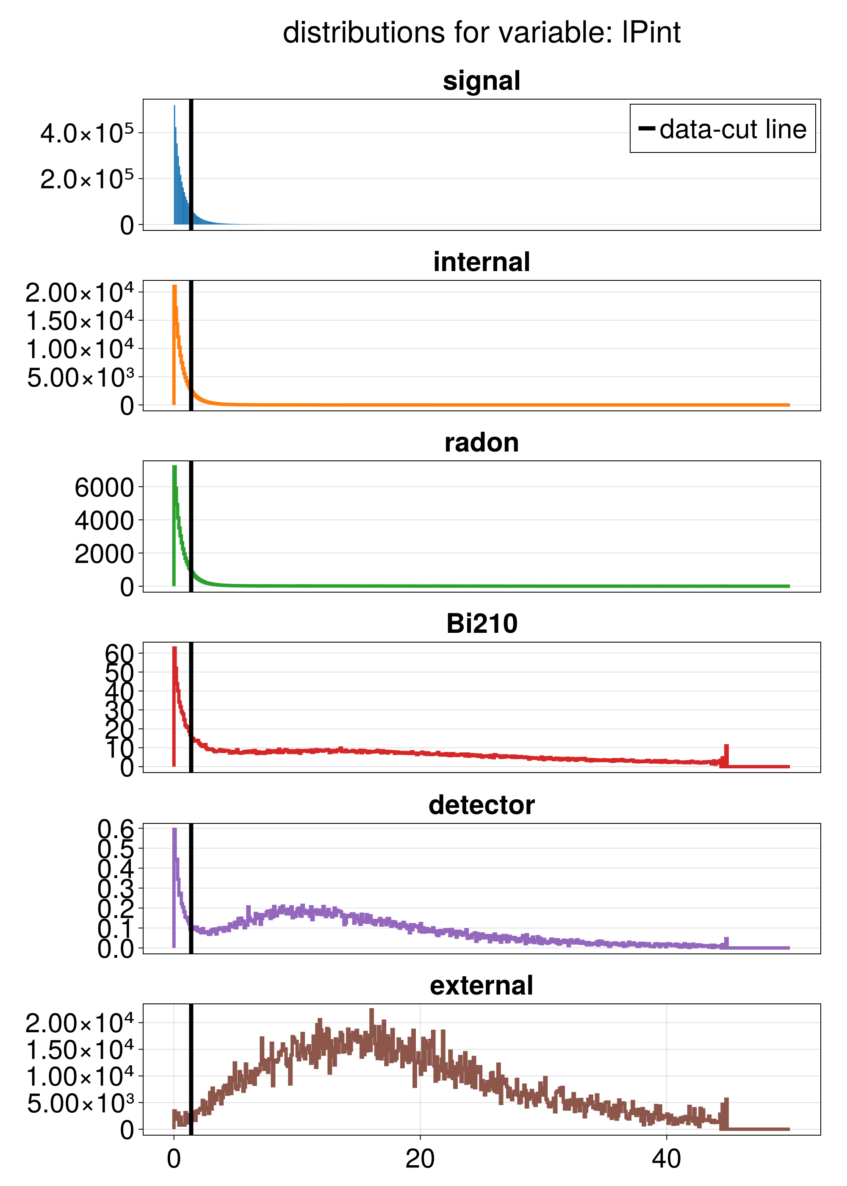
Sensitivities 1D
Distributions of log(P_int)
remove
In traditional sensitivity approach we look at the individual distributions of each measurable and try to find a data-cut that maximizes signal-to-background
Notes:
Click to add Notes

Slide 9
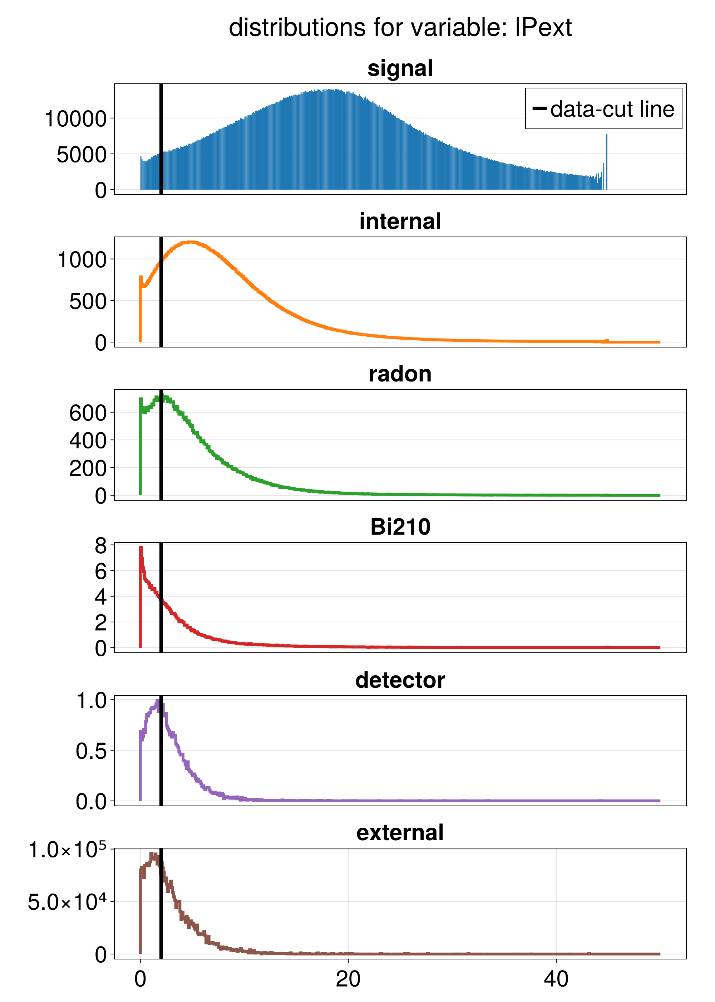
Sensitivities 1D
Distributions of log(P_ext)
In traditional sensitivity approach we look at the individual distributions of each measurable and try to find a data-cut that maximizes signal-to-background
Notes:
Click to add Notes

Slide 10
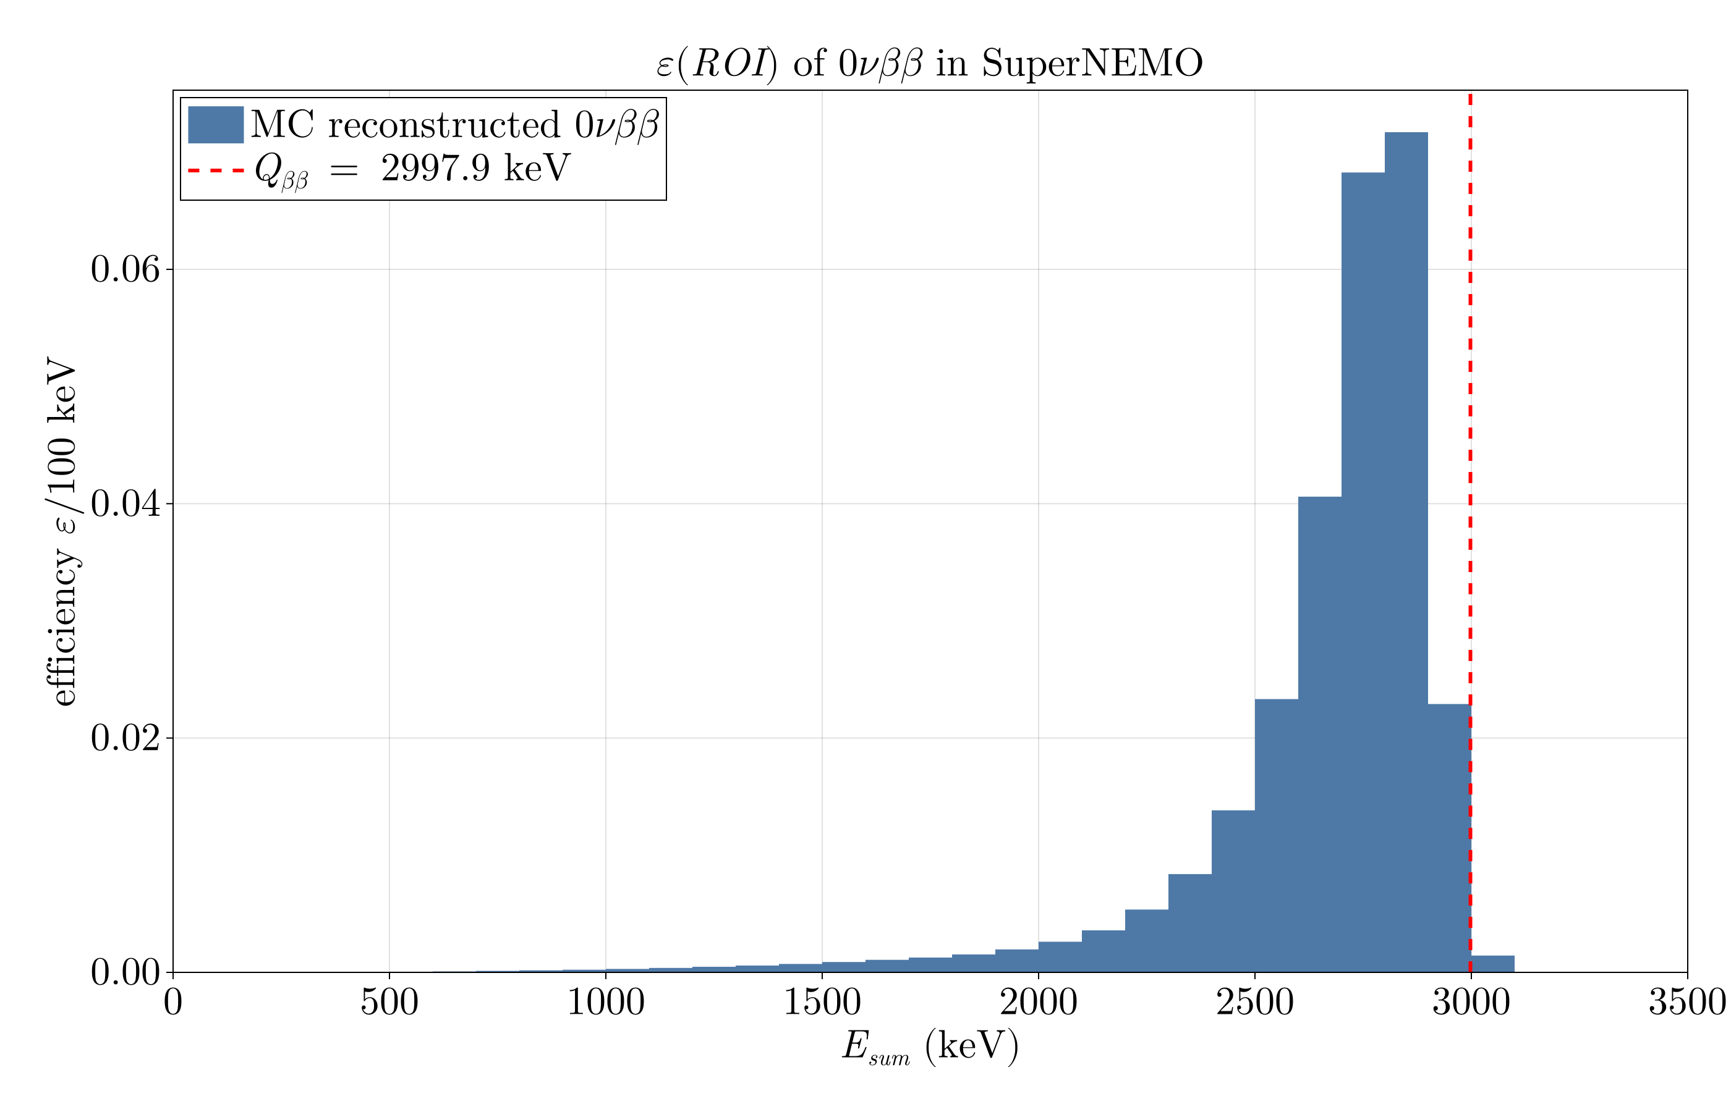
Sensitivities 1D
Data cuts as shown in the background slide
ROIs for E_sum:
  0nubb: 2700 – 3000 keV
  0nubbM1: 2500 – 3000 keV
  0nubbM2: 1300 – 3000 keV
  2nubb RH: 0 – 2700 keV
Radon acitivities:
  Target – 150 uBq/m3
  Bad – 2 mBq/m3
  Middle – 0.6 uBq/m3
  Optimistic – 0.2 uBq/m3
Notes:
Click to add Notes

Slide 11
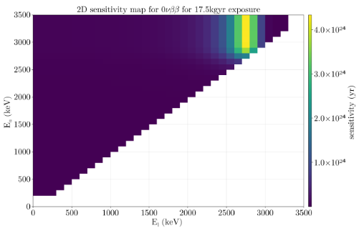
Sensitivities ND
In traditional sensitivity approach we look at the individual distributions of each measureable and try to find a data-cut that maximizes signal-to-background
After data-cuts are applied, calculate sensitivity per ROI, find max
Notes:
Click to add Notes

Slide 12
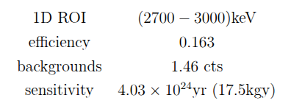
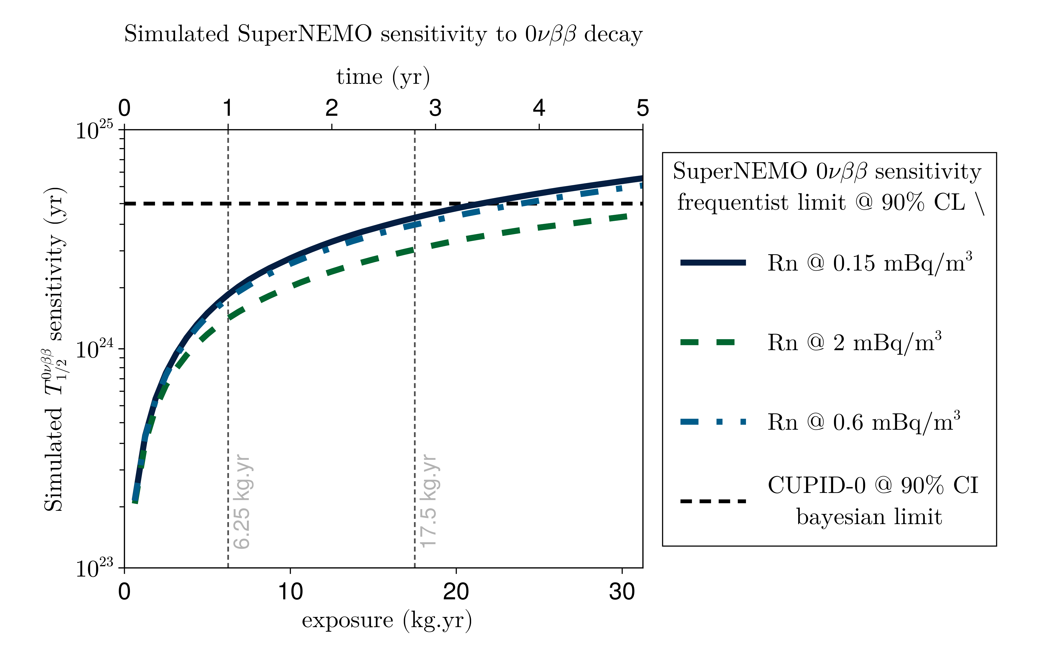
Sensitivities 1D - 0nubb
Notes:
Click to add Notes

Slide 13
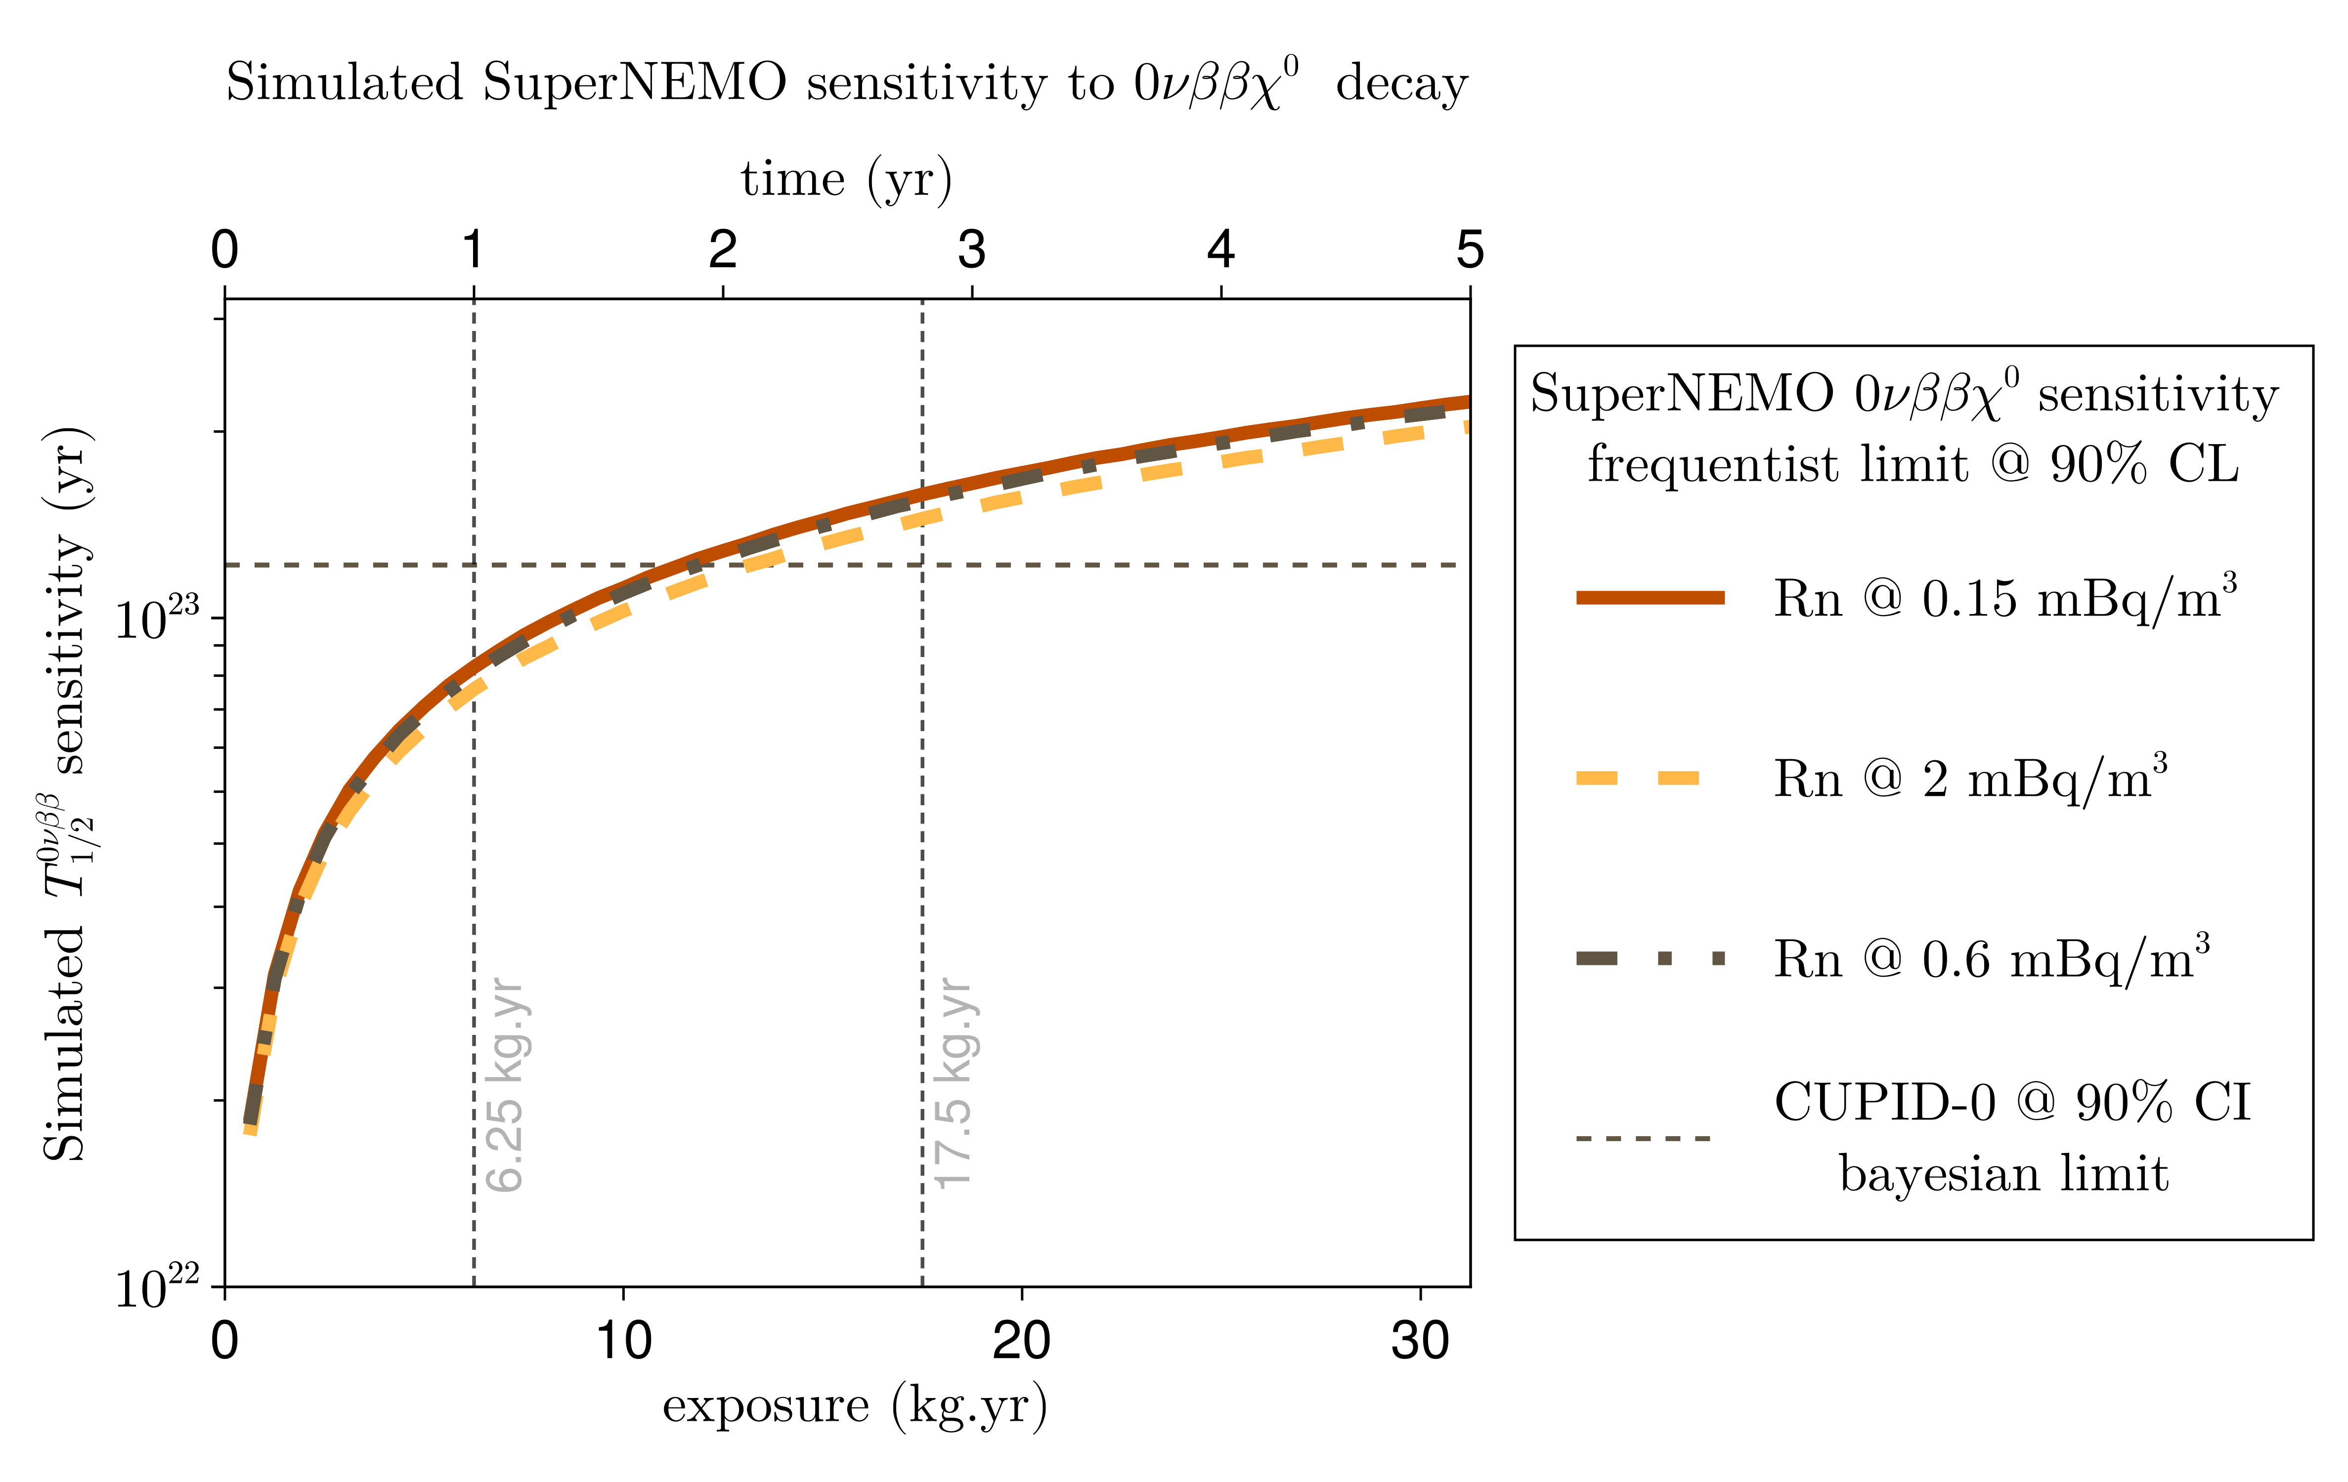
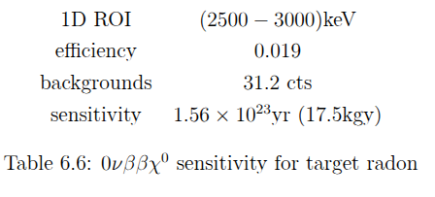
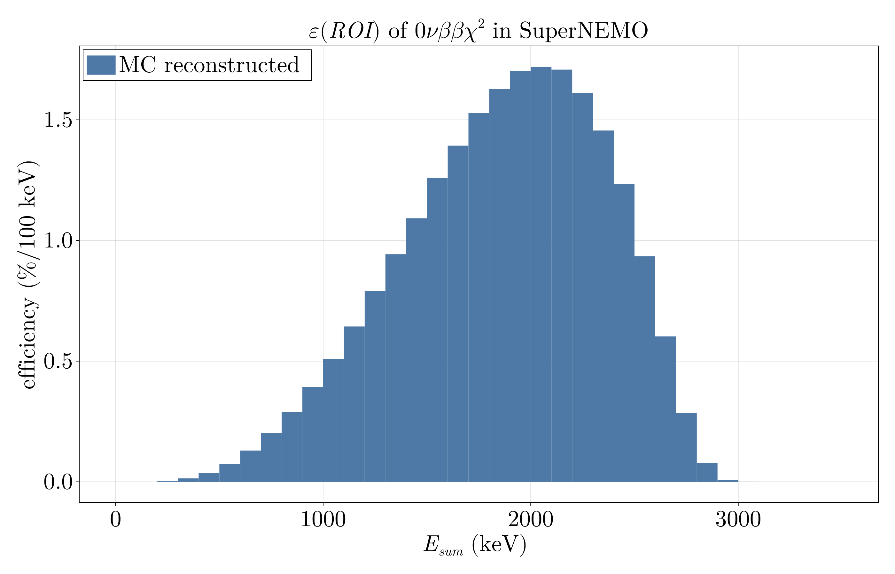
Sensitivities 1D - 0nubbM1
https://www.sciencedirect.com/science/article/pii/0370269381900113
https://arxiv.org/abs/hep-ph/9412365
Notes:
Click to add Notes

Slide 14
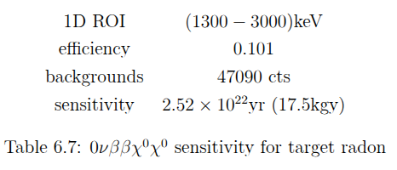
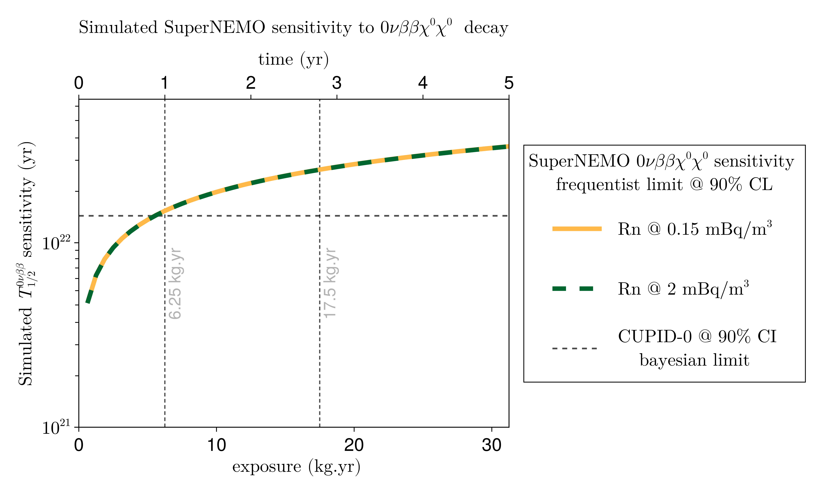
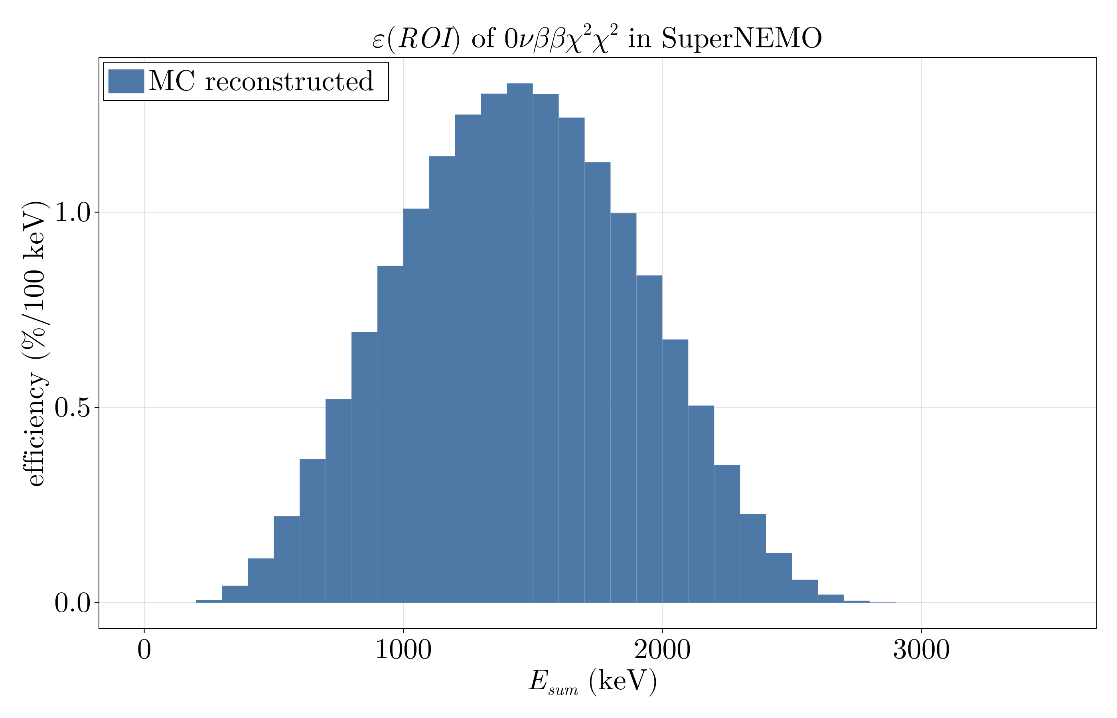
Sensitivities 1D - 0nubbM2
https://www.sciencedirect.com/science/article/pii/0370269381900113
https://arxiv.org/abs/hep-ph/9412365
Notes:
Click to add Notes

Slide 15
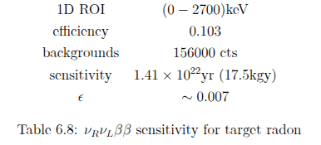
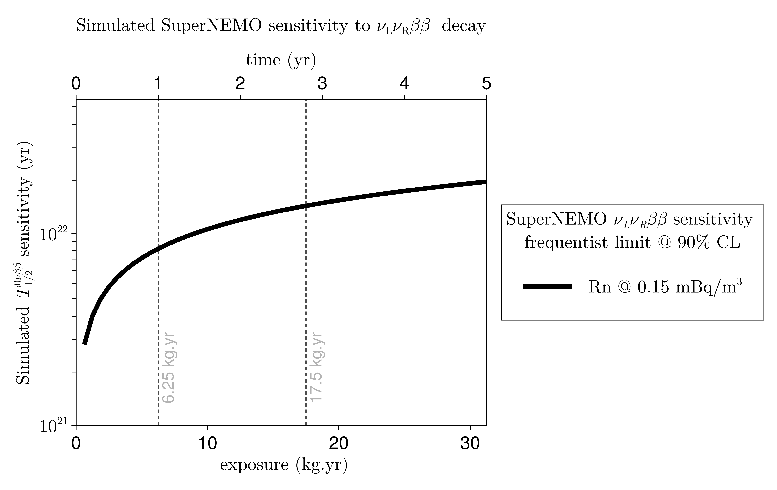
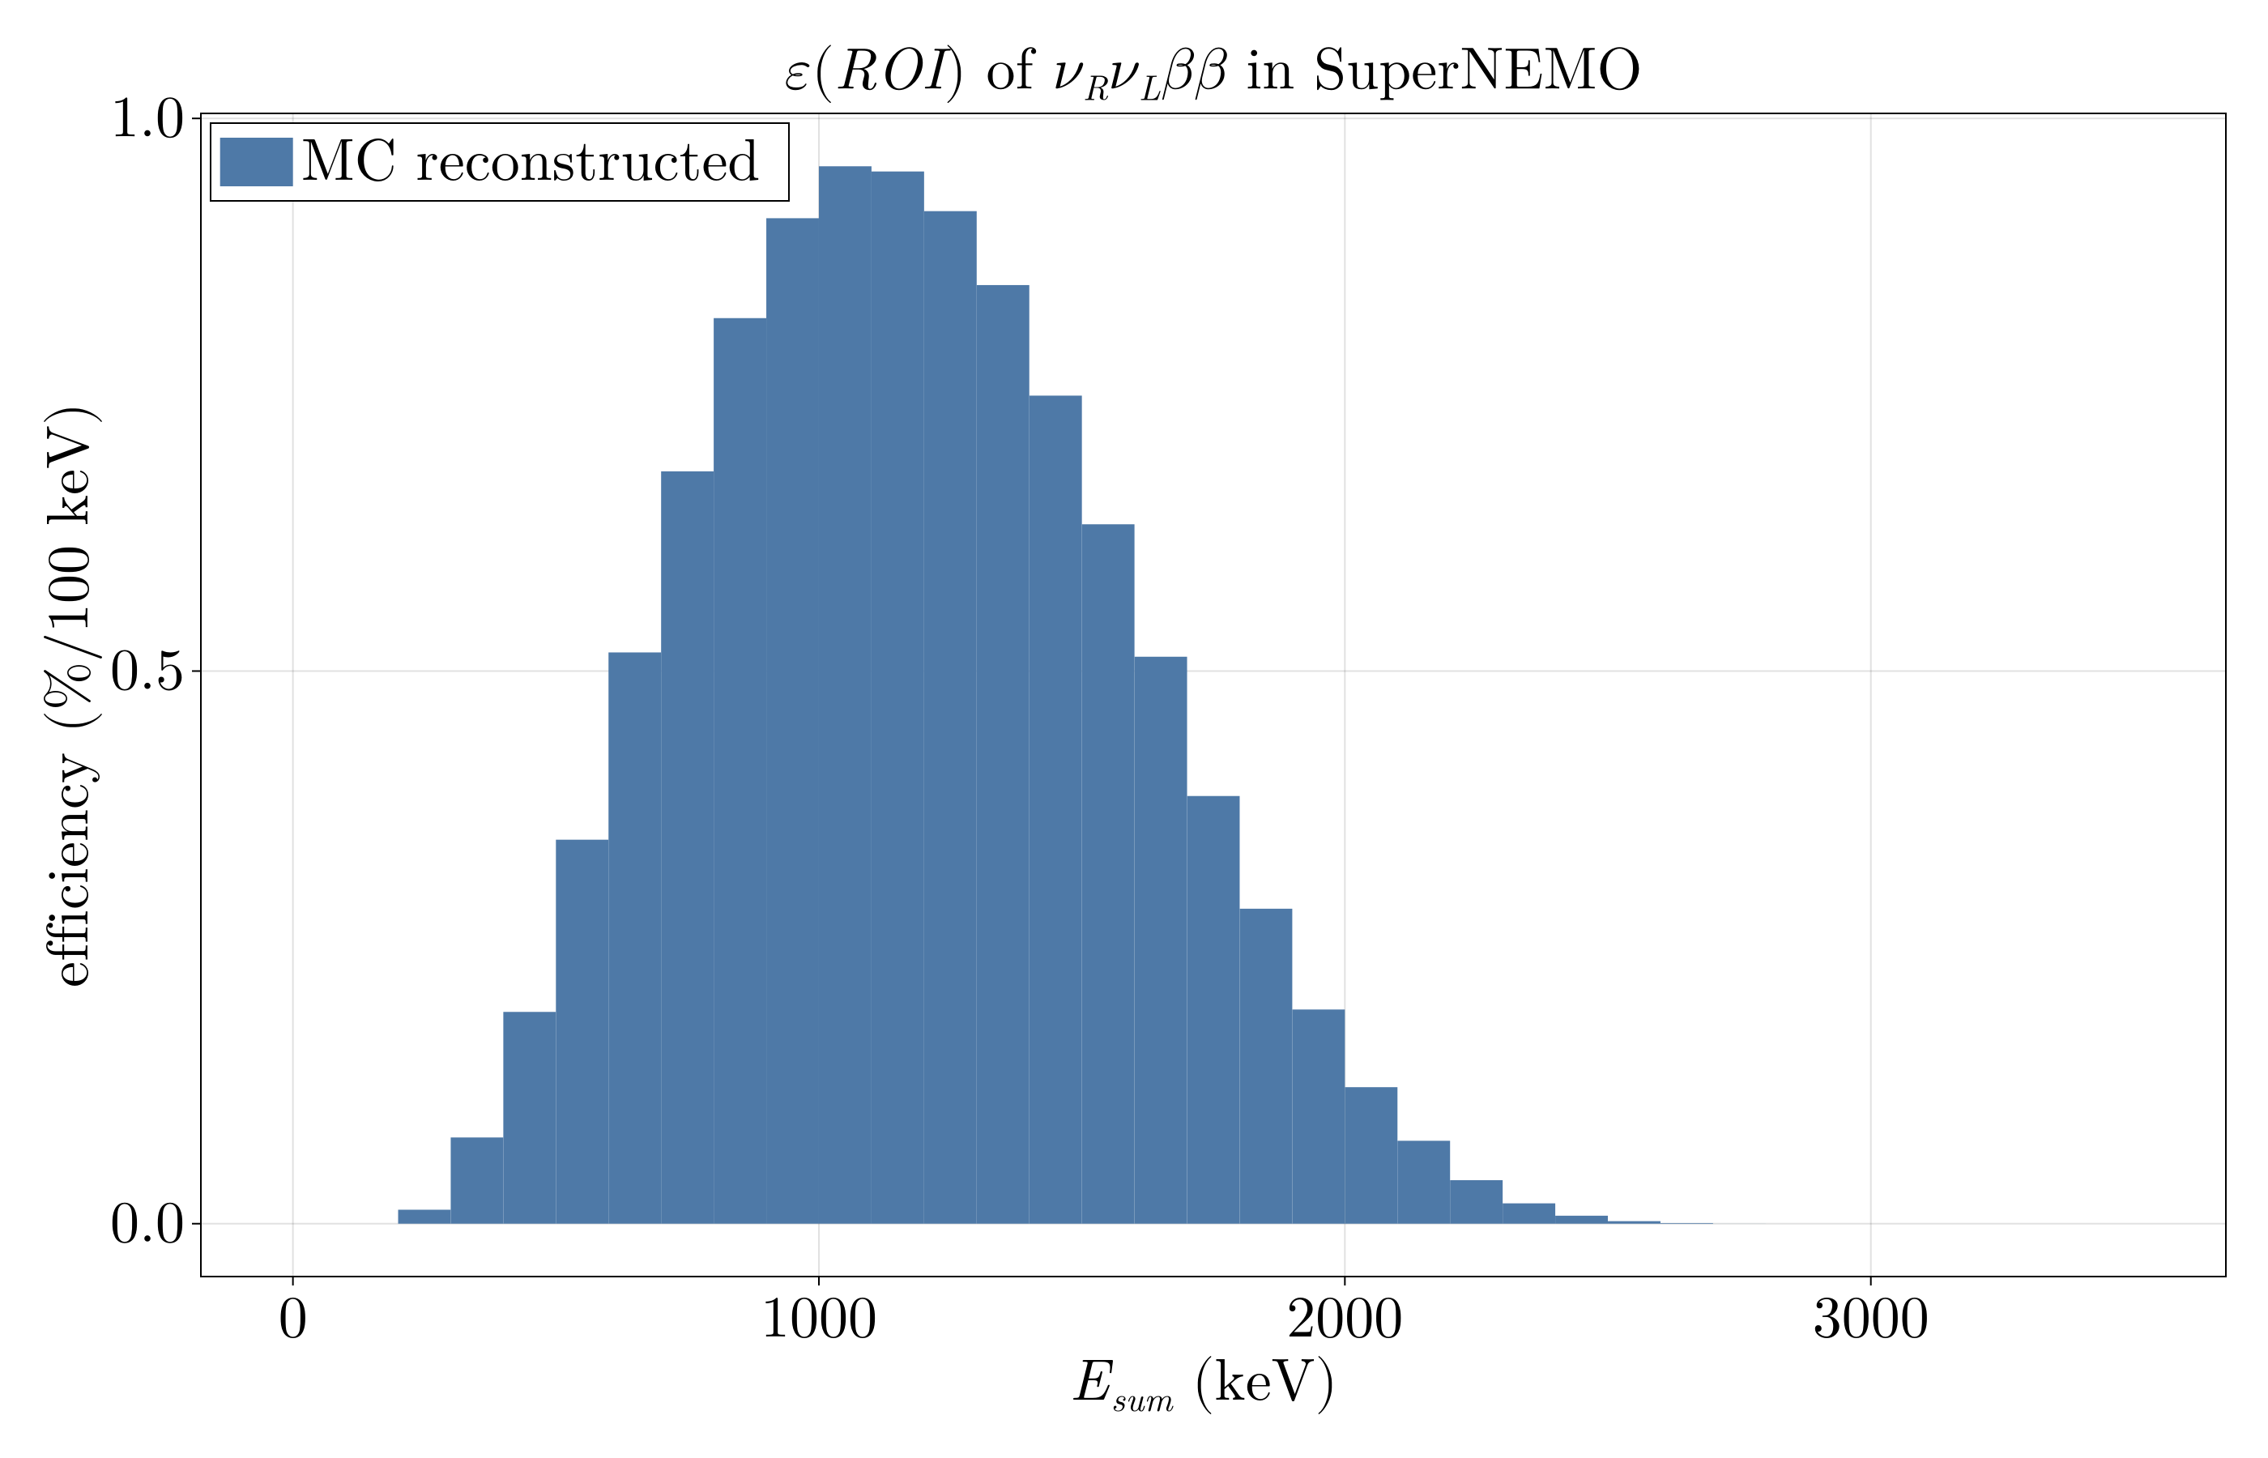
Sensitivities 1D – 2nubb RH
Ref - https://journals.aps.org/prl/abstract/10.1103/PhysRevLett.125.171801
Notes:
Click to add Notes

Slide 16
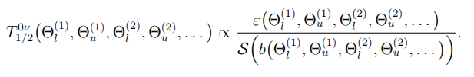
Sensitivities ND
In 1D approach, we select data-cuts first, then optimize ROI (i.e.E_sum) to find best sensitivity!
In ND approach, we optimize the data-cuts while optimizing sensitivity!
Notes:
Click to add Notes

Slide 17
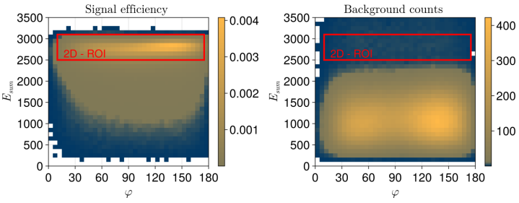
Sensitivities ND
Notes:
Click to add Notes

Slide 18
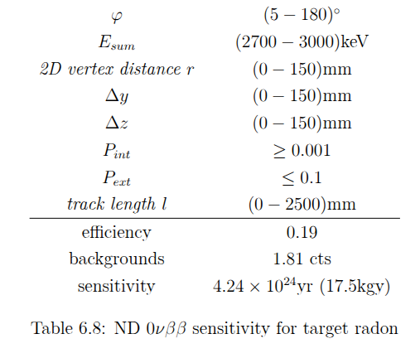
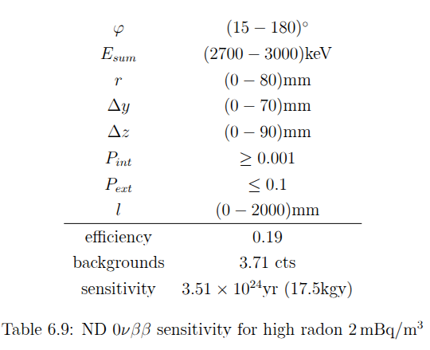
Sensitivities ND
0nubb ND sensitivity for target radon
0nubb ND sensitivity for high radon
Notes:
Click to add Notes

Slide 19
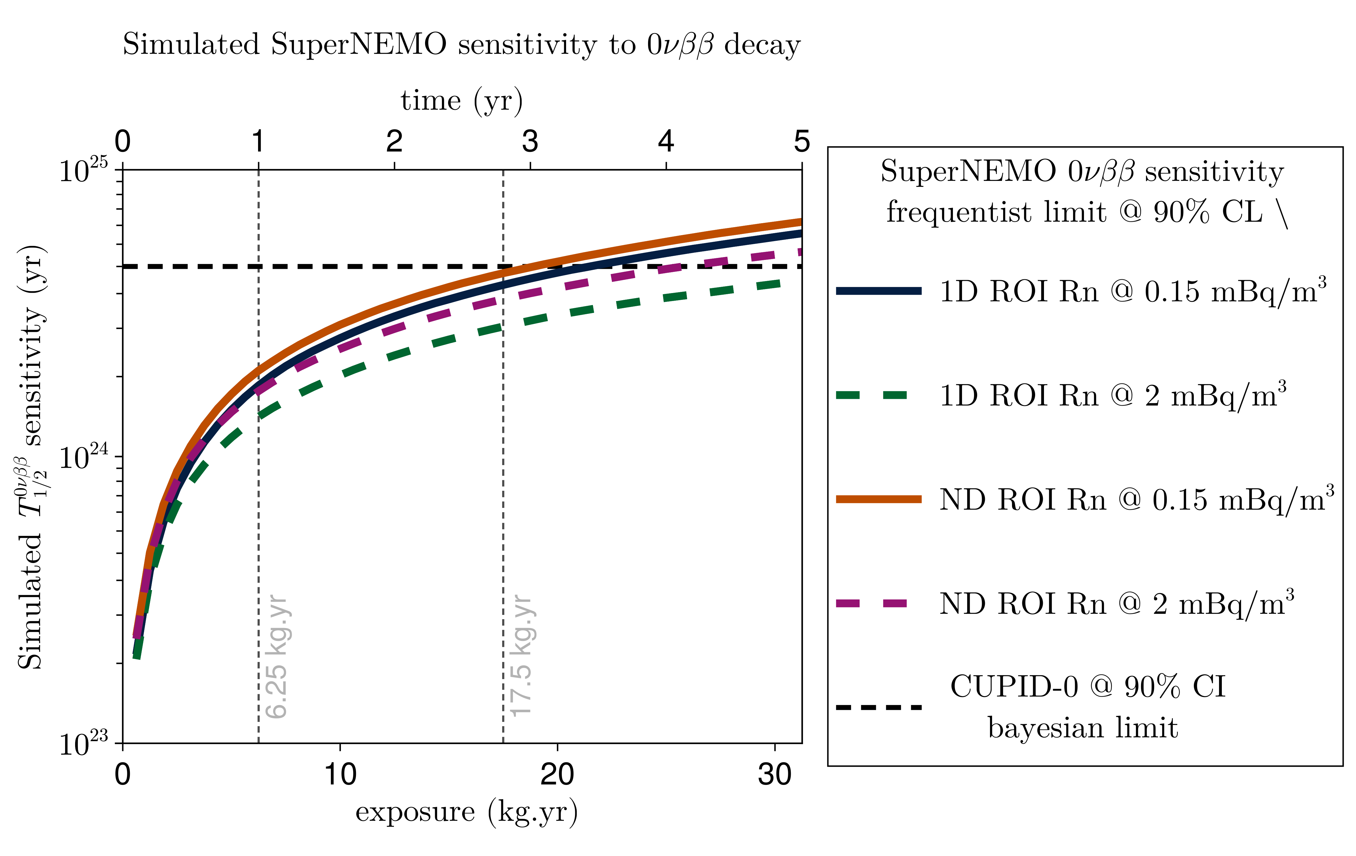
Sensitivities ND
Target radon:
  5% increase
Bad radon (2mBq/m3):
  21% increase
  More room to optimize!
Notes:
Click to add Notes

Slide 20
Conclusion
We need a very precise list of background sources, activities, amounts
Time of flight is very powerful for external sources (duh.)
Using traditional 1D approach, we are close to world bests
ND approach should take us there
  But it is expensive (computationally, statistically)
  More powerful for bad radon (vertex and length cuts become important)
  Can be tailored for each process!
TO DOs:
  Bayesian sensitivities (~3 days of calculations on CC)
  Full ND optimization for all signal processes
  Finish thesis and compile all results there...stay tuned
  Produce 2el spectra with Filip’s tracking + cimrman for phase0 + phase1?
Notes:
Click to add Notes

Slide 21
Backup

Slide 22
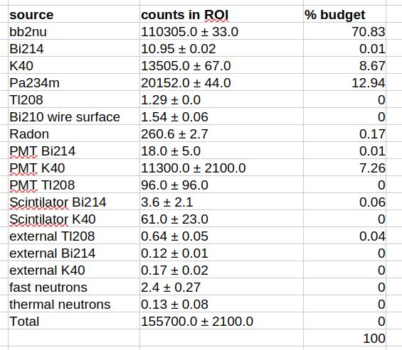
Background composition Esum<3500 keV
Target radon

Slide 23
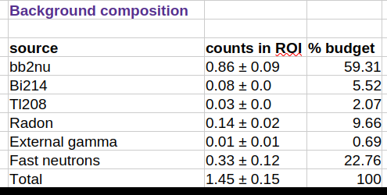
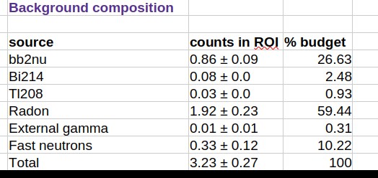
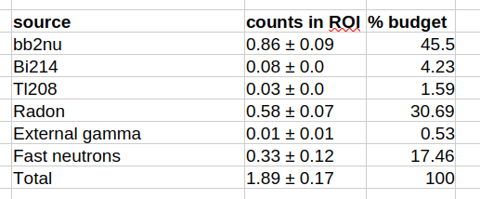
Background composition for 1D ROI
TARGET radon
Radon 2mBq/m3
Radon 0.6mBq/m3

Slide 24
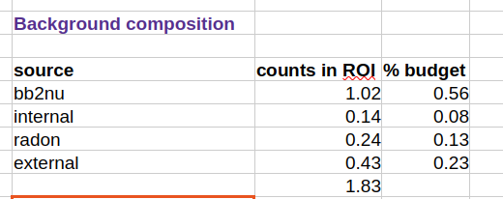
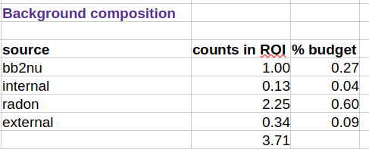
ND background composition 0nubb
TARGET radon
Radon 2mBq/m3

Slide 25

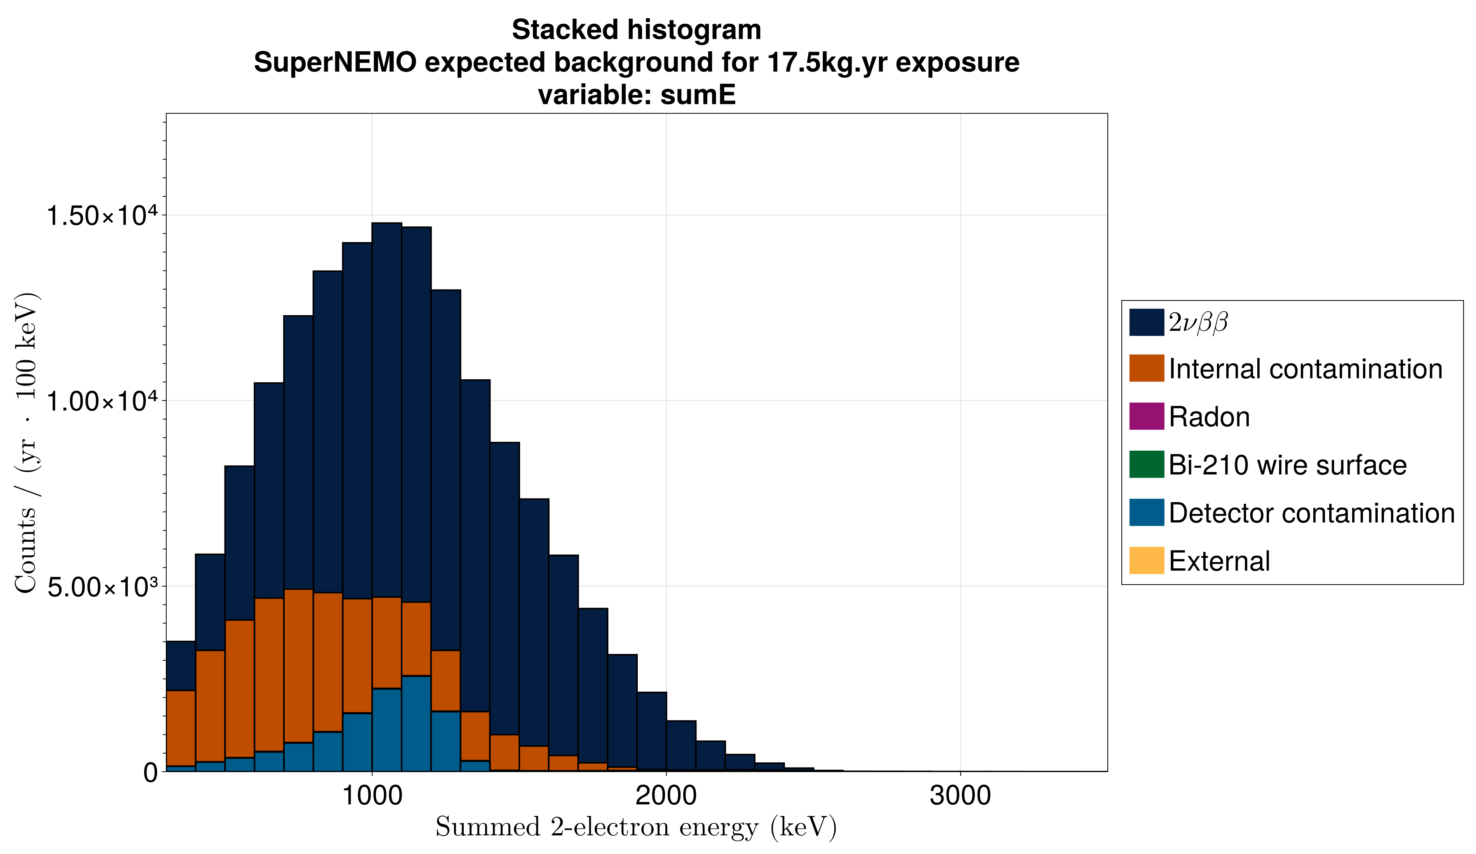
Bad radon background

