Slide 1
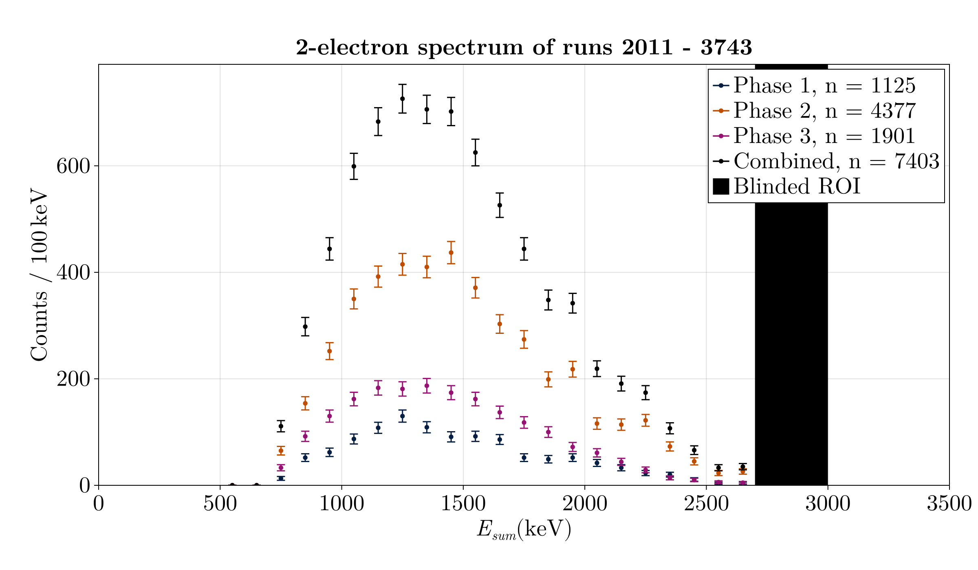
SuperNEMO preliminary
Thesis work

Slide 2
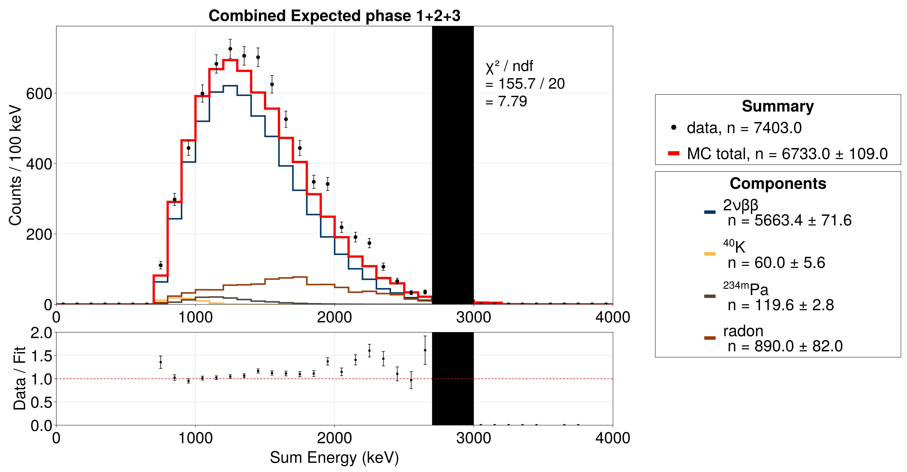
SuperNEMO preliminary
Thesis work

Slide 3
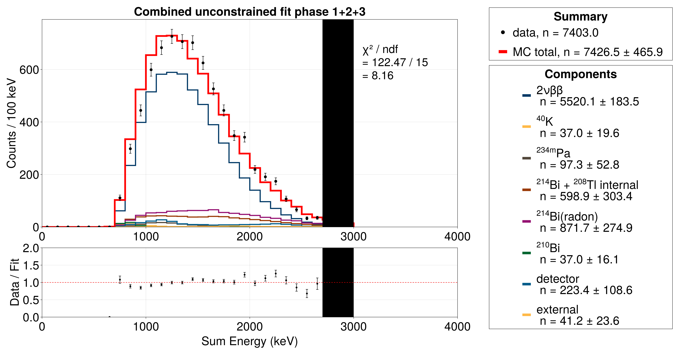
SuperNEMO preliminary
Thesis work

Slide 4
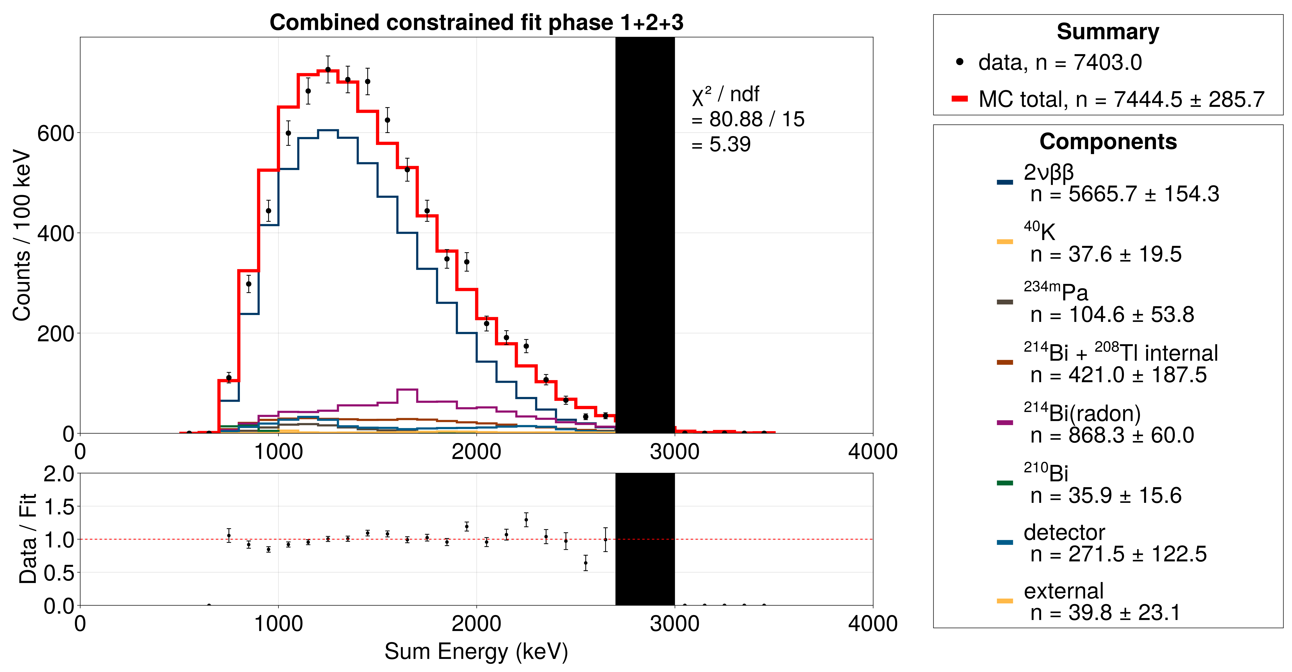
SuperNEMO preliminary
Thesis work

Slide 5
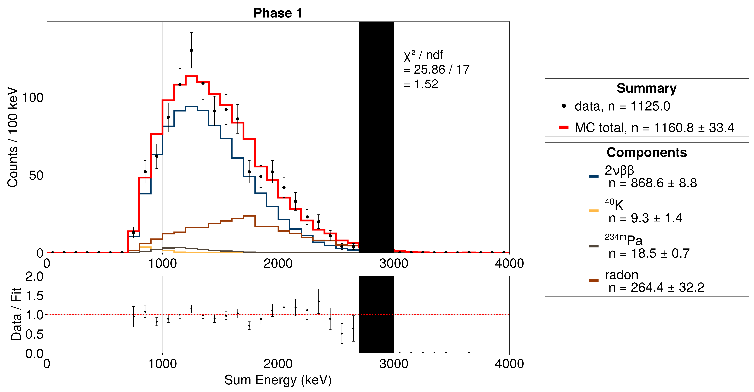
SuperNEMO preliminary
Thesis work

Slide 6
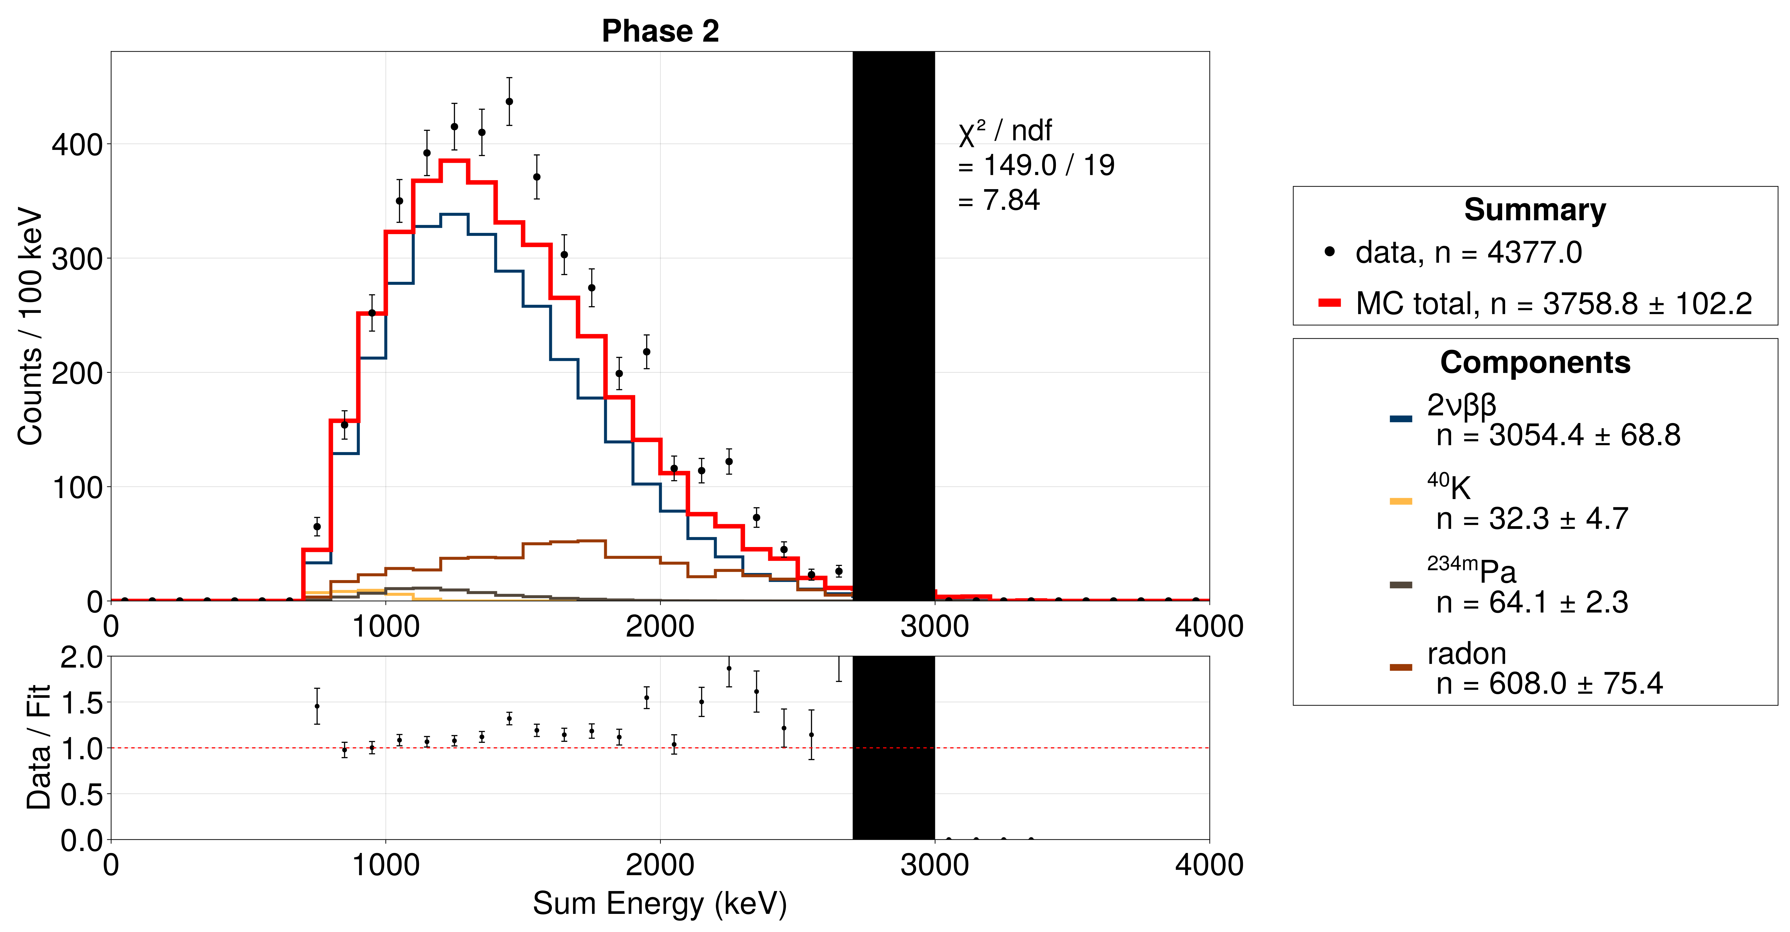
SuperNEMO preliminary
Thesis work

Slide 7
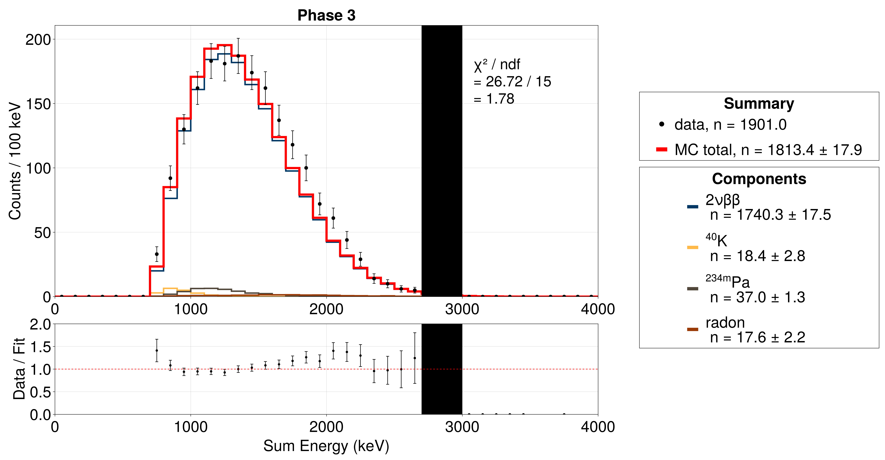
SuperNEMO preliminary
Thesis work

