Slide 1

Neural Networks: The Engine of Modern AI
Understanding the basics
KEY TAKEAWAY
Neural networks power many AI breakthroughs.
1

Slide 2
What is a Neural Network?
Layers of interconnected neurons
Neural networks learn by adjusting weighted connections across layers.
2

Slide 3
Key Performance Milestones
From early perceptrons to today
15.3%
3.6%
ImageNet top‑5 error (2012)
ImageNet top‑5 error (2015)
AlexNet reduced error to 15.3% in 2012
ResNet‑152 achieved 3.6% top‑5 error in 2015
Sources: Krizhevsky et al., 2012, He et al., 2015
3

Slide 4
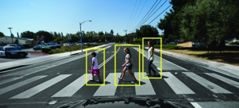

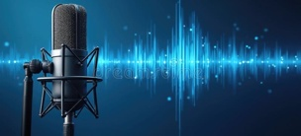
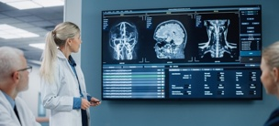
Real‑World Applications
Where neural networks are used
Computer Vision
Natural Language Processing
Speech Recognition
Healthcare
Object detection, image classification, facial recognition
Chatbots, translation, sentiment analysis
Transcribing audio, virtual assistants
Medical imaging diagnosis, drug discovery
4

Slide 5
Takeaways
Core concepts to remember
Neural networks learn patterns through layered computation.
Sources: Goodfellow et al., 2016
5

