Slide 1

OpenCV Overview
Open-source computer vision library
KEY TAKEAWAY
OpenCV is a versatile, free library for computer vision across many languages.
Sources: OpenCV official documentation
1

Slide 2
From Inception to Today
Evolution of OpenCV
OpenCV has evolved from a research prototype to a widely adopted, cross‑platform library.
Sources: OpenCV official documentation
2

Slide 3
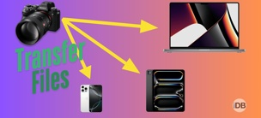



Key Capabilities
What OpenCV can do
Image I/O
Filtering
Feature Detection
Machine Learning
Read, write, and convert many formats.
Apply blur, edge detection, and morphology.
Detect corners, blobs, and keypoints.
Train classifiers and neural networks.
Sources: OpenCV official documentation
3

Slide 4
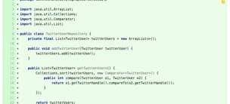



Library Structure
Organized functional modules
Core
Imgproc
Video
DNN
Fundamental data types and utilities.
Filters, transformations, and color conversion.
Capture, encode, and decode video streams.
Run pre‑trained deep neural networks.
Sources: OpenCV official documentation
4

Slide 5
Installation & Setup
Quick start for Python and C++
Sources: OpenCV official documentation
5

Slide 6
Reading and Displaying Images
First steps in code
Loading and showing images requires only three OpenCV functions.
Sources: OpenCV official documentation
6

Slide 7
Feature Detection & Matching
SIFT, SURF, ORB explained
Sources: OpenCV official documentation
7

Slide 8




Real‑World Use Cases
From healthcare to autonomous cars
Healthcare
Autonomous Vehicles
Retail
Augmented Reality
Segmentation of MRI and CT scans.
Real‑time lane and obstacle detection.
Shelf inventory analysis with cameras.
Overlay graphics on live video streams.
Sources: OpenCV official documentation
8

